Slide 1
Unit 9: The world of work
THEME OF THE LESSON: A COOL EXPERIMENT
CLIL NATURAL SCIENCE
THE ARCHIMEDES’ PRINCIPLE
Grade 8
Book: Eyes Open 4

Slide 2
Lesson objectives
Listen and read for gist, read for specific information
Listen and read for gist, read for specific information, get an overview of a module
Listen and read for gist, read for specific information, talk about natural science

Slide 3
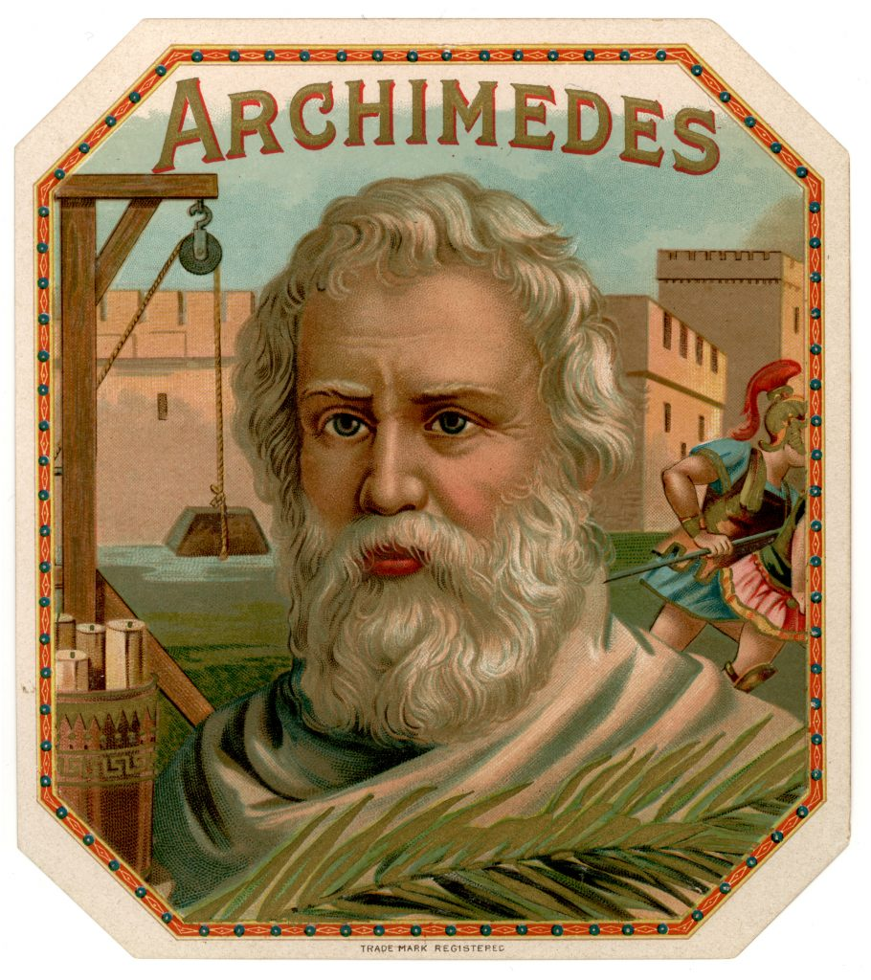
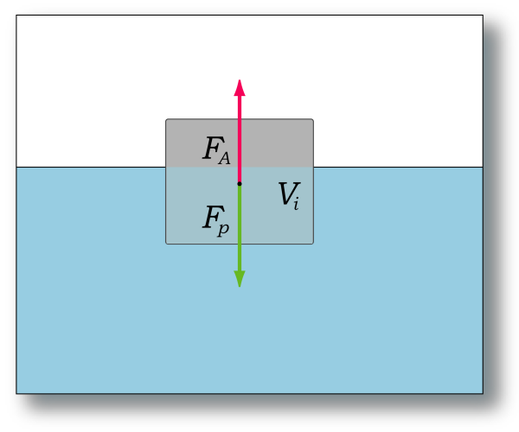
Who is Archimedes?

Slide 4
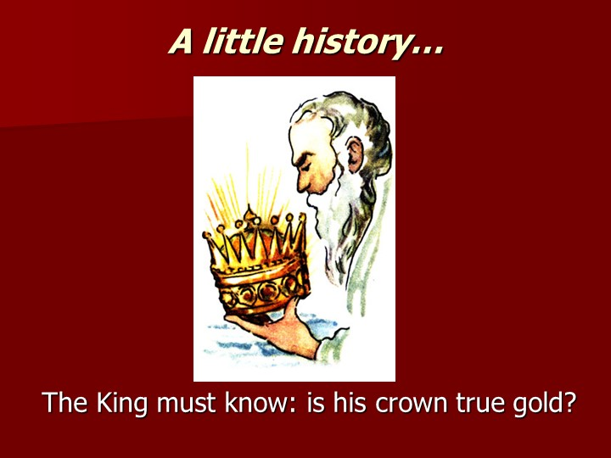
A little history…
'Eureka! Eureka!'
The King must know: Is his crown true gold?

Slide 5
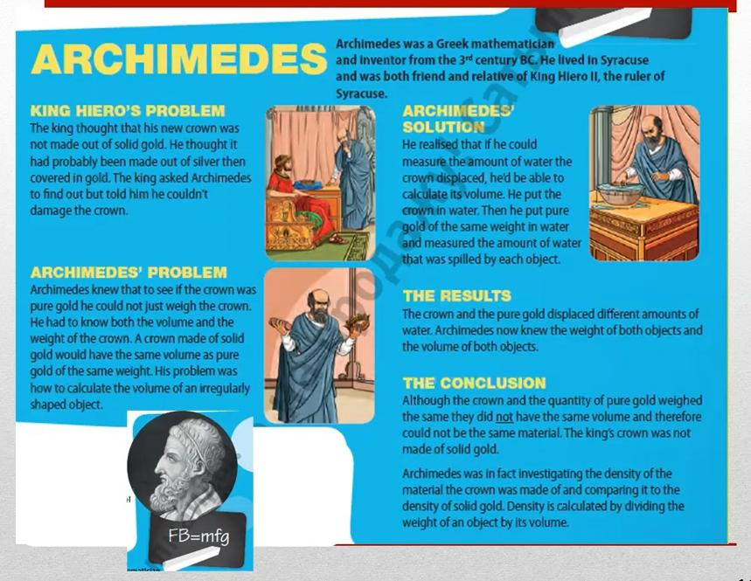
1. Listen & Read about Archimedes. What was he trying to find out?

Slide 6
2. Read the article again. Are these sentences true or false? Correct the false sentences.
The king was not sure exactly what his crown was made out of.
Archimedes calculated the crown’s volume by measuring the amount of water it displaced.
The crown and the pure gold displaced equal amounts of water.
The crown was made of pure gold.
Density is calculated by adding the object’s weight and volume.
True
True
False
False
False
Ex:3, p:108

Slide 7

3. Watch the video about “A cool experiment"
A cool experiment
Learn about global warming.
How old is Eric Gustavsson?
What will be different about each box?
What does Eric think his experiment show?

Slide 8
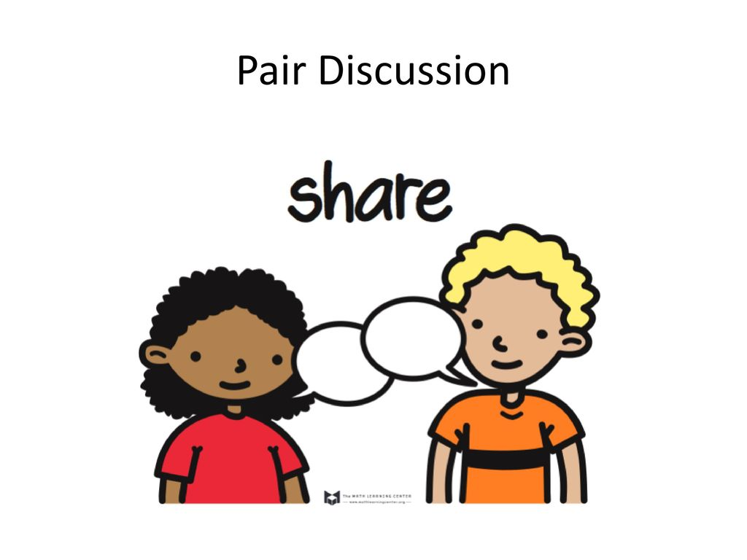
4. Let’s talk. Can you answer this questions?
Work with a partner. When you are swimming in a pool, do you feel lighter, heavier or the same as when you are walking on the ground?
Can you explain why?

Slide 9
Homework
What do you know about what these scientists studied and their achievements?
Charles Darwin
Marie Curie
Galileo Galilei
Albert Einstein
Isaac Newton

