Slide 1
Training and
Qualifications

Slide 2
I scream, you scream, we all scream for ice-cream!

Slide 3
Training refers to acquiring skills needed for a job. A qualification refers to the passing of an official exam which means you can practise in a particular field.

Slide 4


Slide 5
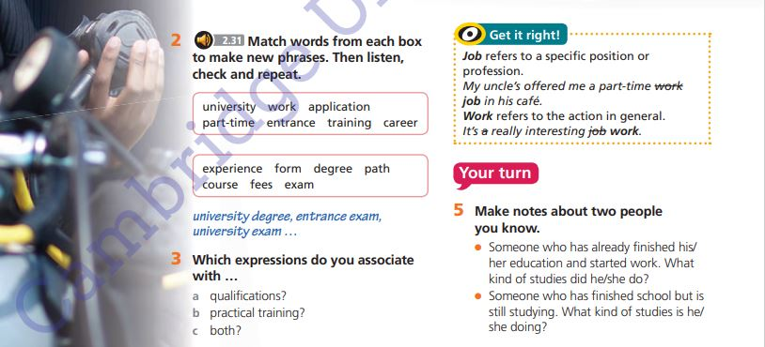

Slide 6

EX 2
University exam
Work experience
Training course
Application form
University degree
Career path

Slide 7
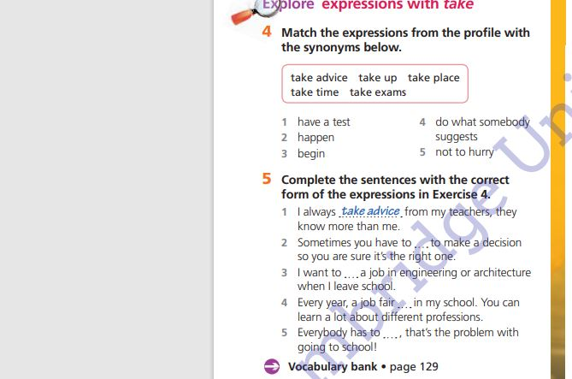
TAKE ADVICE-DO WHAT SOMEBODY SUGGEST
TAKE UP- BEGIN
TAKE PLACE- HAPPEN
TAKE TIME- NOT TO HURRY
TAKE EXAMS- HAVE A TEST

