Slide 1

Unit9: The world of work
Theme of the lesson: Plans for a career
Grade 8

Slide 2

Learning objectives:
8.4.2.1- understand specific information and detail in texts on a growing range of familiar general and curricular topics, including some extended texts;

Slide 3
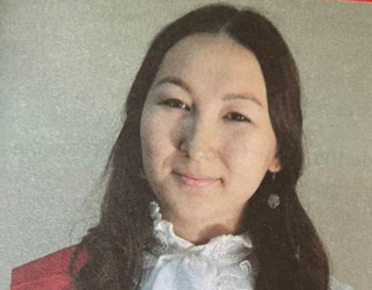
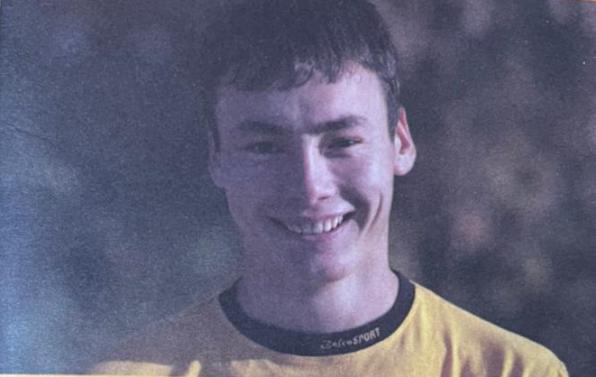
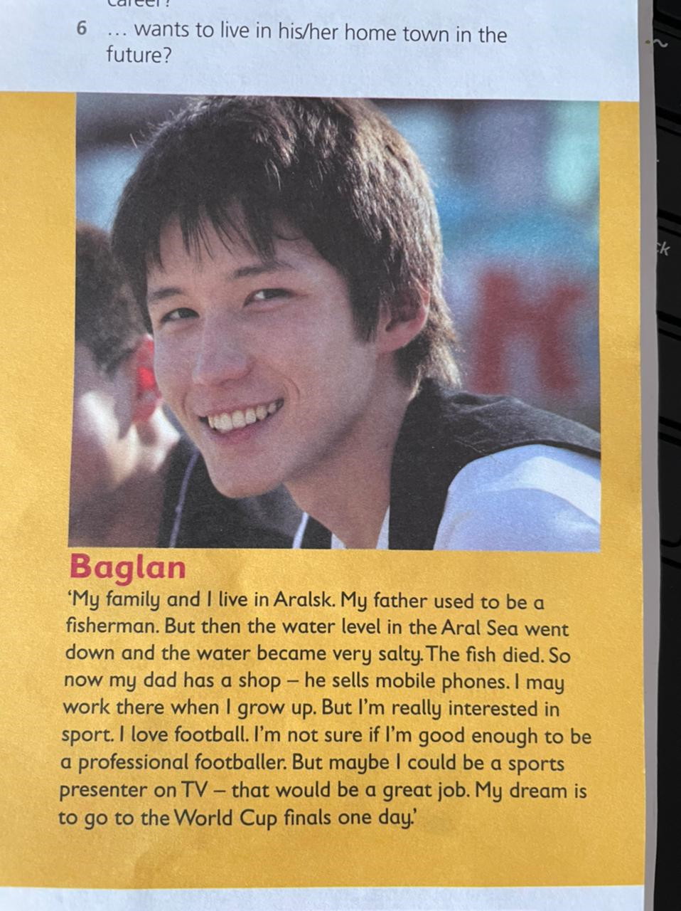
Damir
Baglan
Zhanar

Slide 4
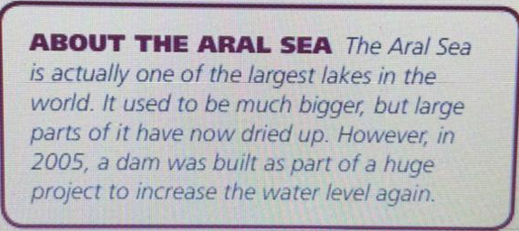
"I live in the west of Kazakhstan, in Atyrau.When I leave school, l'd like to work in a hotel. There are lots of hotels in Atyrau - people from many different countries come here to work in the oil industry l'll need English to speak to these businesspeople. I'm learning it at school, but l'll probably go to England when I'm 18. I might even go to university there. I'd like to get some experience of working in a hotel to0 - maybe a big hotel in London be fun! When my English is good enough, l'll probably come back to Atyrau.
Student’s book page 109
"We live on a farm near Almaty. Both my parents work on the farm. I like living here because I spend a lot of time riding our horses. I'm really interested in animals. If I study hard at school and pass my exams, I might become a vet. I'd really like to look after horses. Or I might become an architect. I went to Astana last year, I think the modern architecture is amazing! It would be great to design buildings like that.
"My family and I live in Aralsk. My father used to be a fisherman. But then the water level in the Aral Sea went down and the water became verų salty. The fish died. So now my dad has a shop he sells mobile phones. I may -work there when I grow up. But I'm really interested in sport. I love football. I'm not sure if I'm good enough to be a professional footballer. But maybe I could be a sports presenter on TV – that would be a great job. My dream is to go to the World Cup finals one day'

Slide 5
2.Answer the questions.
Who…
1 … lives in the country?
2 … wants to study abroad?
3 … would like a career in sport?
4 … wants to work with animals?
5 … has two very different ideas about his/her career?
6 … wants to live in his/her home town in the future?
3.
Work with pairs. Discuss the importance of learning English for work. How important is it? Is it more important in some jobs than others? Which?

Slide 6
Homework
write a short paragraph (similar to the ones on page 109) about their future plans and their ideal job.

