Slide 1
Making decisions
Learning objectives
Theme: Unit 9 world of work - 8th grade
Learning objectives
8.W1 plan, write, edit and proofread work at text level with little support on a range of general and curricular topics
8.S7 use appropriate subject-specific vocabulary and syntax to talk about a range of general topics, and some curricular topics.
8.C10 use talk or writing as a means of reflecting on and exploring a range of perspectives on the world.

Slide 2

Time to make a decisions!!!
Why do we need to be able to make a decision? Why is it so important? Whether this book, profession, food, color, taste etc….making decision is very important

Slide 3
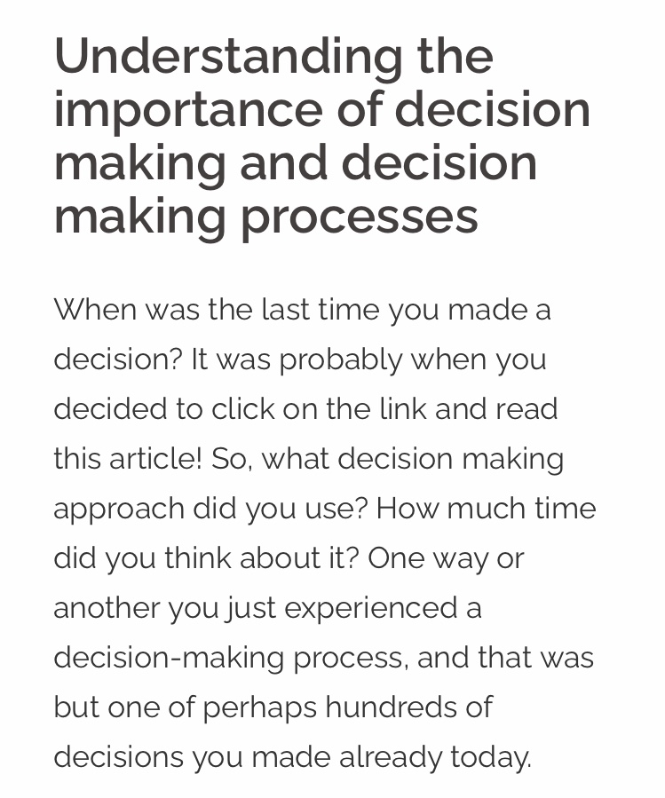

Slide 4


Task №1 speaking time!!! world of work choose one of the profession and answer the question , why did you choose it ? Give your opinion

Slide 5

writing time!!! Choose one of the picture and write 3 positively and negatively side of each profession

Slide 6
New words (students book page 106)
Argument -дәлел
to decide-шешім қабылдау
Decision -шешім
Support-қолдау
Conversation-әңгіме
Suggestion -ұсыныс
Possibilities -мүмкіндіктер
Social –әлеуметтік
Charity -қайырымдылық

Slide 7
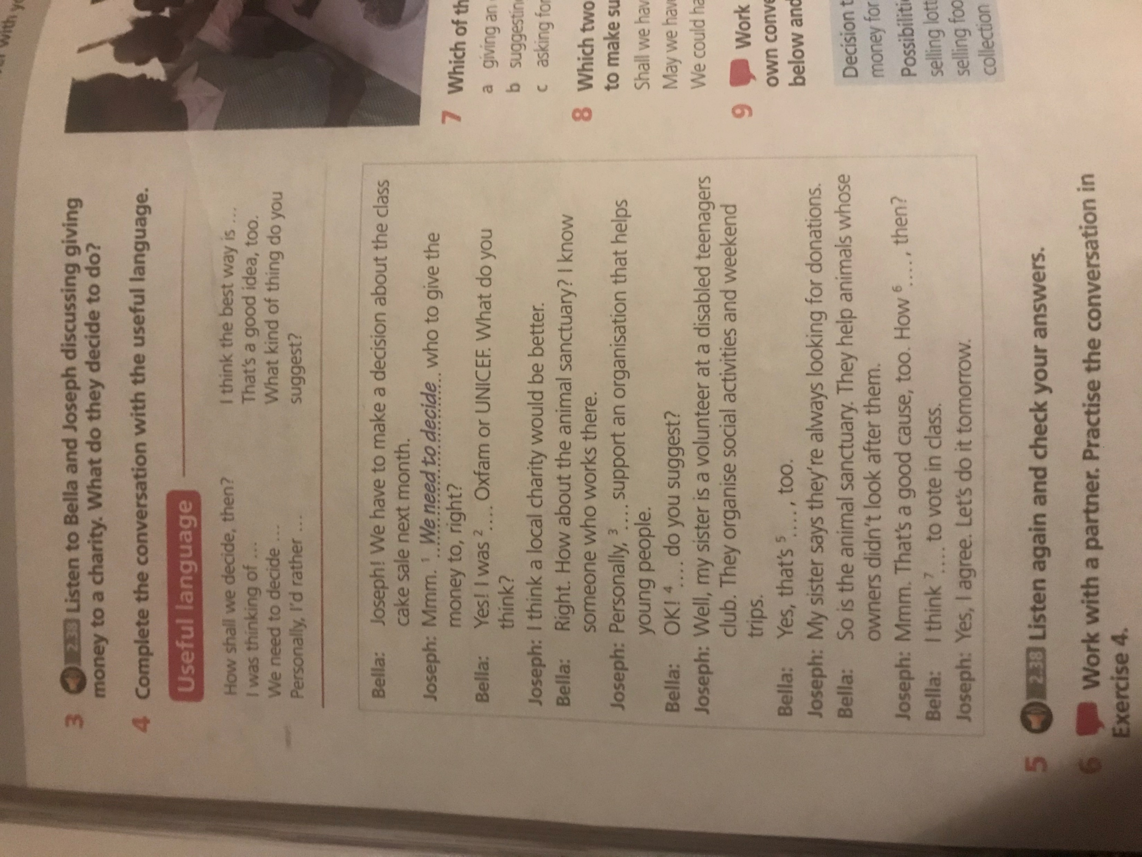
Task 3 sb page 106 ,ex 4 useful language complete the conversation with the useful language

Slide 8
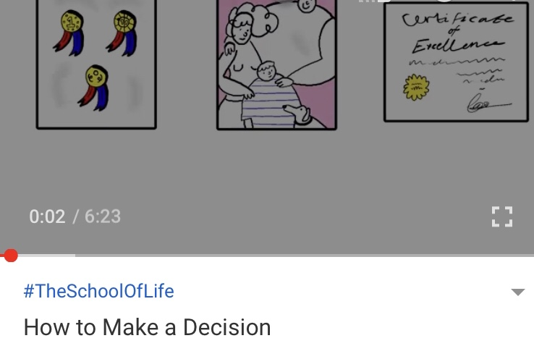
Watching the vdeo!!!
https://www.youtube.com/watch?v=okdsAZUTJ94

Slide 9


Slide 10


