Slide 1


Theme: A blog
Grade 8

Slide 2
Objectives:
Read a travel blog
Learn complex noun phrases
Describe places using complex noun phrases

Slide 3
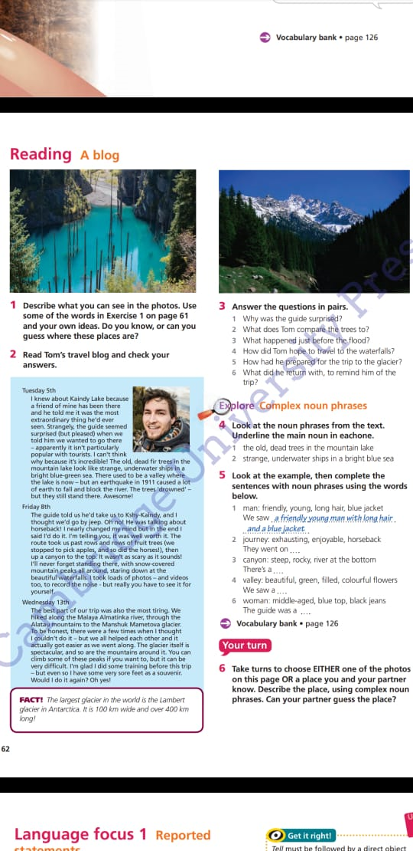
Do you know, or can you guess where these palaces are?

Slide 4
Read Tom’s travel blog and check your answers

Slide 5
Answer the questions
Why was the guide surprised?
What does Tom compare the trees to?
What happened just before the flood?
How did Tom hope to travel to the waterfalls?
How had he prepared for the trip to the glacier ?
What did he return with, to remind him of the trip?

Slide 6
Complex noun phrase
Structure
Noun phrases play an important role in the construction of a sentences .
Basic noun phrase can be pronouns , numerals or head nouns with different determiner while complex ones include pre-modification, head noun and post-modification.

Slide 7
Look at the noun phrases from the text . Underline the main noun in each one.
The old, dead trees in the mountain lake
Strange, underwater ships in a bright blue sea

Slide 8
Look at the example, then complete the sentences with noun phrases using the words below

Slide 9
H/T: take turns to choose Either one of the photos on this page OR a place, using complex noun phrases. Can your partner guess the place

Slide 10
The lesson is over!

