Slide 1
Unit 6. The Natural World
Grade 8
Book: Eyes Open

Slide 2

Lesson objectives
identify specific information in the video
predict the content of the video
use dictionaries to check the meaning of unknown words
work collaboratively to complete the group task

Slide 3

Watch the video and guess the theme our lesson. https://www.youtube.com/watch?v=_I08WnI1-1I&t=5s

Slide 4
Vocabulary
canyon – |ˈkænjən| - шатқал
cave – |keɪv| - үңгір
cliff – |klɪf| - құз
coast – |kəʊst| - жағалау
glacier - |ˈɡlasɪə| - мұздық
peak – |piːk| - шың
rock(s) – |rɒk| - жартас
stream – |striːm| - бұлақ, ағыс, ағын,
earth – |ɜːθ| - жер
valley – |ˈvælɪ| - алқап
waterfall - |ˈwɔːtəfɔːl| - сарқырама

Slide 5
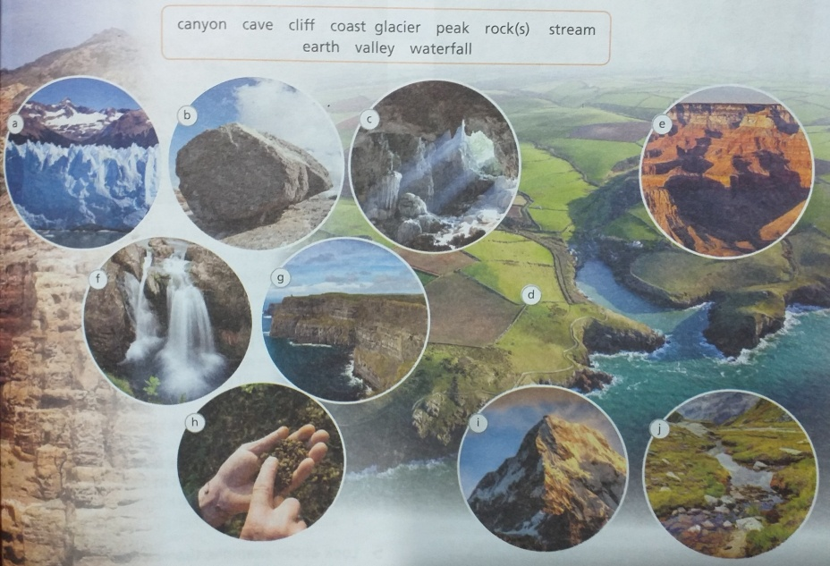
Ex:1, p:61. Match the photos below with the words in the box.
rock
cave
glacier
canyon
valley
waterfall
coast
peak
earth
stream

Slide 6
Ex:2, p:61. Look at the words again and sort them into groups.
Canyon, cave, cliff, coast, glacier, peak, rock, stream, earth, valley, waterfall.
The shape of the land | Forms of water
Canyon
Cave
Cliff
Peak
Rock
Earth
valley
Coast
Glacier
Stream
waterfall

Slide 7

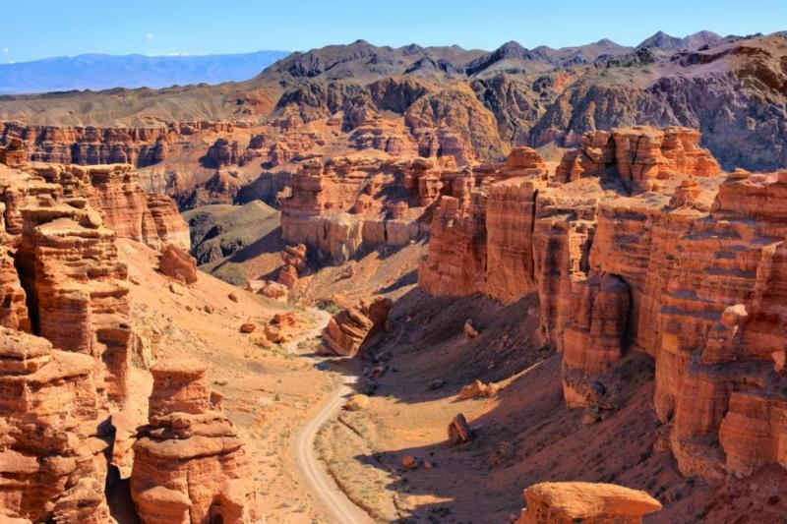
Be
curious
What can you see in the photo?
Start thinking.
Where do you think this is?
Have you been there?
What do the rocks in the photo look like?
How do you think they were formed?
Sharyn Canyon

Slide 8

Let’s watch the video about Sharyn Canyon. https://www.youtube.com/watch?v=k8_CF4GtFkc&t=2s

Slide 9

Task 4.Use the information through the video and answer
Sharyn canyon is the biggest canyon in the world.
It is located 200 kilometres from the Tien Shan Mountains
Rare ash trees grow at the top of the valley
Thousands of years of strong winds formed the colors on the rocks.
The whole canyon has rocks that look like buildings.
False
False
True
True
False

Slide 10


