Slide 1

Theme: Linking phrases
8th grade

Slide 2
Learning objectives
8.W1 plan, write, edit and proofread work at text level with little support on a range of general and curricular topics
8.S7 use appropriate subject-specific vocabulary and syntax to talk about a range of general topics, and some curricular topics.
8.C10 use talk or writing as a means of reflecting on and exploring a range of perspectives on the world.

Slide 3
Linking or Connective Words and Phrases
What for do we use linking or connective words?
Linking or connective words and phrases are used to show relationships between ideas. They can be used to join two or more sentences or clauses.
Linking words help to connect ideas and sentences when you speak or write English. We can use linking words to give examples, add information, summarize, sequence information, give a reason or result, or to contrast ideas.
Using linking or connective words and phrases
can improve the quality of your speech
your ideas flow more smoothly
the logical relationships between the ideas are expressed clearer
act like bridges between parts of your writing and speaking

Slide 4
New words
Firstly-біріншіден
Secondly-екіншіден
In my opinion-менің ойымша
For instance-мысалы
Finally-ақыры
Also-сондай-ақ
However-дегенмен
Because-себебі
In spite of – соған қарамастан
Though-дегенмен
But-бірақ
Despite-қарамастан
According to-сәйкесінше

Slide 5
Task 1* Choose the correct options
1.I enjoy watching tennis on TV ______ I prefer playing it.
A) despite B) because C) although
2. _____ having a well-paid job, she never has any money.
A) Despite B) Because C) Even though
3. Sarah can play the piano _____ the guitar.
A) due to B) as well as C)also
4. I was able to walk slowly__ the pain in my leg
A) however B) in spite of C) besides
5. My girlfriend likes the town ____ I like the country.
A) however B) whereas C) and
6. We drove very slowly____ the icy roads.
A) like B) because of C) therefore

Slide 6
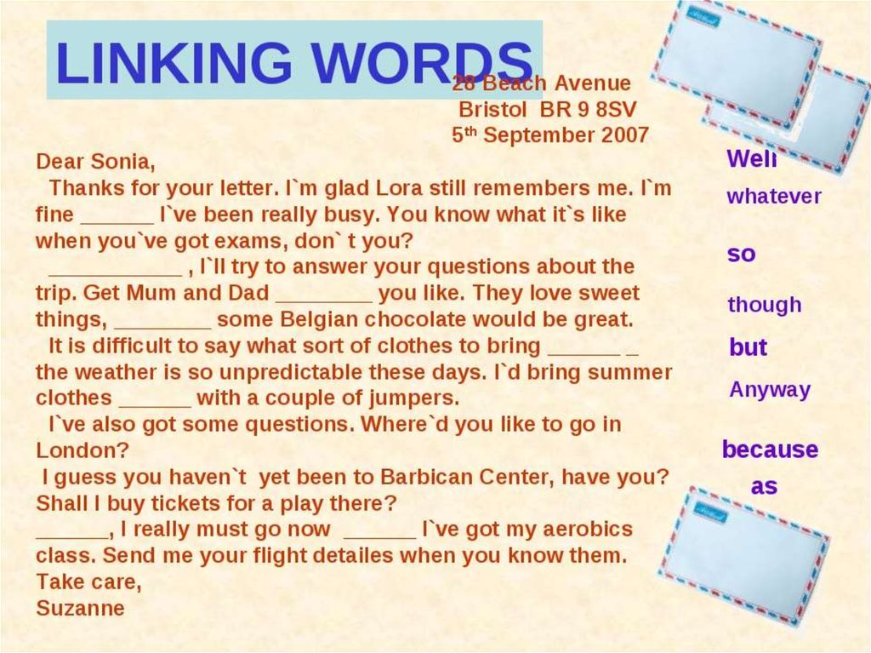

Task 2 *choose the correct options
N b

Slide 7
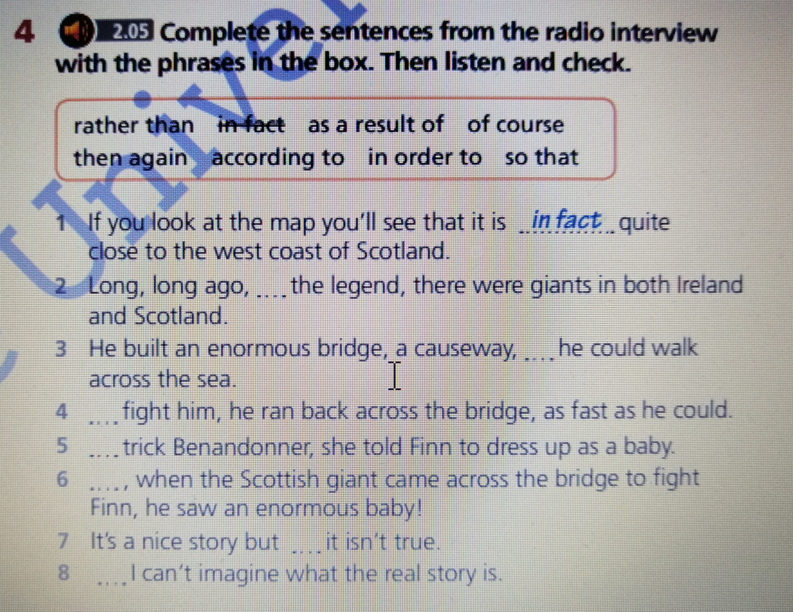
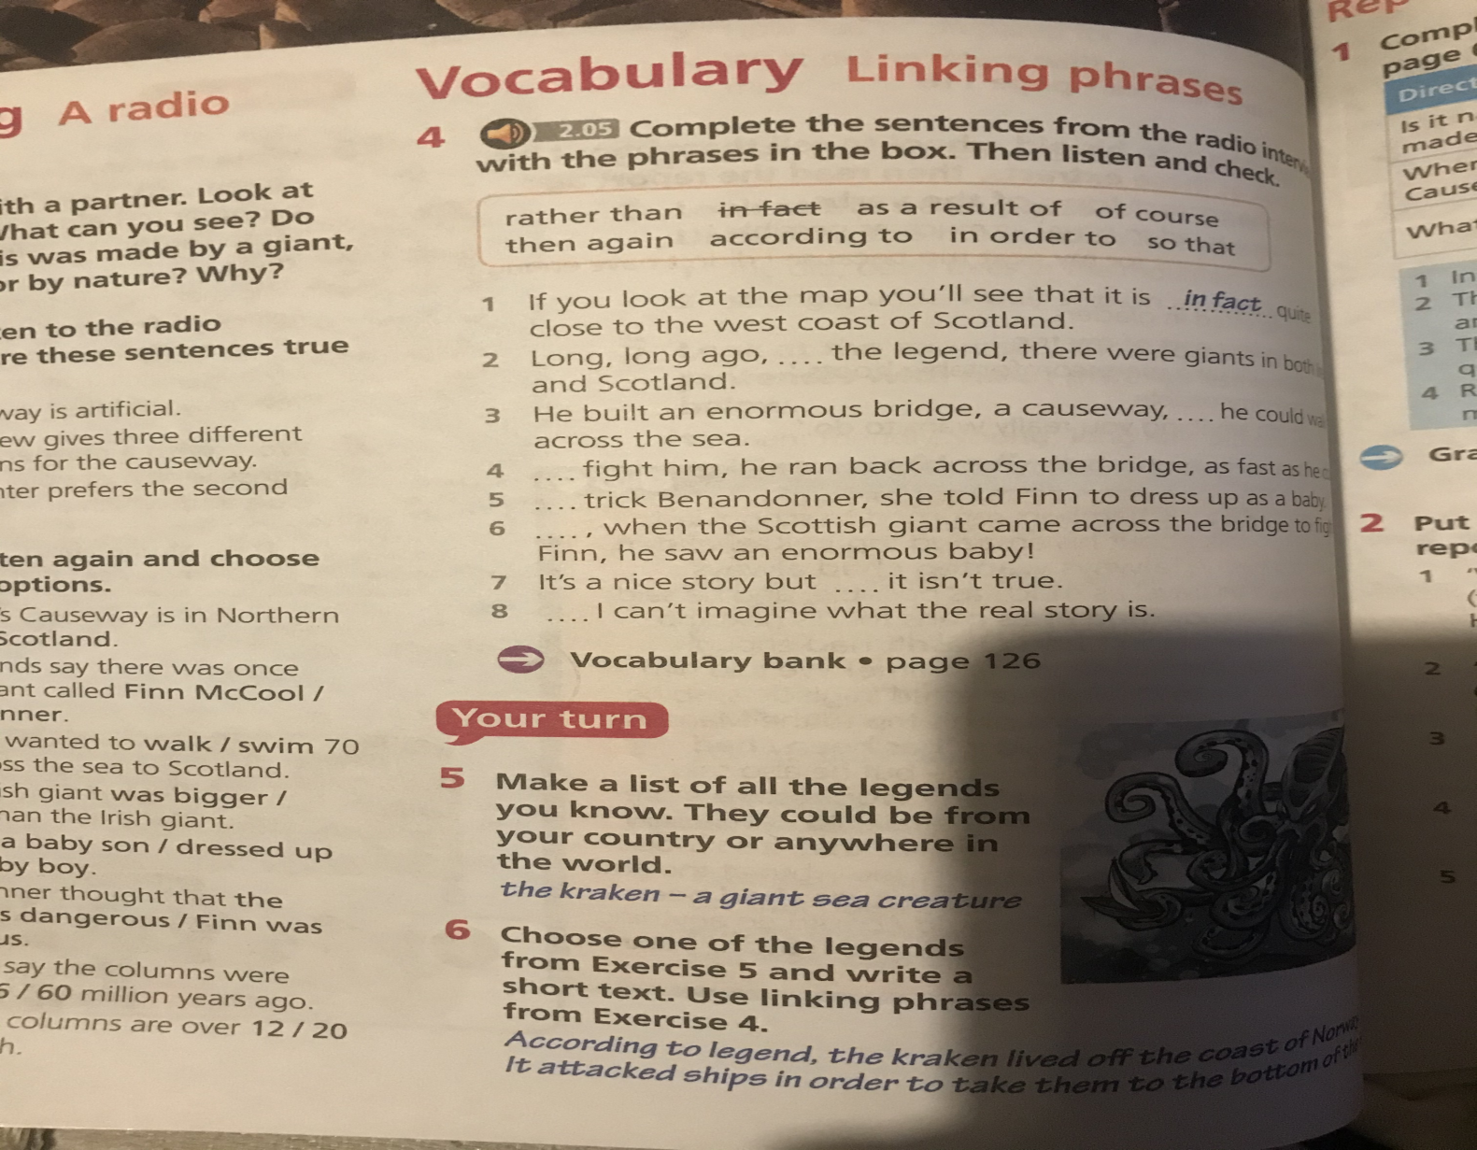
Task 3* Students book page 64, ex 4

Slide 8
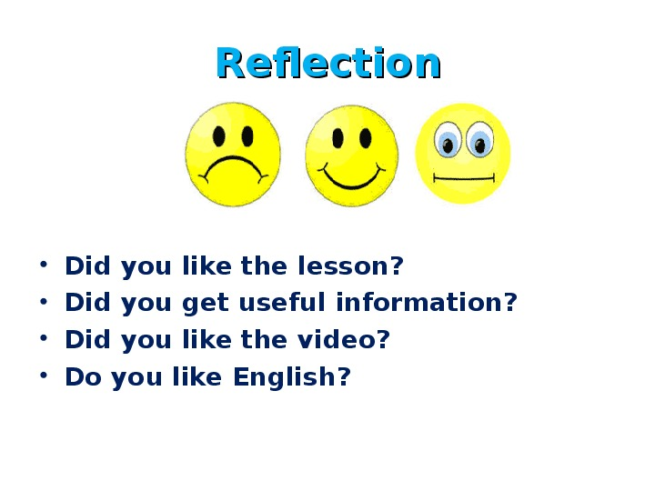
Feed back

Slide 9

It was a good job students !!! Thank you!!!

