Slide 1

Reported statements

Slide 2
Lesson objectives:
8.6.5.1- use questions which include a variety of different tense on a range of familiar general and curricular topics;
8.6.7.1- use a variety of simple perfect forms to express recent, indefinite and unfinished past on a range of familiar general and curricular topics;

Slide 3
The Natural world “One touch of Nature makes the whole world kind”
by W. Shakespeare.

Slide 4
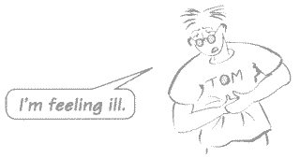
You want to tell somebody else what Tom said.
In order to report Tom’s words you can use reported speech:
Tom said that he was feeling ill.

Slide 5
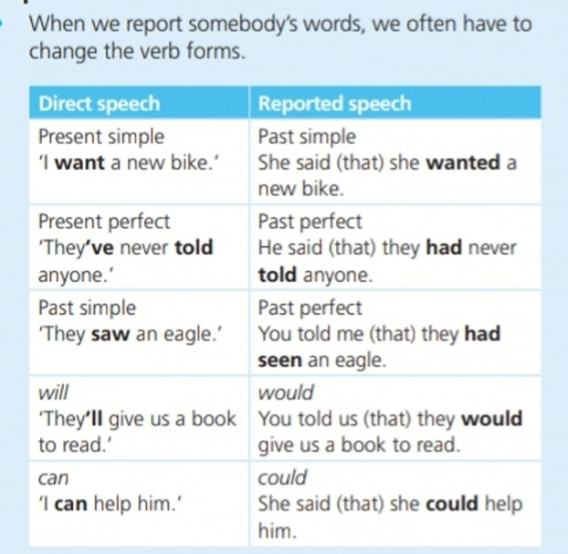
When we use reported speech
and the main verb of the sentence is past
(Tom said that…).
The rest of the sentence is usually past too:
Tom said that he was feeling ill.

Slide 6
In general, the Present form in direct speech changes to the Past form in reported speech:
am/is ->
are ->
do/does ->
have/has ->
shall ->
will ->
can ->
may ->
must ->
was
were
did
had
should
would
could
might
had to

Slide 7
Remember
today ->
tonight ->
yesterday ->
tomorrow ->
(a week)ago ->
last year ->
next year ->
now ->
here ->
this ->
these ->
that day
that night
the day before
the next day
(a week) before
the year before
the following year
then
there
that
those

Slide 8
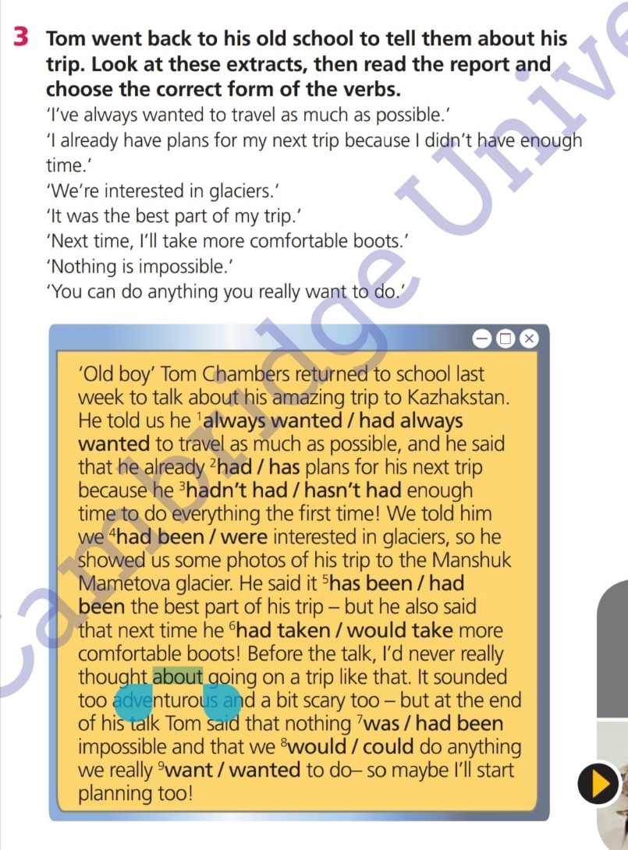

Slide 9
Task 2 Complete the reported statements
“I had the most fantastic time.”
Tom said …
2. “I travelled with a group of friends.”
He told us …
3. “Geography has always been my favourite subject.”
He said …
4. “I’ll need to save hard for the next trip.”
He said …
5. “I can’t afford another trip yet.”
He told us …

Slide 10
Task. Work in pairs and interview each other.
Group A’s QUESTIONS
What things do you think about when you hear the word ‘nature'?
How important is nature to you? Why?
What is the most beautiful thing in nature? Why?
How does being in nature make you feel? Why?
What bad things are people doing to nature?
Group B’s QUESTIONS
What is nature?
What would life be like without nature?
How important is nature in your culture?
Are there any bad things about nature?
What three things can you do today to help nature?

Slide 11
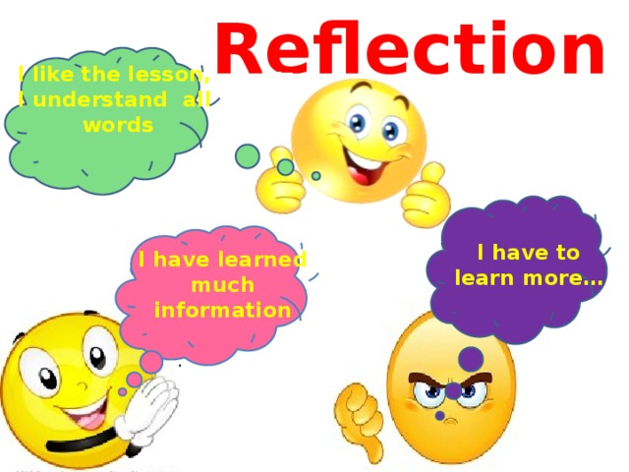

Slide 12
The lesson is over.
Good bye!

