Slide 1
Films. Reading-Vocabulary
School-gymnasium # 74
Grade 7

Slide 2

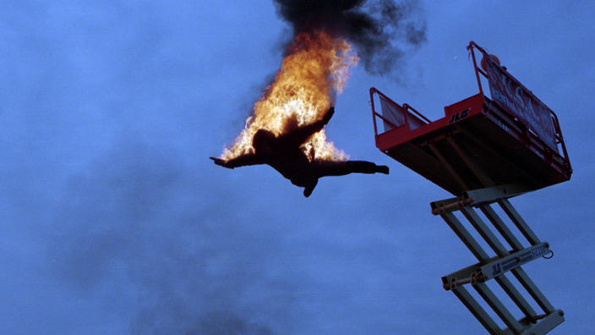
Films

Slide 3
Lesson objectives
Practice the using of reading-vocabulary on the topic “Films”
Develop listening skills in understanding most specific information and details through the recording on the topic
Improve writing skills through the e-mail on the
given topic

Slide 4
Brainstorming activity
Name…..
A film that makes you feel afraid.
A film with cowboys.
A funny film.
A film about murders, thieves and robbers.
A love story.

Slide 5
Revision of reading vocabulary
S P E C B W S D R C P
… ound
… lot
… ffects
… ast
… omputer-animated
… lockbuster
….tar
…irect
…elease
…ompose
….lay

Slide 6
Check and remember the reading vocabulary
S P E C B W S D R C P
sound-дыбыс
plot- астыртын сөз байласу, сюжет
effects- әсерлер
cast-лақтыру, актерлік құрам
computer-animated-компьютерлік анимация
blockbuster-блокбастер
star-жұлдыз
direct- бағыттау, басқару
release-шығару
compose-құрастыру
play- ойнау, қойылым

Slide 7
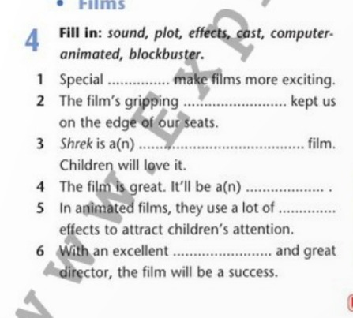
Word search

Slide 8
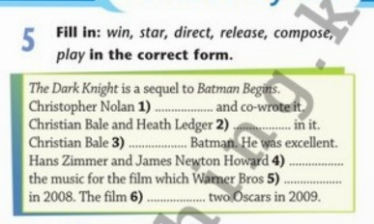
Verbs related to the theme “Films”

Slide 9
Listening
Listen to three people talking about the films they like. Which type(s) of film does each: like? not like? Why?

Slide 10
Speaking
Think of your favourite film. What type is it? Who directed it? Who stars in it? What is it about? Tell the class.

Slide 11
Home assignment
Complete the e-mail to your English pen-friend about your favourite film.

Slide 12
Feedback: 2 stars and a wish
You should write two things that you have learnt and one thing that you want to learn in the future about films.

