Slide 1
Entertainment and Media
Module 6
Grade 7

Slide 2
Learning objectives:
7.C1 use speaking and listening skills to solve problems creatively and cooperatively in groups
7.R2 understand specific information and detail in texts on a range of familiar general and curricular topics
7.S6 begin to link comments with some flexibility to what are they say at sentence and discourse level in pairs, group and whole class exchange topic

Slide 3



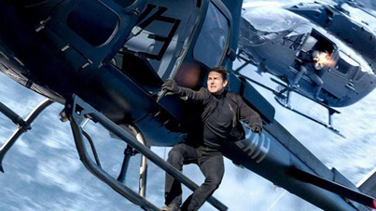

Greetings. Brainstorming activity
- Have you seen a science-fiction film? Tell the class about it.
- In which film have the characters in the pictures appeared? What is each film about?

Slide 4
Read the words and explain the meanings.
Direct- бағыттау
Alone-жалғыз
Solution-шешім
Race back- басын қатыру
Universe-әлем
War-соғыс
Action-packed- әрекеті шектеулі
Cast- лақтыру
Feature-ерекшелік
Destroy-талқандау
Mankind-адамды сипаттау
Plot-астыртын сөз байланыстыру
Battle- шайқас

Slide 5
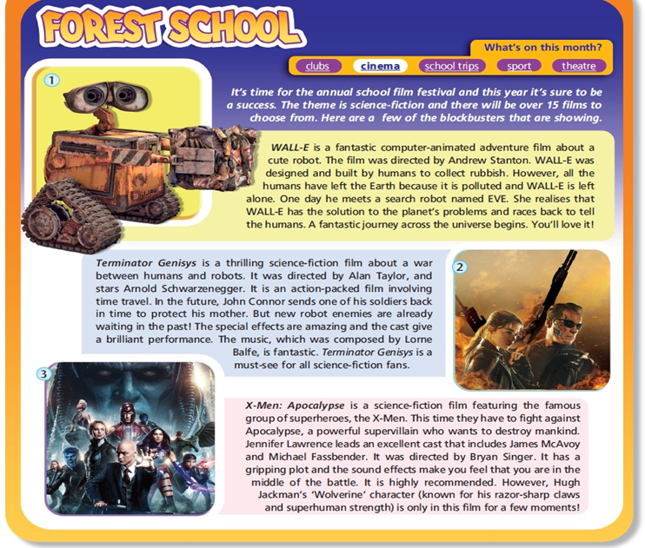
Listen and read the text.

Slide 6
Mark the sentences T(true) or F (False)
1. Wall-E was directed by Andrew Stanton
2. Wall-E lives on Earth
3. Wall-E is very clever
4. Terminator Genisys is about robots fighting people
5. Terminator Genisys takes place at several different times
6. The X-men can travel through time
7. Apocalypse is a friend of the X-men

Slide 7
Make notes under the heading.
?
Name | Type | Director | Plot
Wall-E
Terminator Genisys
The X-men

Slide 8
Imagine that you were Wall-E. What solutions would you suggest to save Earth from its problems? Say or write a few sentences. Tell the class.
Example: If I were Wall-E, I`d invevt a machine
If I were Wall-E, I`d ………………..

Slide 9




Feedback (WG)
KWL Chart (Know, want to know, learned)
What I know | What I want to know | What I learned

