Slide 1
Grade: 7
Unit: Entertainment and Media
Topic: Playing with your food

Slide 2

7.C9 Use imagination to express thoughts, ideas, experiences and feelings;
7.S3 Give an opinion at sentence and discourse level on an increasing range of general and curricular topics;
7.S7 Use appropriate subject-specific vocabulary and syntax to talk about a limited range of general topics, and some curricular topics.
All students will be able to
Read and translate the text
More students will be able to
Answer the questions
Understand specific information in listening with some support
Some students will be able to
Retell the text
Complete listening task correctly without support

Slide 3

1) Orchestra - [ˈɔː.kɪ.strə] – оркестр;
2) Found – [faʊnd] – табу;
3) Produce – [prəˈdʒuːs] – өндіру;
4) High-quality sound – [ˈhaɪˌkwɒl.ə.ti saʊnd] – жоғары сапалы дыбыс;
5) Leek – [liːk] – сопақ басты пияз;
6) Pumpkin – [ˈpʌmp.kɪn] – асқабақ;
7) Bass drum – [ˌbeɪs ˈdrʌm] – бас барабан;
8) Create – [kriˈeɪt] – жасау;
9) Cucumber – [ˈkjuː.kʌm.bər] – қияр;
10) Depend on – [dɪˈpend on] – тіуелді;
11) Repertoire – [ˈrep.ə.twɑːr] – репертуар;
12) Range from – [reɪndʒ frɒm] – аралығында;
13) Environmentally-conscious – [ɪnˌvaɪ.rənˈmen.təl.i- ˈkɒn.ʃəs] – экологиялық тұрғыдан;
14) Biodegradable – [ˌbaɪ.əʊ.dɪˈɡreɪ.də.bəl] – биологиялық ыдырайтын;
15) Audience – [ˈɔː.di.əns] – аудитория.

Slide 4
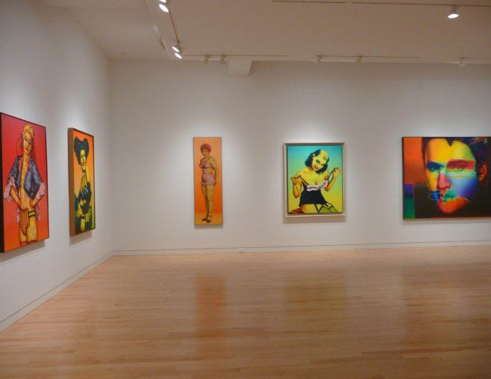
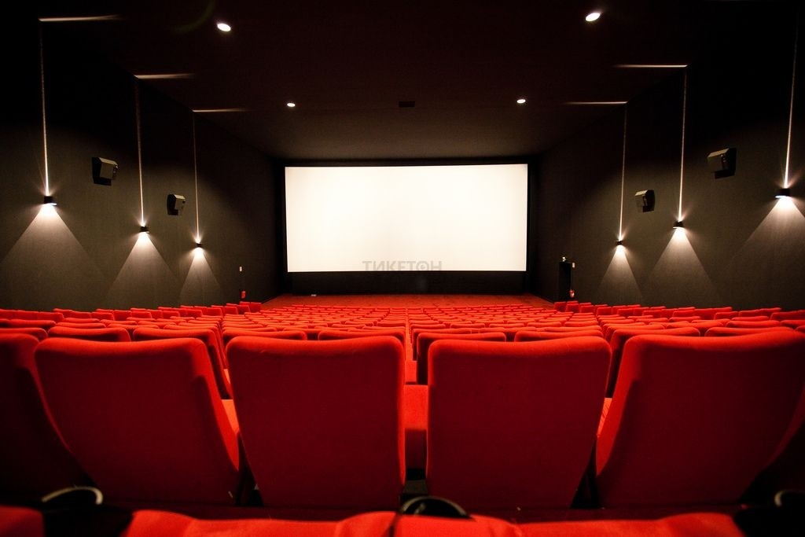
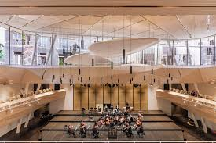
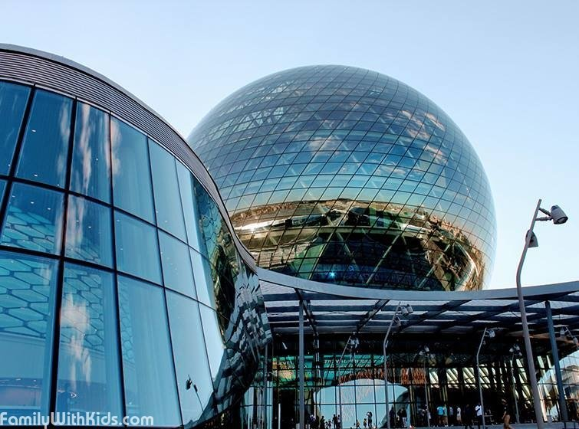
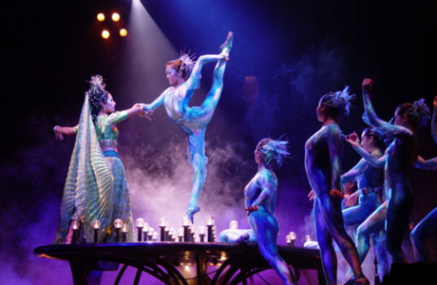
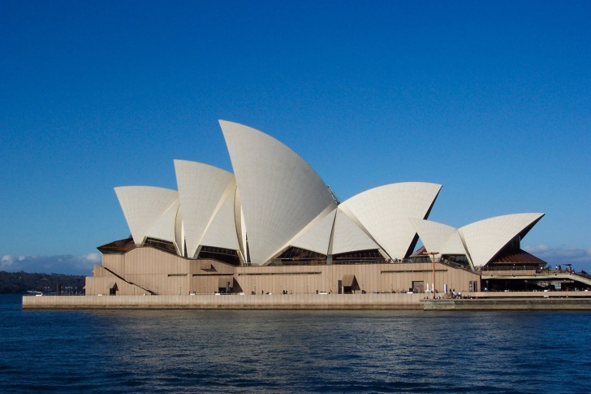
What can you do in the following places?

Slide 5
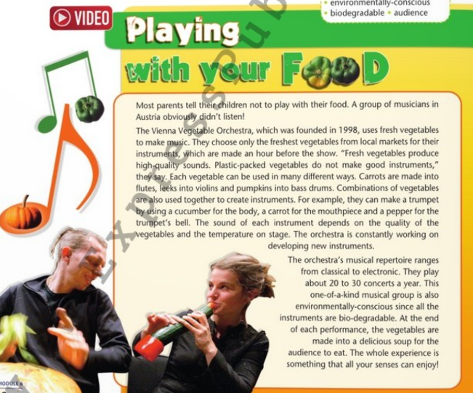
Reading skill. Read the text. “Playing with your food”

Slide 6

Task 1. Read the text and answer the questions.
1. Where is the orchestra from?
2. What makes it special?
3. Where do they get their instruments from?
4. How is a trumpet made?
5. What does the sound of the instruments depend on?
6. What music do they play?
7. How does a concert end?

Slide 7

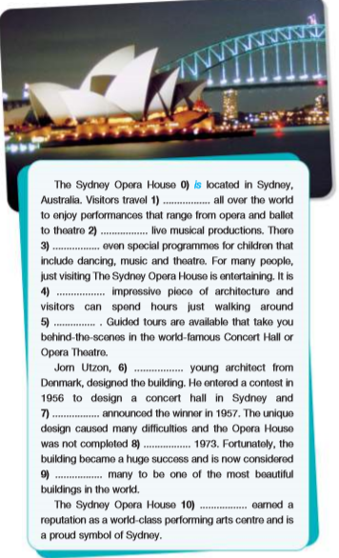
Read the text and complete the gaps with the correct missing words.

Slide 8
Task 2. Read the text and answer the questions.
1. Who visits the Sydney Opera House?
2. What kind of performances can you see there?
3. As well as watching a performance, what else can visitors do there?
4. Who was the building designed by?
5. Why did this person design it?
6. Why did it take a long time to build?

Slide 9

Reflection
Give the learners the stickers where they can give the reflection according to the content of the lesson:
1) What did you learn during the lesson?
2) What skills did you try to develop during the lesson?
Learners should write three best moments during the lesson, and one moment which was not so good.

Slide 10


