Slide 1

Grade: 7
Unit: Entertainment and media lesson 5
Topic: ‘by’ and ‘with’ in passive voice

Slide 2
learners will be able to:
1. Use appropriately active and passive voice;
2. Ask complex questions to get information;
3. Write with moderate grammatical accuracy.

Slide 3
plan:
1. Learn how to use ‘by’ and ‘with’ in the passive voice;
2. Practise forming questions in the passive;
3. Practise asking and answering using the passive.

Slide 4
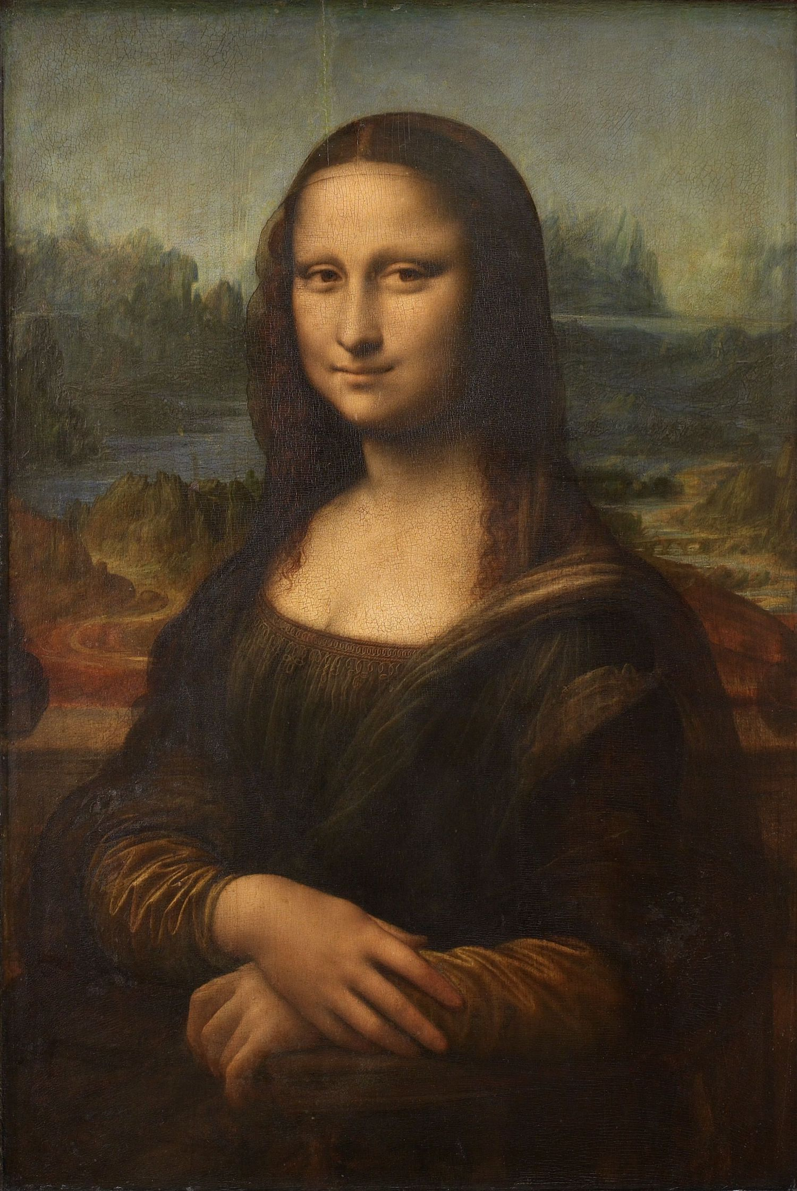

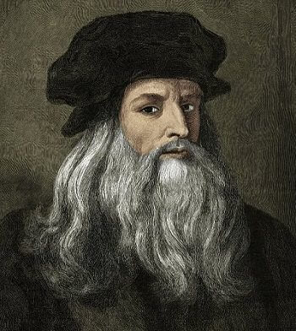
“Who painted The Mona Lisa?”
“Do you think Leonardo da Vinci painted it with oil paints?”.

Slide 5

Use the verbs and the names to form a passive question
A | B | C
America | invent | Giuseppe Verdi
Hamlet | sing | Alexander Graham Bell
Aida | discover | Michelangelo
The Pieta | compose | Elvis Presley
Blue Suede Shoes | paint | Christopher Columbus
The Mona Lisa | write | William Shakespeare
The telephone | sculpt | Leonardo da Vinci

Slide 6
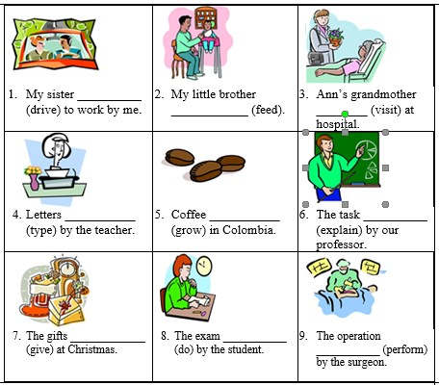
complete the sentences with the correct passive form of the verbs in brackets.

