Slide 1
The passive (present simple and past simple)
Grammar

Slide 2

7.C7 develop and sustain a consistent argument when speaking or writing
7.UE9 use appropriately a variety of active and passive simple present and past forms and past perfect simple forms on a range of familiar general and curricular topics
All students will be able to
revise Present Simple Passive and practice Past Simple Passive
More students will be able to
practice speaking meanwhile applying the vocabulary and grammar of the lesson
Some students will be able to
how and when to use Present Simple and Past Simple Passive;

Slide 3
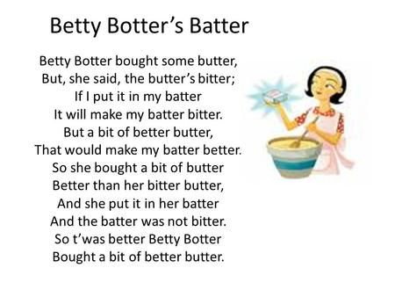
Tongue-twister “Betty Botter”

Slide 4
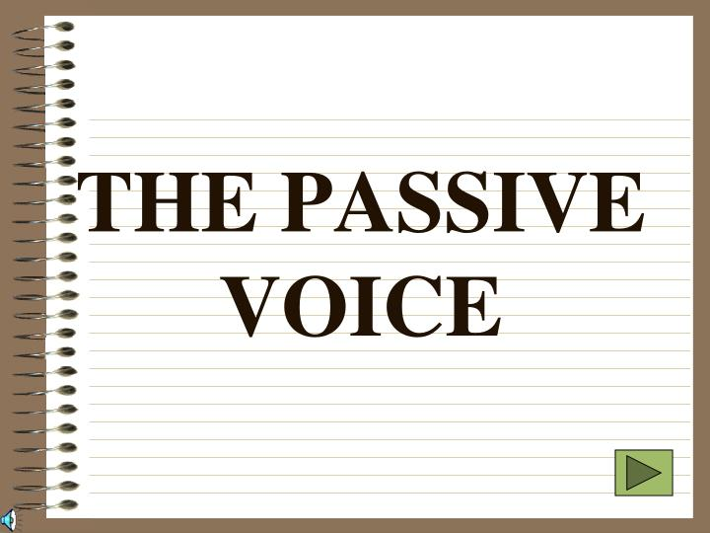
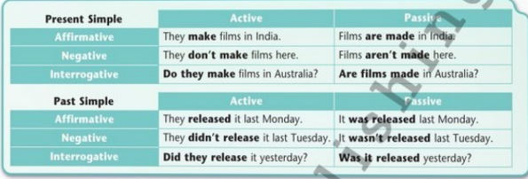

Slide 5

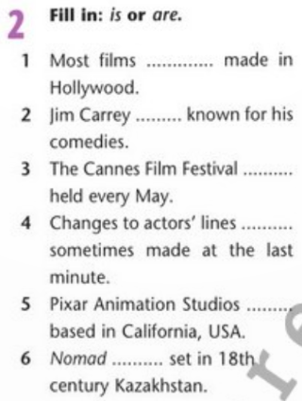
Task 1. Open the book page 66 exercise 2.
Fill in: is or are.

Slide 6
Task 2. Put the verbs in brackets into the past simple passive.
Robot is a sci-fiction thriller starring Will Smith. It … (produce) by Twentieth Century Fox Film Corporation. The film … (direct) by Alex Proyas and … (write) by Jeff Vintar and Akiva Goldsman. It … (nominate) for an Oscar and won an ASCAP Award for the Top Box Office Film.

Slide 7
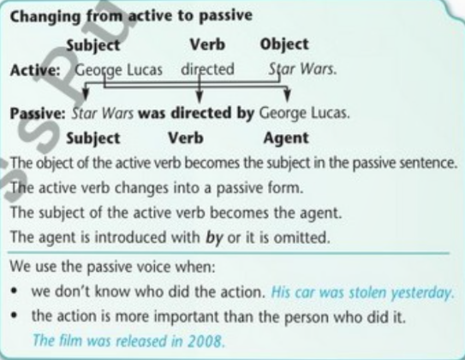
Read the theory. Is there a similar structure in Kazakh language?

Slide 8
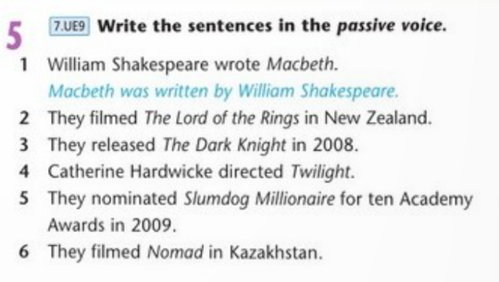

Slide 9
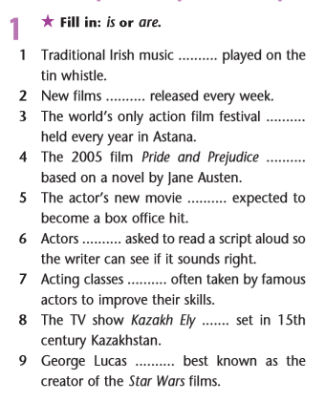

Task 4.
Fill in: is or are.

Slide 10

Reflection:
Give the students the stickers where they can give the reflection according to the content of the lesson:
Did you like the lesson?
Have you got any questions about new grammatical rule?
What is the formula of the passive voice?

Slide 11
Homework:
Workbook. Page 42 ex 3,4

