Slide 1
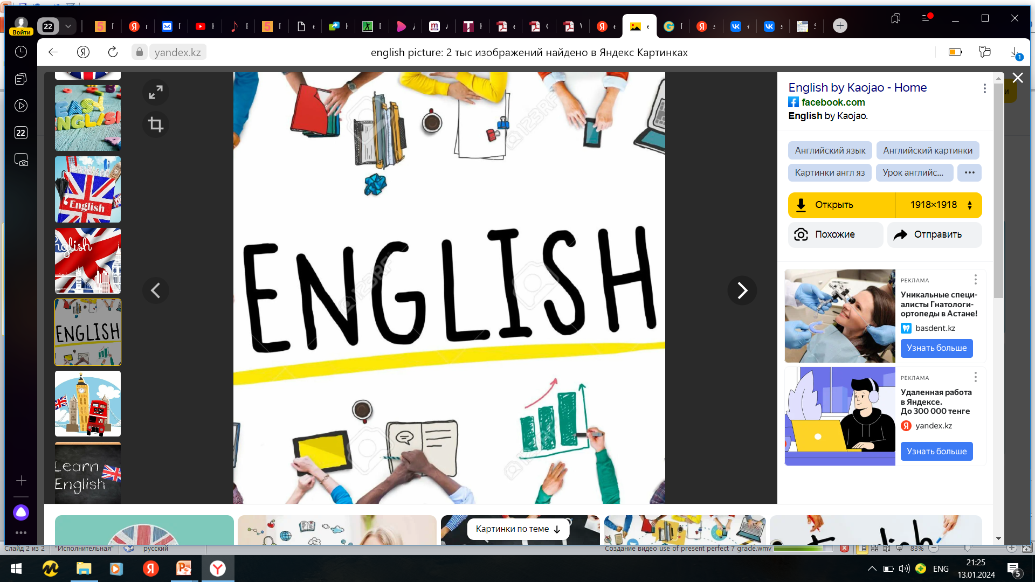

Subject: English language
Grade: 6
The theme of the lesson: An email about your neighborhoods

Slide 2
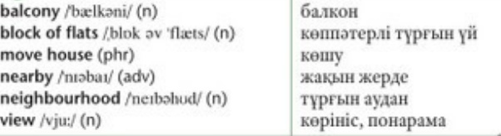
New words

Slide 3
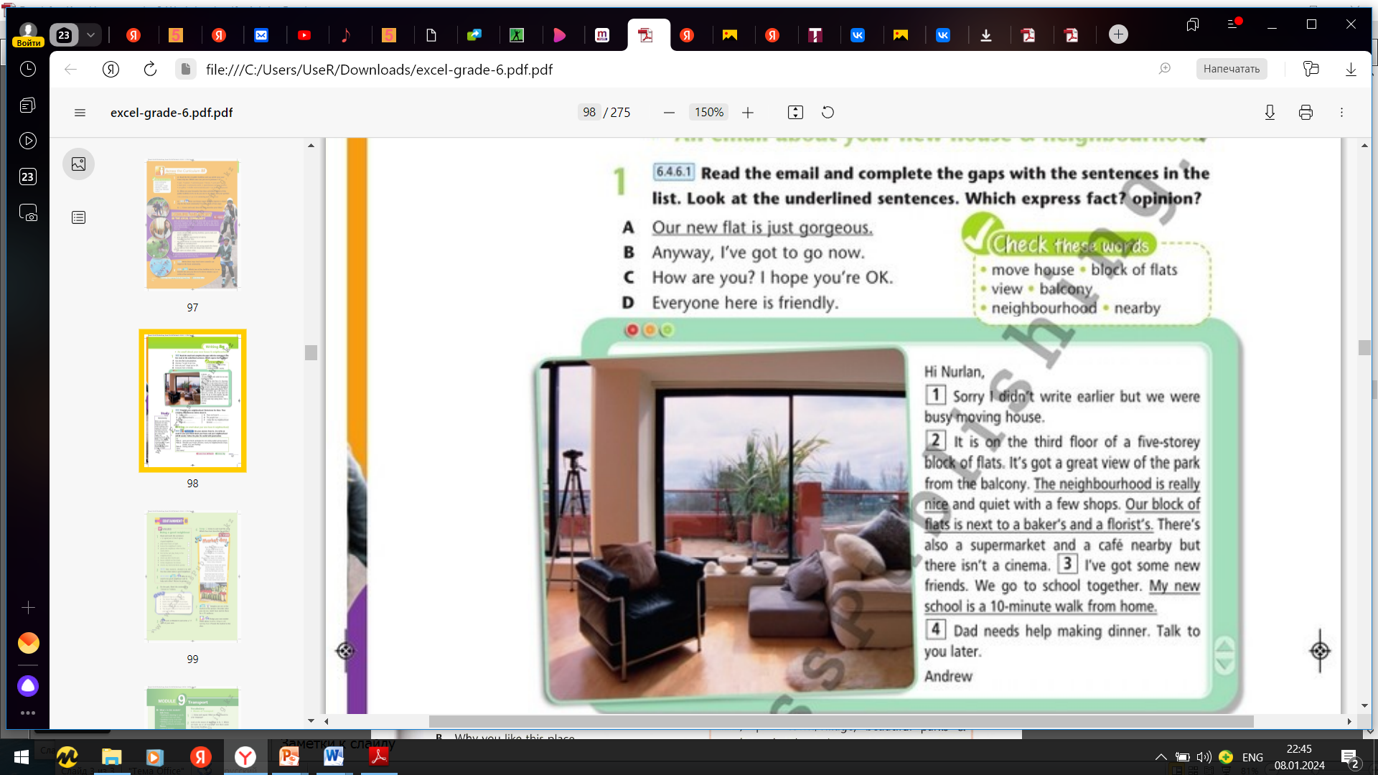
Ex.1,p.97 Read the email and complete the gaps with the sentences in the list. Look at the underlined sentences. Which express fact? opinion?
1 C
2 A
3 D
4 B
Opinion: Our new flat is just gorgeous. – The neighbourhood is really nice.
Fact: Our block of flats is next to a baker’s and a florist’s. – My new school is a 10-minute walk from home.

Slide 4
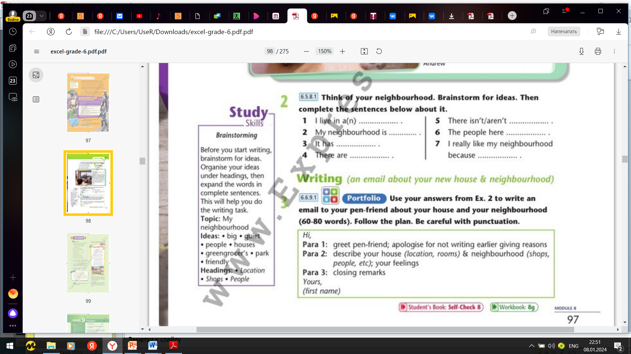
Ex.2,p.97 Think of your neighbourhood. Brainstorm for ideas. Then complete the sentences below about it.
1)I live in a flat.
2) My neighbourhood is busy and noisy.
3)It has a great view of the city.
4)There are a lot of shops and cafés nearby.
5)There isn’t a cinema in my neighbourhood.
6)The people here are very friendly.
7)I really like my neighbourhood because it is a nice place to live with everything we need nearby.

Slide 5

Ex.3,p.97 Use your answers from Ex.2 to write an email to your pen-friend about your house and your neighbourhood (60-80 words). Follow the plan. Be careful with punctuation.
Hi Keith, How are you? Sorry I didn’t write earlier, but we were busy moving house. Our new flat is really nice. It’s on the 5th floor of a block of flats and it has a great view of the city. The neighbourhood is nice, too. There are a lot of shops and cafés nearby, although there isn’t a cinema. I really like the neighbourhood and the people here are really friendly. Well, I’ve got to go now. Write back soon. Yours, Roman

Slide 6
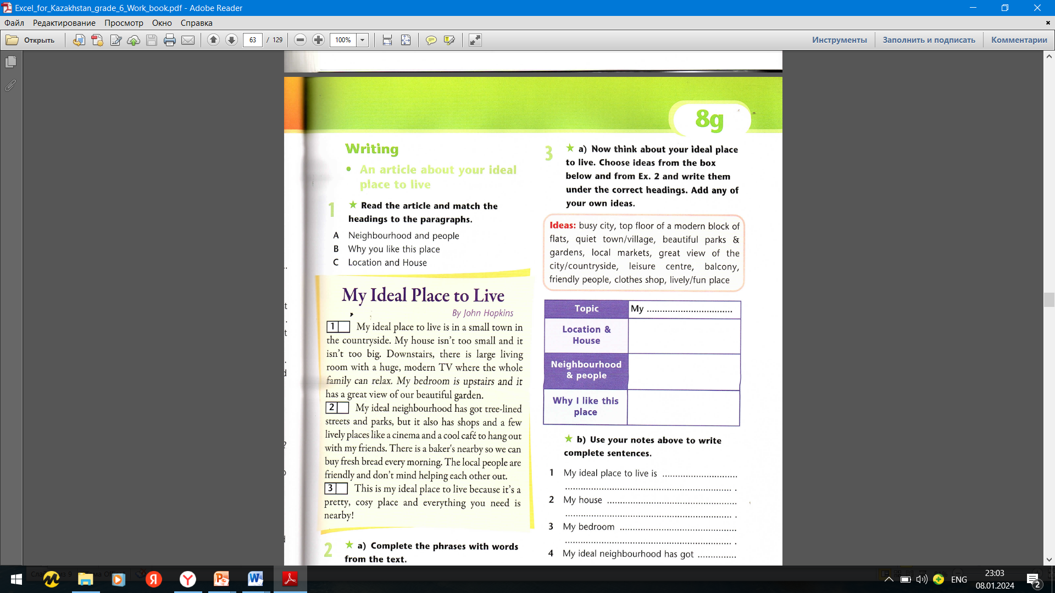
Ex.1,p.63 Workbook Read the article and match the headings to the paragraphs.
C
A
B

Slide 7
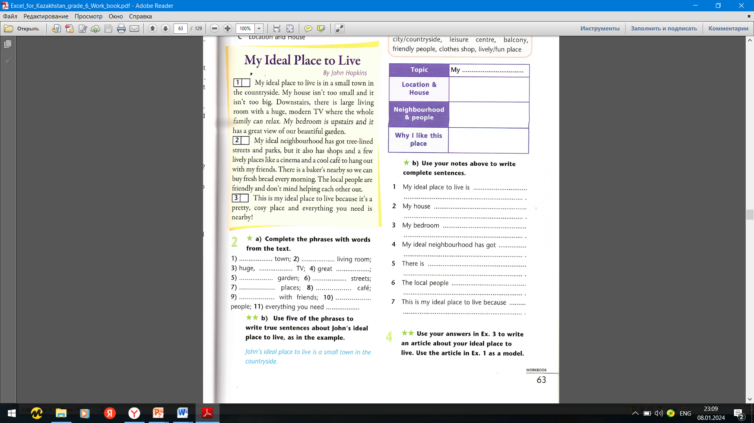
Ex.2a,p.63 Workbook Complete the phrases with words from the text.
1)Small town
2)Large living room
3)Huge, modern TV
4)Great view
5)Beautiful garden
6)Tree-lined streets
7)Lively places
8)Cool café
9)Hang out with friends
10)Everything you need is nearby

Slide 8
Ex.2b,p.63 Workbook Use five of phrases to write true sentences about John`s ideal place to live, as in the example.
1)John`s ideal place to live is a small town in the countryside.
2)John`s living room is large with huge, modern TV.
3)John`s bedroom is upstairs and it has great view of beautiful garden.
4)John`s ideal neighbourhood has got tree-lined streets and parks.
5)This is John`s ideal place to live because it`s a pretty, cosy place and everything you need is nearby.

Slide 9


