Slide 1
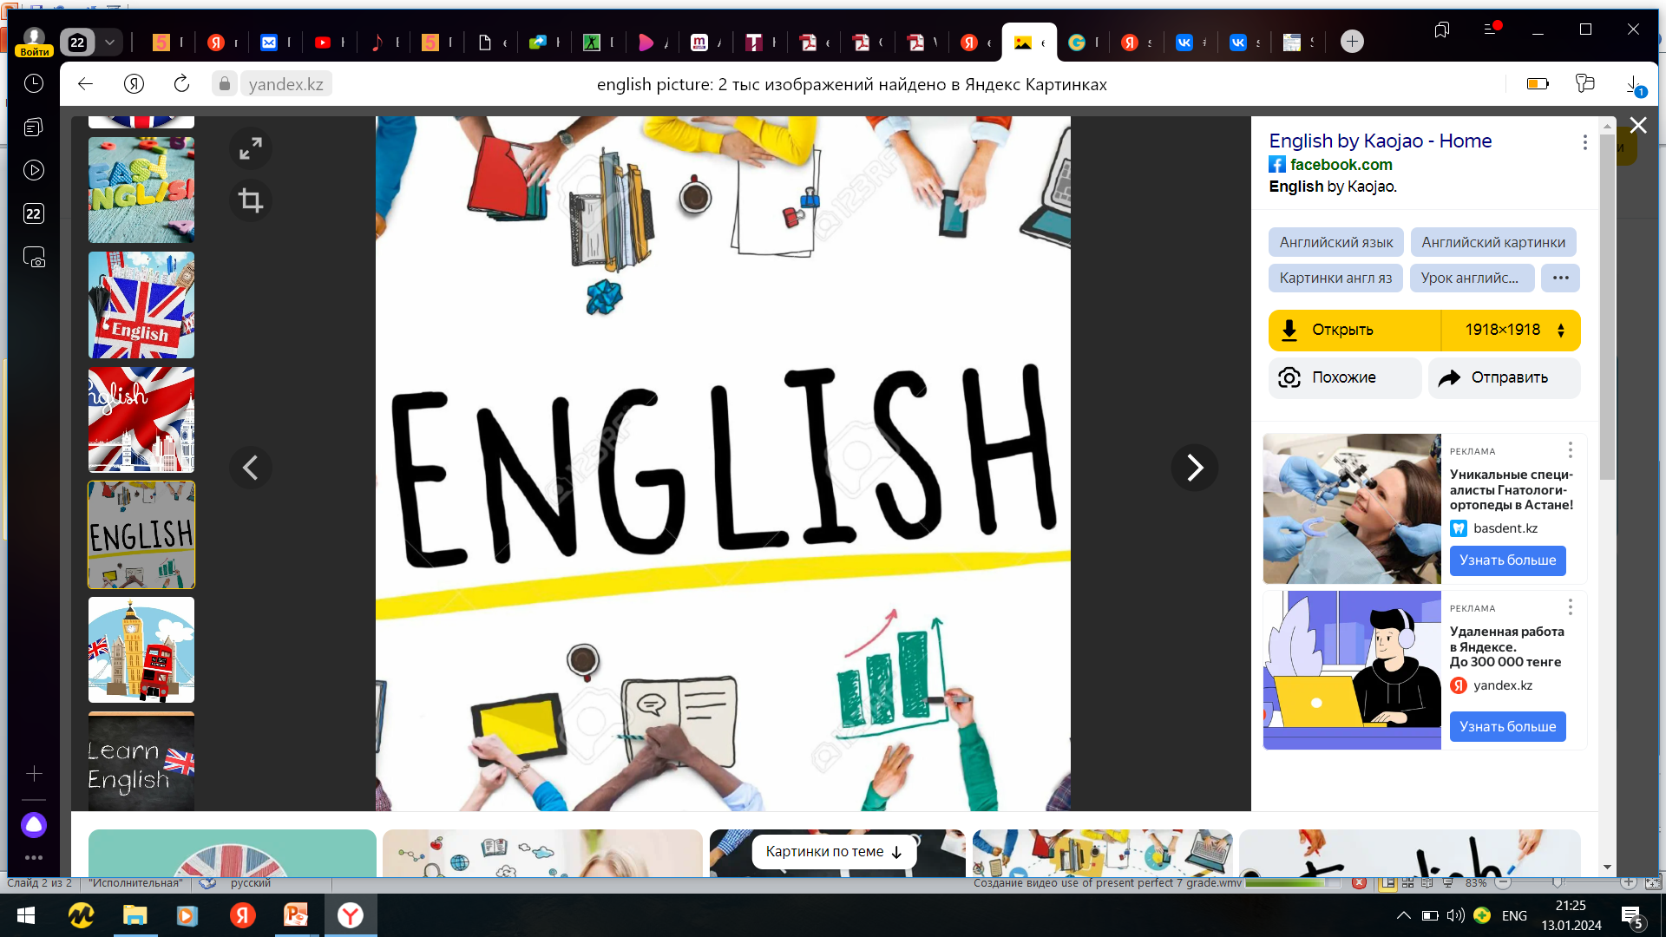
Subject: English language
Grade: 6
The theme of the lesson: Markets around the world

Slide 2

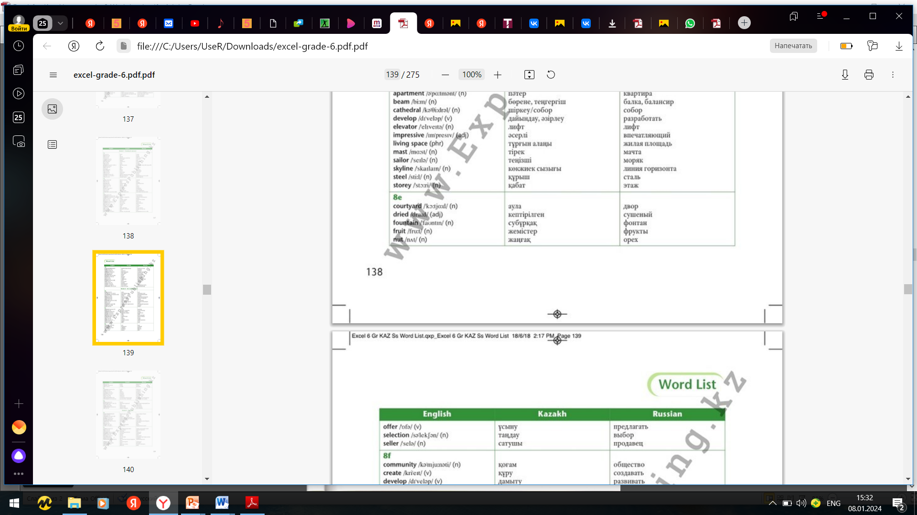
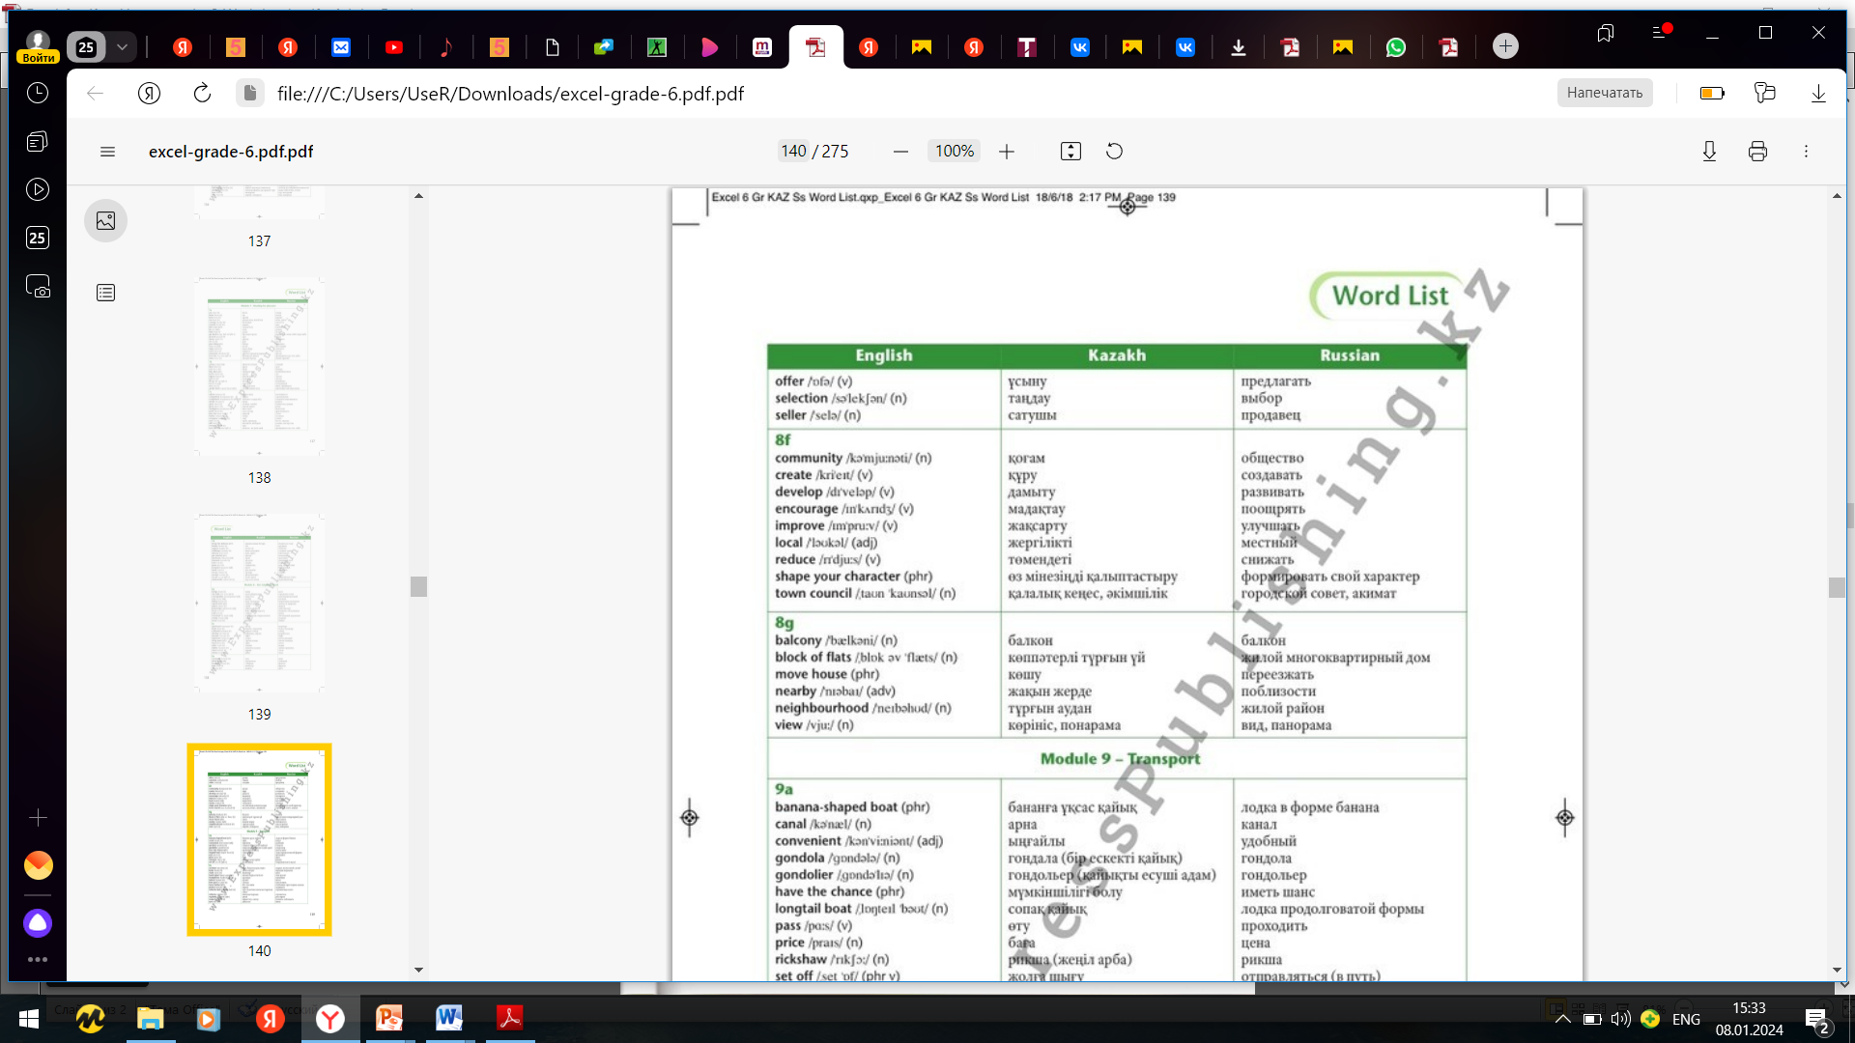
New words

Slide 3
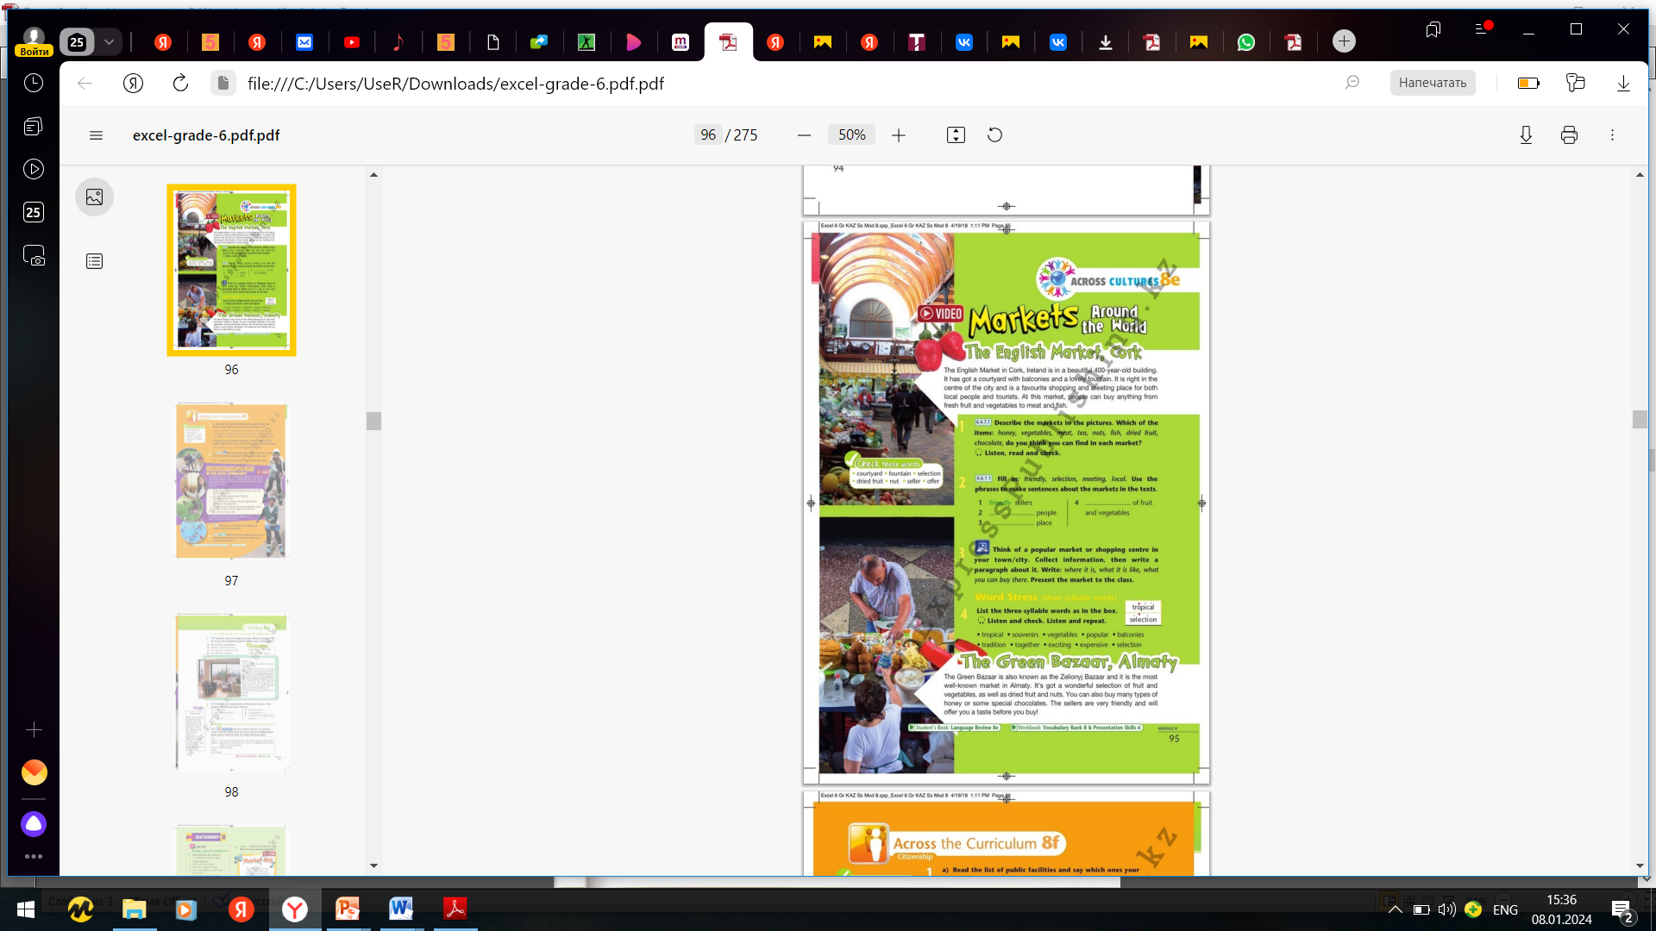
Ex.1,p.95
Describe the markets in the pictures. Which of the items: honey, vegetables, meat, tea, nuts, fish, dried fruit, chocolate, do you think you can find in each market?
The market at the top of the page is indoors. There are two levels and lots of stalls. I can see fruit and vegetables downstairs and it looks like a café upstairs. I think you can find vegetables, meat and fish here. The market at the bottom of the page has a lot of nuts and dried fruit. It seems quite exotic. I think it is indoors too. I think you can find tea, nuts, dried fruit and chocolate here.

Slide 4
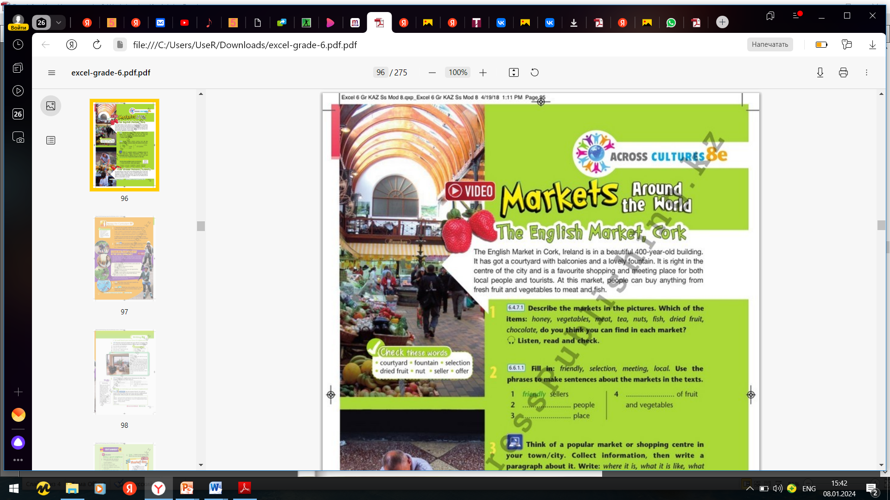
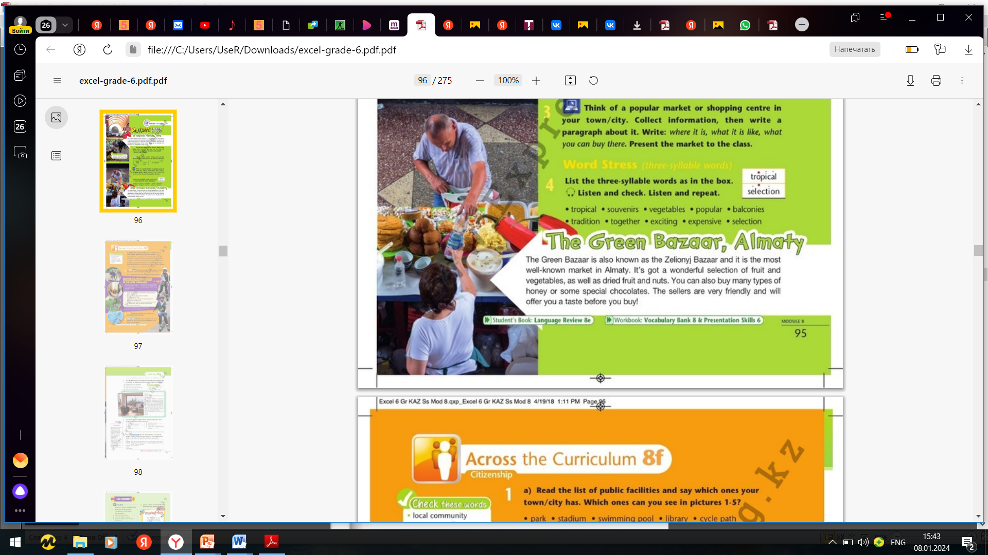
P.95
Read the text.

Slide 5
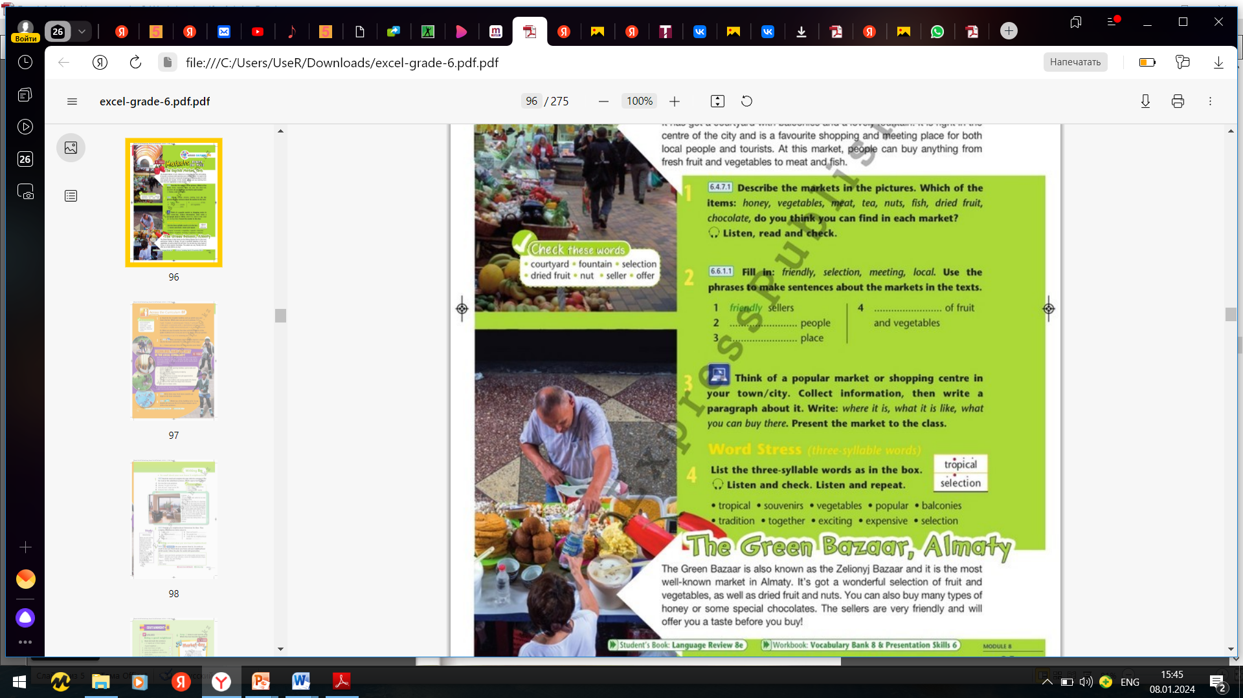
Ex.2,p.95
Fill in: friendly, selection, meeting, local. Use the phrases to make sentences about the markets in the texts.
selection
local
meeting
1)There are friendly sellers at the Green Bazaar who offer you a taste before you buy.
2)Local people and tourists visit these markets.
3)The English Market is a popular meeting place.
4)There is a huge selection of fruit and vegetables at the Green Bazaar.

Slide 6
Ex.3,p.95
Think of a popular market or shopping centre in your town/city. Collect information, then write a paragraph about it. Write : where it is, what it is like, what you can buy there. Present the market to the class.
name: Artem Market
where it is: in the middle of Astana
what it is like: covered market, two levels
what you can buy there: downstairs – fresh fruit and vegetables, dried fruit and nuts, meat, fish, homemade sauces; upstairs – clothes, toiletries, furniture, nail bars, barber's shops, souvenirs
A popular market in my city is the Artem Market in the middle of Astana. It is a covered market with two levels. Downstairs, you can buy fresh fruit and vegetables, dried fruit and nuts, meat, fish and homemade sauces at market stalls. Upstairs, you can buy clothes, toiletries, furniture and souvenirs. You can also get your nails done or get your hair cut. It is famous for the wide variety of goods available.

Slide 7
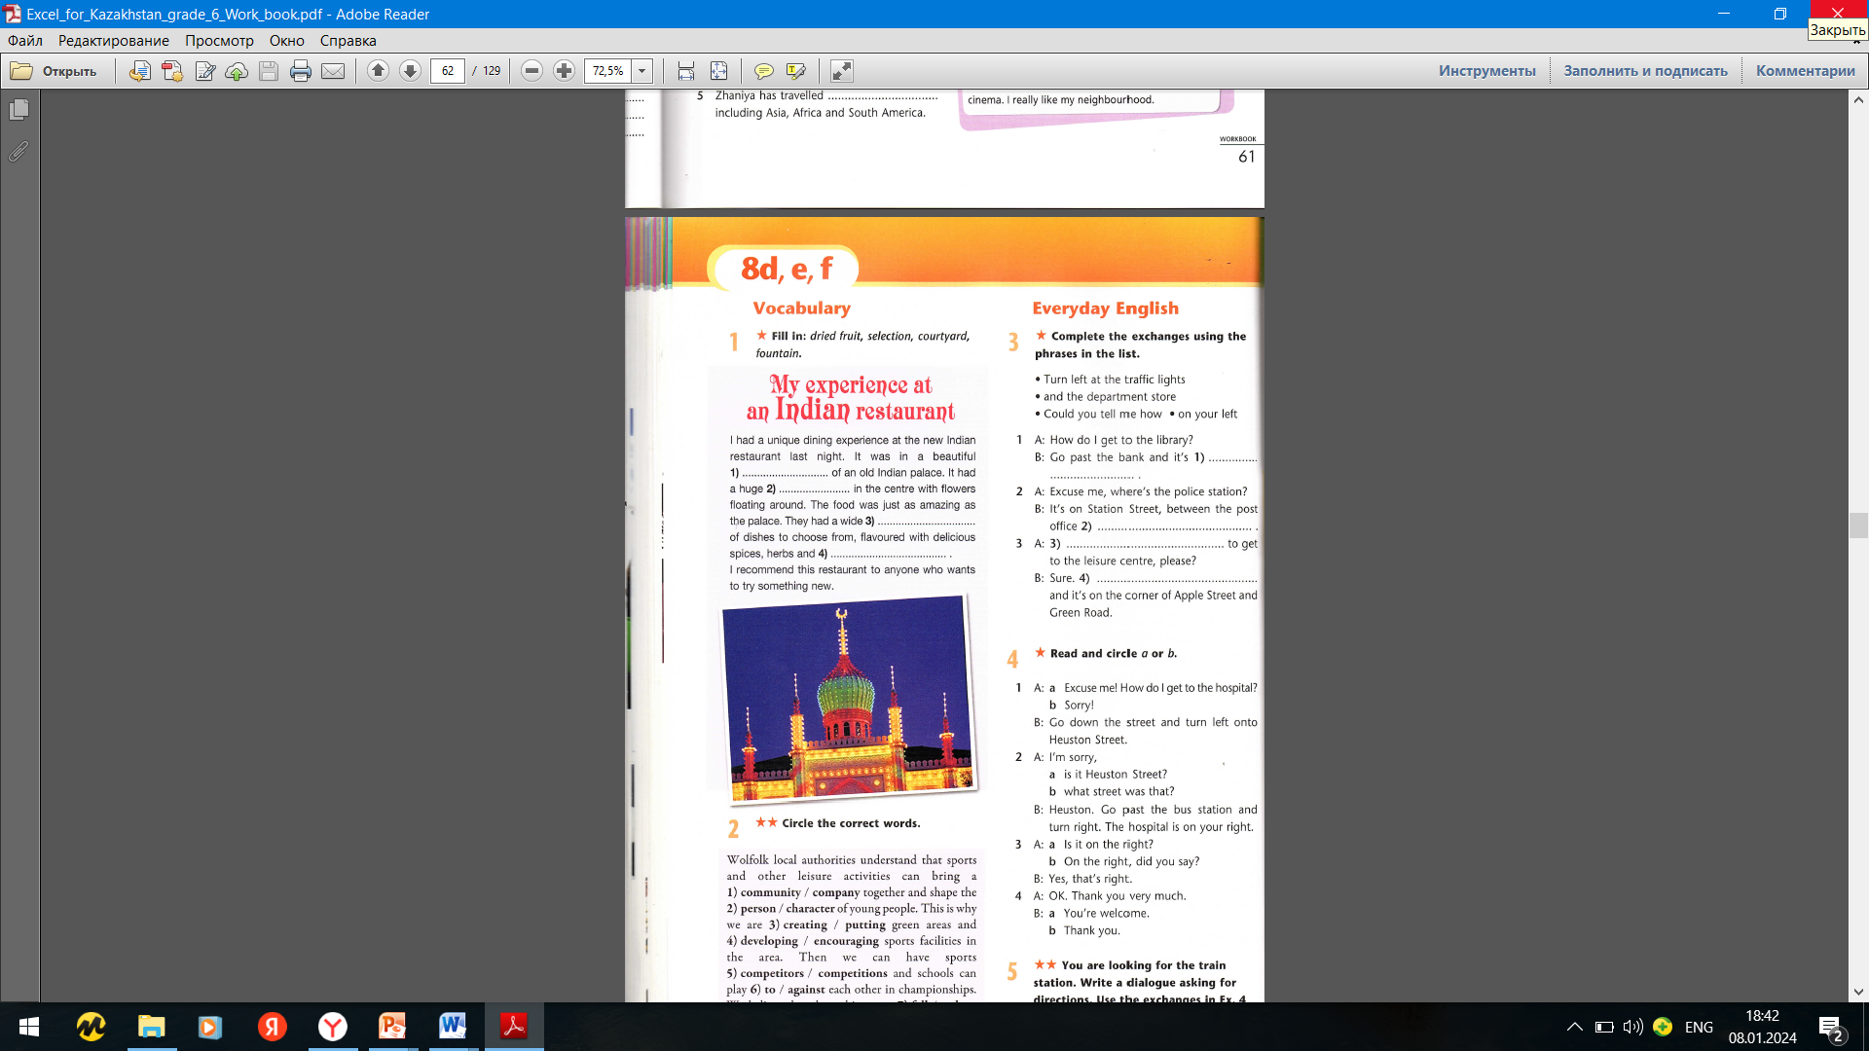
Ex.1,p.62 Workbook
Fill in: dried fruit, selection, courtyard, fountain.
courtyard
fountain
selection
dried fruit

Slide 8
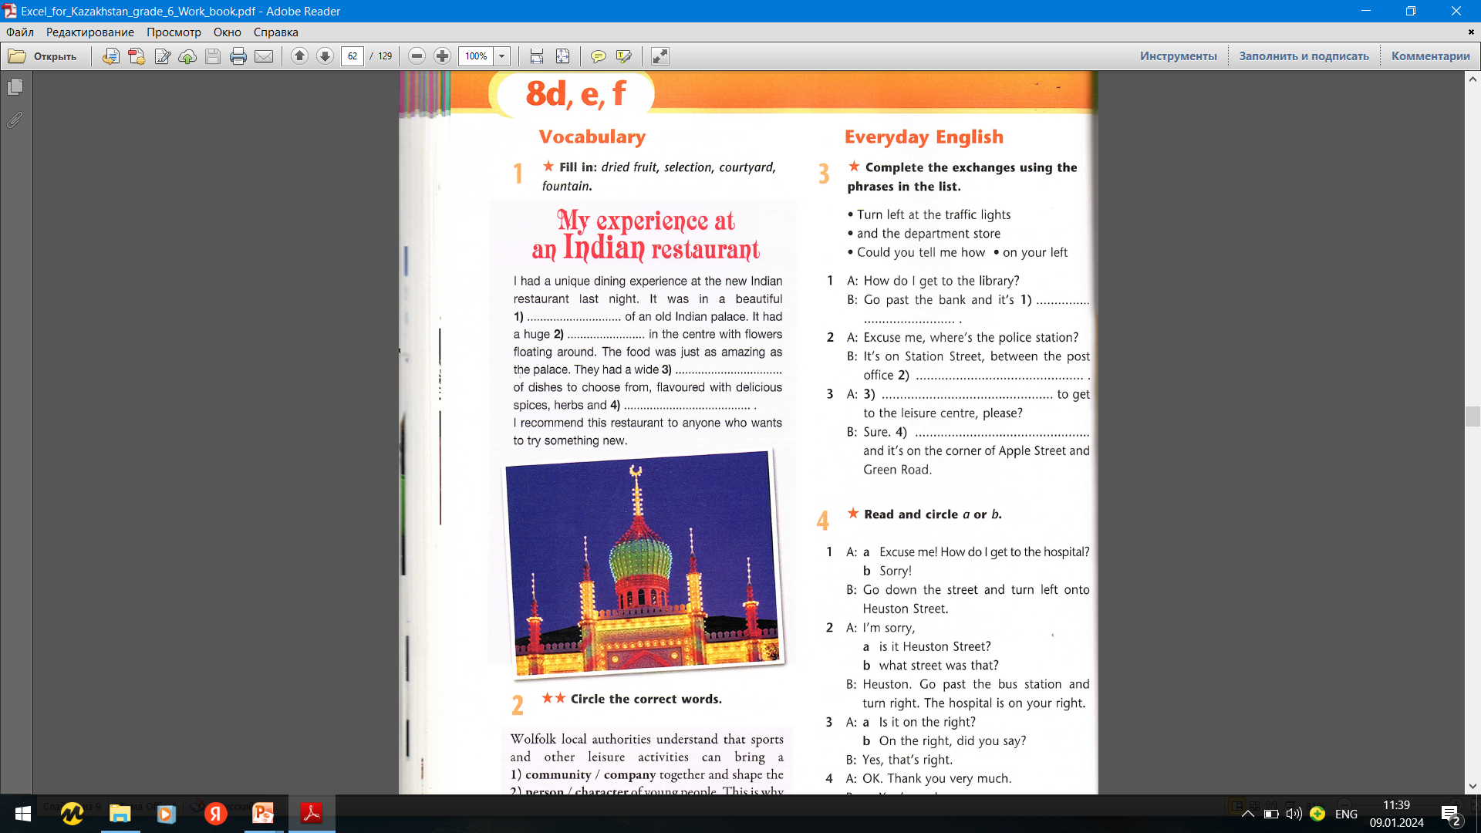
Ex.3,p.62 Workbook
Complete the exchanges using the phrases in the list.
on your left
and department store
Could you tell me how
Turn left at the traffic lights

Slide 9


