Slide 1
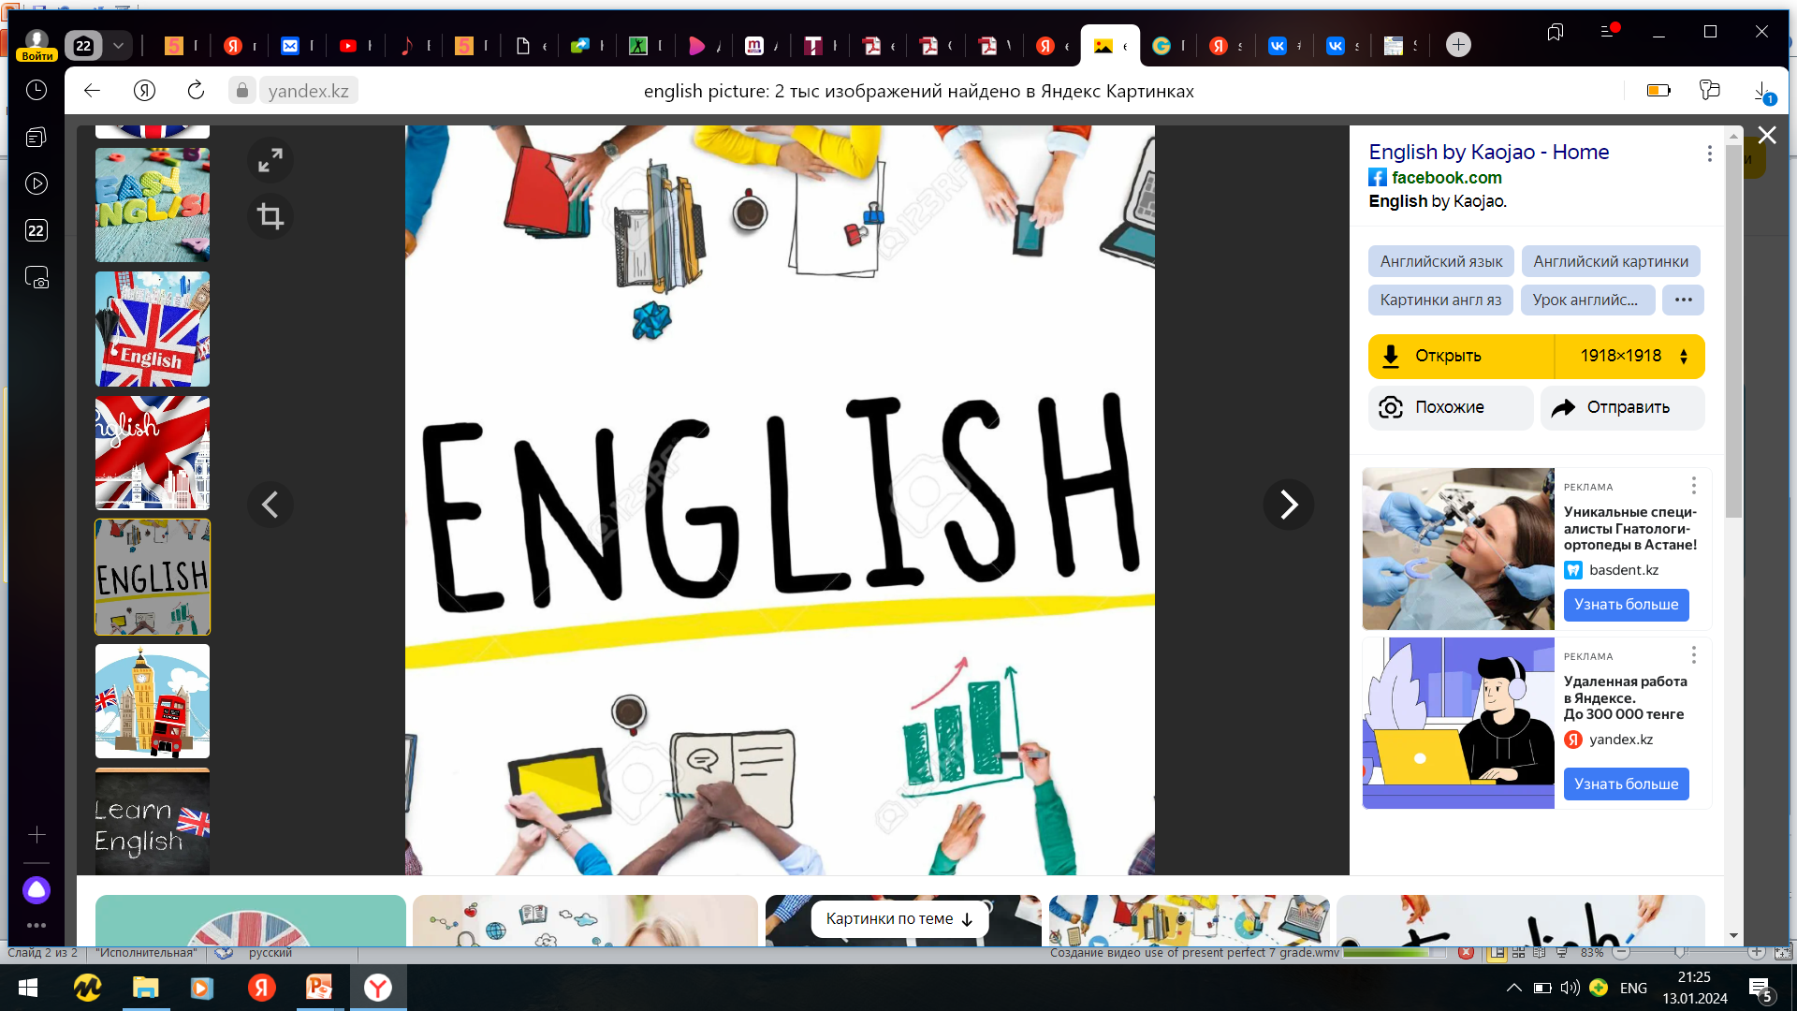

Subject: English language
Grade: 6
The theme of the lesson: Buildings above the world/Asking and giving directions

Slide 2
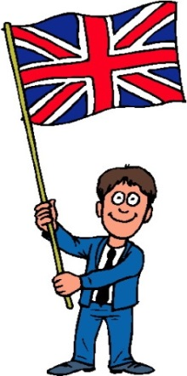
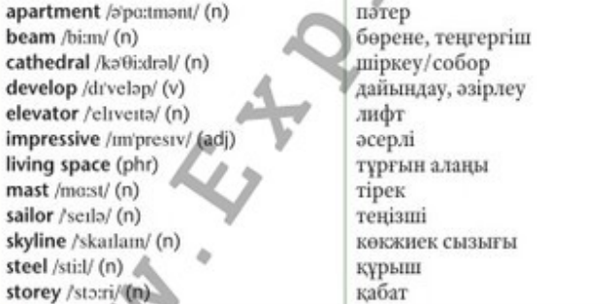
New words

Slide 3
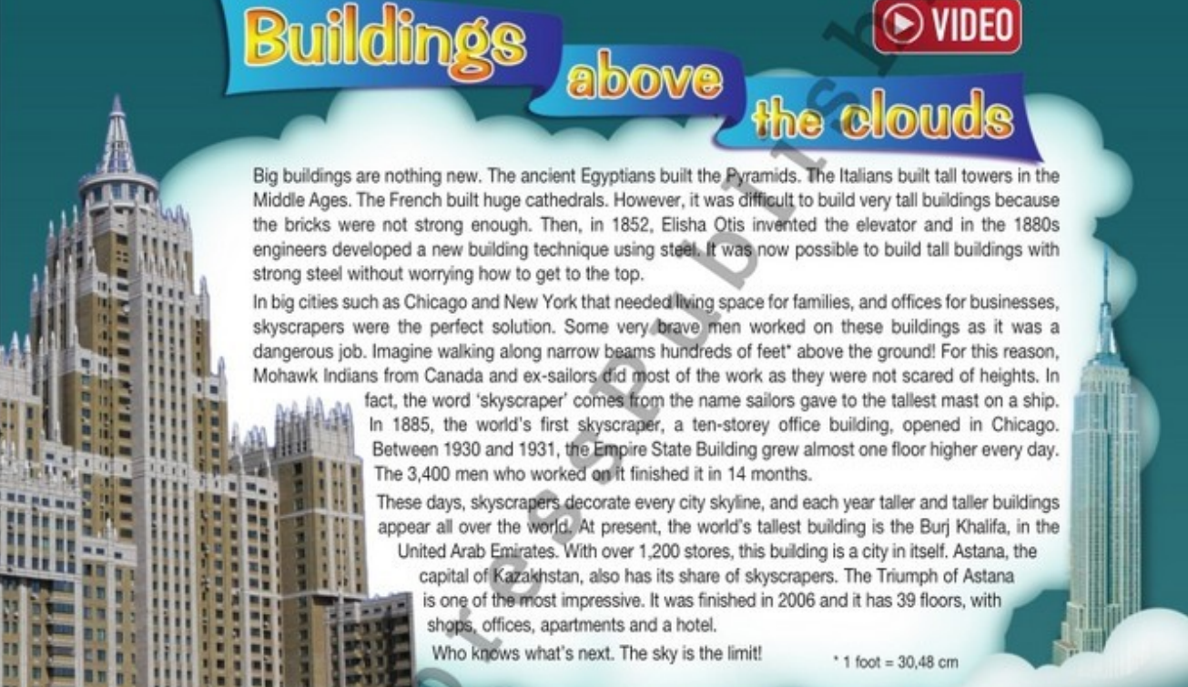
Ex,2,p.92
What do you know about skyscrapers? What is the origin of the word “skyscraper” ? Listen to find out.

Slide 4
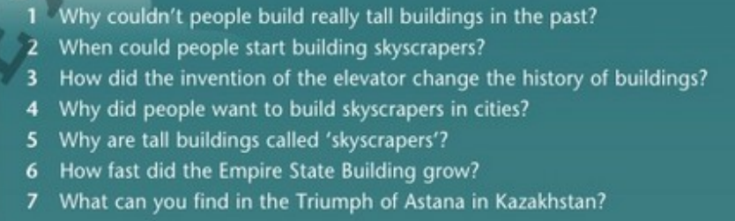
Ex.3a,p.92
Read the text and answer the questions.
1)Bricks weren’t strong enough and they didn’t have steel or elevators.
2)From the 1880s.
3)People could build tall buildings without worrying how to get to the top.
4)They needed living space and offices for business.
5)Because many ex-sailors worked on them and it is their word for the tallest mast on a ship.
6)One floor a day.
7 )You can find shops, offices, apartments and a hotel.

Slide 5
Ex.3b,p.92
Say or write three things that impressed you from the text. What is the author`s purpose?
I was impressed that the lift/elevator was invented in 1852. I was impressed that ex-sailors and Mohawk Indians built the skyscrapers. I was impressed that today there is a building with 1,200 stores. The author's purpose is to inform and entertain because he/she presents interesting information about skyscrapers without making it boring.

Slide 6
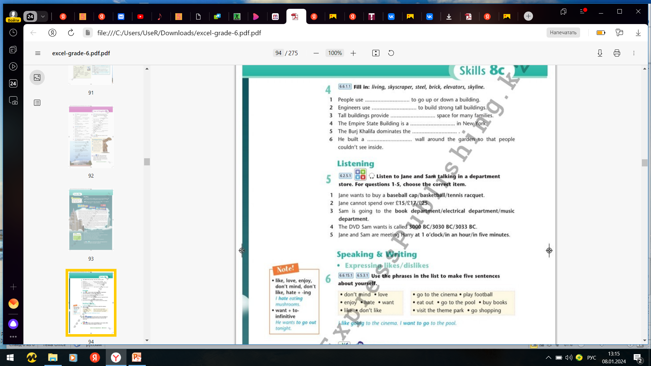
Ex.4,p.93
Fill in: living, skyscraper, steel, brick, elevators, skyline.
elevators
steel
living
skyscraper
skyline
brick

Slide 7
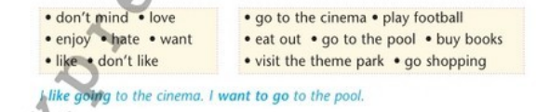
Ex.6,p.93
Use the phrases in the list to make five sentences about yourself.
I love playing football.
I hate eating out.
I want to go to the pool.
I enjoy going to the cinema.
I like buying books.
I don’t like visiting the theme park.
I don’t mind going shopping.

Slide 8
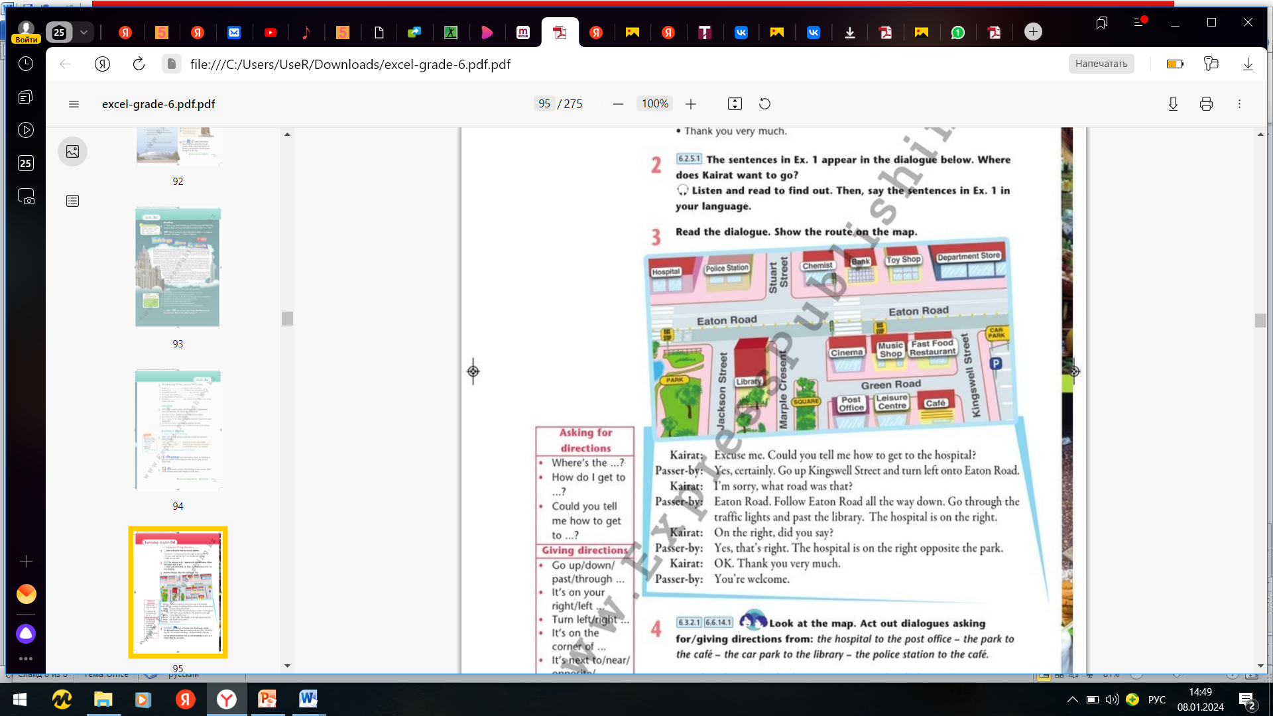
Ex.3,p.94
Read the dialogue. Show the route on the map.

Slide 9
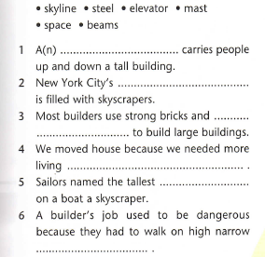
Ex.3,p.61 Workbook
Complete the sentences with the words below.
elevator
skyline
steel
space
mast
beam

Slide 10
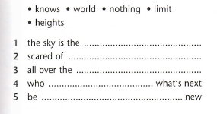
Ex.4a,p.61 Workbook
Use the words to complete the phrases.
limit
heights
world
knows
nothing

Slide 11

Ex.4b,p.61 Workbook
Use the phrases in the correct form to complete the sentences.
scared of heights
are nothing new
who knows what`s next
the sky is the limit
all over the world

Slide 12


