Slide 1


Subject: English language
Grade: 6
The theme of the lesson: The Passive (Present, Past Simple)

Slide 2

The Passive Voice
Passive voice in English is a sentence structure that focuses on the object of the sentence rather than the subject. This may sound complicated but trust me, it is very simple.
What is Passive Voice in English?
In English, sentences can be written in two forms — passive and active. In active sentences, the person/thing who is doing the action is considered the subject of the sentence and the person/thing who is receiving the action is considered the object of the sentence.
For example: The singer is singing a beautiful song.
In the above sentence,
Subject: singer
Object: song
Verb: singing

Slide 3

In passive sentences, the person/thing who is receiving the action, which is ideally the object of the sentence is placed at the beginning, and the person/thing who is doing the action, which is ideally the subject in the sentence is placed at the end of the sentence.
For example: The song is being sung by the singer.
In the above sentence,
Subject: The song
Object: is being sung
Verb: the singer
How do you form sentences in Passive Voice?
To form the passive voice of a sentence, we use passive verbs. Passive verbs are formed by using the verb ‘be’ and the past participle.

Slide 4
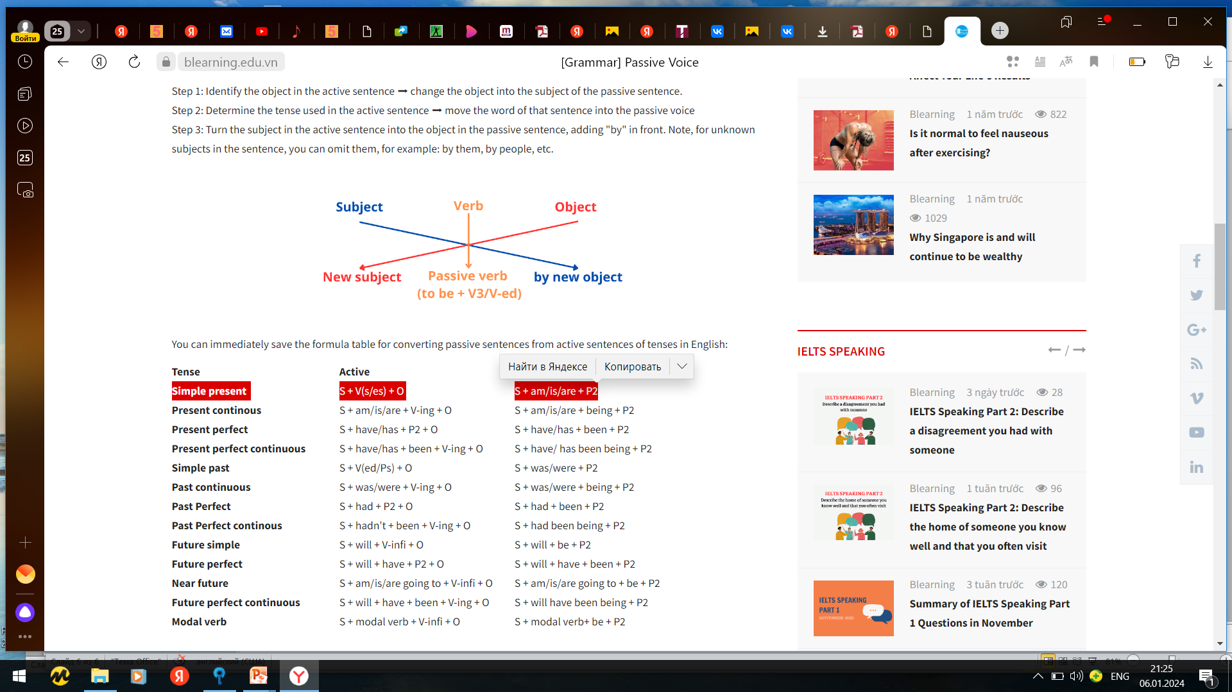
Rules for Conversion
While converting a sentence which is in its active form to its passive form, you should use the following rules:
The subject and the object will be interchanged: In passive sentences, the subject and the object in passive voice are interchanged. The object (in active sentences) becomes the subject in passive sentences, and the subject (in an active sentence) becomes the object in active sentences.
Example: Sam reads a book. — active voice
The book is being read by Sam. — passive voice
The preposition by is used before the object: The object in a passive sentence will always be preceded by the preposition ‘by’. This is because the object in such sentences explains that the action is being performed by somebody.
Example: Gauri is making pasta. — active voice
The pasta is being made by Gauri. — passive voice

Slide 5
Passive sentence structure
Core structure of the passive voice:
S + be + V3/Ved + (by + O) + (…)
S ➡ the subject in the sentence, the object (person/thing, ...) is affected by a certain action.
be + V3/ Ved ➡ The word "be" can change depending on the tense used in the active sentence.
V3/ Ved ➡ the verb is always kept the same, the thing that changes with the tense in this structure is the verb "be" above.
(by + O) ➡ "by" in English means "by", this word is used to introduce/refer to the object performing the action in the sentence after "by".
“O” ➡ indicates the object performing the action in the sentence.
+ (…) ➡ information about the place/time at which the S in the sentence will be affected by the action. This part is optional, it may or may not be available on a case-by-case basis.

Slide 6

Present Simple Passive
S + am/is/are + Ved/V3
Affirmative: Spain is visited by a lot of tourists every year.
Negative: Spain is not visited by a lot of tourists every year.
Interrogative: Is Spain visited by a lot of tourists every year?

Slide 7
Past Simple Passive
S + was/were + Ved/V3
Affirmative: Dinner was served at 9 pm.
Negative: Dinner was not served at 9 pm.
Interrogative: Was dinner served at 9 pm.

Slide 8
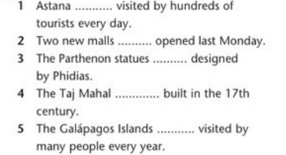
Ex.5,p.91
Fill in: is, are, was or were (x2).
is
were
were
was
are

Slide 9
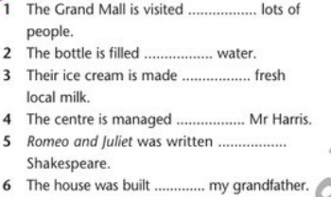
Ex.6,p.91
Fill in: by or with.
by
with
with
by
by
by

Slide 10
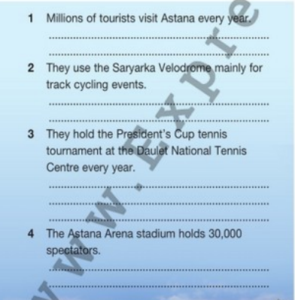
Ex.7,p.91
Rewrite the sentences in the present simple passive.
Astana is visited by millions of tourists every year.
The Saryarka Velodrome is used mainly for track cycling events.
The President`s Cup tennis tournament is held at the Daulet National Tennis Centre every year.
30,000 spectators are held by the Astana Arena stadium.

Slide 11
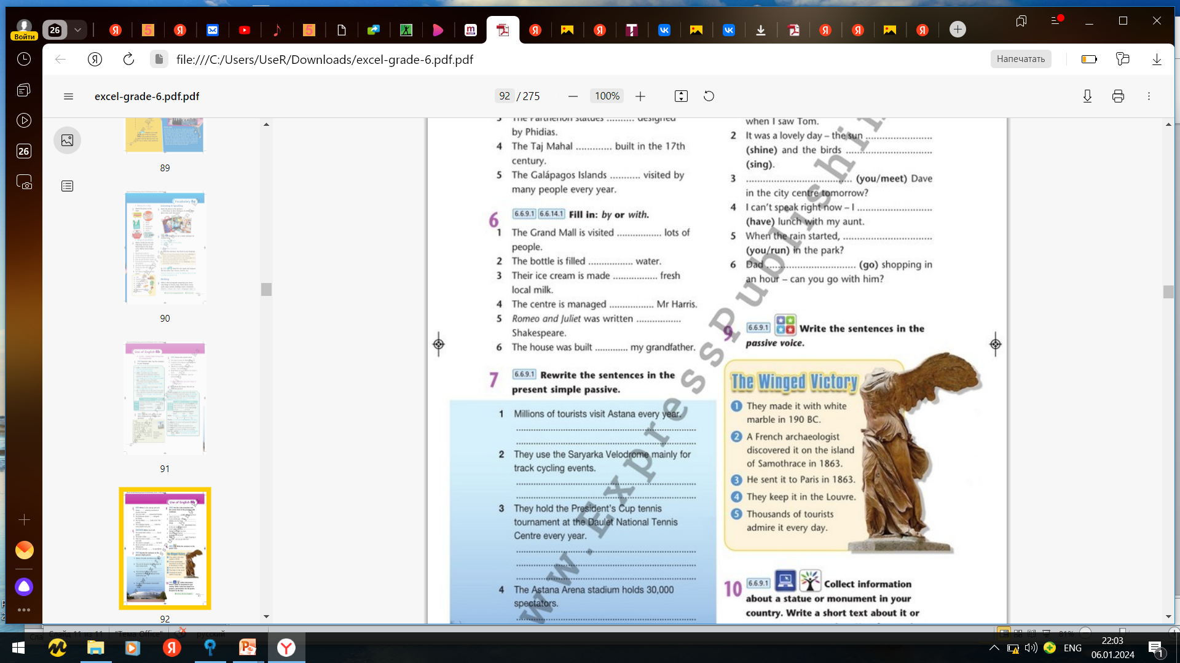
Ex.9,p.91
Write the sentences in the passive voice.
1)It was made with white marble in 190 BC.
2)It was discovered on the island of Samothrace in 1863 by a French archaeologist.
3)It was sent to Paris in 1863.
4)It is kept in the Louvre.
5)It is admired by thousands of tourists every day.

Slide 12
Ex.10,p.91
Collect information about a statue or monument in your country. Write a short text about it or prepare a presentation. Use the passive. Present it to the class.
The Bayterek Tower is a monument in Astana, Kazakhstan. It was designed by Akmurza Rustembekov and it was opened in 2002. It is 97 metres tall and weighs more than 1,000 tons. It is a famous symbol of Astana and it is admired by thousands of tourists every year.

Slide 13


