Slide 1


Subject: English language
Grade: 6
The theme of the lesson: A/ an, some/ any, how much/ how many and compounds

Slide 2
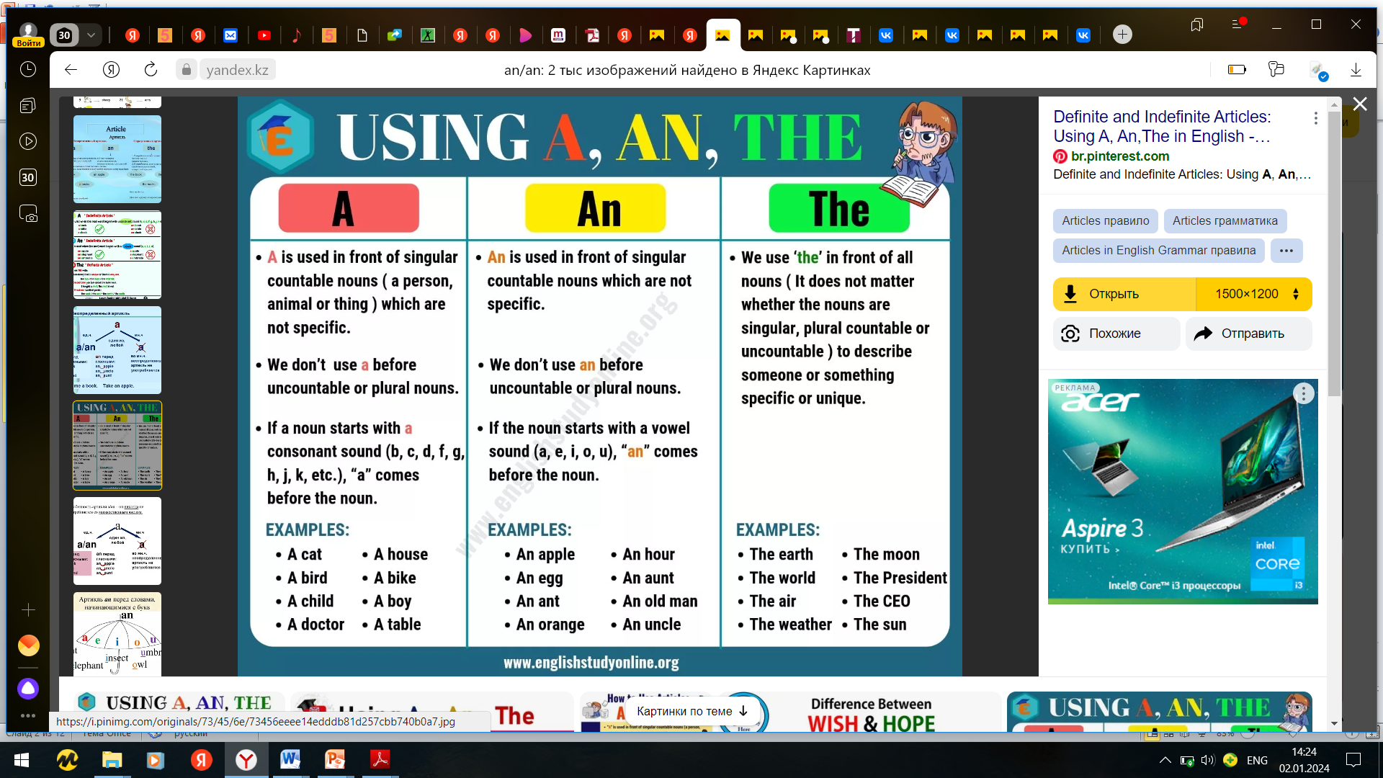

Slide 3
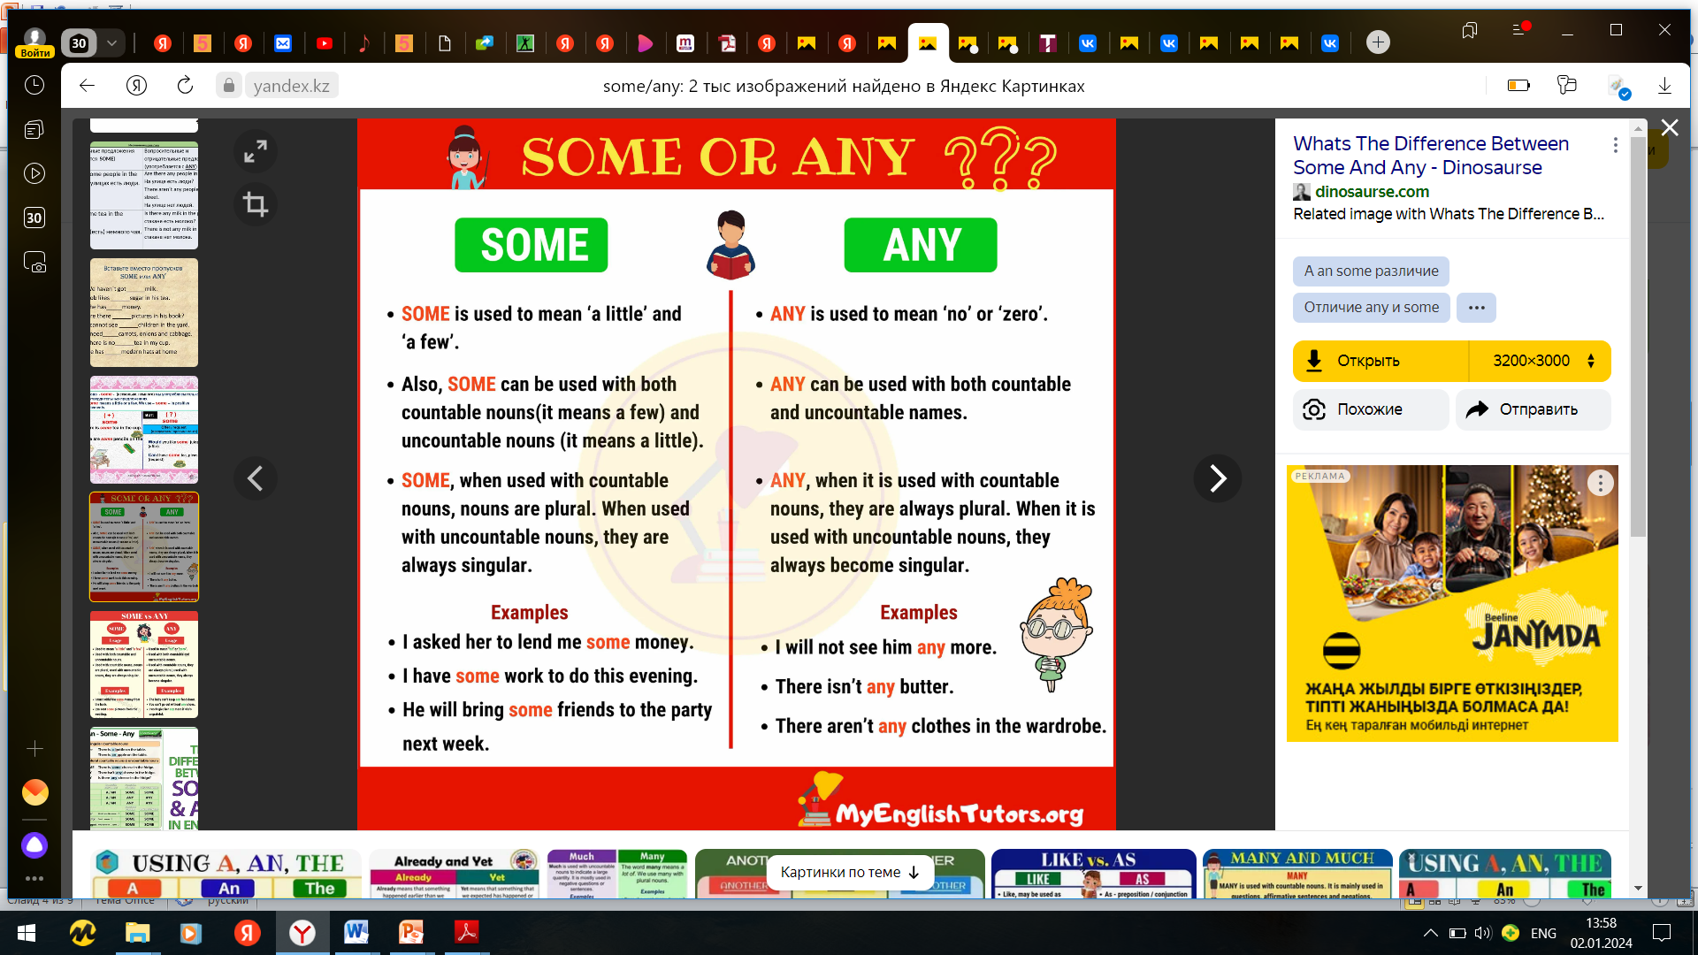

Slide 4
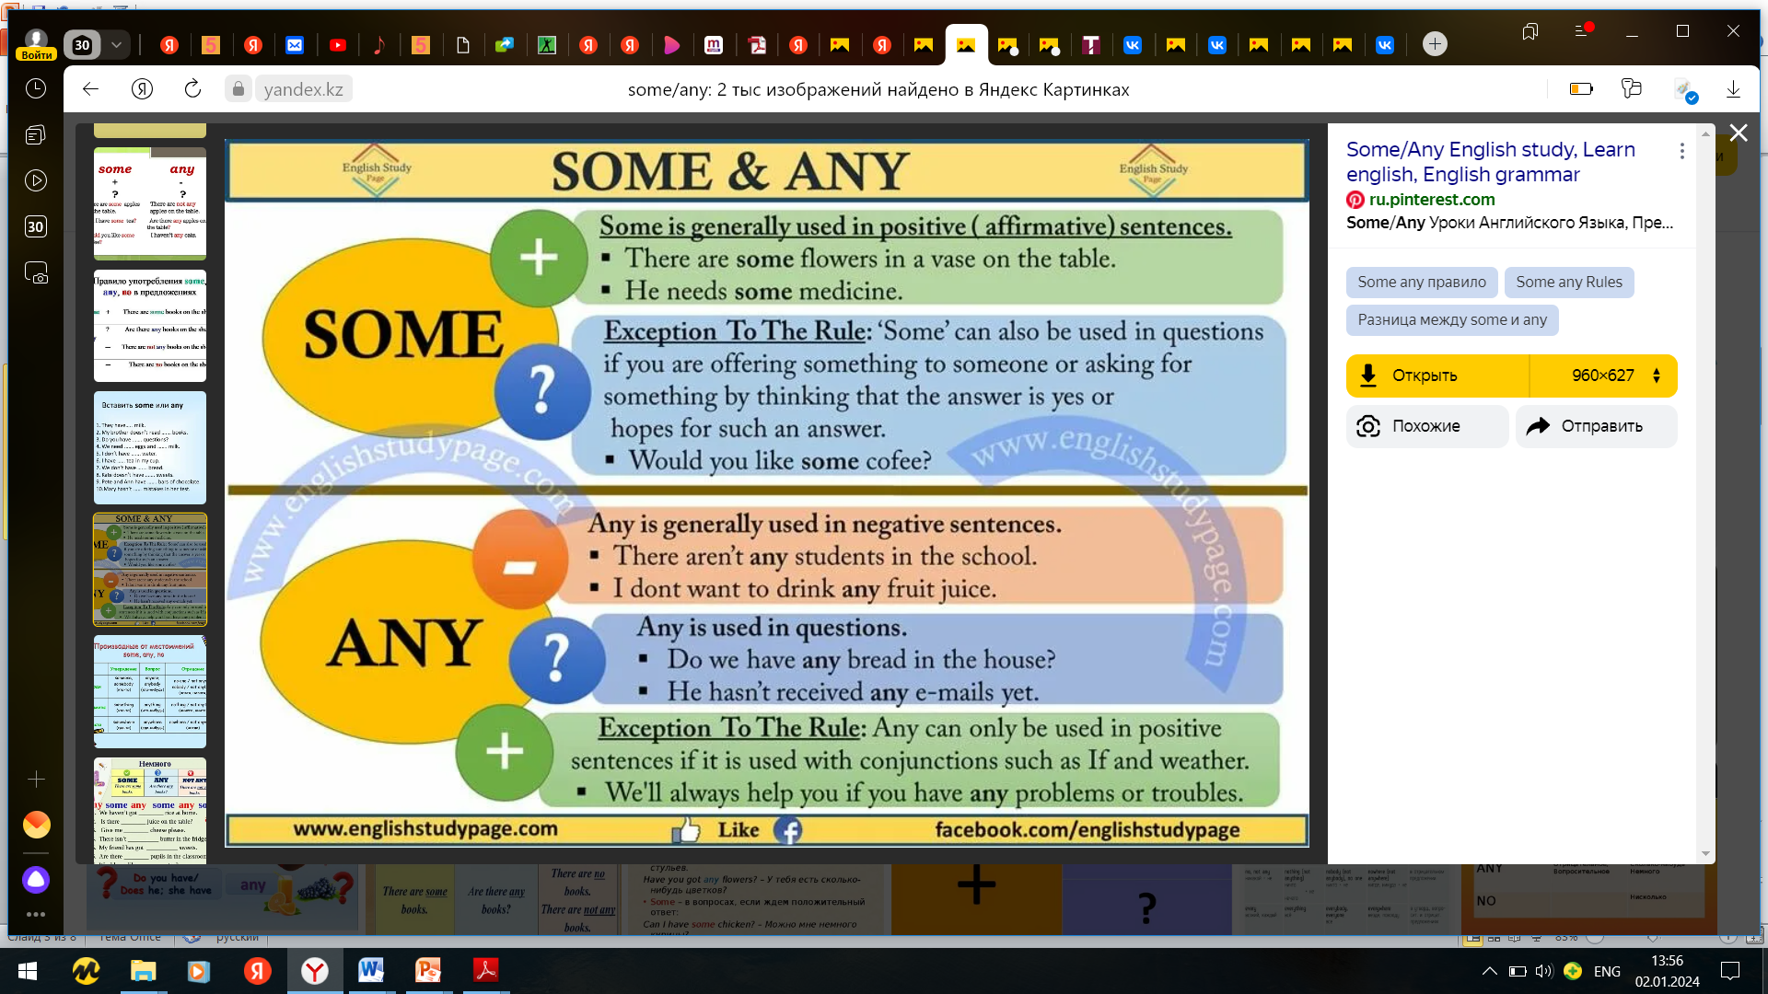

Slide 5
Compound nouns
The words 'some', 'any' and 'no' are often combined with the words 'body', 'one', 'where' and 'thing' to form the following series of commonly-used compound nouns:
Somebody, Someone, Somewhere, Something, Anybody, Anyone, Anywhere, Anything, Nobody, No one / No-one, Nowhere, Nothing

Slide 6
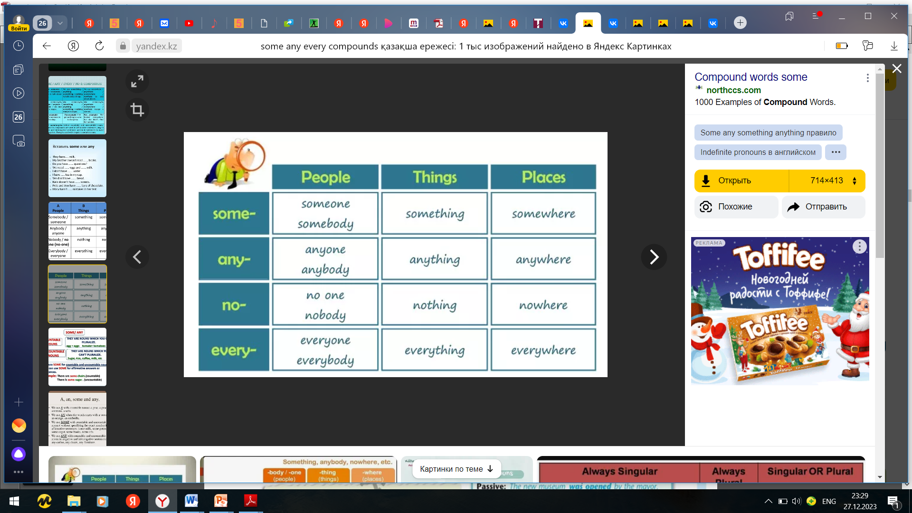
Somebody, Someone, Somewhere, Something
The compound nouns Somebody, Someone, Something and Somewhere are used in positive sentences. They can also be used in questions to offer or ask for a thing, or when we expect a positive response.
Somebody and Someone refer to a single unknown or unspecified person
something refers to a single unknown or unspecified thing
Somewhere refers to a single unknown or unspecified place.

Slide 7
Anybody, Anyone, Anywhere, Anything
The compound nouns Anybody, Anyone, Anything and Anywhere are generally used in negative sentences and questions as objects, but are only used as subjects in positive sentences.
Anybody, anyone, anywhere and anything refer to one of many people, places or things.

Slide 8
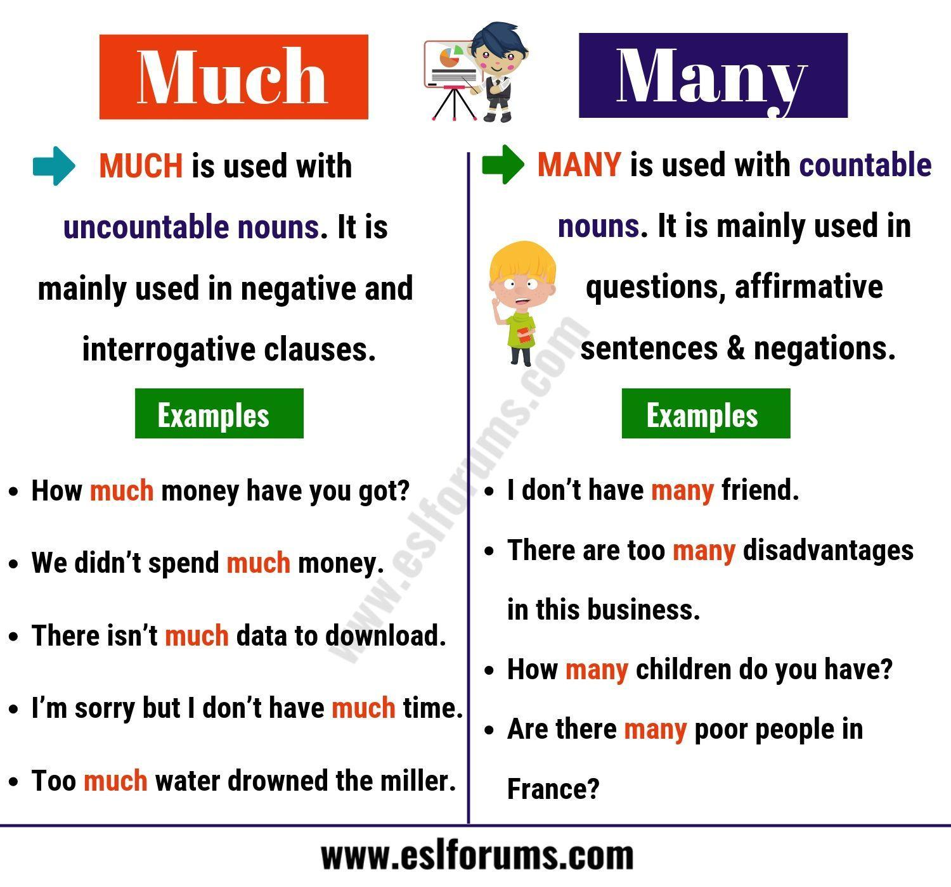

Slide 9
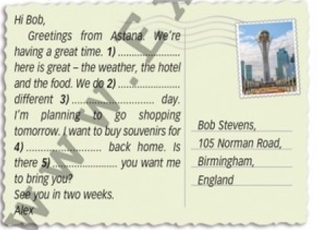
Ex.2,p.90
Use some, every, any and their compounds to complete the postcard.
everything
something
every
everyone
anything

Slide 10
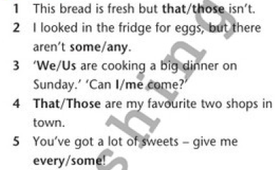
Ex.3,p.90
Choose the correct word.

Slide 11
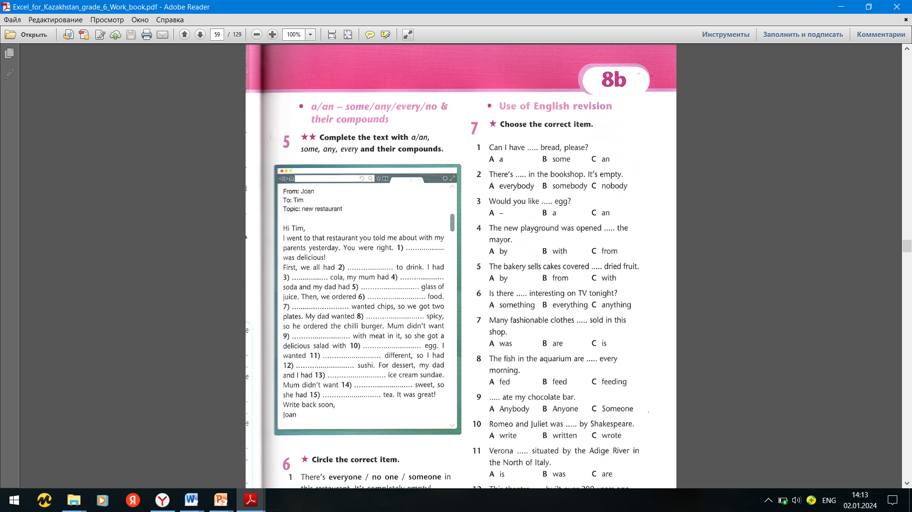
Ex.5,p.59 Workbook
Complete the text with a/an , some, any, every and their compounds.
it
some
a
something
a
some
everyone
something
anything
an
something
some
an
anything
a

Slide 12
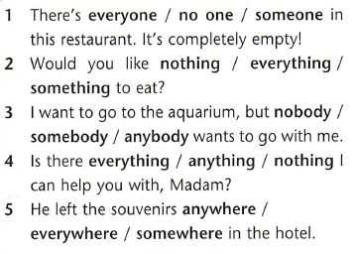
Ex.6,p.59 Workbook
Circle the correct item.

Slide 13


