Slide 1
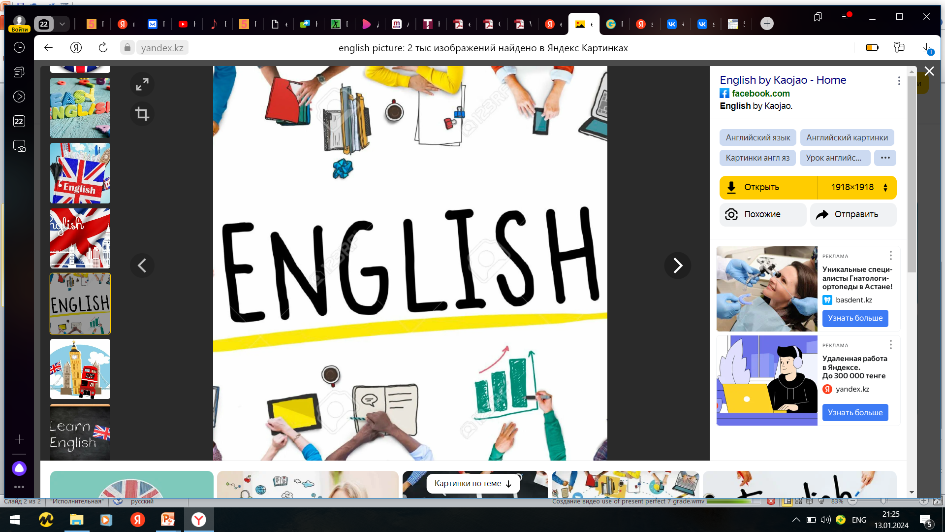

Subject: English language
Grade: 6
The theme of the lesson: Edutainment/ Market day

Slide 2
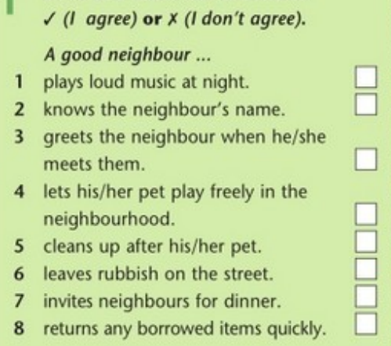
Ex.1,p.98
Read and mark the sentences.
✗
✓
✓
✗
✓
✗
✓
✓

Slide 3
Ex.2,p.98
Use must(n`t), should(n`t) to tell the class what makes a good neighbour.
A good neighbour mustn't play loud music at night.
A good neighbour should know his/her neighbour's name.
A good neighbour should greet his/her neighbour when he/she meets them.
A good neighbour shouldn't let his/her pet play freely in the neighbourhood.
A good neighbour must clean up after his/her pet.
A good neighbour mustn't leave rubbish on the street.
A good neighbour should invite neighbours to dinner.
A good neighbour should return any borrowed items quickly.

Slide 4
Ex.3,p.98
Why do we need to be good neighbours and to help each other?
We need to be good neighbours and help each other because if we do, life will be easier and happier for everyone. If we help one another then we can make our neighbourhood an amazing place to live.

Slide 5
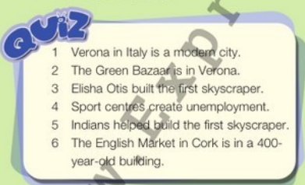
Ex.4,p.98
Do the quiz. Mark the sentences as T (true) or F (false).
1)F
2)F
3)F
4)F
5)T
6)T

Slide 6
Ex.5,p.98
Look at Module 8 and write a T/F quiz on your own.
1)Verona, Wisconsin is a large city. (F) 2)Thousands of tourists visit Verona, Italy every year. (T)
3)The Italians built the pyramids. (F)
4)The world’s tallest building is in the United Arab Emirates. (T)
5)The Triumph of Astana was finished in 2008. (F)
6)The English Market is in England. (F)

Slide 7
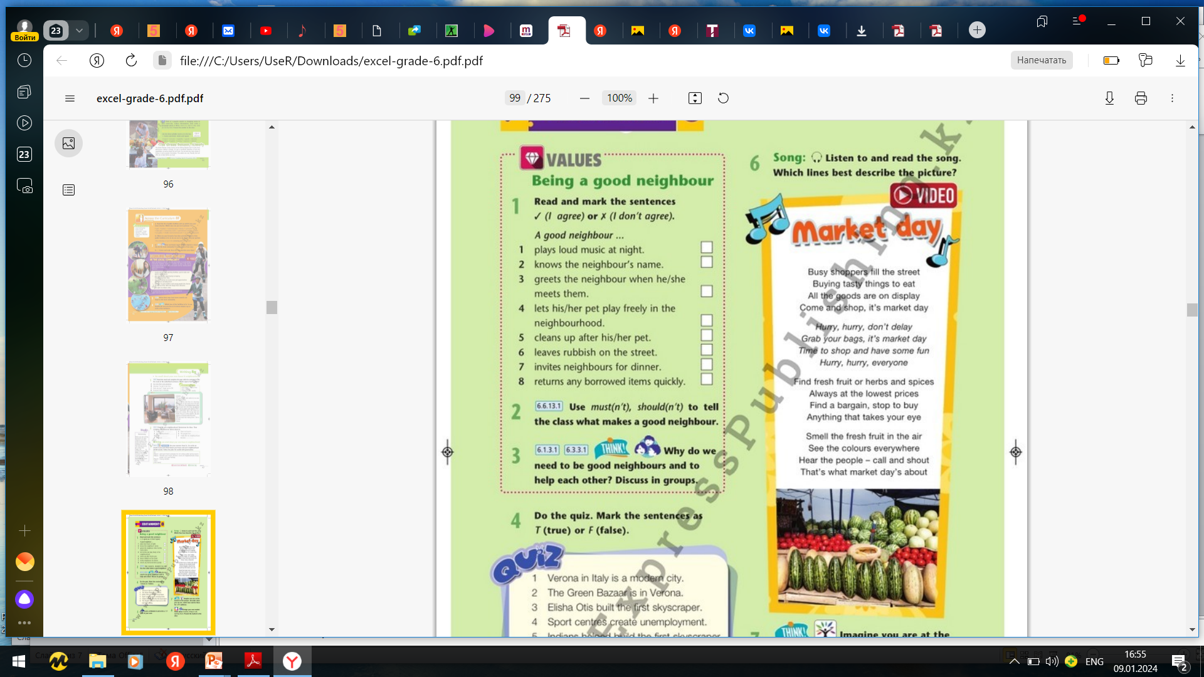
Ex.6,p.98
Listen to and read the song. Which lines best describe the picture?
All the goods are on display
Come and shop, it's market day
Smell the fresh fruit in the air
See the colours everywhere

Slide 8
Ex.7,p.98
Imagine you are at the market in the picture. Describe what you can see, smell, hear and do there for a TV audience.
Here I am at the market and as you can see there are lots of colourful stalls selling fresh fruit and vegetables and all sorts of other goods. You won't believe the amazing smells that are in the air. I can smell fresh flowers and the fruit from the stall behind me, but there is also the delicious smell of hot food and fresh coffee from the food stalls nearby. As you can hear its quite noisy with all the stallholders shouting to the customers and the buzz of the people doing their shopping. The reason it’s so busy though is that you can buy everything you need here. You can also meet friends here at one of the cafés and grab a bite to eat at the food stalls. It’s a great place.

Slide 9
Ex.8,p.98
Design your own market. Think about: location, things to sell, opening hours. Present the market to the class.
location: Almaty
things to sell: fresh fruit and vegetables, dried fruit and nuts, meat, fish, clothes, furniture, souvenirs, hot food
opening hours: 10 am-6 pm, Monday to Saturday
Our market is in Almaty. It is a covered market. You can buy fresh fruit and vegetables, dried fruit and nuts, meat, fish, clothes, furniture and souvenirs. You can also buy hot food. It is open from 10 am to 6 pm from Monday to Saturday.

Slide 10
