Slide 1



Slide 2
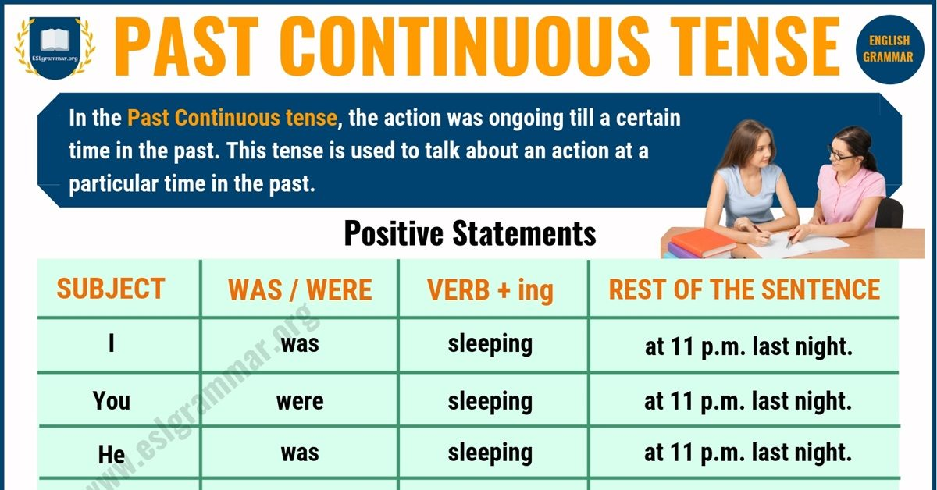

Slide 3
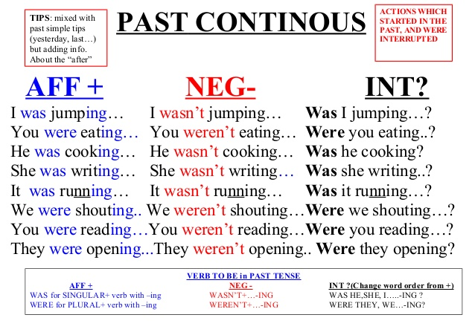

Slide 4
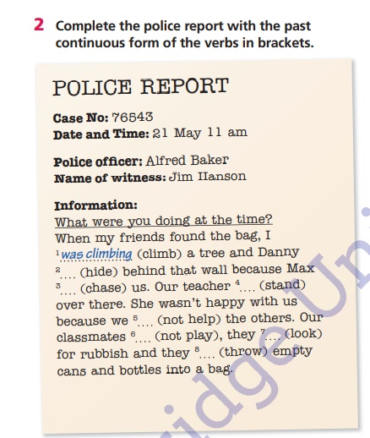

Slide 5
Answers
1 – was climbing
2 – was hiding
3 – was chasing
4 – was standing
5 - were not helping
6 – were not playing
7 – were looking
8 – were throwing

Slide 6
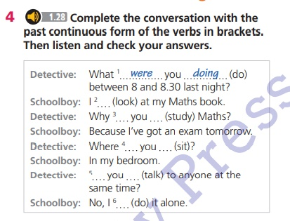

Slide 7
Answers
1 – were doing
2 - was looking
3 – were studying
4 - were sitting
5 – were talking
6 - was doing

Slide 8
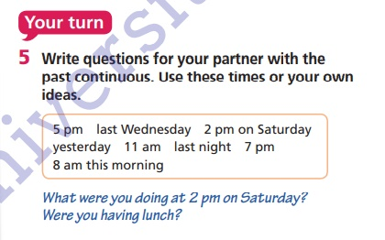

Slide 9

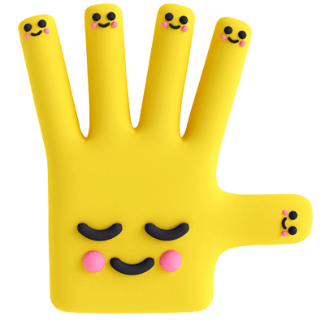
Bye!

