Slide 1
English. Grade:6
Theme:
Researching and writing a magazine article on adventure holidays for families

Slide 2
Learning objectives
6.4.9.1 – recognize the difference between fact and opinion in short, simple texts on a wide range of general and curricular topics.
6.5.3.1 – write with some support about personal feelings and opinions on a limited range of familiar general and curricular topics.

Slide 3
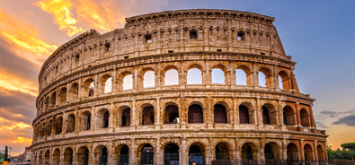
Warm-up.
What place is it?
Where would you like to go on holidays?

Slide 4

Warm-up.
Well, have you got a pen-friend?
Do you like writing e-mails from a holiday destination?

Slide 5
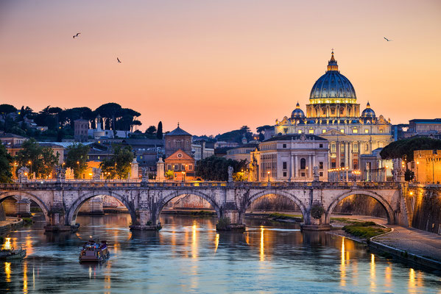
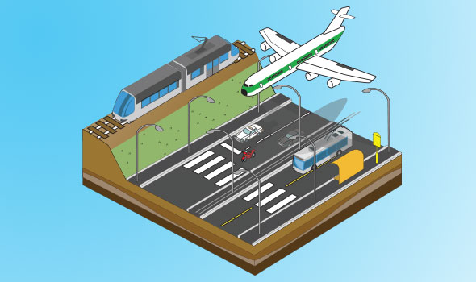
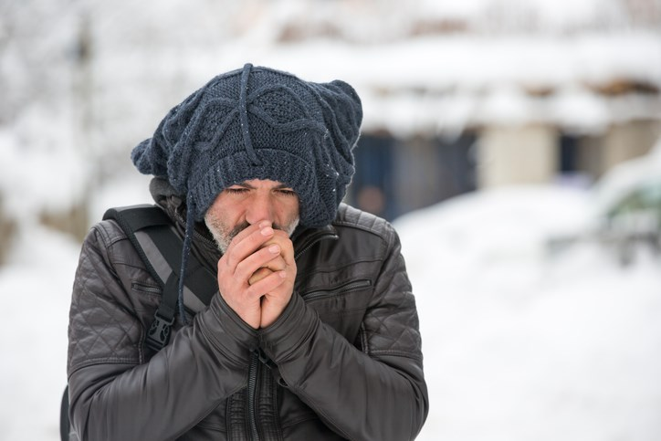
Pre-reading:
Arrive-reach a place at the end of a journey or a stage in a journey
View-a sight or prospect, typically of attractive natural scenery, that can be taken in by the eye from a particular place.
Sightseeing-the activity of visiting places of interest in a particular location.
Chilly -uncomfortably cool or cold.

Slide 6
Read the e mail and complete the gaps (1-4) with the missing sentences (a-d)
a. The city looks amazing.
b. Tomorrow, we are all going to the Korgalzhyn Nature Reserve.
c. See you in two weeks time.
d. How are you?
Hi, Kamila,
(1) We arrived in Astana last Sunday. We are staying in a really great hotel right in the centre of the city. It has an amazing view of the Bayterek Monument. It’s a bit chilly here but we don’t mind.
(2) We can’t wait to explore everything. Today we are taking a sightseeing bus for a tour of the city. We are going to see the Presidential Palace and the Fountain Circus. My mum and my sister can’t wait to go on the river boat tour. My dad and I are going to visit the National Museum of Kazakhstan.
(3) It’s famous for protecting 300 birds species as well as other wildlife. There are so many impressive buildings here and I’m looking forward to seeing them all. I’m especially excited about seeing the fantastic Astana Arena. It’s the home of the Kazakhstan National Team.
That’s all my news for now. (4)
Take care,
Luiza
1-d; 2-a; 3-b; 4-c

Slide 7
For discussion:
What is each paragraph about?
-Greetings/where people are/stay -plans for tomorrow -fixed arrangements for today -closing remarks. You are on holiday. Write an email to pen-friend. Follow the plan, (60-80 words.)

Slide 8
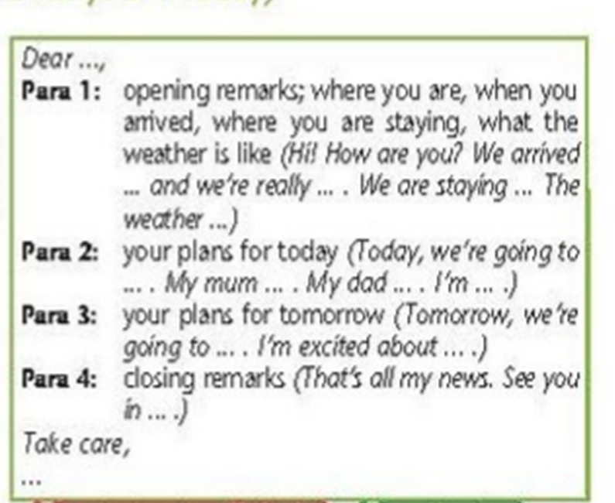
Plan

Slide 9
Hi Leyla,
Greetings from Rome!
I’m on a school trip here. We arrived yesterday and are staying in a lovely hotel in the city centre. It’s near all the tourist attraction. The weather is warm and sunny! It’s a bit chilly at night but that’s OK.
Yesterday, we were all tired after our flight, so we slept a lot. Now, we are all looking forward to visiting the city. This afternoon, we’re going on walking tour.
Tomorrow morning, we’re going to visit the Pantheon, an ancient temple, and in the afternoon we’re going to visit the pasta Museum. It’s going to be a great weekend. I’ve got to go now. See you when I get back.
Love,
Aruzhan

Slide 10
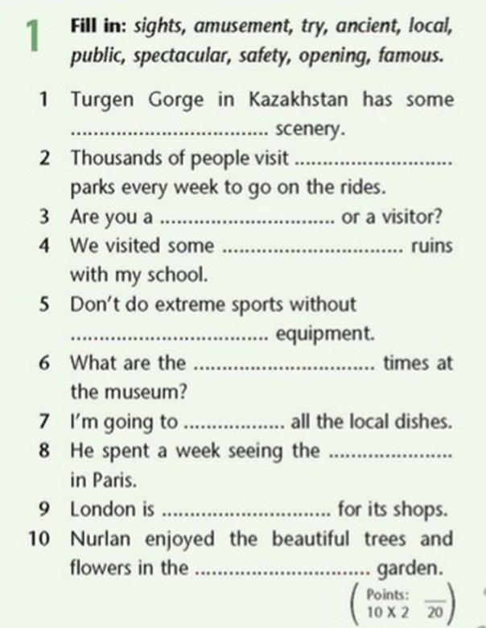
Revision
1. spectacular
2. amusement
3. local
4. opening
5. safety
6. ancient
7. try
8. sights
9. famous
10. public

Slide 11
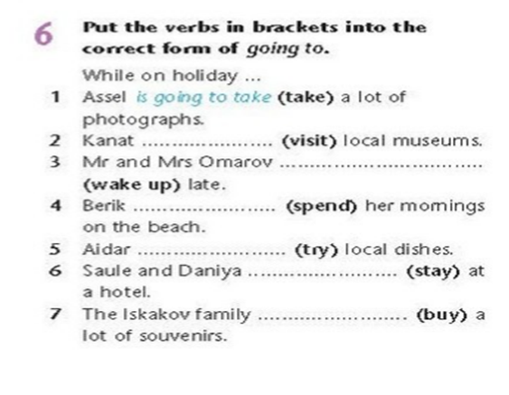
2. is going to visit
3.are going to wake up
4. is going to spend
5.is going to try
6. are going to stay
7.is going to buy

Slide 12
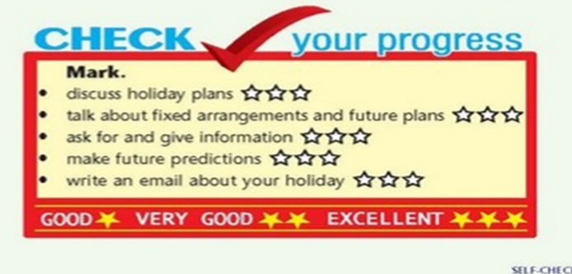

Slide 13



