Slide 1
Grade:6 Theme: Researching and writing a magazine article on adventure holidays for families

Slide 2
6.4.2.1 understand independently specific information and detail in short, simple texts on a limited range of general and curricular topics 6.4.5.1 deduce meaning from context on a limited range of familiar general and curricular topics, including some extended texts 6.3.3.1 give an opinion at sentence and discourse level on an increasing range of general and curricular topics
Learning objectives

Slide 3
Warm –up
We prepares cards with the words from the previous lesson and sticks them under the learners’ chairs. Learners should find the words and not showing to group-mates explain the word (using either words or gestures
Suggested words: hiking, fishing, tasting local food, camping, shopping, sunbathing, cold, ice, rainy, sunny, hot, windy ) for others to guess.

Slide 4
Focus on reading
Pre-reading
Learners look at the pictures in PPT and try to guess what the text is going to be about. Learners should say what country it is and share some information they know about it. Teacher gives 1 minute to learners to think about the questions, then learners work in pairs, teacher may ask some of them to share the information.
While-reading
Before reading learners can listen to the text and then listen and drill the pronunciation.
Teacher gives learners a text in the form of a letter. At first they should decide where boxes A-D should go in the letter. Weaker learners can work in pairs.

Slide 5
Post- reading
Stronger learners should share their experience about going either abroad or around Kazakhstan with their classmates or weaker learners retell the text

Slide 6
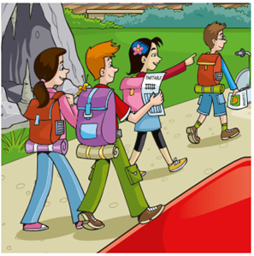
Activity 1
Emma, Richard, Michael and Helen are going on a train journey. Emma asks Richard some questions about their journey. What does Richard say?
Read the conversation and choose the best answer.
Write a letter (A–H) for each answer.
You do not need to use all the letters. There is one example.
Example
Emma: Richard, is that the train station over there?
Richard: ........................D.........................................................
Questions
1
Emma: What time does our train leave?
Richard: .................................................................................
2
Emma: Have we got our tickets?
Richard: .................................................................................
3
Emma: Can we buy something to eat on the train?
Richard: .................................................................................
4
Emma: Is the journey long?
Richard: .................................................................................
5
Emma: What time will we arrive?
Richard: .................................................................................
A Yes, there’s a café on the train.
B We’ll get there at a quarter past eleven.
C It takes two hours.
D Yes, it is. (example)
E Yes, I bought them yesterday.
F Of course there is.
G I’ll take a tablet.
H It goes at half past nine.

Slide 7
Answers
1 – H
2 – E
3 – A
4 – C
5 – B

Slide 8
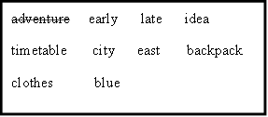
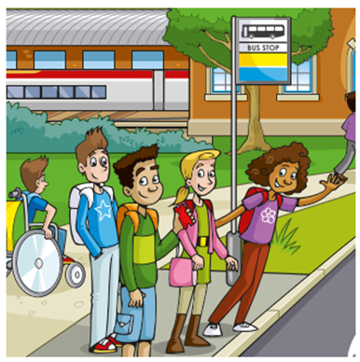
Activity 2 Read the story. Choose a word from the box. Write the correct word next to numbers 1–5. There is one example.
It was the summer holiday and there was no school. Harry, Sarah, David and Katy were going on an ...........adventure...................... ! Everyone had a (1) ..................................... full of things they might need. They met at the bus stop. ‘What time does the bus come?’ said Harry. ‘I don’t know,’ said Katy, ‘let’s look at the (2) ..................................... . The next bus to the big (3) ..................................... is going to arrive in five minutes.’
The children were very excited and wanted to begin their journey, but after twenty minutes the bus still wasn’t there! Then Sarah said, ‘I’ll search for some information on my phone.’ ‘That’s a good (4) .................................’ said Katy. ‘What does it say?’ asked David. ‘The bus is (5) ................................... because the driver is ill,’ answered Sarah. Suddenly Harry shouted, ‘Look, here comes another bus!’ The four friends were very happy! ‘Let’s go!’ they shouted.

Slide 9
Answers
Backpack
Timetable
City
Idea
Late
Now choose the best name for the story: Children wait for the bus

Slide 10
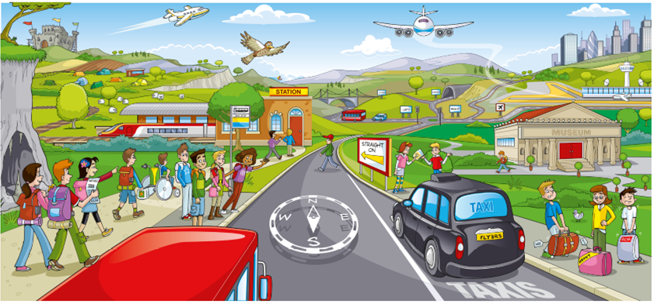
Activity 3 Look at the picture and read the story. Write some words to complete the sentences about the story. You can use 1, 2, 3 or 4 words. There is one example.
Flyers adventure
The students in the Flyers class studied hard all year. Now it was summer and time for a holiday! George and Holly’s friends prepared exciting adventures. One friend took a bus to the big city to visit a zoo and see the skyscrapers. Another friend travelled by train to see an old castle. A group of friends went by taxi to the airport and flew to a different country.
George and Holly couldn’t decide where they wanted to go. Holly said, ‘I’d like to go to a desert but there isn’t one near here.’ George said, ‘I’ve always wanted to see a camel but they don’t live in this country.’
Suddenly Holly and George saw a picture outside the museum. The picture showed a camel which was walking in a hot desert. Under the picture there were some words. Holly read, ‘Come inside and see our film about Charlie the camel who lives in the desert.’ George was very excited. ‘I think we have just found our adventure,’ he said. ‘I think so, too,’ said Holly, ‘let’s go in!’
Example
All year, the Flyers students ........studied hard........................... .

Slide 11
Complete.
1 In the .............................................. George and Holly’s friends wanted to go on fun holidays.
2 One friend travelled to the city by .............................................. .
3 Another friend went on a .............................................. to visit an old castle.
4 A group of friends took a plane and went ......................................................... ................................................................................................................................. .
5 George and Holly didn’t know ................................................... wanted to go.
6 Holly thought that a ................................................. was too far away.
7 George thinks that camels are interesting but they ......................................... in his country.
8 Holly and George decided to ............................................................................... a camel who lives in the desert.

Slide 12
Answers
Flyers class
Bus
Train
To a different country
Where they
Desert
Don’t live
Watch a film

Slide 13
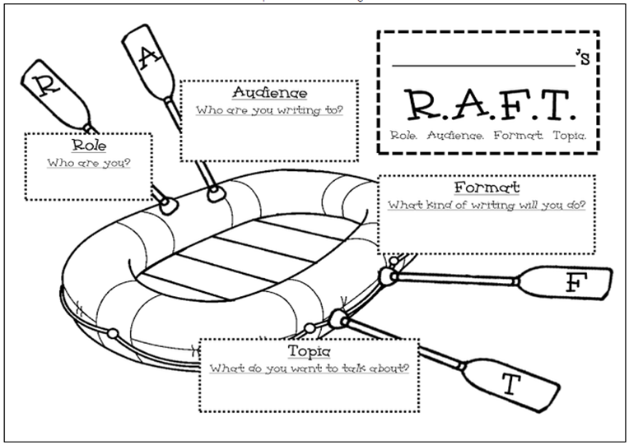
Activity 4
A magazine article
Task: Write an article for a magazine about your adventure holiday.
Magazine article → is more formal, can be posted online or printed as a magazine article, can include pictures.

Slide 14
Feedback
3 new words they learnt
2 activities they liked
1 challenge (difficulty) they experienced

