Slide 1
English. Grade:8 Online class
Theme: Learning about the weather and how to create a cloud.

Slide 2
Learning objectives
6.4.2.1 understand independently specific information and detail in short, simple texts on a limited range of general and curricular topics

Slide 3
Warm-up Did you know that clouds have different types too? Well after watching this video, you’d be able to identify most of them and in this video to know more about clouds. Let’s watch the video. Teacher asks questions for discussion How many types of clouds? What are they?
https://youtu.be/yod3wMbFHUY

Slide 4
New words: transpiration [ trænspəˈreɪʃn ] - булану evaporation [ɪˈvæp.ər.eɪt] - булану precipitation [prɪˌsɪpɪˈteɪʃn| - атмосфереалық жауын-шашын condensation [ kɑːndenˈseɪʃn ] – конденсация, ұлғайту water vapour – су буы water cycle – су айналымы
https://youtu.be/auvGBmIxG08
2 min.

Slide 5
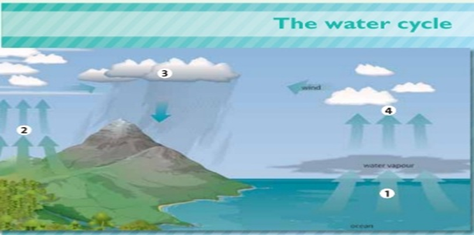
Reading text: The water cycle.
When it’s cloudy/sunny the water in rivers and oceans becomes warmer. Some of the water becomes water vapour /rain and it goes into the air. This process is called evaporation.
Water from plants and trees also goes into the ocean/air. This process is called transpiration.
When the water vapour travels higher, it becomes colder/warmer. The water vapour becomes water again and this makes clouds /ice . This process is called condensation.
Fog/Wind moves the clouds over the land and it starts to rain. When it’s very cold, it snows. The rain or snow is called precipitation. This water goes into rivers and oceans and then the water cycle starts again.

Slide 6
Read the text again and match the words in the box with labels 1-4 in the picture
evaporation transpiration precipitation condensation

Slide 7
Are the sentences true or false? Answer In the water cycle water returns to earth as Condensation usually in the form of rain or snow. True or False During the dry weather the water level in a small pond drops because of run off. True or False In the water cycle water vapor leaves the atmosphere by Condensation. True or False Water vapor in the atmosphere condenses to form clouds. True or False. Warm air can hold more water vapor than cool air. True or False.

Slide 8
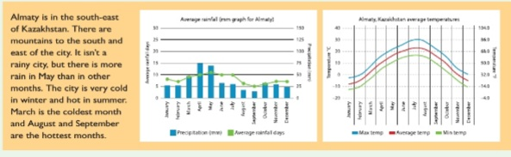
Look at the weather charts for the average precipitation and temperature in Almaty and look at the text, then find three mistakes in the text.

Slide 9
Complete the mini-dialogues with the words in the box.
don’t about Let’s matter like
A. What’s the weather ____ today? B. It’s hot and sunny. 2. A. I’m really tired. B. Why ___ you go to bed early to night? 3. A. What’s the ____? B. I’m bored. 4. A. It’s raining. B. ____ watch a DVD. 5. A. How ___ going to a restaurant? B. We can’t do that.

Slide 10
Feedback Name 3 things: I have learnt… I still want to know… I didn’t understand Doing task: Write an email about favourite film.

