Slide 1
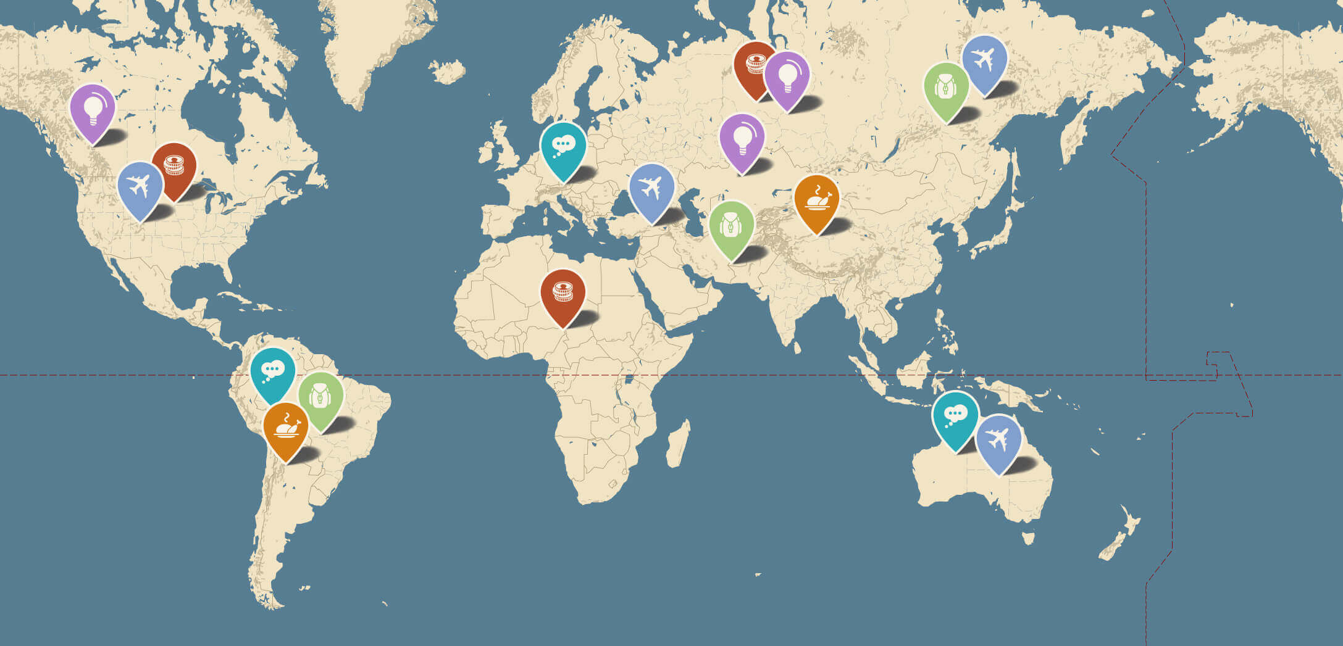
English. Grade:6
Theme: Reviewing map reading skills

Slide 2
Learning objectives
6.4.2.1 understand independently specific information and detail in short, simple texts on a limited range of general and curricular topics

Slide 3

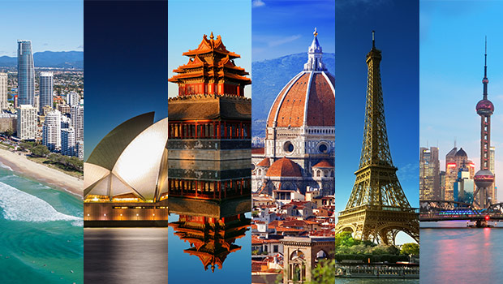
Warm-up.
1. Have you ever been abroad? Where have you been? 2. Do you have your favourite destination? 3. What English-speaking countries do you know? Where would you like to go to? 4.What do you know about ?

Slide 4
Read a travel guide about Bangkok to practise and improve your reading skills. Before reading Do the preparation task first. Then read the text and do the exercises. Preparation task Match the definitions (a–f) with the vocabulary (1–6). Vocabulary Definition
1. …… polluted 2. …… noodles 3. …… alternative 4. …… authentic 5. …… express 6. …… a stand | a. real or normal for a place, not specially for tourists b. dirty from traffic or chemicals c. fast d. another way to do something e. a table where food or other t f. a long, thin food made from flour, water and egg are sold in a market
Preparation task 1. b 2. f 3. d 4. a 5. c 6. e

Slide 5
A travel guide A travel guide Whether you’re travelling to the islands or the mountains of Thailand, you’re likely to spend at least one night in its capital city on the way. Bangkok might be noisy and polluted but it’s also an exciting city with plenty of things to see and do. Why not make it a longer stay? Where to stay The Khao San Road was a famous traveller spot even before Leonardo di Caprio’s character in the film The Beach stayed there. But it’s noisy, not very pretty and not very Thai. For something more authentic, Phra Kanong offers an alternative place to stay, with its fantastic street markets where everyday Bangkok people eat, work and live. It’s not as convenient for the main tourist sites, but it has a Skytrain station so you can be at the Grand Palace in 20 minutes. How to get around Bangkok’s traffic can be a nightmare. Sure, you can easily take a taxi – if you want to spend hours stuck in traffic jams – but there are two much better ways to get around the city. To explore the temples and historical sites, catch an express boat river taxi or a longtail boat along the Chao Phraya river and the canals. For the modern part of the city, the Skytrain is a fast, cheap way to travel from the river to the shopping malls and nightlife of Sukhumvit, and the famous Chatuchak street market.

Slide 6
Where to eat
The simple answer is everywhere! Thai street food is among the best in the world, and for around $5 you can eat a filling and delicious meal. Some food stands have little plastic seats where you can sit and eat and they cook the same dish over and over, like fried chicken on rice or Pad Thai noodles. Head for Chinatown – Yaowarat Street – and choose whatever looks most interesting from the many excellent Chinese and Thai restaurants and food stands.
What to do After you’ve seen the main sites like the Giant Buddha at the temple of Wat Pho and the spectacular Grand Palace, and shopped at Chatuchak market, check out the snake farm and watch the live snake show. You can even touch a snake yourself if you want to!

Slide 7
Match the Bangkok landmarks and places with the descriptions.
Wat Pho Khao San Road Sukhumvit Yaowarat Street Phra Kanong Chao Phraya
1. ………………………………………… a place that you might see in the film The Beach 2. ………………………………………… a place where local Thai people go 3. ………………………………………… an alternative route through the city 4. ………………………………………… a place to go for shopping and bars 5. ………………………………………… a place to go for food 6. ………………………………………… an important sightseeing spot

Slide 8
Match the Bangkok landmarks and places with the descriptions.
Wat Pho Khao San Road Sukhumvit Yaowarat Street Phra Kanong Chao Phraya
1. ………Khao San Road ……………… a place that you might see in the film The Beach 2. ………Phra Kanong…………………… a place where local Thai people go 3. ………Chao Phraya ……………………… an alternative route through the city 4. …… Sukhumvit…………………… a place to go for shopping and bars 5. … ……Yaowarat Street …………………… a place to go for food 6. …………Wat Pho……………………………… an important sightseeing spot

Slide 9
Are the sentences true or false? Answer
1. One night is enough time to see Bangkok. 2. Khao San Road is an authentic Thai area of the city. 3. Phra Kanong is further away from the main tourist sites than Khao San Road is. 4. The river boat taxis often get stuck in traffic too. 5. Taking the Skytrain is a faster way to see the city than going by taxi. 6. You need to choose where to eat carefully, as not everywhere is good.
1. False 2. False 3. True 4. False 5. True 6. False

Slide 10
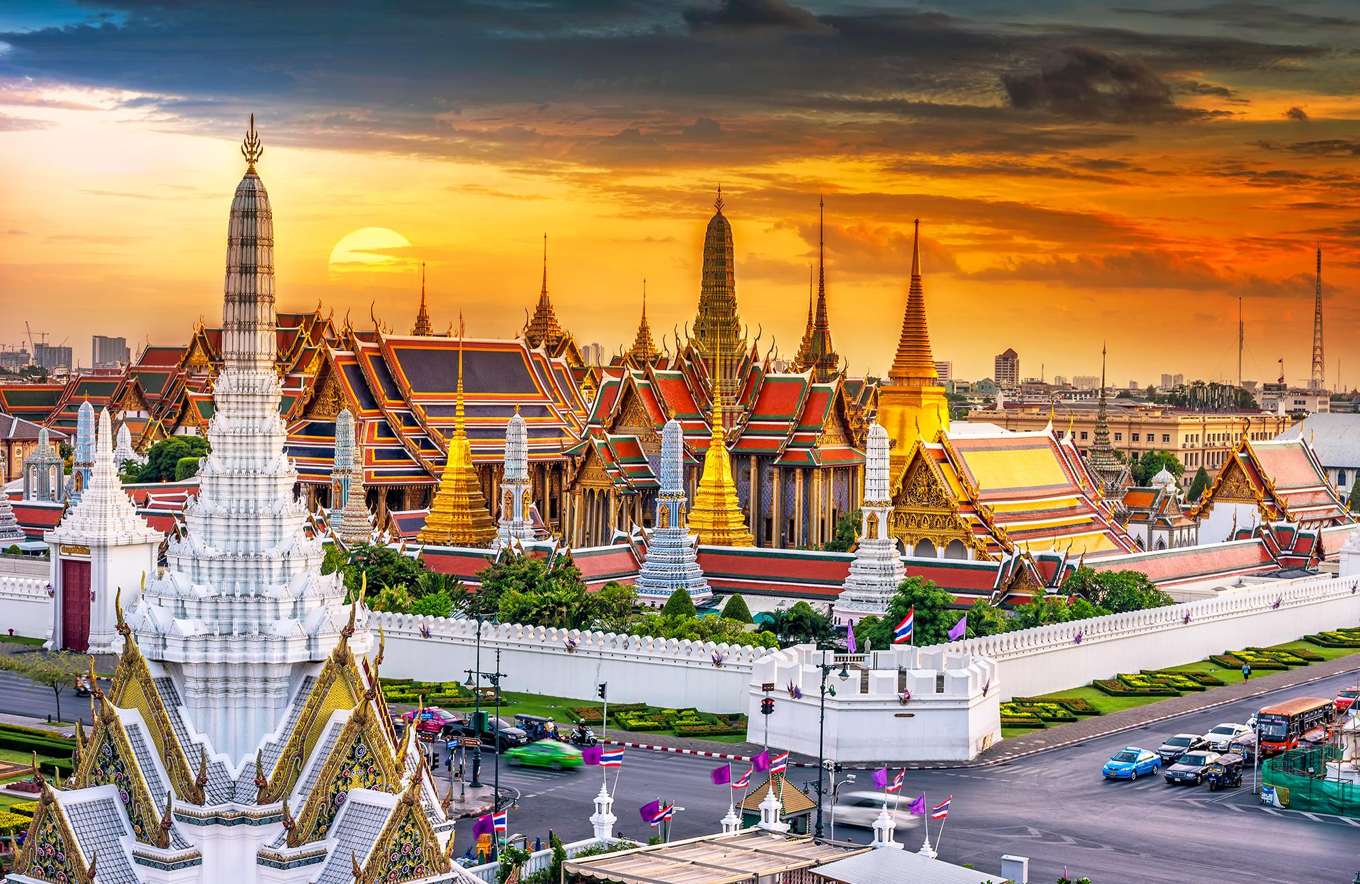
Discussion Would you like to visit Bangkok? Why or why not?

