Slide 1
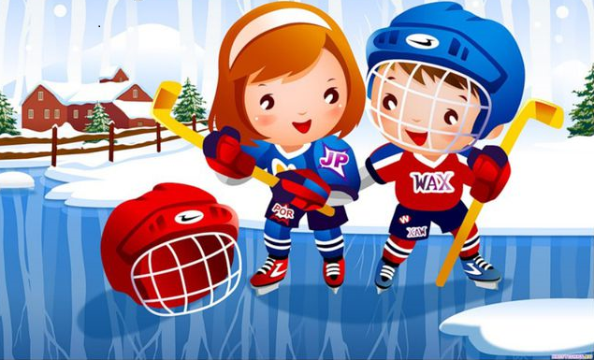
HUMAN BODY AND EXERCISE

Slide 2

In today’s lesson:
read the dialogue;
watch the videos;
do the tasks.

Slide 3

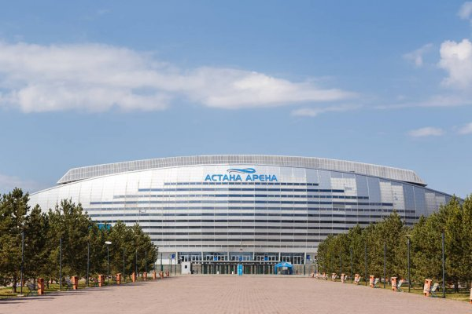
Read the dialogue and answer the questions.
Hollie: Have you got any plans for Sunday?
Daniel: I’ve got a tennis lesson at 10 o’clock in the morning. Why?
Hollie: There’s a football match at the Astana Arena. Do you want to come with me?
Daniel: When is it?
Hollie: It starts at 5.30.
Daniel: OK! I can meet you at the train station at 4 o’clock.
Hollie: See you then!

Slide 4
Answer the question.
Where do they want to go?
They want to go to the Astana Arena.

Slide 5

Answer the question.
What time are they going to meet?
They are going to meet at 4.30.

Slide 6
Read and match.
Would you like to come too?
When is it?
What time is it?
Have you got any plans for Sunday?
What plans have you got for Sunday?
Do you want to come with me?

Slide 7
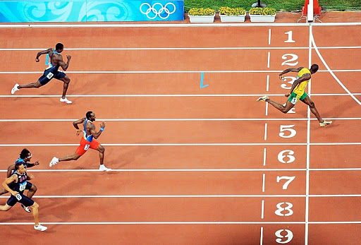
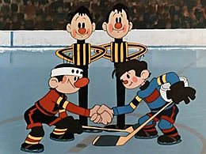
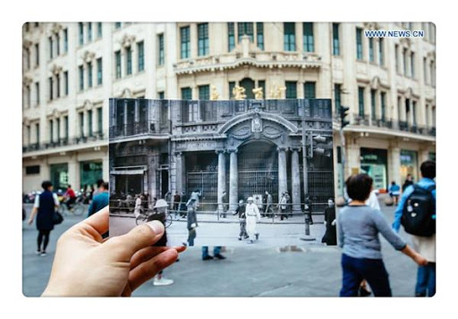
Remember the words!
championship
match
take place

Slide 8


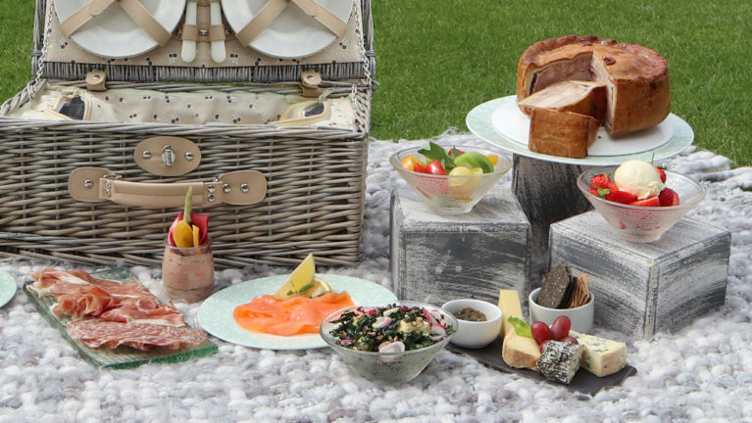

Remember the words!
coffee shop
tournament
takeaway picnic
spot

Slide 9






Look, read and match.
coffee shop
championship
tournament
match
spot
takeaway picnic
take place
5
2
1
4
3
2
7
4
6
3
1
6
7
5

Slide 10
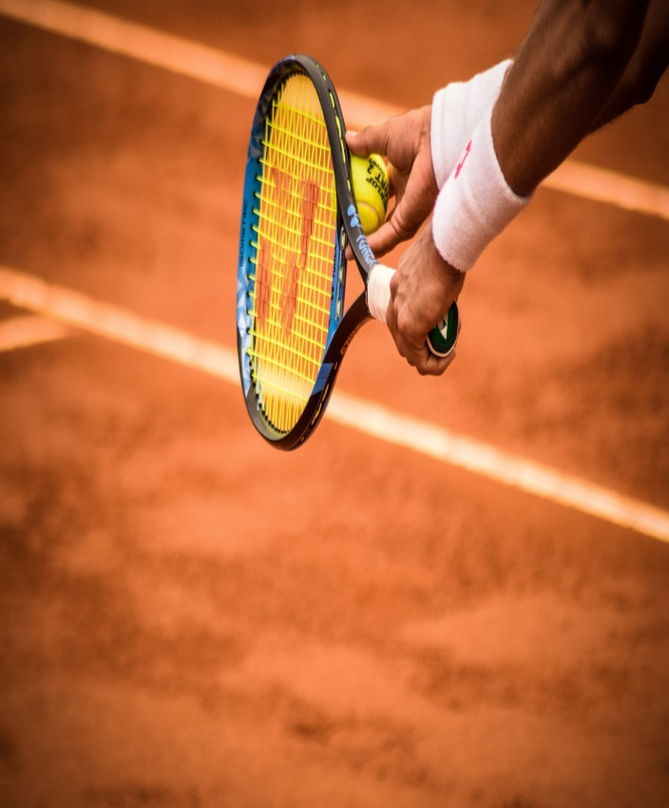
Read the text.
The Championships, Wimbledon
Every summer, a famous tennis competition takes place at Wimbledon, London, UK. Amazing players come from all over the world, and very famous ones play their matches on Centre Court. It’s fun to go to Wimbledon. Apart from the exciting tennis matches, you can visit coffee shops and restaurants, or buy a takeaway picnic. People drink around 350,000 cups of tea and coffee at Wimbledon.

Slide 11

Watch “The Championships, Wimbledon”
(https://www.youtube.com/watch?v=9ydeqAOTtIs)

Slide 12
Read and write the answers.
The Championships, Wimbledon
Every summer, a famous tennis competition takes place at Wimbledon, London, UK. Amazing players come from all over the world, and very famous ones play their matches on Centre Court. It’s fun to go to Wimbledon. Apart from the exciting tennis matches, you can visit coffee shops and restaurants, or buy a takeaway picnic. People drink around 350,000 cups of tea and coffee at Wimbledon.
Where does it take place?
_____________________________
2. Where do famous players play the matches?
___________________________
3. Where do you buy coffee, tea or takeaway picnic?
_____________________________
4. How much coffee and tea do people drink?
_____________________________

Slide 13
Read and write the answers.
The Championships, Wimbledon
Every summer, a famous tennis competition takes place at Wimbledon, London, UK. Amazing players come from all over the world, and very famous ones play their matches on Centre Court. It’s fun to go to Wimbledon. Apart from the exciting tennis matches, you can visit coffee shops and restaurants, or buy a takeaway picnic. People drink around 350,000 cups of tea and coffee at Wimbledon.
Where does it take place?
__________________________________________
2. Where do famous players play their matches?
__________________________________________
3. Where can you buy coffee, tea or takeaway picnic?
________________________________________
__________________________________________
4. How much coffee and tea do people drink there?
__________________________________________
It takes place at Wimbledon, London, UK.
It takes place at Wimbledon, London, UK
Famous players play their matches on Centre Court.
You can buy coffee, tea or takeaway picnic in
coffee shops and restaurants.
People drink around 350,000 cups of coffee and tea there.

Slide 14

Super Job!

Slide 15
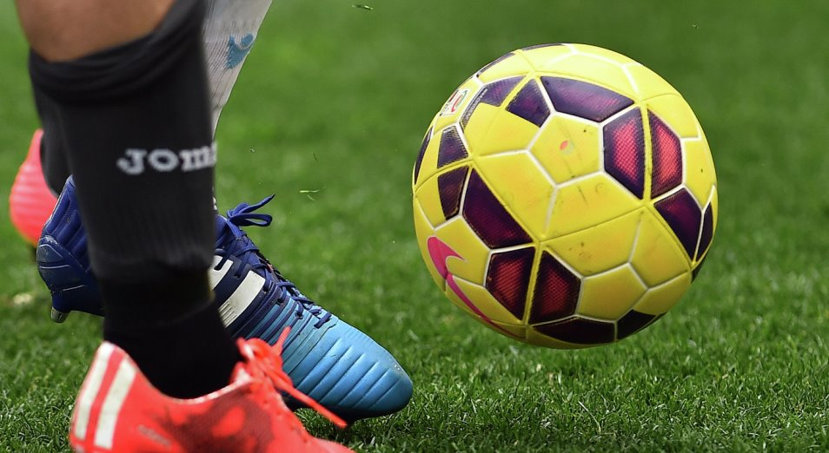
Read the text.
Kazakhstan President Cup
The President Cup takes place every year in June at the Astana Arena, Kazakhstan. It is a special football tournament for teenagers under 17 years old. Teams from many different countries take part, from China to Serbia and Spain. It’s a great event to visit if you want to spot the football stars of the future!

Slide 16

Watch “Kazakhstan President Cup”
(https://www.youtube.com/watch?v=9ydeqAOTtIs)

Slide 17
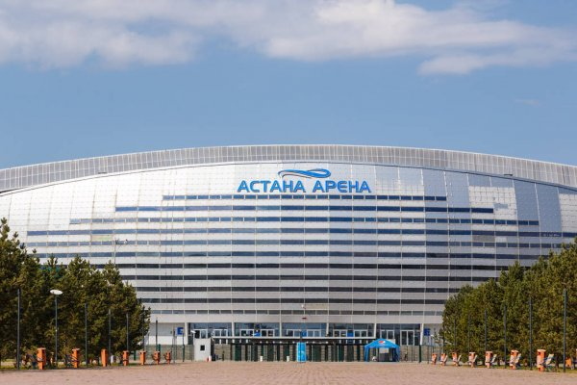
True or False?
The President Cup
takes place in Kazakhstan.
True

Slide 18
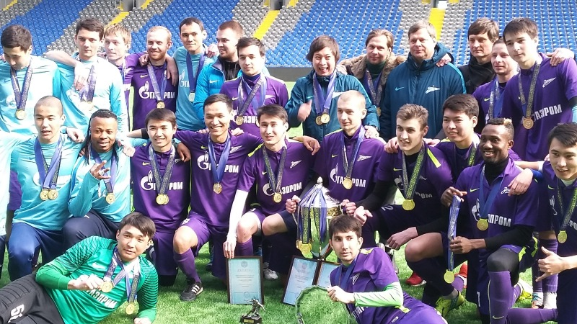
True or False?
It is a special football tournament for people above 17.
False
It is a special football tournament for teenagers under 17.

Slide 19
True or False?
Teams from all the regions of Kazakhstan take part in it.
False
Teams from many countries take part, from China to Serbia and Spain.

Slide 20
True or False?
It’s a great event to visit if you want to spot the football stars of the future!
True

Slide 21

Read and circle.
The President Cup takes place every year in June / July.
It takes place in Almaty Arena / Astana Arena.
It is a football tournament for adults / teenagers.
A famous tennis competition takes place in London / Nur-Sultan.
People drink around 350,000 cups of tea, coffee / juice and water.

Slide 22


Slide 23

We have :
read the dialogue;
watched the videos;
done the tasks.

Slide 24

Goodbye!

