Slide 1
DESTINATION
5 GRADE
Notes:
Оригинальные шаблоны для презентаций: https://presentation-creation.ru/powerpoint-templates.html
Бесплатно и без регистрации.

Slide 2
In today’s lesson you will:
1
learn new words and phrases
2
read the text and answer the questions
3
talk about Burabai National Park
4
5

Slide 3
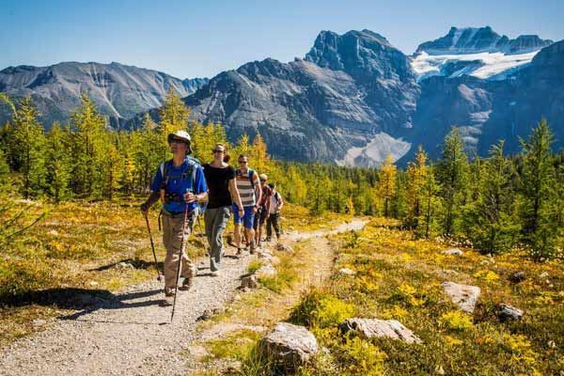
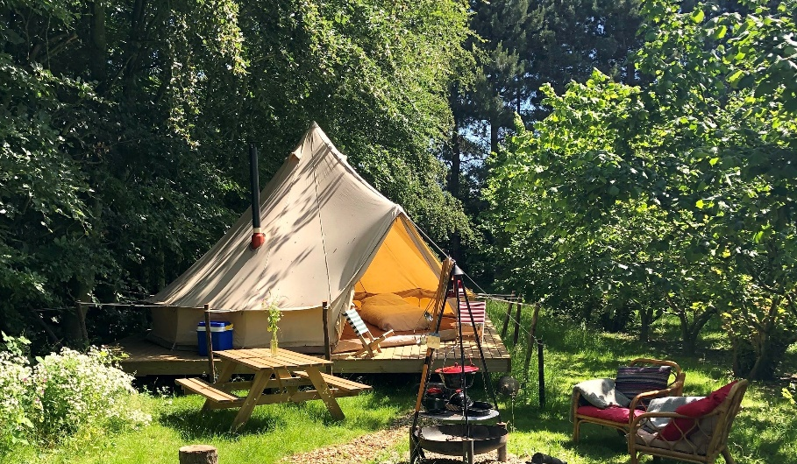
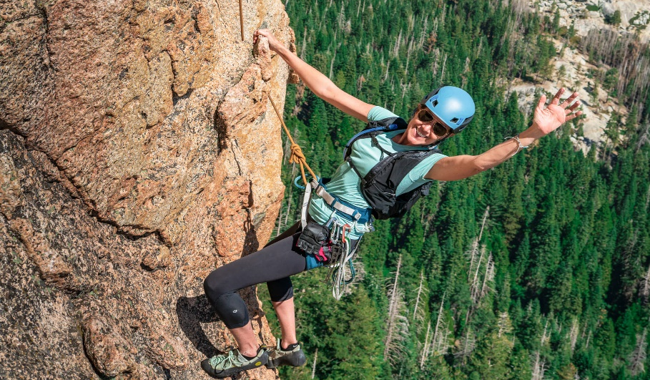
hike camp rock climbing

Slide 4
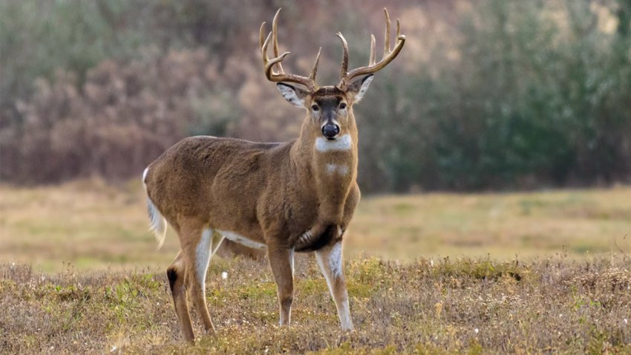
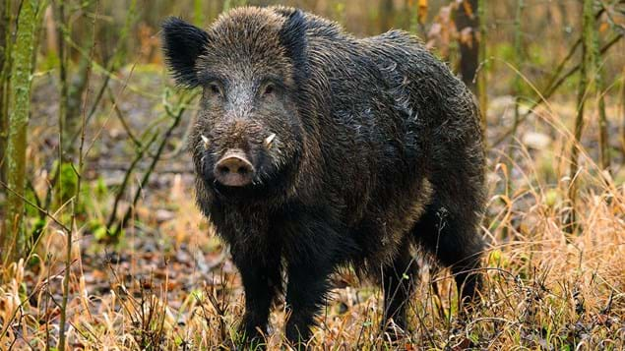
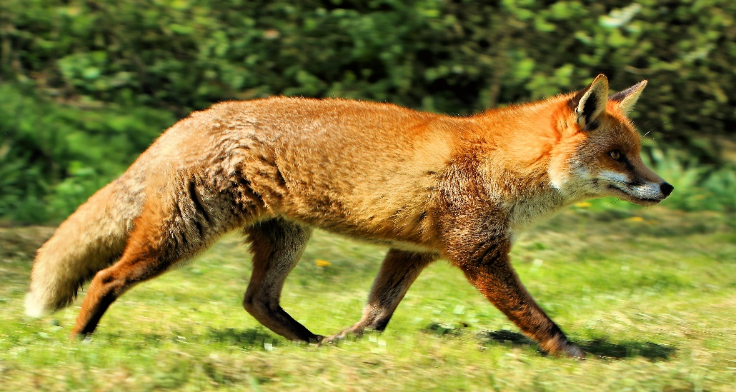
deer wild boar fox

Slide 5
Brainstorming
Do you like travelling?
Who do you usually travel with?
I usually travel…
Do you prefer travelling by plane or by train?
I prefer …
Why do people travel?
People travel because…

Slide 6
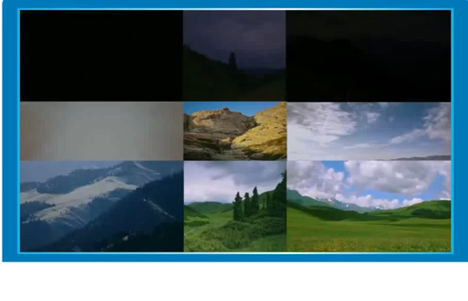
Watch the video and answer the questions

Slide 7
Where is Burabai National park?
Burabai National park is in the north of Kazakhstan.

Slide 8
How many large lakes are there?
There are 14 large lakes.

Slide 9
What is the name of the highest mountain?
The highest mountain is mount Kokshetau.

Slide 10
Where did Serik set up his tent?
Serik set up his tent on the shore.

Slide 11
What animals can you find in Burabai National Park?
I can find foxes, wild boar and deer.

Slide 12
Tell the class
Why do people call Burabai National Park “The Pearl of Kazakhstan”?
Burabai National Park is a beautiful place with amazing scenery and interesting wildlife. It is a treasure of our country, so people call it “The Pearl of Kazakhstan”.
Have you been to Burabai National Park?
What did you see in Burabai?
What was the weather there?

Slide 13
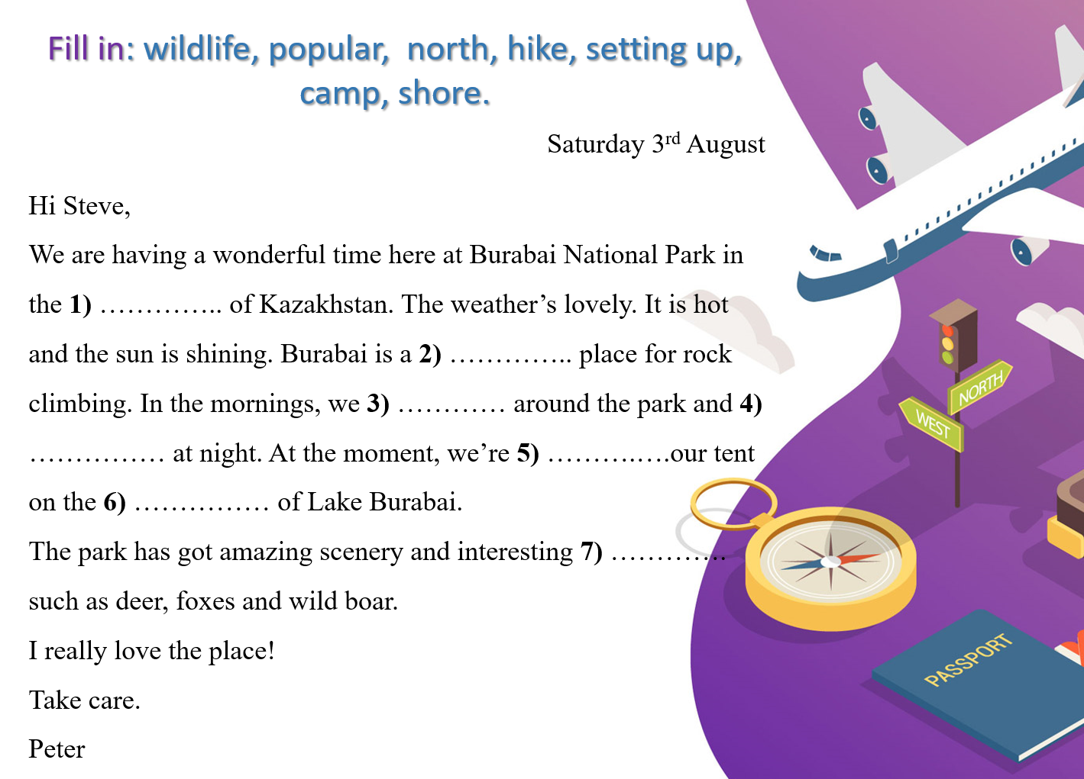
north
popular
hike
camp
setting up
shore
wildlife

Slide 14
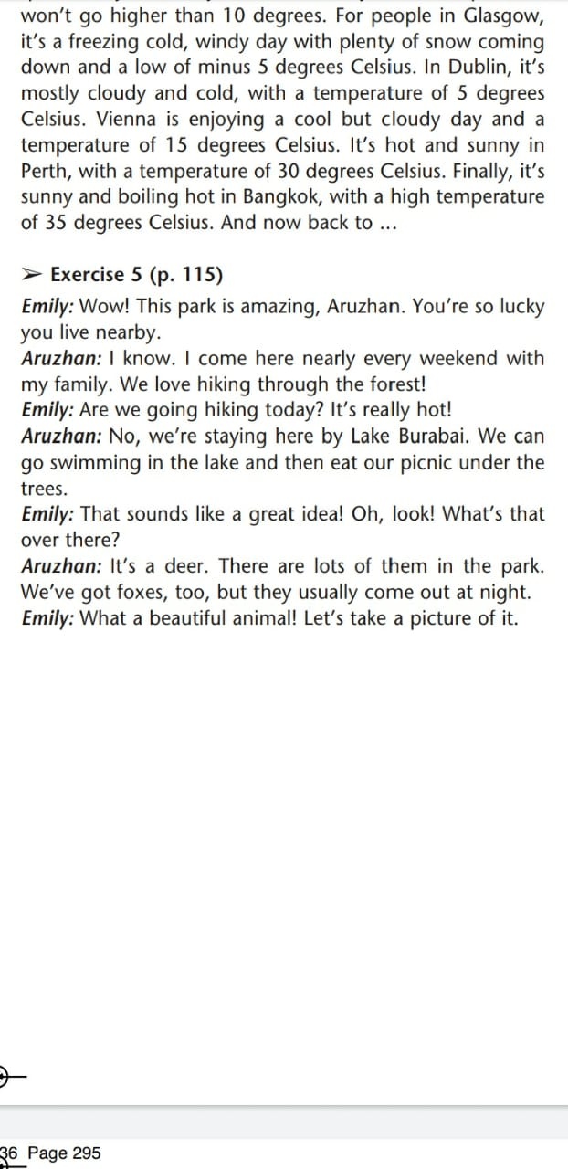
Read the dialogue and complete the sentences.
Aruzhan and her friend Emily are visiting
Burabai National Park.

Slide 15
Complete the sentences
Aruzhan and her family usually go ……….…
Today the weather is ………..
Aruzhan and Emily are by…………
Emily sees a …..... .
hiking
really hot
Lake Burabai
deer

Slide 16

Home task
Write your ideas to go on holiday in Kazakhstan.
What places can you recommend to visit?
Why do you advise this place?
What can people do here?
What is best time to visit this place?

Slide 17
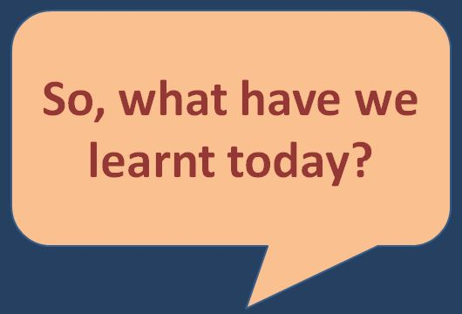

Slide 18
In today’s lesson you:
1
learnt new words and phrases
2
read the text and answered the questions
3
talked about Burabai National Park
4
5

Slide 19
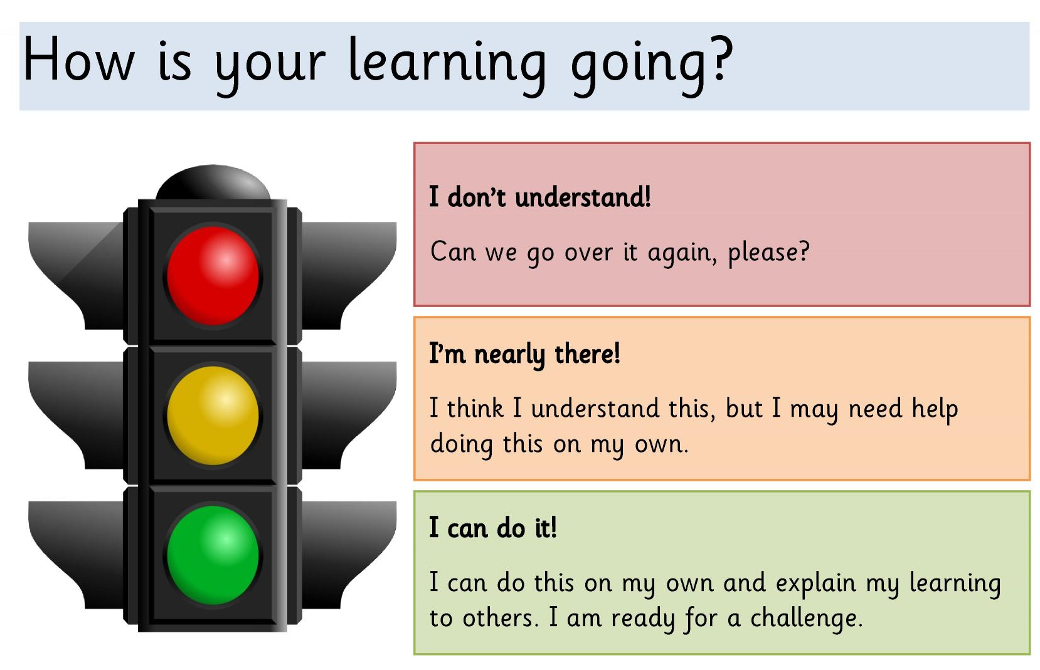

Slide 20


