Slide 1
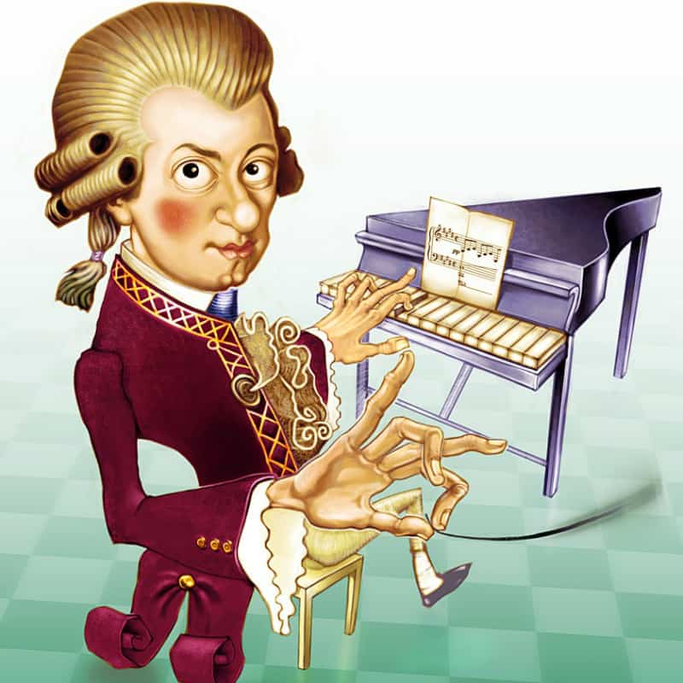
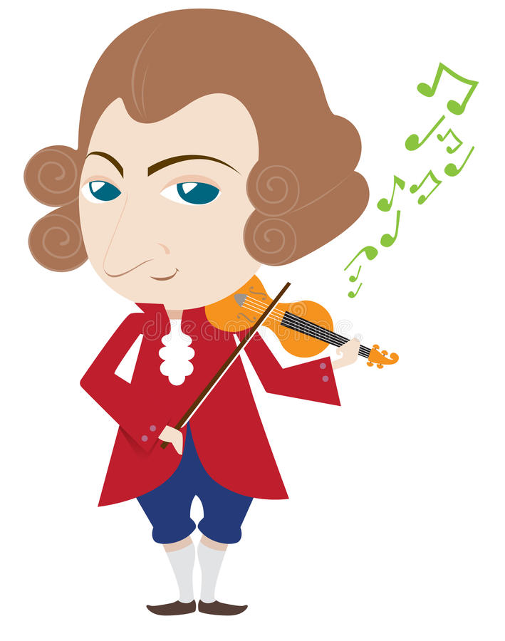



Slide 2
Theme of the lesson: Art
Lesson objective:
•Recognize factual details in a given argument related to the topic

Slide 3
Task 1. Read the paragraphs 1-4 about the effects of music.
Match the headings to the correct paragraphs A-D.
A. Music for stress and pain
B. Get a better score and remember more
C. The right music to study better
D. All kinds of music have an effect
1._________________________________
Music is not just entertainment. It is medicine for both the brain and the body. Don Campbell is an expert on The Mozart effect and the incredible power of music. He says that all kinds of music, from Mozart to jazz, from Latin to rock can affect our learning and our health.
2._________________________________
Many people use music to help them feel relaxed after a busy day at work. Music can also reduce the stress of being ill, especially by reducing pain' The director of Baltimore Hospital says that thirty minutes of classical music has the same effect as ten milligrams of the painkiller Valium.
Descriptor A learner
• reads the paragraphs for general information and matches the headings with the paragraphs.

Slide 4
Task 1. Read the paragraphs 1-4 about the effects of music.
Match the headings to the correct paragraphs 1-4.
3. _________________________________
Campbell also says that music can help you concentrate but you need the right kind of music for your mood. And you need to listen for about ten minutes before you start studying' Perhaps your mind needs relaxing or maybe you are tired and you want to feel more energetic' So you should choose the appropriate music to help you. You can use many different kinds of music to help you concentrate' Mozart's music is very popular, however because it is very organized and it makes your brain more alert and imaginative.
4.___________________________________
Music helps you to study better and it can also actually make you more intelligent. In one study, students who listened to Mozart before doing a test got much higher marks than those who didn't. Many studies also show that children who learn to play a musical instrument before the age of twelve have better memories for the rest of their lives.
A. Music for stress and pain
B. Get a better score and remember more
C. The right music to study better
D. All kinds of music have an effect
Descriptor A learner
• reads the paragraphs for general information and matches the headings with the paragraphs.

Slide 5
Check yourself
1. B Get a better score and remember more
Music is not just entertainment. It is medicine for both the brain and the body. Don Campbell is an expert on The Mozart effect and the incredible power of music. He says that all kinds of music, from Mozart to jazz, from Latin to rock can affect our learning and our health.
2. A Music for stress and pain
Many people use music to help them feel relaxed after a busy day at work. Music can also reduce the stress of being ill, especially by reducing pain' The director of Baltimore Hospital says that thirty minutes of classical music has the same effect as ten milligrams of the painkiller Valium.
3. D All kinds of music have an effect
Campbell also says that music can help you concentrate but you need the right kind of music for your mood. And you need to listen for about ten minutes before you start studying' Perhaps your mind needs relaxing or maybe you are tired and you want to feel more energetic' So you should choose the appropriate music to help you. You can use many different kinds of music to help you concentrate' Mozart's music is very popular, however because it is very organized and it makes your brain more alert and imaginative.
4. C The right music to study better
Music helps you to study better and it can also actually make you more intelligent. In one study, students who listened to Mozart before doing a test got much higher marks than those who didn't. Many studies also show that children who learn to play a musical instrument before the age of twelve have better memories for the rest of their lives.

Slide 6
Task 2. Read the text again. Mark the statements True (T),
False (F) or Not given (NG)
1. Music is good for our bodies and brains. ____
2. Don Campbell loves Mozart's music. ____
3. Music helps many people to relax after work. ____
4. Many hospitals use music to help with pain. ____
5. Listening to music before you study is a bad idea. ____
6. Only Mozart's music helps you study. ____
7. The students listened to Mozart for fifteen minutes before doing the test. ____
8. It's a good idea for children to learn to play a musical instrument. ____
Descriptor A learner
• Reads the paragraphs again to find factual details and distinguishes True, False or Not given statements.

Slide 7
Check yourself
1. Music is good for our bodies and brains. T
2. Don Campbell loves Mozart's music. T
3. Music helps many people to relax after work. T
4. Many hospitals use music to help with pain. T
5. Listening to music before you study is a bad idea. F
6. Only Mozart's music helps you study. F
7. The students listened to Mozart for fifteen minutes before doing the test. NG
8. It's a good idea for children to learn to play a musical instrument. T

Slide 8

The lesson is over!

