Slide 1
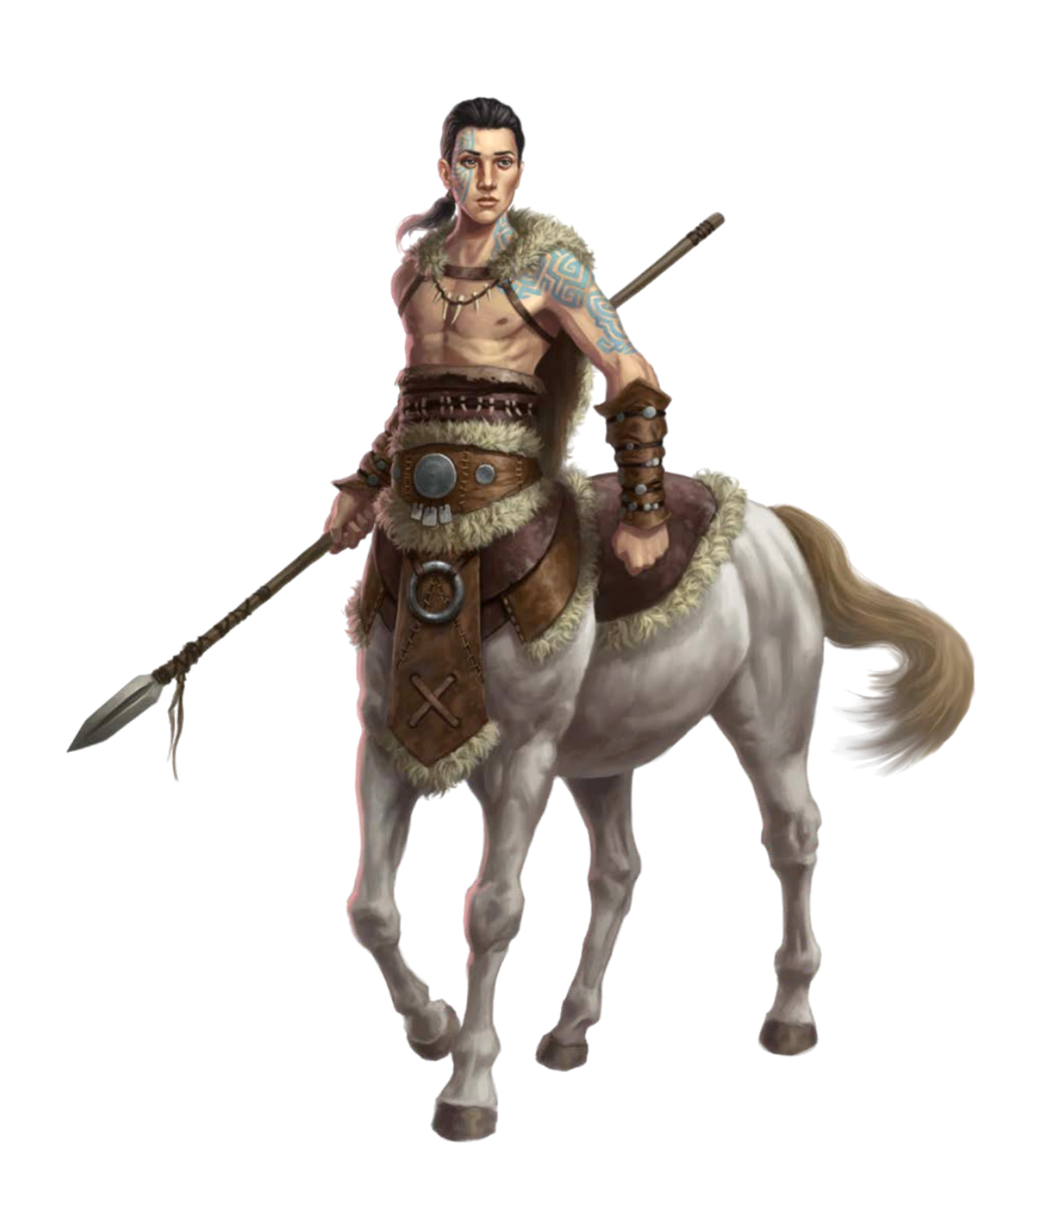
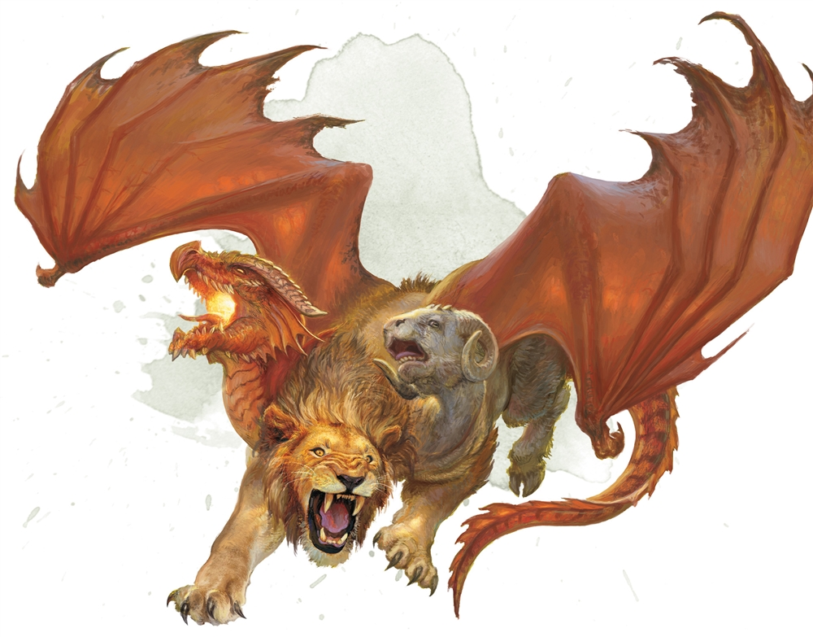
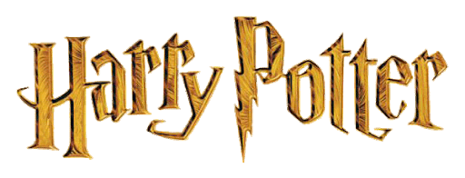
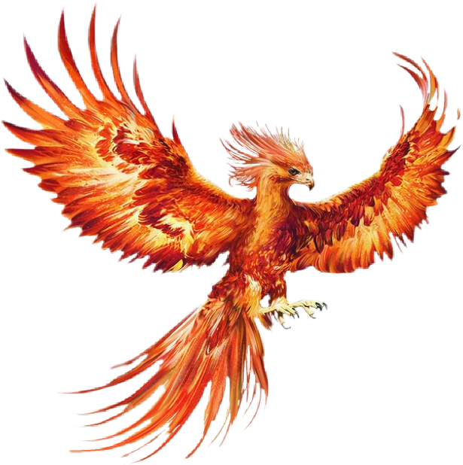
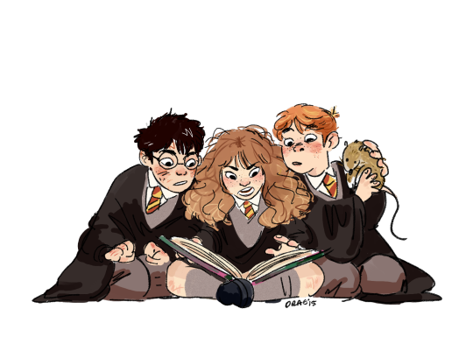
Mythical creatures

Slide 2
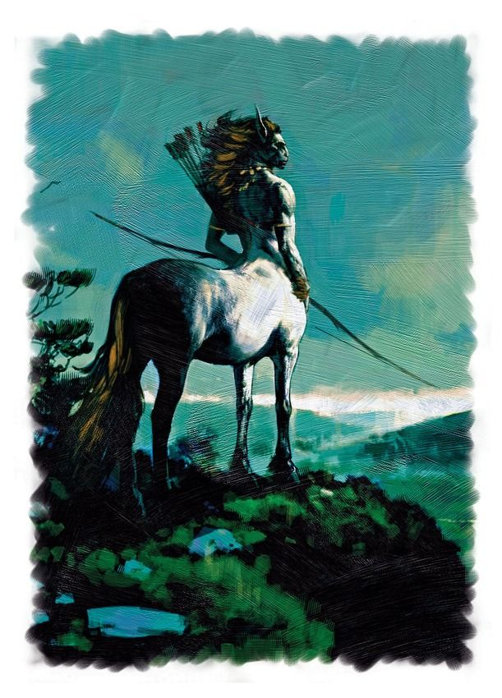
In today’s lesson you’ll:
find out about mythical creatures
learn new words and phrases from the text
listen and read the text about mythical creatures from J.K. Rowling’s Harry Potter books and Mythology

Slide 3
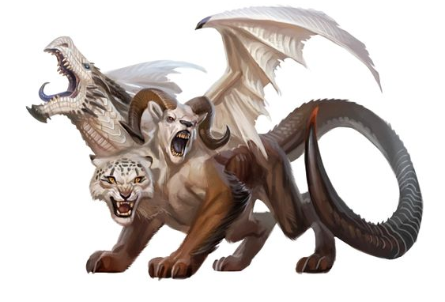
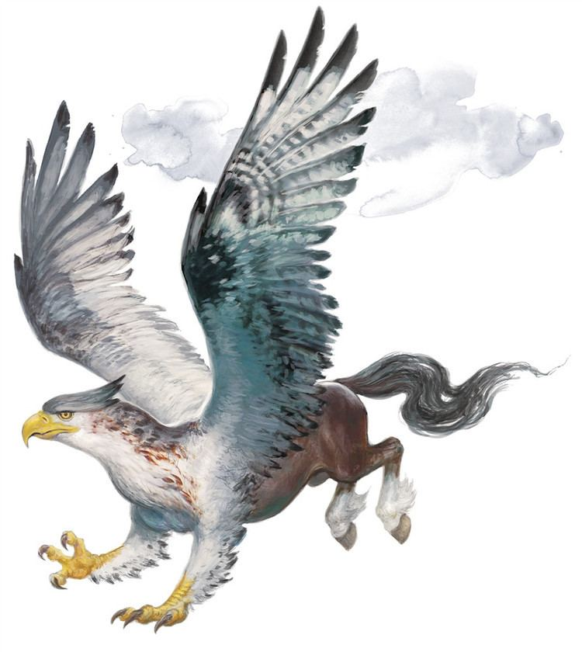
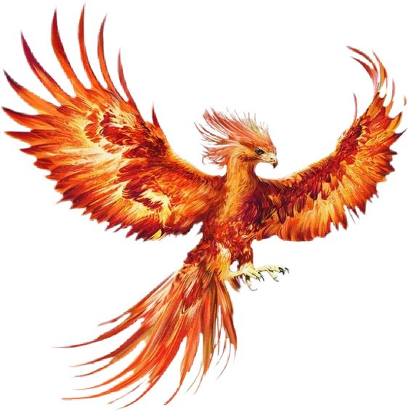
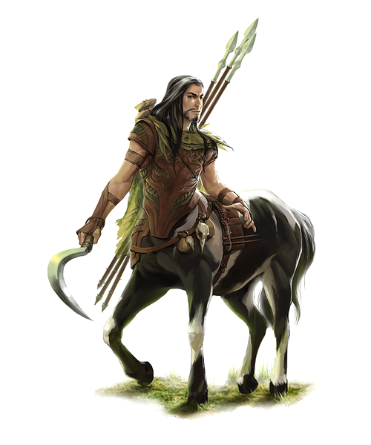
Look at these pictures.
What are these creatures in your language?
CHIMERA
HIPPOGRIFF
PHOENIX
CENTAUR

Slide 4
Match pictures with sentences:
HIPPOGRIFF
Is half human and half horse
Has got three heads
Has got a sharp beak
Has got a long tail
PHOENIX
CENTAUR
CHIMERA

Slide 5
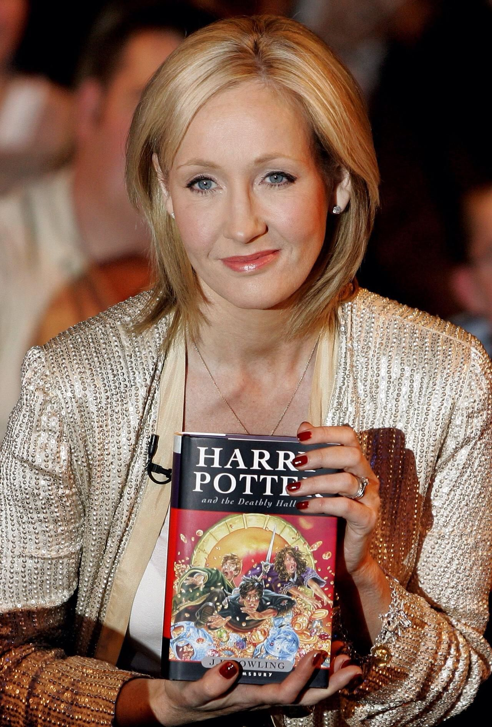

Read the title and the introduction to the text.
Mythical creatures
J.K. Rowling, the creator of Harry Potter uses a lot of weird and wonderful creatures from mythology. Нow different are they from the mythical creatures?

Slide 6
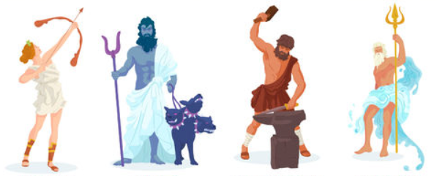

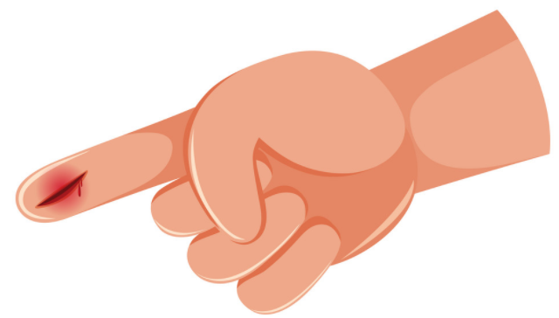
New words
Mythology
a collection of myths
Mythical creatures
unreal animals
Poisonous
harmful
Wound
when your skin is broken

Slide 7

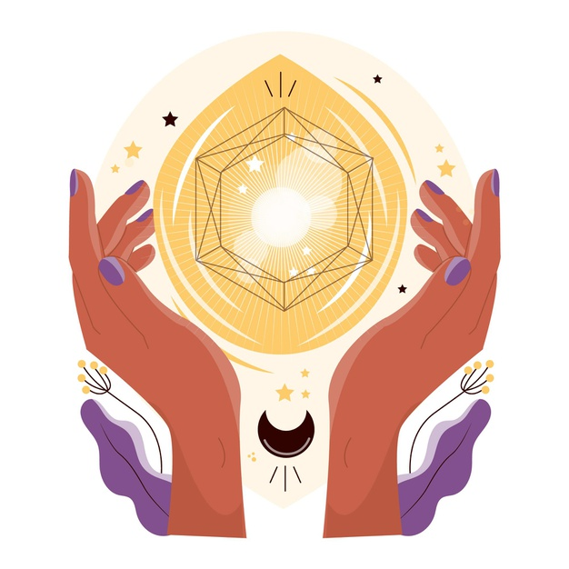
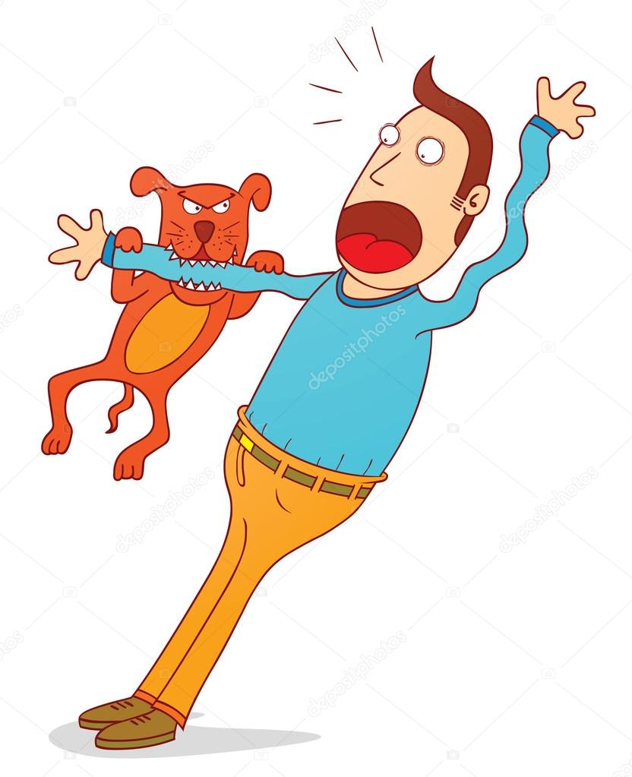

New words
Ashes
left after the burning smth
heal
make smb healthy
Bite
use teeth to cut smth
Burst into flames
suddenly begin burning

Slide 8
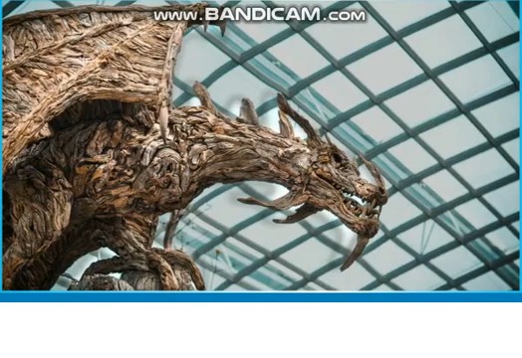
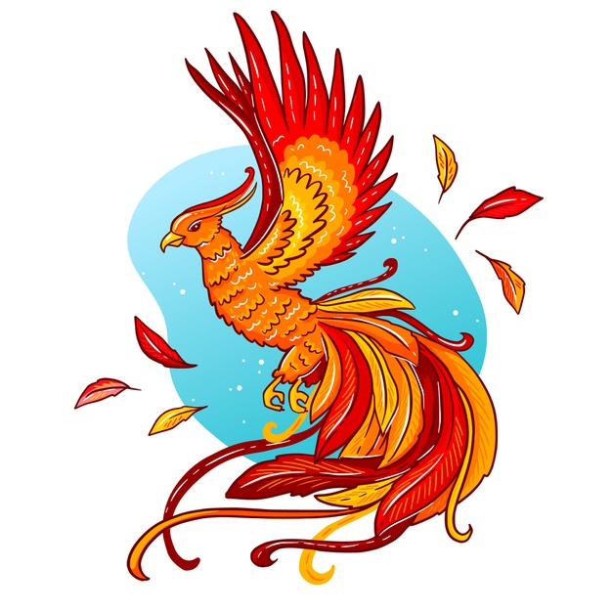
Watch the video “Mythical creatures”

Slide 9
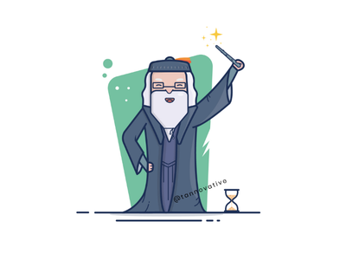
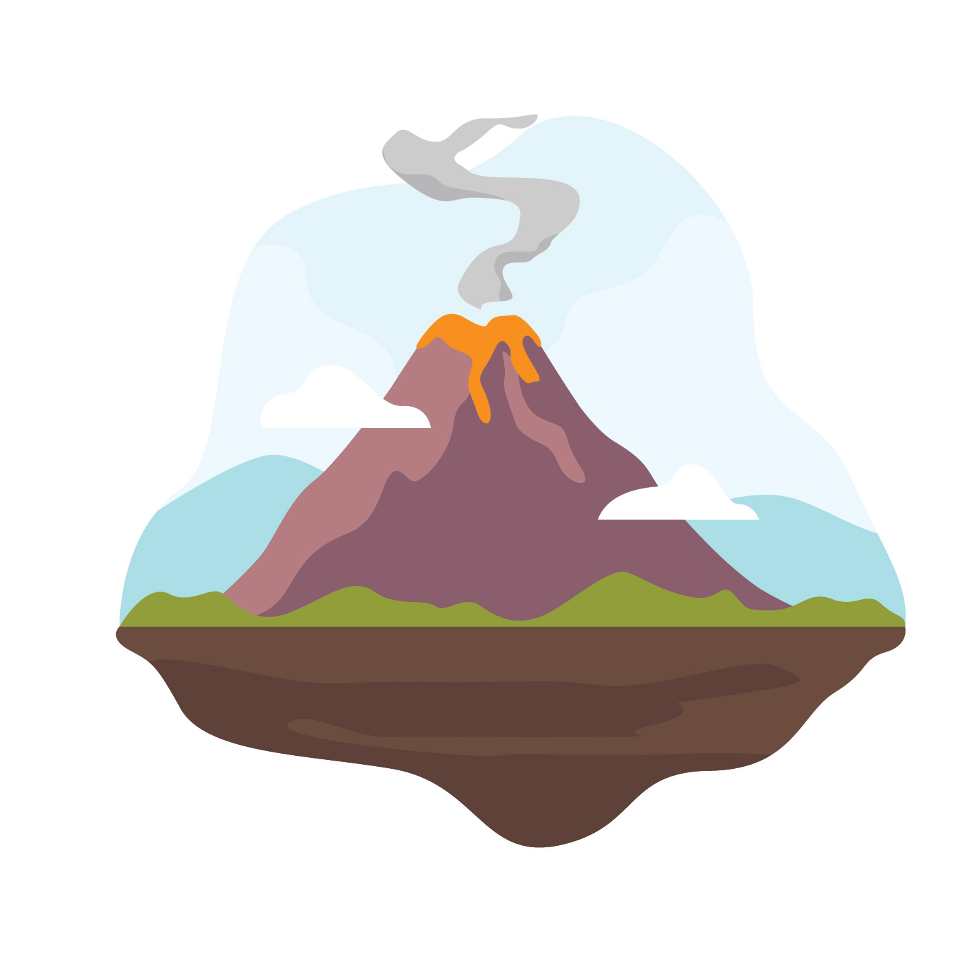
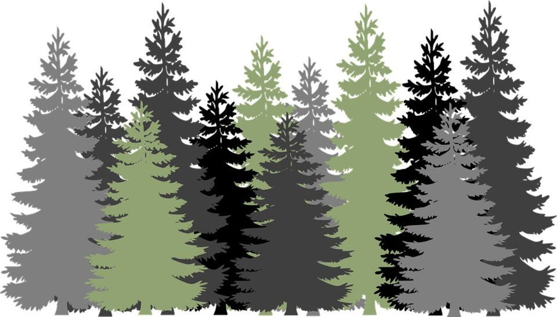
Where does each creature in Harry Potter world live? Give a full answer.
The phoenix
Chimeras
Centaurs

Slide 10
Where do each creature in Harry Potter world live? Give a full answer.
The phoenix lives with Harry’s headmaster.
Chimeras
Centaurs

Slide 11
Where do each creature in Harry Potter world live? Give a full answer.
The phoenix lives with Harry’s headmaster.
Centaurs
Chimeras live near volcanoes.

Slide 12
Where do each creature in Harry Potter world live? Give a full answer.
The phoenix lives with Harry’s headmaster.
Chimeras live near volcanoes.
Centaurs live in forests.

Slide 13
MYTHICAL CREATURES IN HARRY POTTER BOOKS
Centaurs live in forests. They are very intelligent. They study the stars and the planets and sometimes see the future. Most centaurs stay far away from реople, but one of them, Firenze, saves Harry's life. He even becomes a teacher at Harry's school.
The Phoenix is a beautiful bird. Harry's headmaster has a pet phoenix called Fawkes. Tears from its eyes save Harry's life after а poisonous monster bites him. Harry is shocked when Fawkes suddenly bursts into flames one day. Of coursе, Fawkes is born again from the ashes.
Chimeras live near volcanoes. They are very dangerous and very difficult to kill.

Slide 14
Look at the pictures, choose a creature and write a few sentences about it.
For example:
1. Centaurs live in forests and sometimes see the future.
2. Phoenix is a very beautiful bird. It could burst into flames and could be born again from the ashes.
3. Chimeras live near volcanoes and it is very difficult to kill them.

Slide 15
MYTHICAL CREATURES IN MYTHOLOGY
Centaurs were half human and half horse. They were from the mountains and forests of central Greeсе. They were wild, dangerous - except for one, Chiron, who was an astronomer and famous teacher of medicine.
The Phoenix was a beautiful red or purple bird with a long golden tail. It was from india and Egypt. It could burst into flames and could be born again from the ashes. Its tears could heal someone's wounds.
The Chimera was a weird Greek mythical creature. It was really weird. It had three heads from three different animals. At the front it had a lion's head, in the middle it had a goat's head and its tail was a snake. It was a terrifying creature. It could bite like a lion and it could breathe fire like a dragon from its goat's head.

Slide 16
Mark the sentences with True or False
Centaurs had two heads.
Centaurs could see the future.
The Phoenix could heal someone’s wounds with its tears.
Phoenix was an ugly bird.
The Chimera could breathe fire.
The Chimera had three lion heads.

Slide 17

Mark the sentences with True or False
Centaurs had two heads.
Centaurs could see the future.
The Phoenix could heal someone’s wounds with its tears.
Phoenix was an ugly bird.
The Chimera could breathe fire.
The Chimera had three lion heads.
Centaurs had only one head.

Slide 18
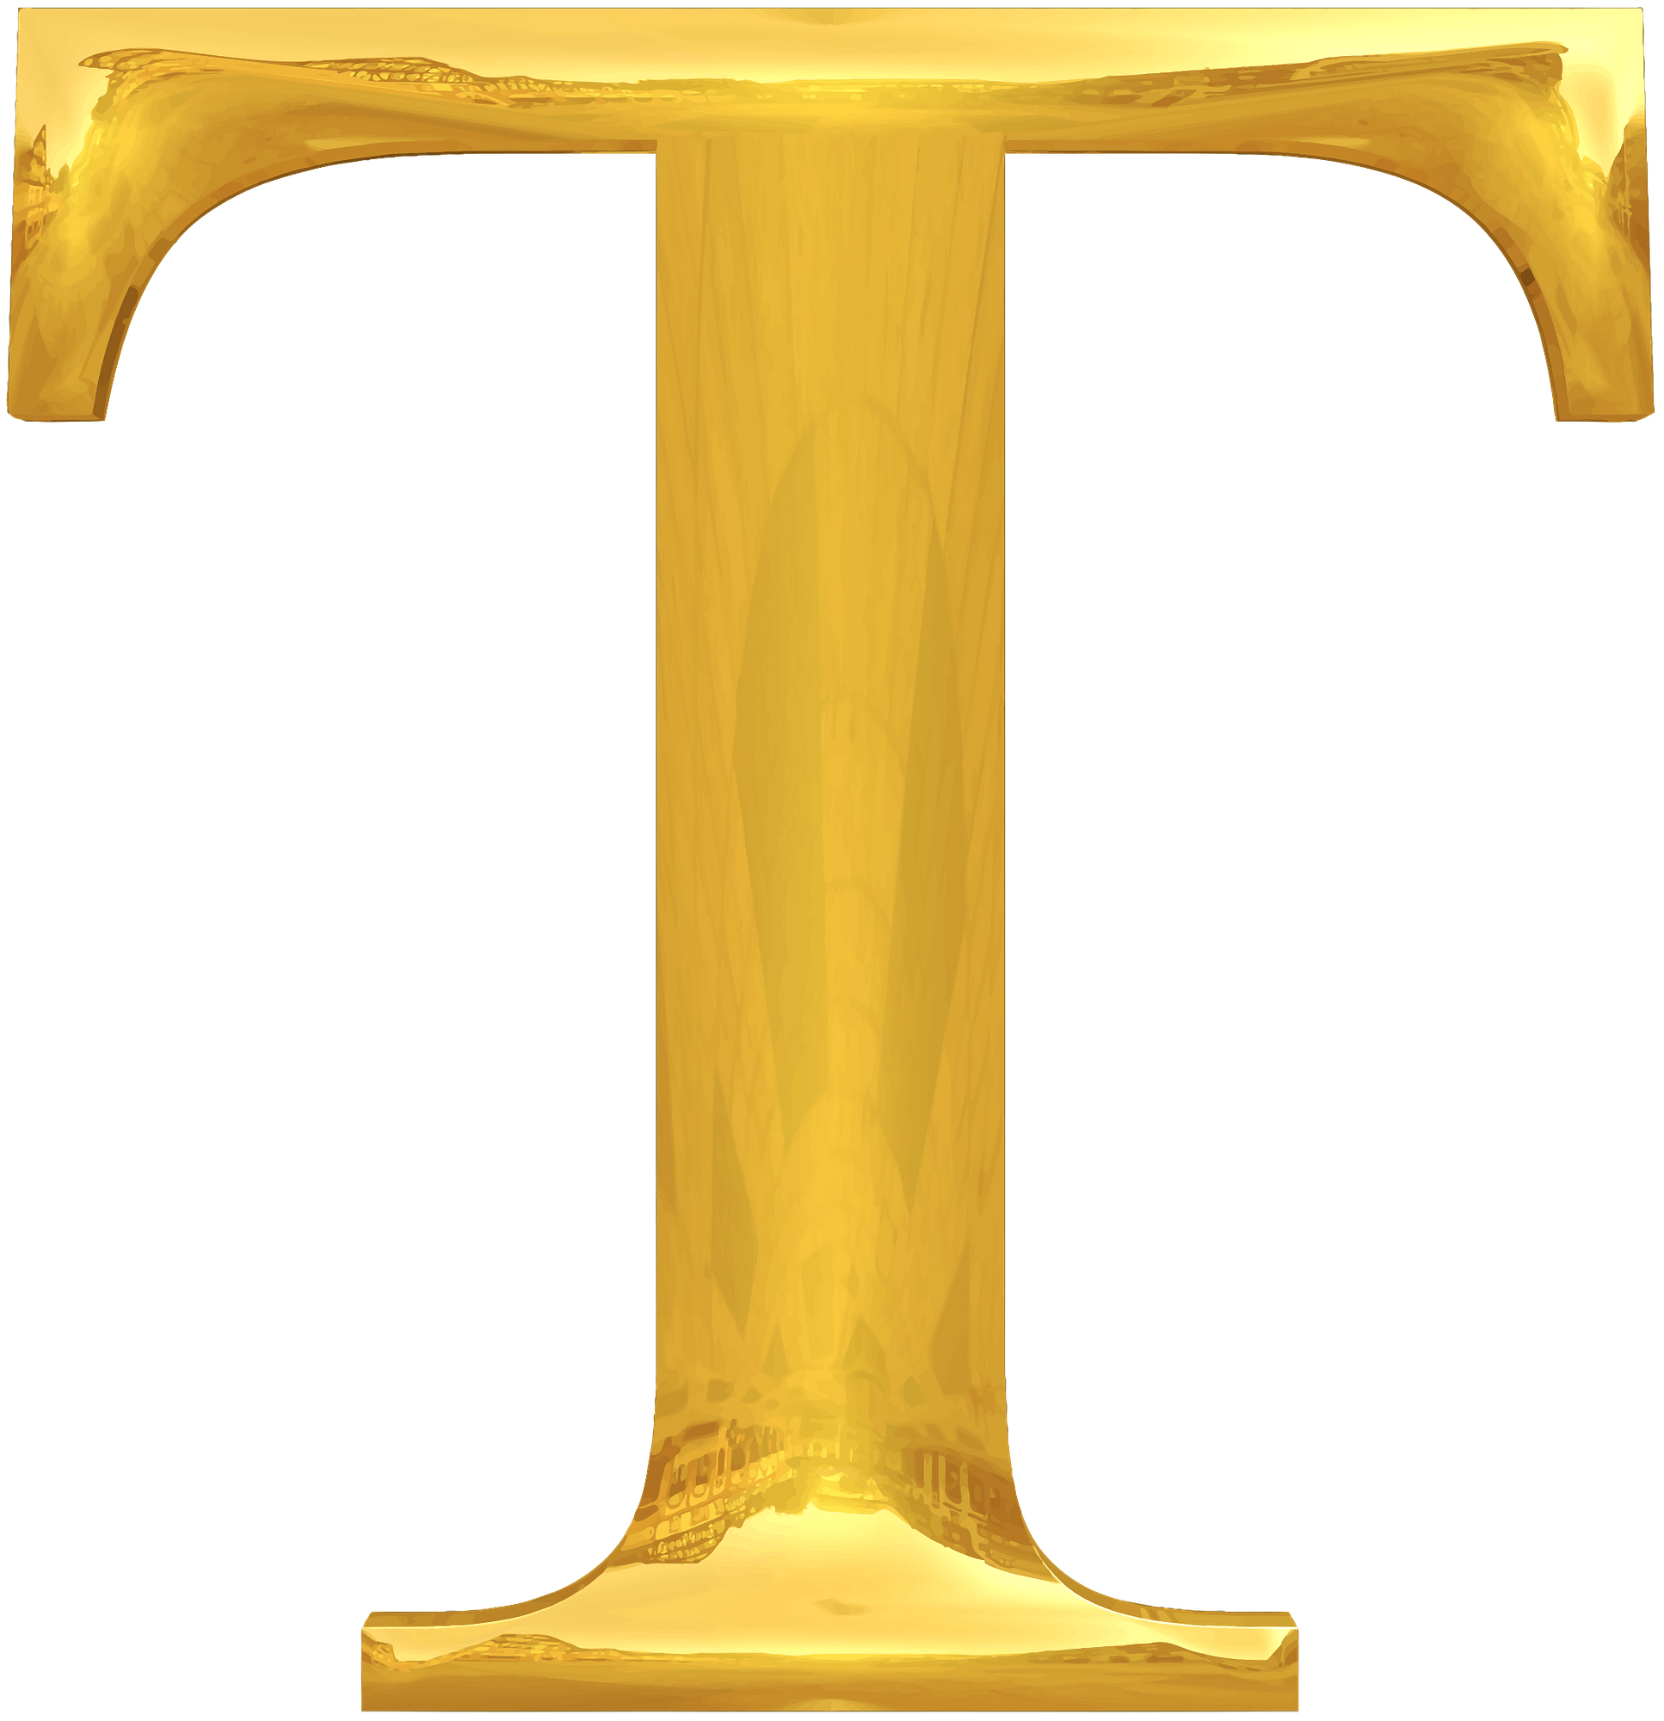
Mark the sentences with True or False
Centaurs had two heads.
Centaurs could see the future.
The Phoenix could heal someone’s wounds with its tears.
Phoenix was an ugly bird.
The Chimera could breathe fire.
The Chimera had three lion heads.

Slide 19
Mark the sentences with True or False
Centaurs had two heads.
Centaurs could see the future.
The Phoenix could heal someone’s wounds with its tears.
Phoenix was an ugly bird.
The Chimera could breathe fire.
The Chimera had three lion heads.

Slide 20
Mark the sentences with True or False
Centaurs had two heads.
Centaurs could see the future.
The Phoenix could heal someone’s wounds with its tears.
Phoenix was an ugly bird.
The Chimera could breathe fire.
The Chimera had three lion heads.
Phoenix was a beautiful bird.

Slide 21
Mark the sentences with True or False
Centaurs had two heads.
Centaurs could see the future.
The Phoenix could heal someone’s wounds with its tears.
Phoenix was an ugly bird.
The Chimera could breathe fire.
The Chimera had three lion heads.

Slide 22
Mark the sentences with True or False
Centaurs had two heads.
Centaurs could see the future.
The Phoenix could heal someone’s wounds with its tears.
Phoenix was an ugly bird.
The Chimera could breathe fire.
The Chimera had three lion heads.
It had a lion, a goat and a snake’s head

Slide 23
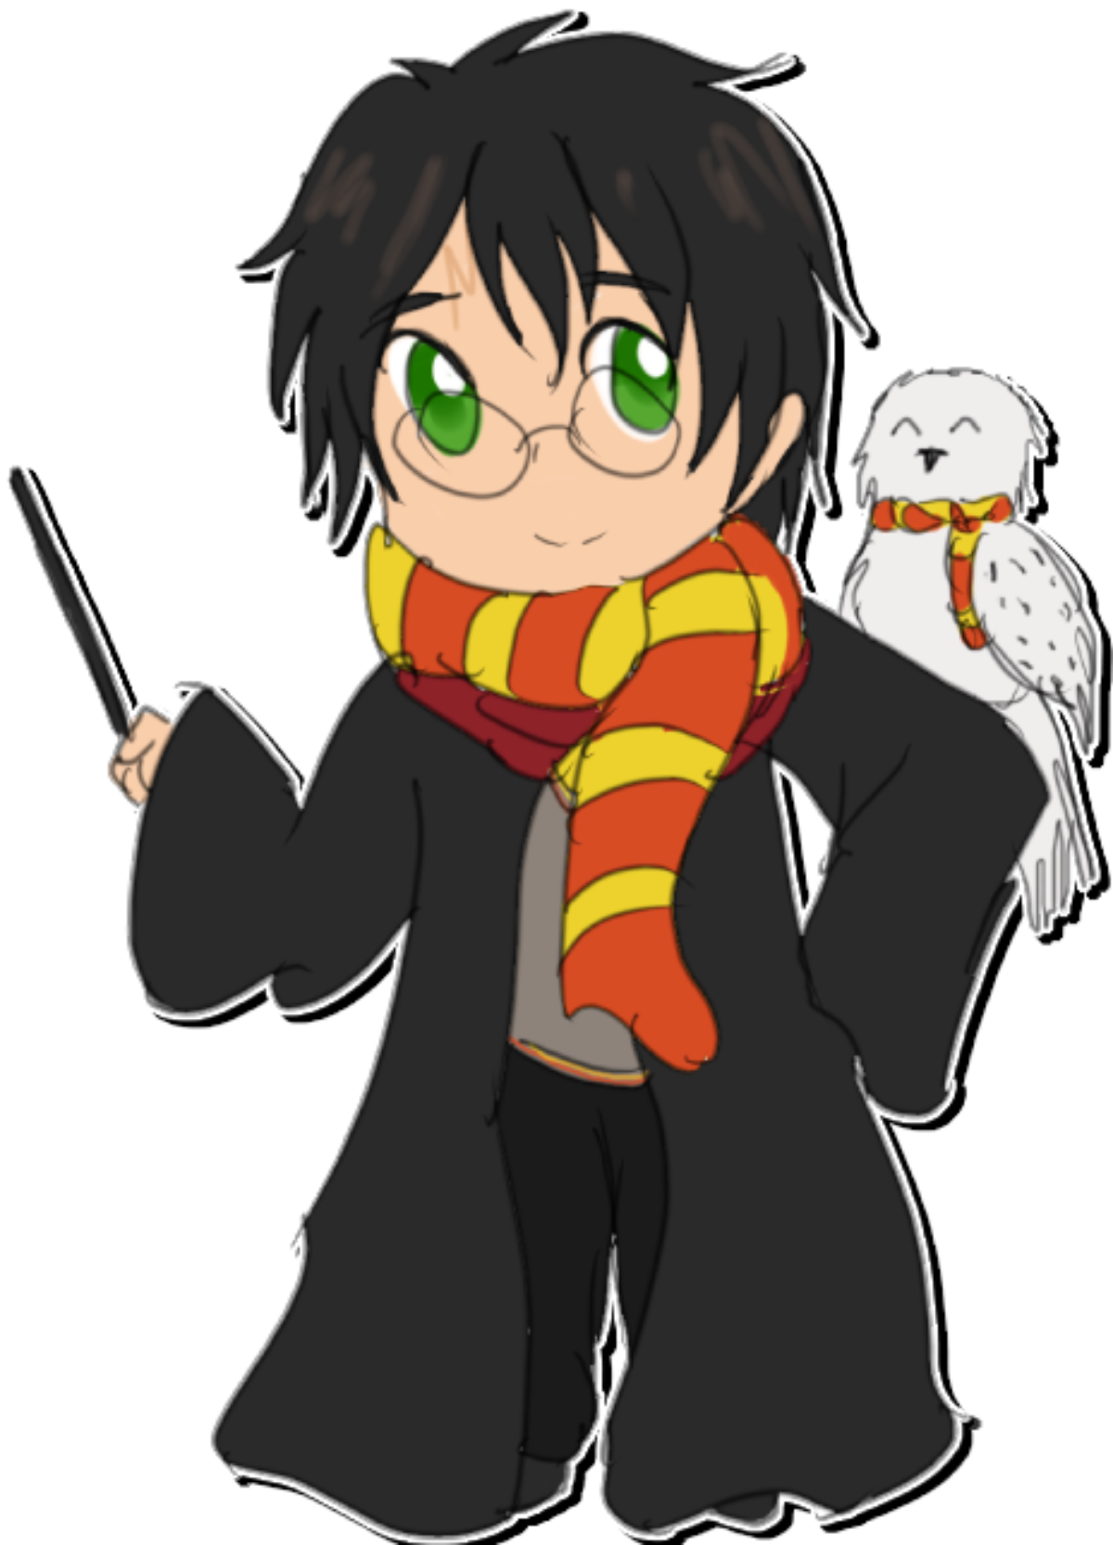
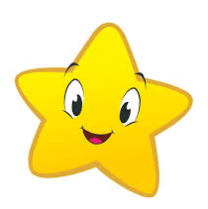
Self-evaluation
If you have 5-6 correct answers Harry gives you 3 stars.
If you have 3-4 correct answers Harry gives you 2 stars.
If you have 1-2 correct answers Harry gives you 1 star.

Slide 24
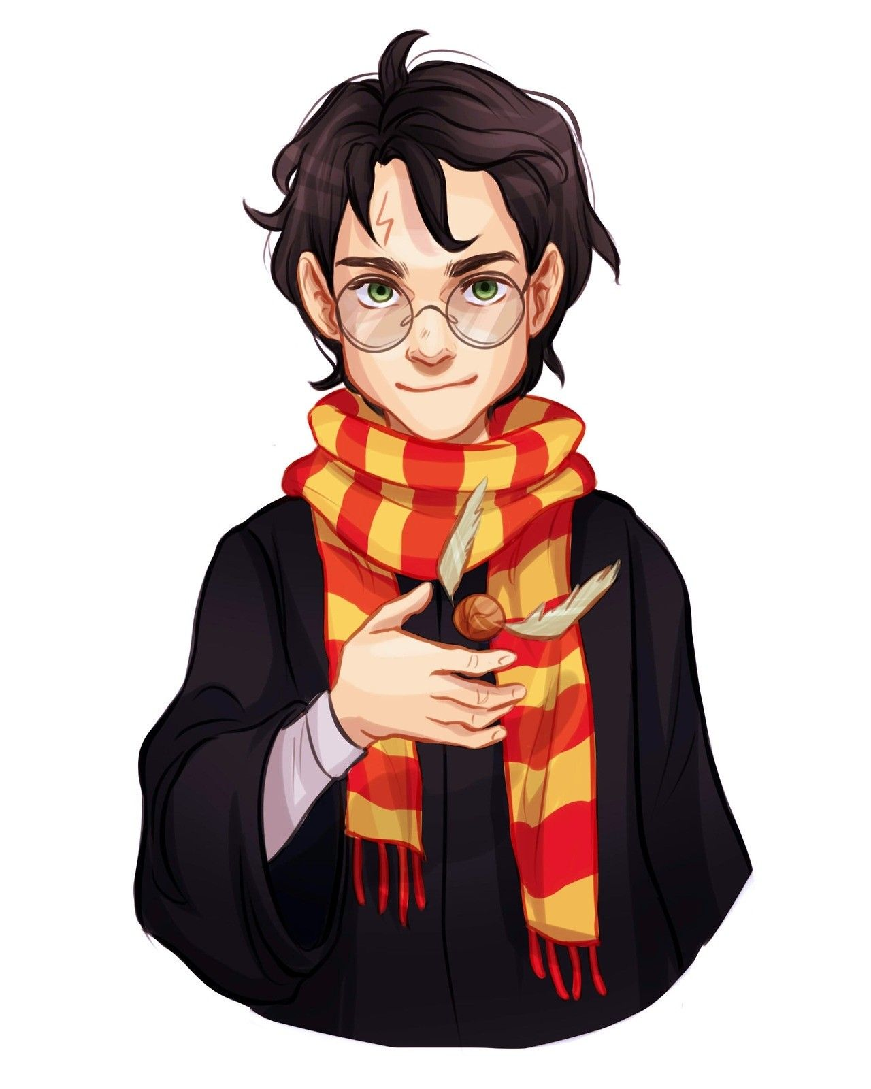
Homework
Use internet to find information about other Harry Potter creatures. Write 5-6 sentences about it in your own words.

Slide 25
In today’s lesson you’ve:
found out about mythical creatures
learnt new words and phrases from the text
listened and read the text about mythical creatures from J.K. Rowling Harry Potter books and Mythology

