Slide 1

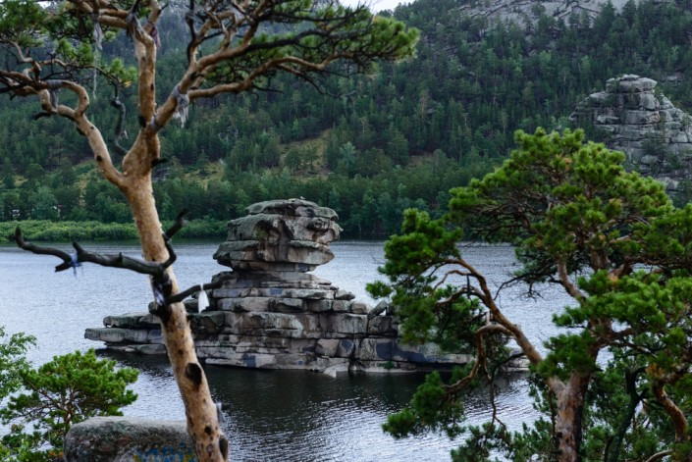
The Pearl
of Kazakhstan

Slide 2
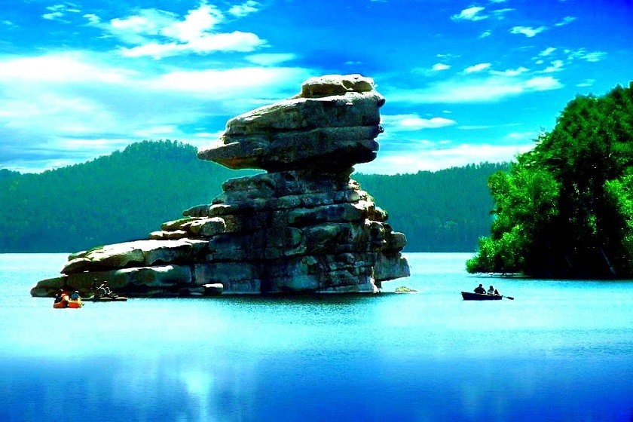

The Pearl of Kazakhstan
Cultures across the world have their own myth. These stories are about beliefs, historical events, mythical creatures or the world around us. In Kazakhstan, in the steppe that covers most of the country, there is the beautiful and green Burabai National Park. People have their own story about how this park came to be.

Slide 3
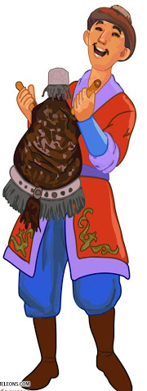
The Pearl of Kazakhstan
This myth story told us by the Kazakh myth character Aldar-Kosse. Have you ever heard about Aldar-Kosse? Yes, he is a character of funny folk stories.

Slide 4

In today’s lesson we will
talk about “The Pearl of Kazakhstan” - Burabai National Park;
watch the video and answer the questions;
read the parts of the text and do the tasks
use adjectives and regular/irregular past forms of the verbs

Slide 5
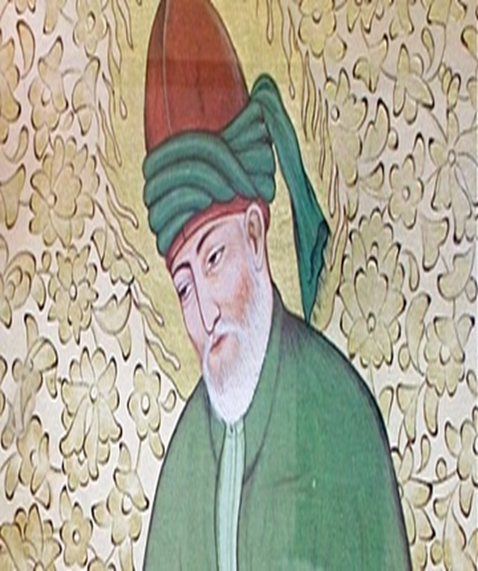
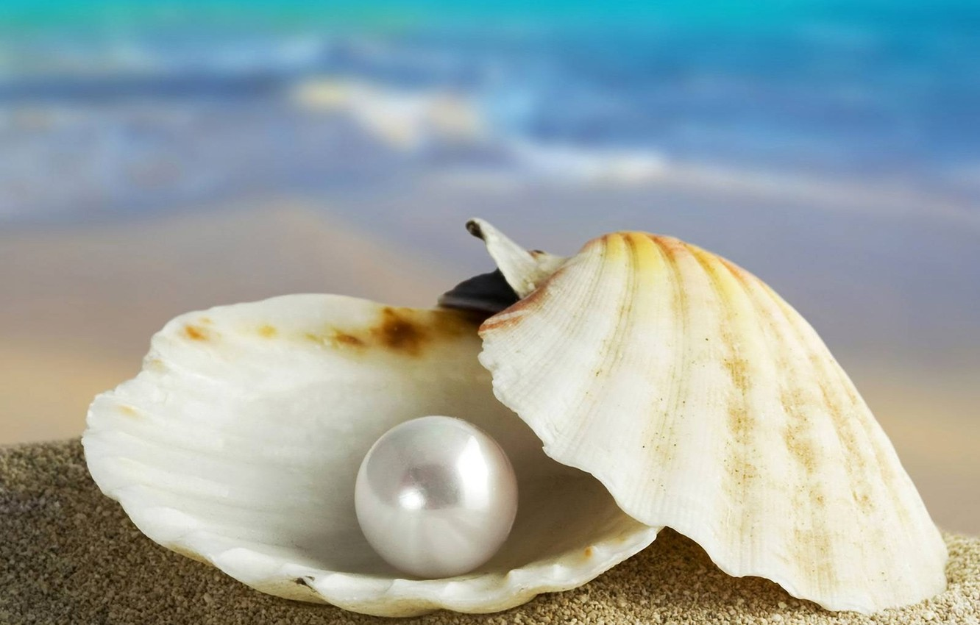
The Pearl of Kazakhstan
Learn the new topical vocabulary.
Creator
Pearl

Slide 6
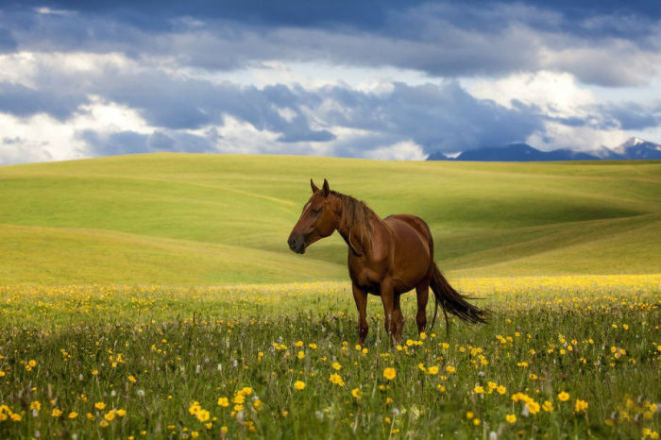
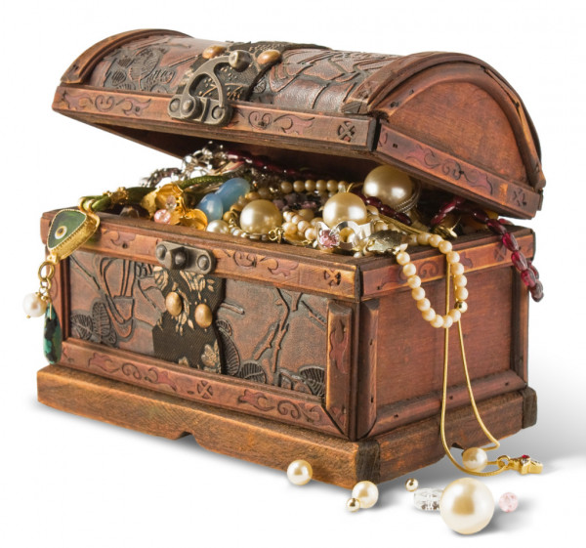
The Pearl of Kazakhstan
Learn the new topical vocabulary.
Steppe
Treasures

Slide 7
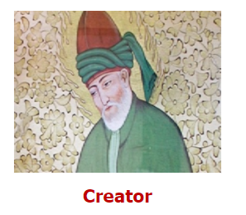
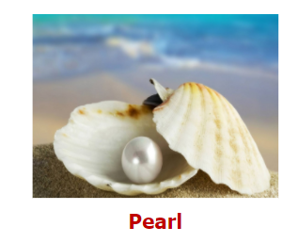

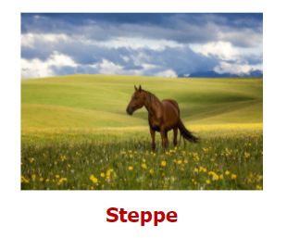
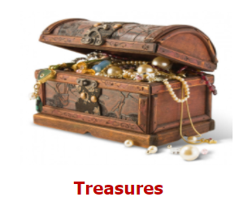
The Pearl of Kazakhstan Match the sentence with the appropriate picture.
It is a myth person who created the nature, the people and the animals.
We call mountains, forests, lakes, rivers, animals with this word.
People compare Burabai National Park with this jewelry.
This nature place is flat and wide with a lot of grass on it.

Slide 8
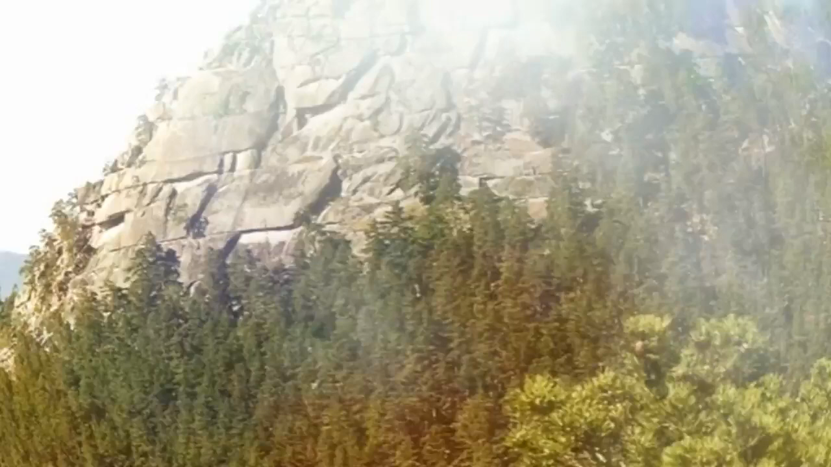
The Pearl of Kazakhstan
Watch the video “The Pearl of Kazakhstan” and
answer the questions according to the video.

Slide 9
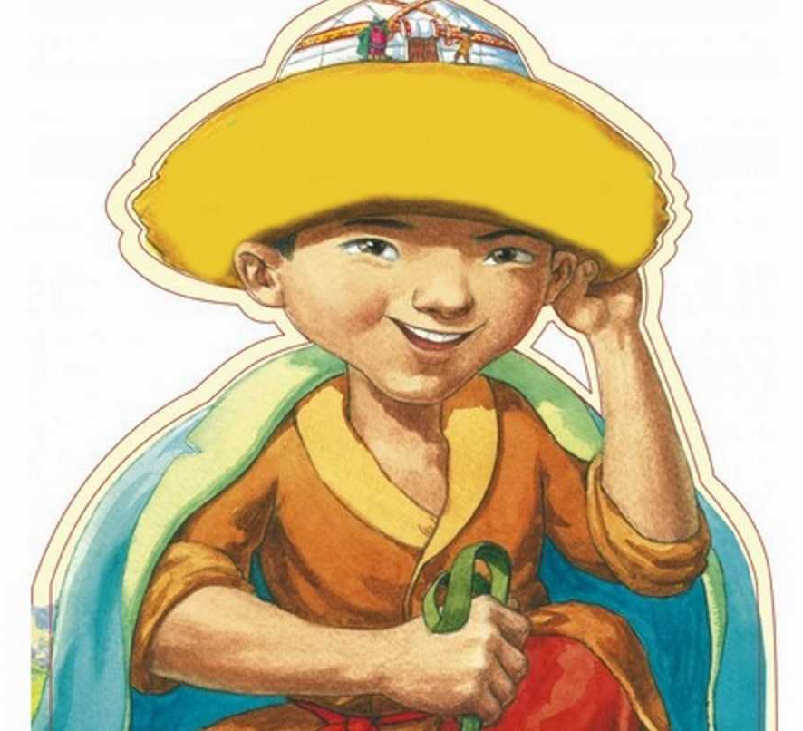
The Pearl of Kazakhstan
Why were the Kazakh people sad?
The Creator left them only with huge steppe and there weren’t any mountains and forests with wild animals, any lakes and rivers with fish there.

Slide 10
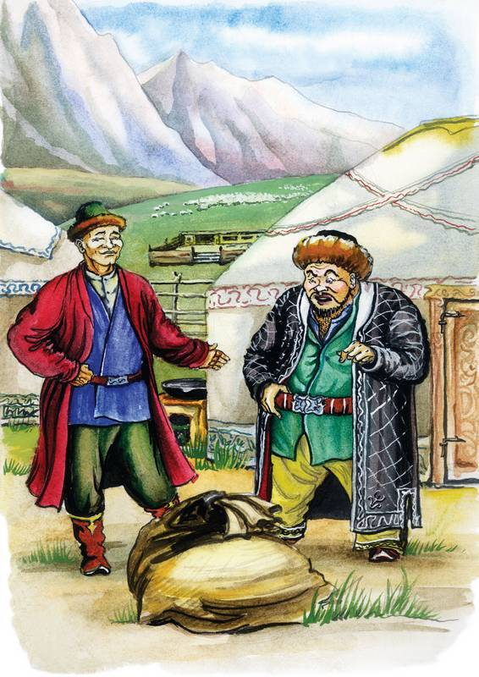
The Pearl of Kazakhstan
Why did Aldar –Kosse decide to help the Kazakh people ?
He didn’t like to see the Kazakh people so miserable.

Slide 11
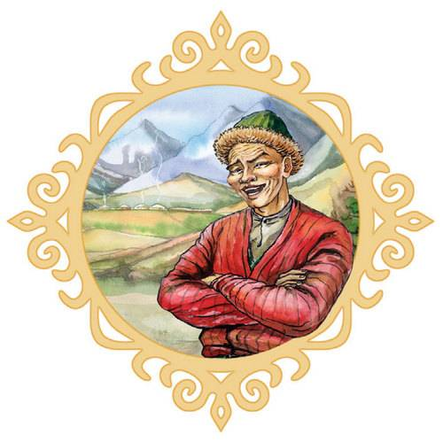
The Pearl of Kazakhstan
What did Aldar-Kosse ask the Creator to give the Kazakh people?
He asked to give some mountains.

Slide 12
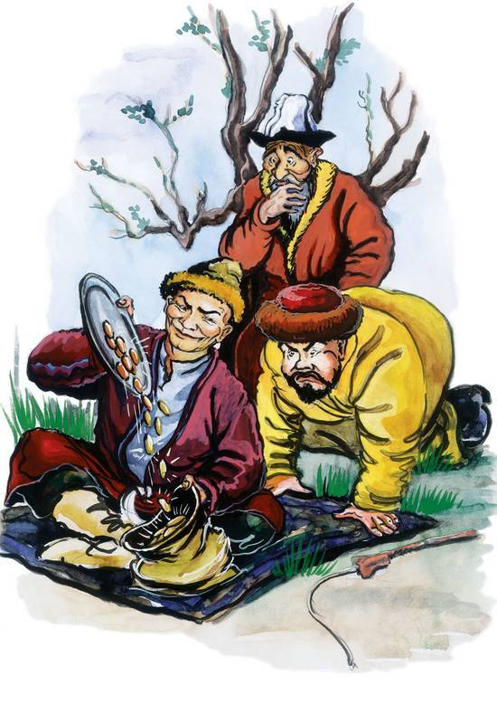
The Pearl of Kazakhstan
Where did the Creator keep all the treasures?
The Creator kept all the treasures in a sack.

Slide 13
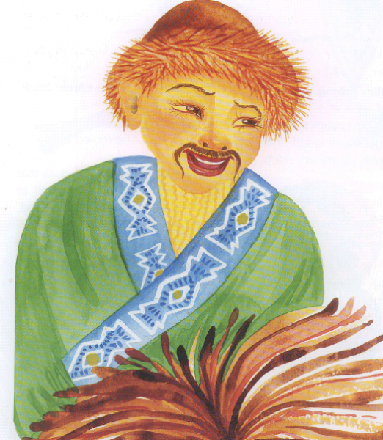
The Pearl of Kazakhstan
How did Aldar –Kosse get the treasures out?
Aldar –Kosse crept up to the sack and made a hole in it. Mountains, forests, rivers, lakes, fish and wild animals fell out and landed right in the middle of the empty steppe.

Slide 14

Evaluation

Slide 15

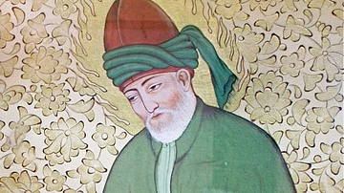
Let’s read! Read the first part of the text and match the words in bold to their synonyms.
The Pearl of Kazakhstan
The Creator made the world up and he gave high mountains, clear lakes and green forests to all the countries. But for some reasons he forgot about the Kazakh people. He left them with only huge steppe that stretched across the country. It was beautiful, but the people were sad. Where were their mountains, forests and lakes with wild animals and fish? Aldar-Kosse the cheeky man didn’t like to see the Kazakh people so miserable and decided to go and see the Creator himself.

Slide 16
Match the words to their synonyms.
The Pearl of Kazakhstan
The Creator made the world up and he gave high mountains, clear lakes and green forests to all the countries. Bit for some reasons he forgot about the Kazakh people. He left them with only huge steppe that stretched across the country. It was beautiful, but the people were sad. Where were their mountains, forests and lakes with wild animals and fish? Aldar- Kosse the cheeky man didn’t like to see the Kazakh people so miserable and decided to go and see the Creator himself.
pure
unhappy
tragic
daring
enormous

Slide 17
Match the words to their synonyms.
The Pearl of Kazakhstan
The Creator made the world up and he gave high mountains, pure lakes and green forests to all the countries. Bit for some reasons he forgot about the Kazakh people. He left them with only huge steppe that stretched across the country. It was beautiful, but the people were sad. Where were their mountains, forests and lakes with wild animals and fish? Aldar- Kosse the cheeky man didn’t like to see the Kazakh people so miserable and decided to go and see the Creator himself.
pure
unhappy
tragic
daring
enormous

Slide 18
Match the words to their synonyms.
The Pearl of Kazakhstan
The Creator made the world up and he gave high mountains, pure lakes and green forests to all the countries. Bit for some reasons he forgot about the Kazakh people. He left them with only enormous steppe that stretched across the country. It was beautiful, but the people were sad. Where were their mountains, forests and lakes with wild animals and fish? Aldar- Kosse the cheeky man didn’t like to see the Kazakh people so miserable and decided to go and see the Creator himself.
pure
unhappy
tragic
daring
enormous

Slide 19
Match the words to their synonyms.
The Pearl of Kazakhstan
The Creator made the world up and he gave high mountains, pure lakes and green forests to all the countries. Bit for some reasons he forgot about the Kazakh people. He left them with only enormous steppe that stretched across the country. It was beautiful, but the people were unhappy. Where were their mountains, forests and lakes with wild animals and fish? Aldar- Kosse the cheeky man didn’t like to see the Kazakh people so miserable and decided to go and see the Creator himself.
pure
unhappy
tragic
daring
enormous

Slide 20
Match the words to their synonyms.
The Pearl of Kazakhstan
The Creator made the world up and he gave high mountains, pure lakes and green forests to all the countries. Bit for some reasons he forgot about the Kazakh people. He left them with only enormous steppe that stretched across the country. It was beautiful, but the people were unhappy. Where were their mountains, forests and lakes with wild animals and fish? Aldar- Kosse the daring man didn’t like to see the Kazakh people so miserable and decided to go and see the Creator himself.
pure
unhappy
tragic
daring
enormous

Slide 21
Match the words to their synonyms.
The Pearl of Kazakhstan
The Creator made the world up and he gave high mountains, pure lakes and green forests to all the countries. Bit for some reasons he forgot about the Kazakh people. He left them with only enormous steppe that stretched across the country. It was beautiful, but the people were unhappy. Where were their mountains, forests and lakes with wild animals and fish? Aldar- Kosse the daring man didn’t like to see the Kazakh people so tragic and decided to go and see the Creator himself.
pure
unhappy
tragic
daring
enormous

Slide 22
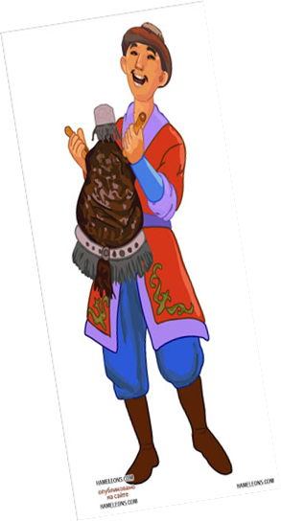
Read the second part of the text and complete the graphic organizer with the appropriate word.
Oh, wise Creator! called Aldar -Kosse. The Kazakh people are so good! Why did you give them only the empty steppe? Can you please give us some mountains too? So the Creator gave Kazakhstan the Karatau mountains. Aldar-Kosse the cheeky man watched carefully. He saw that the Creator took the mountains from a sack. “That’s where the Creator keeps all the treasures!’ thought Aldar-Kosse.

Slide 23
Read the second part of the text and complete the graphic organizer with the appropriate word.
The Creator -
The Kazakh people –
Aldar-Kosse -
The steppe -
Watched -
Keeps -
Wise
Oh, wise Creator! called Aldar -Kosse. The Kazakh people are so good! Why did you give them only the empty steppe? Can you please give us some mountains too? So the Creator gave Kazakhstan the Karatau mountains. Aldar-Kosse the cheeky man watched carefully. He saw that the Creator took the mountains from a sack. “That’s where the Creator keeps all the treasures!’ thought Aldar-Kosse.
Good
Cheeky
Empty
Carefully
Treasures

Slide 24
Read the third part of the text and complete the sentences.
Quietly, Aldar-Kosse crept up to the sack and made a hole in it. The rest of the treasures fell out – mountains, lakes, forests, rivers, and fish and wild animals, too. They landed in Kazakhstan, right in the middle of the empty steppe. The people were happy. Even today, you can see all the treasures from the Creator’s sack in one place – in Burabai National Park, “The Pearl of Kazakhstan”.

Slide 25
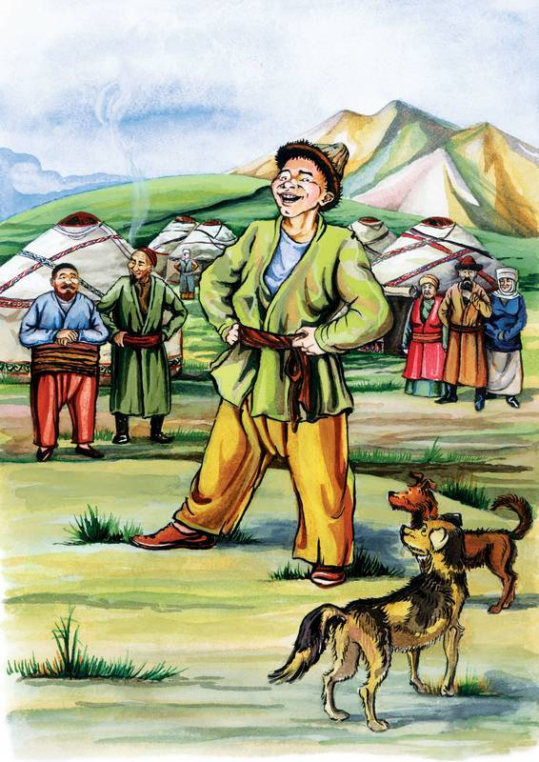
Read the third part of the text and complete the sentences.
Use fell, landed, made, crept, were.
The people of Kazakhstan ……. very happy.
Aldar- Kosse ……... a hole in a sack.
Mountains, rivers, animals ………. in the middle of Kazakhstan.
Aldar-Kosse …….. to the sack of the Creator.
The rest of the treasures ……... on the land.

Slide 26
Read the third part of the text and complete the sentences.
Use fell, landed, made, crept, were.
The people of Kazakhstan were very happy.
Aldar- Kosse ……... a hole in a sack.
Mountains, rivers, animals ………. in the middle of Kazakhstan.
Aldar-Kosse …….. to the sack of the Creator.
The rest of the treasures ……... on the land.

Slide 27
Read the third part of the text and complete the sentences.
Use fell, landed, made, crept, were.
The people of Kazakhstan were very happy.
Aldar- Kosse made a hole in a sack.
Mountains, rivers, animals ………. in the middle of Kazakhstan.
Aldar-Kosse …….. to the sack of the Creator.
The rest of the treasures ……... on the land.

Slide 28
Read the third part of the text and complete the sentences.
Use fell, landed, made, crept, were.
The people of Kazakhstan were very happy.
Aldar- Kosse made a hole in a sack.
Mountains, rivers, animals landed in the middle of Kazakhstan.
Aldar-Kosse …….. to the sack of the Creator.
The rest of the treasures ……... on the land.

Slide 29
Read the third part of the text and complete the sentences.
Use fell, landed, made, crept, were.
The people of Kazakhstan were very happy.
Aldar- Kosse made a hole in a sack.
Mountains, rivers, animals landed in the middle of Kazakhstan.
Aldar-Kosse crept up to the sack of the Creator.
The rest of the treasures ……... on the land.

Slide 30
Read the third part of the text and complete the sentences.
Use fell, landed, made, crept, were.
The people of Kazakhstan were very happy.
Aldar- Kosse made a hole in a sack.
Mountains, rivers, animals landed in the middle of Kazakhstan.
Aldar-Kosse crept up to the sack of the Creator.
The rest of the treasures fell out on the land.

Slide 31
The Pearl of Kazakhstan
Aldar-Kosse noticed the place where the Creator all the nature wealth keeps.
Part 2.

Slide 32
The Pearl of Kazakhstan
The empty steppe covered with the nature treasures fell out from a sack.
Part 3.

Slide 33
The Pearl of Kazakhstan
There weren’t any mountains, forests, lakes, wild animals and fish Creator left the Kazakh people.
Part 1.

Slide 34

Evaluation

Slide 35


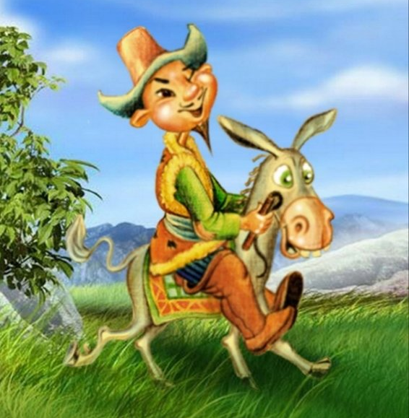
Homework:
Make up a brochure about Burabai National park and create your own myth about this place.

Slide 36
You have:
talked about “The Pearl of Kazakhstan” - Burabai National Park;
watched the video and answered the questions;
read the text and done the tasks
used adjectives and regular/irregular past forms.

Slide 37

I wish you to enjoy the beauty of Burabai!

