Slide 1

The Lord of Greenwood

Slide 2
In today’s lesson we will
Learn the new words, predict the content of story;
Listen and read the text about Robin Hood;
Complete the tasks after reading the story.
Notes:
<number>

Slide 3
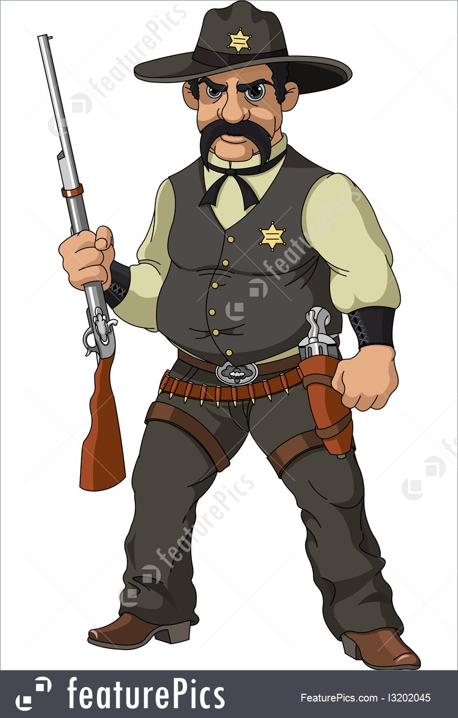
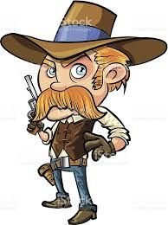

Learn the new words
sheriff
burst open
outlaw

Slide 4
Learn the new phrases
Recognize
title
gather around the fire
present with
cheer loudly

Slide 5

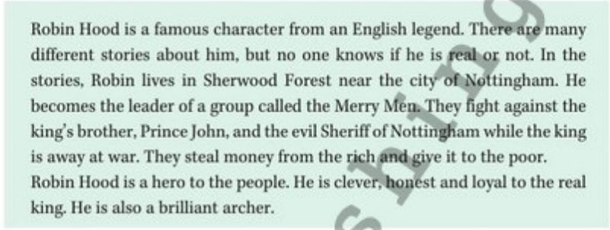
Robin Hood
What do you know about Robin Hood?
Was he a real person?

Slide 6
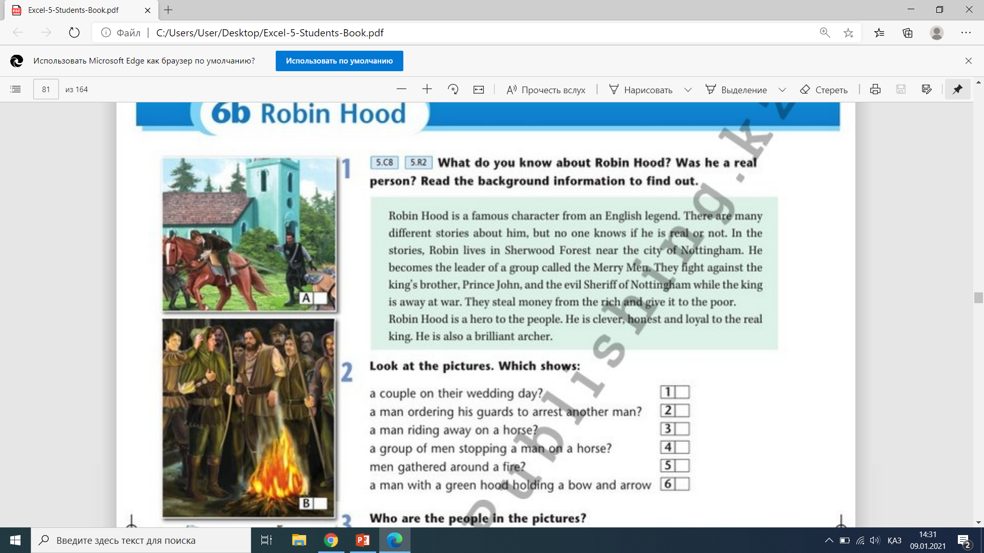
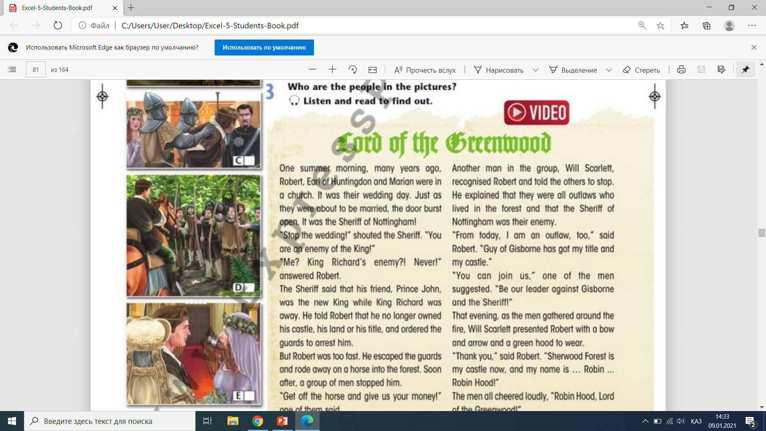
a couple on their wedding day? a man ordering his guards to arrest another man? a man riding away on a horse? a group of men stopping a man on a horse? men gathered around a fire? a man with a green hood holding a bow and arrow?
Look at the pictures. Which shows:
E
C
A
D
B
B

Slide 7
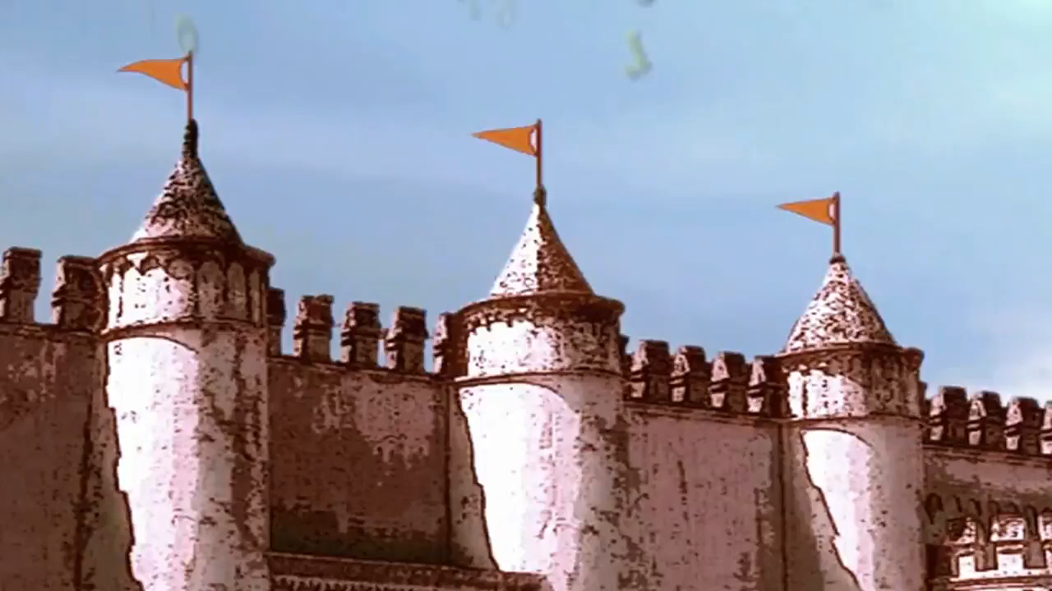
Who are the people in the pictures?
Listen to the story to find out

Slide 8
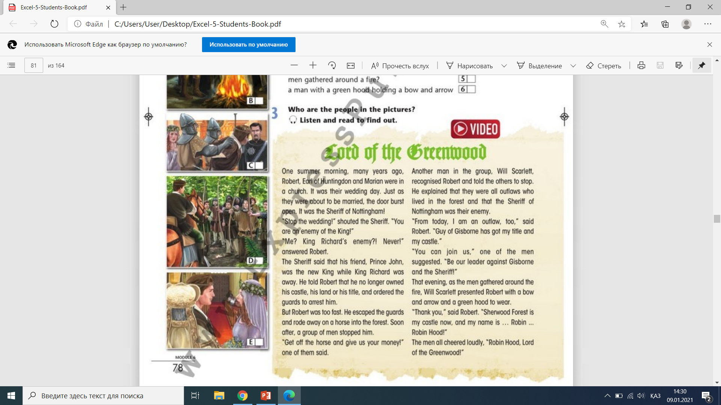
Find seven verbs in the text that mean “said”

Slide 9
Complete the sentences.
Use: escaped, gathered, stopped. ordered, presented.
The sheriff the guards to arrest Robert.
The sheriff of Nottingham the wedding.
Robert into the forest.
Will Scarlet with a bow and arrow.
The men around the fire.
ordered
stopped
escaped
presented
gathered

Slide 10


Slide 11








Put the events in the order they happened
A The men asked Robert to be their leader.
B Robert changed his name to Robin Hood.
C Will Scarlet gave Robin Hood a bow and arrow and a green hood to wear.
D The sheriff entered the church.
E Marian and Robert were in a church.
F Robert escaped the guards on a horse.
G The sheriff told his men to arrest Robert.
H A group of men stopped Robert in the forest.

Slide 12


Slide 13
Complete the table using the words below
Loyal to Prince John
honest
lives in Sherwood forest
Loyal to King Richard
evil
lives in Nottingham castle
Robin Hood | Sheriff of Nottingham

Slide 15
In today’s lesson:
learnt new words;
discussed the story about Robin Hood;
complete all the tasks.
Notes:
<number>

Slide 16


