Slide 1

Stories and Poems

Slide 2

In today’s lesson:
learn about Kazakh poetry and Haiku.

Slide 3
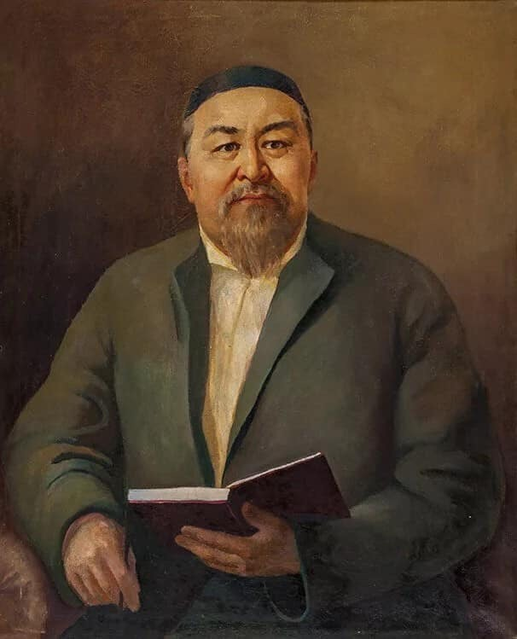
Kazakh Poetry
Traditionally, Kazakh poetry is a rule, quatrains, where each verse consists of 11 syllables, rhyme – “AABA”.
That is, the 1st ,2nd and 4th lines rhyme, and the 3rd doesn’t;
For example:
Parting is winter, your absence is sorrow
I wish to stay until the morrow
Between your fair arms
when the nightingale sings, 'Terrow‘
Abai
А
А
В
А

Slide 4
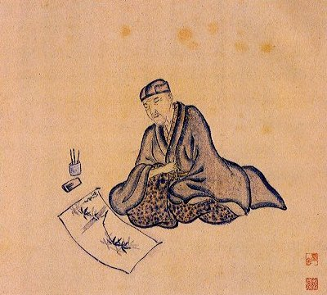
Haiku Poetry
Haiku is a Japanese form of poetry.
Traditionally, the poems had a nature theme, but these days they can be written about a variety subjects.

Slide 5
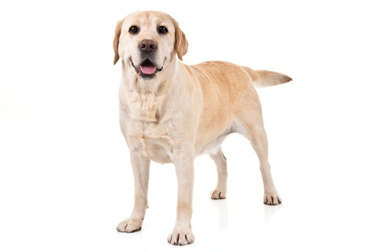
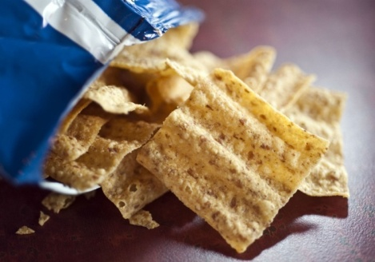
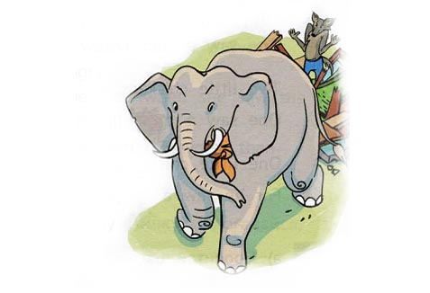
To write a poem, you must understand syllables.
A syllable is a part of a word that has one beat or sound.
For example:
dog = one syllable.
crunchy = two syllables (crun-chy)
elephant = three syllables (e-le-phant)

Slide 6
A haiku poem has three lines and follows a pattern of syllables.
The first line has five syllables.
The second line has seven syllables.
The third line has five syllables.
5
7
5

Slide 7
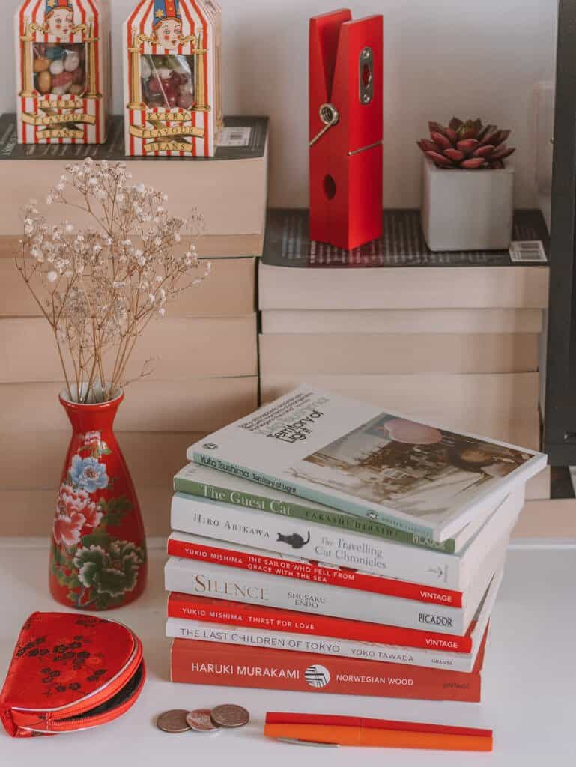
A haiku poems doesn’t have rhyme.
The leaf falls gent-ly
Floa-ting down to-wards the ground
Crun-ching un-der-foot.
5
7
5

Slide 8

Another example:
The wave ri-ses high,
Cra-shes down on-to the rocks
gone but still a-live
5
7
5

Slide 9

Remember!!!
a haiku does not have rhyme;
has three lines;
follows the syllable pattern
5 – 7 - 5

Slide 10
What am I?
Green and speckled legs
Hops on logs and lily pads
Splash in cool water.

Slide 11
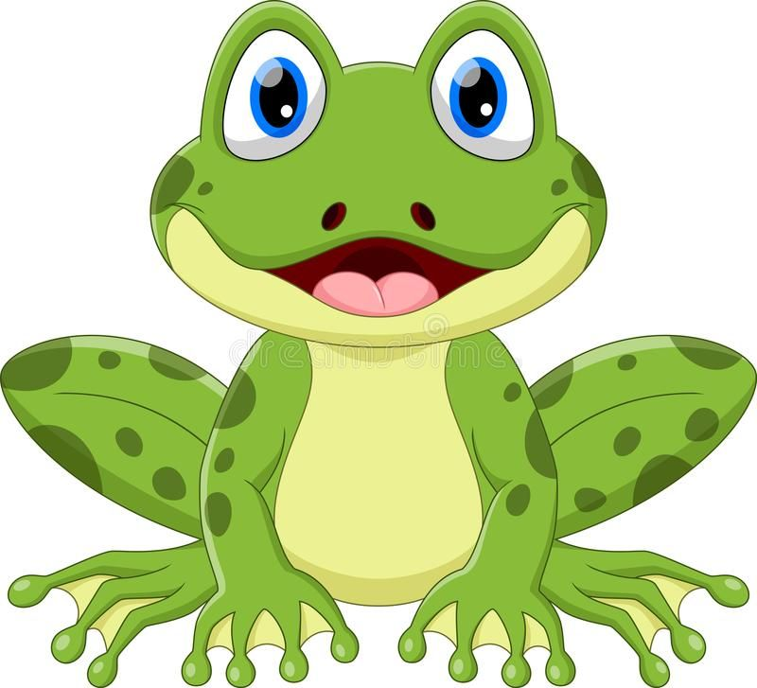
What am I?
Green and spec-kled legs
Hops on logs and li-ly pads
Splash in cool wa-ter.
5
7
5

Slide 12
What am I?
Made from trees and ink
I’m full of words, fun and wise, for you to enjoy.

Slide 13

What am I?
Made from trees and ink
I’m full of words, fun and wise, for you to en-joy.
5
7
5

Slide 14
What am I?
In a pouch I grow
On a Southern Continent
Can jump very high.

Slide 15
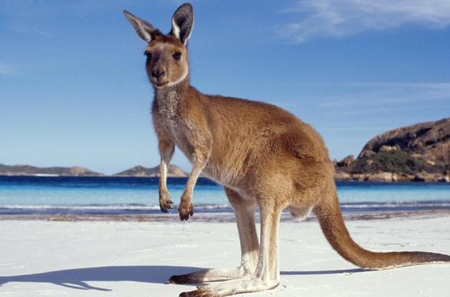
What am I?
In a pouch I grow
On a Sou-thern Con-ti-nent
Can jump ve-ry high.
5
7
5

Slide 16

Kazakh poems
- AABA rhyme;
- 4 lines.
Haiku
no rhyme;
3 lines;
5-7-5 syllables.

Slide 17


In today’s lesson:
learnt about Kazakh poetry and Haiku.

Slide 18


