Slide 1


Subject: English language
Grade: 4
The theme of the lesson: Snow and ice

Slide 2
New words
Brick – кірпіш
Sculpture – мүсін
Castle – қамал
Fairy tale – ертегі
Famous – атақты
Building – ғимарат
Shine – жарқырау
Carnival – карнавал

Slide 3
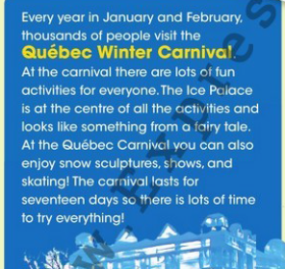
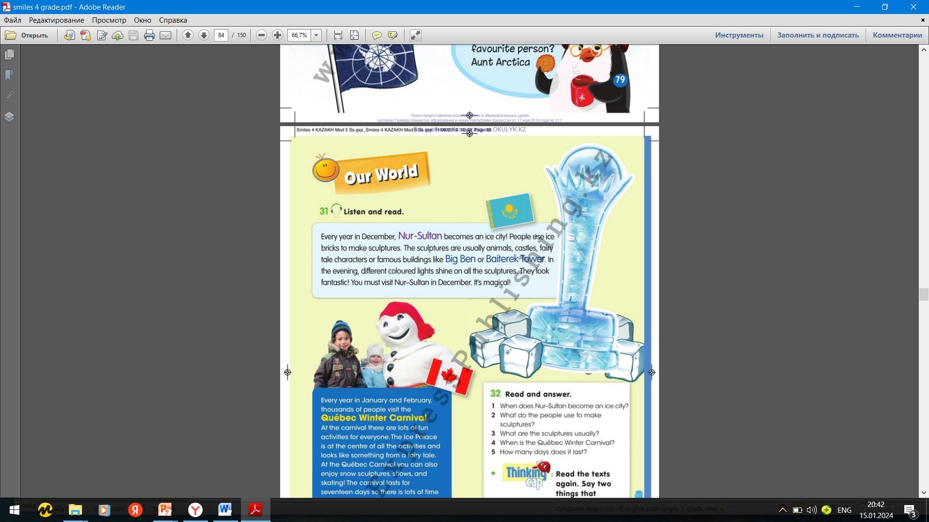
Ex.31,p.80 Listen and read

Slide 4

Ex.32,p.80 Read and answer.
1)Every year in December.
2) People use to make sculptures ice bricks.
3)Animals, castles, fairy tale characters or famous building.
4)Every year in January and February.
5)It lasts seventeen days.

Slide 5
Ex.33,p.80 Find information about an unusual festival. When it is? What can you see/do there? Present it to the class.
Every year in January or February, thousands of people visit the Norway Ice Music Festival. People use ice make musical instruments. These instruments look like a real and you can even play music with them. At the festival there are a lot of concerts . Musicians from around the world play music in igloos with the ice instruments . You must visit the Norway Ice Music Festival. It`s magical.

Slide 6
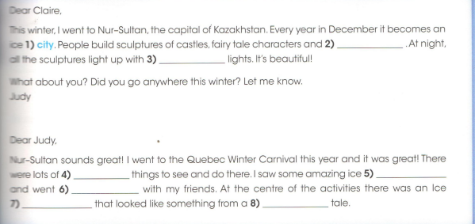
Ex.17,p.55 Activity book Complete the emails. Use: city, sculptures, fairy, animals, palace, skating, coloured, fun.
2)animals
3)coloured
4)fun
5)sculptures
6)skating
7)palace
8)fairy

Slide 7
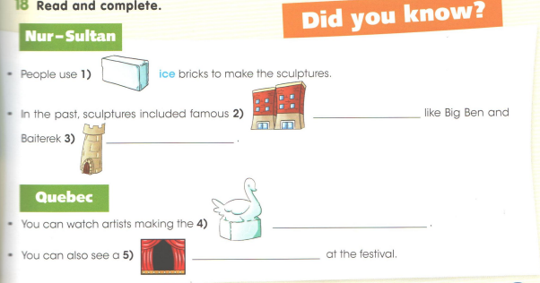
Ex.18,p.55 Activity book Read and complete.
buildings
tower
sculptures
carnival

Slide 8
