Slide 1


Subject: English language
Grade: 4
The theme of the lesson: Volcanoes

Slide 2
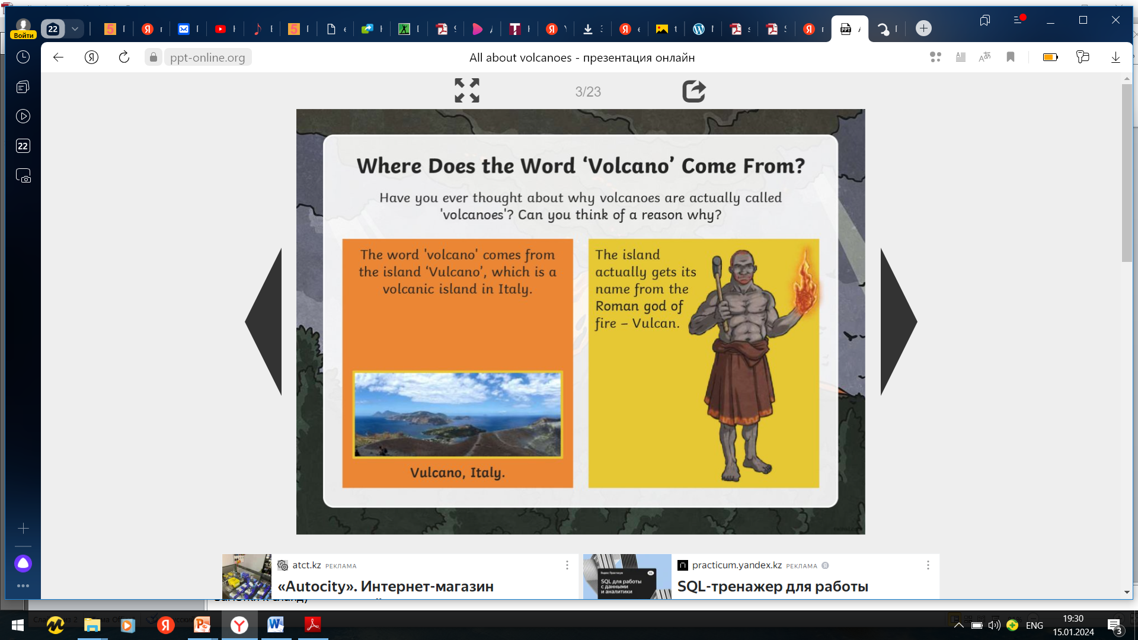

Slide 3
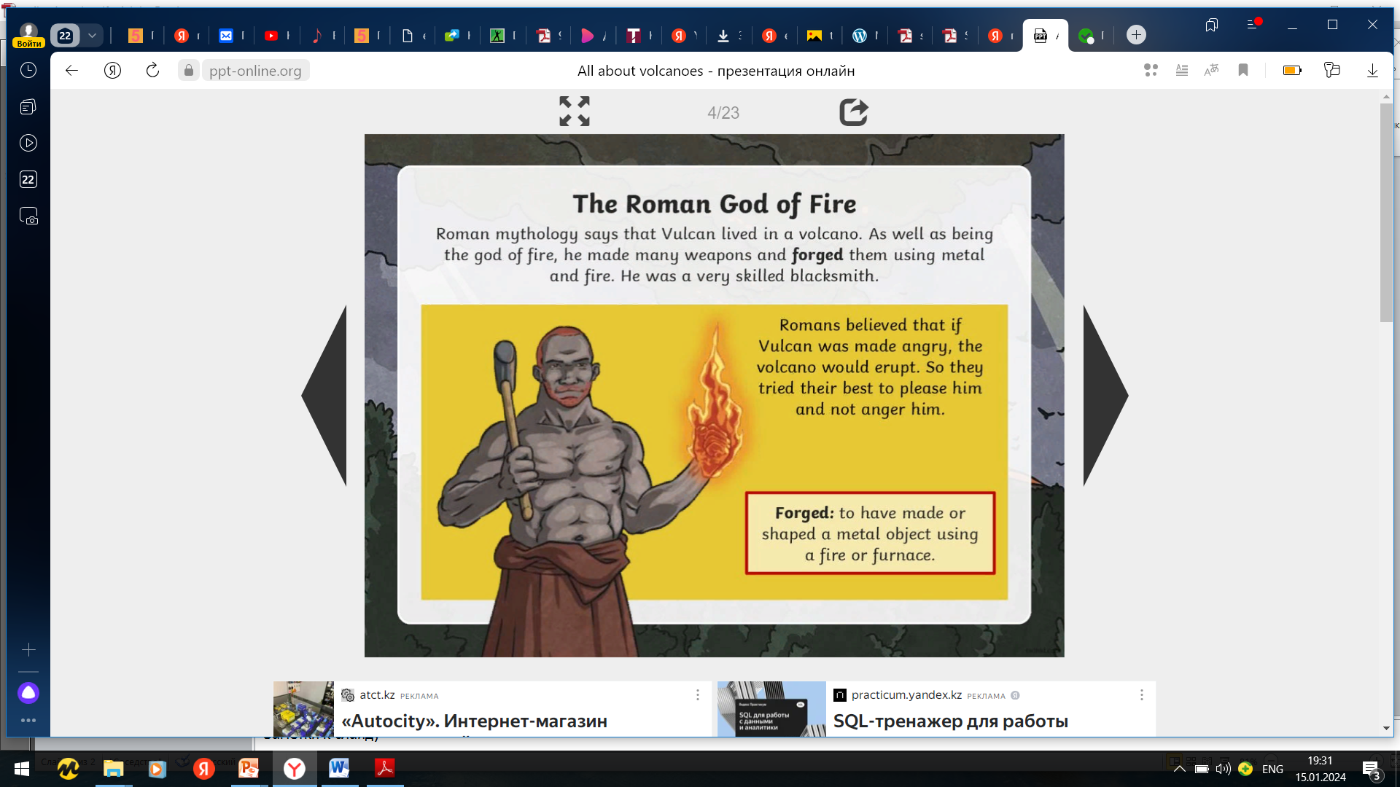

Slide 4
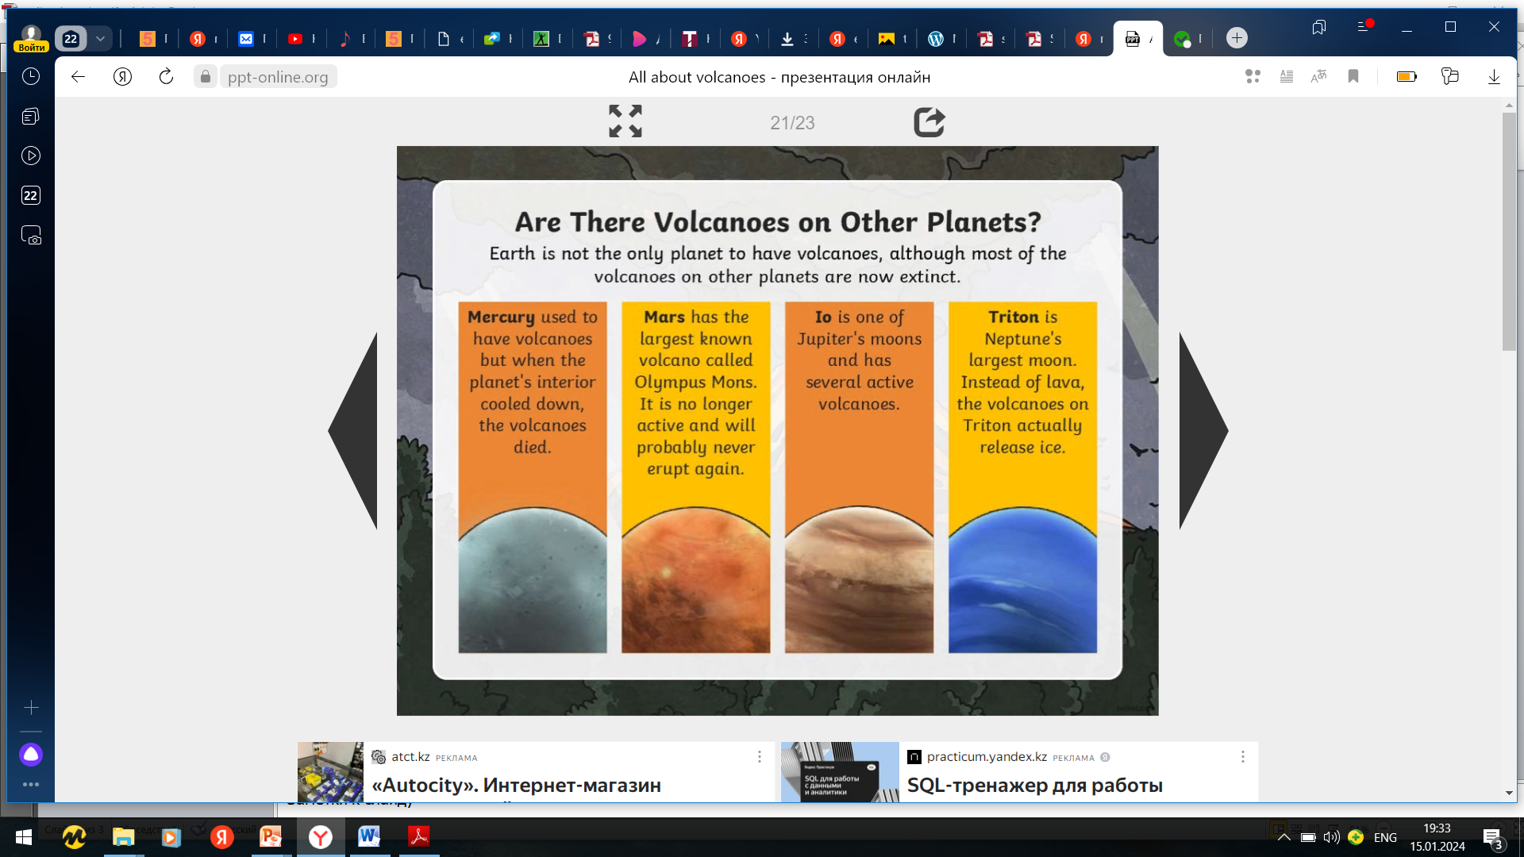

Slide 5
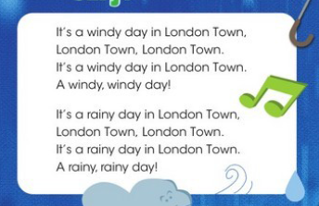
Ex.23,p.77 Let`s sing.

Slide 6
Ex.24,p.77 Riddle time: Read and answer.
What always falls, but never gets hurt?
(You can see it in the picture in Ex.23.)
It is a rain. It falls but never gets hurt.

Slide 7
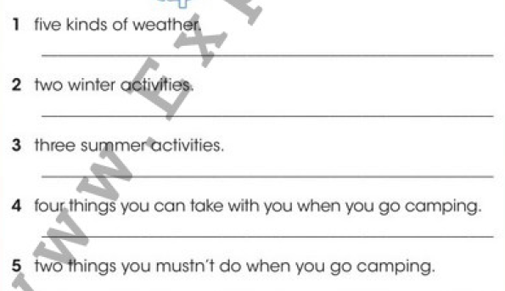
Ex.25,p.77 In three minutes write.
1)hot, cold, foggy, windy, sunny
2)skiing, snowboarding
3)swimming, surfing, camping
4)rope, first-aid kit, cool box, whistle
5)Go near wild animals, go for a walk alone

Slide 8
