Slide 1


Subject: English language
Grade: 4
The theme of the lesson: Volcanoes

Slide 2
New words
Countryside – қаланың шеті
Look – қарау
Watch – қарау
Volcano – жанартау
Believe – сену
Campsite – кемпинг
Walking – жаяу
Fishing – балық аулау
Horse riding – атпен жүру
View – көрініс

Slide 3
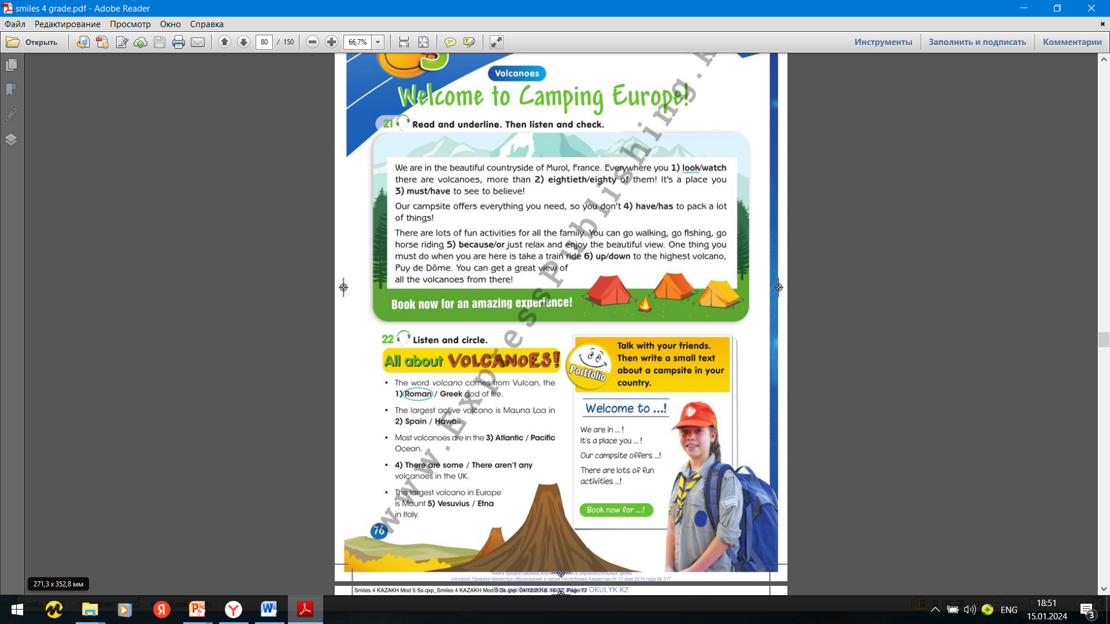
Ex.21,p.76 Read and underline. Then listen and check.
2)eighty
3)have
4)have
5)or
6)up

Slide 4
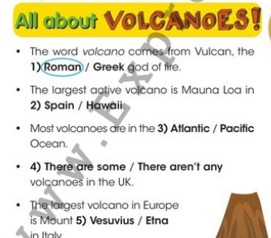
Ex.22,p.76 Listen and circle.

Slide 5

P.26 Talk with your friends. Then write a small text about a campsite in your country.
Welcome to Turgen!
We are in the beautiful countryside of Turgen, Kazakhstan. It`s a place have to see to believe! Our campsite offers everything you need, so you don`t have to pack a lot of things. There are a lot of fun activities for all the family. You can go walking in the pine forest, go fishing in the lake or just relax and enjoy the view. One thing you must do when you are here is go up the mountain to one of the waterfalls of Turgen. You can go swimming in the river there. Book now for an amazing experience.

Slide 6
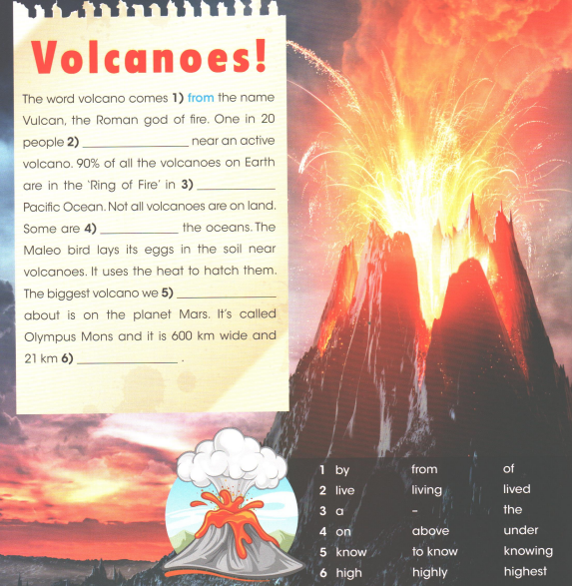
Ex.13,p.52 Activity book Read the text. Choose the right words and write them on the lines.
2)Live
3)The
4)Under
5)Know
6)High

Slide 7
