Slide 1


Subject: English language
Grade: 4
The theme of the lesson: Weather 2

Slide 2
New words
Thunder and lighting – күннің күркіреуі мен найзағай
Flood – су тасқыны
Storm – дауыл
Tornado – қатты құйын, торнадо
Avalanche – көшкін
Hail – бұршақ

Slide 3
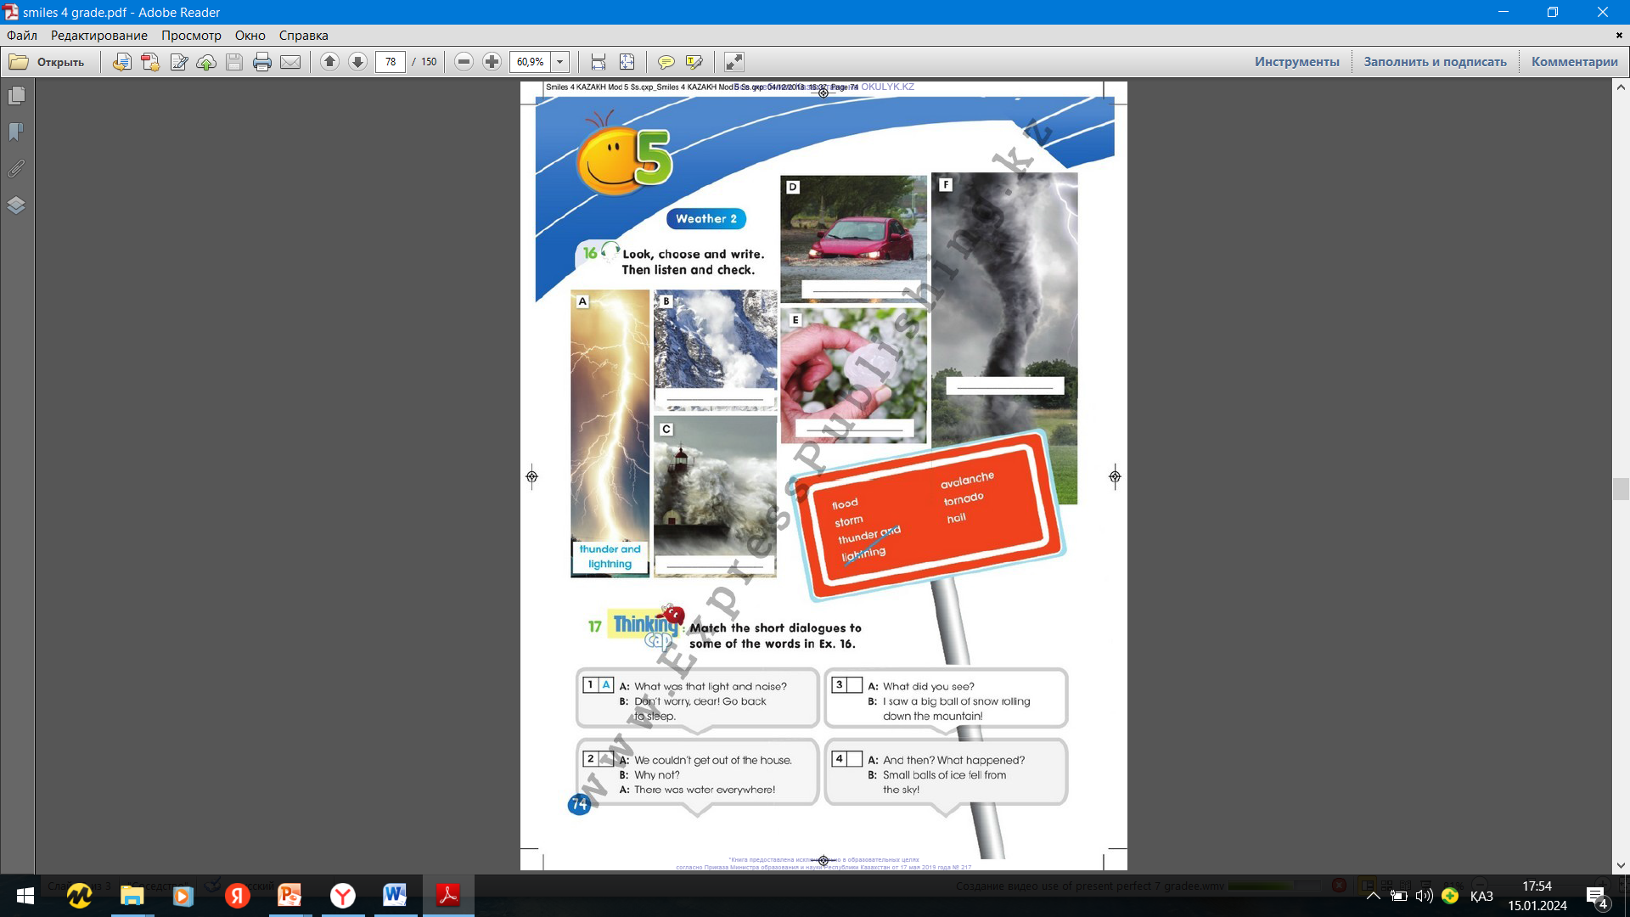
Ex.16,p.74
Look, choose and write. Then listen and check.
flood
tornado
avalanche
hail
storm

Slide 4
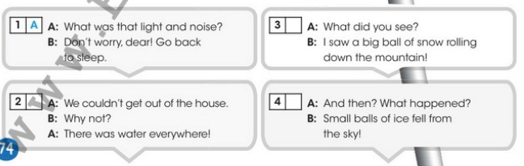
Ex.17,p.74
Match the short dialogues to some of the words in Ex.16.
2)Flood
3)Avalanche
4)Hail

Slide 5
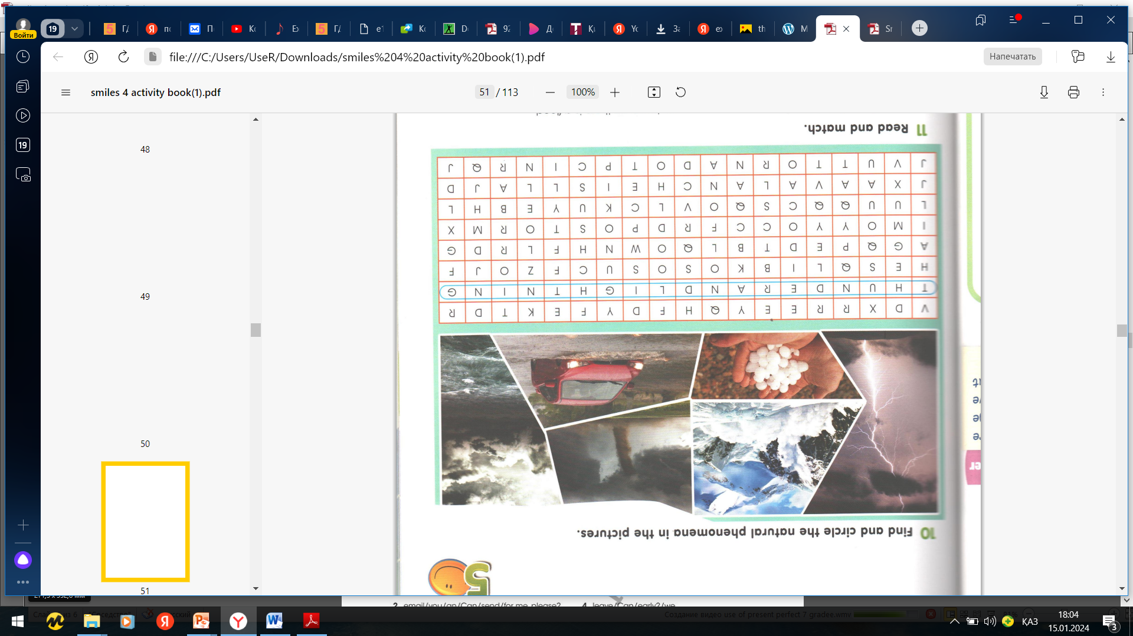
Ex.10,p.51 Activity book
Find and circle the natural phenomena in the pictures.

Slide 6
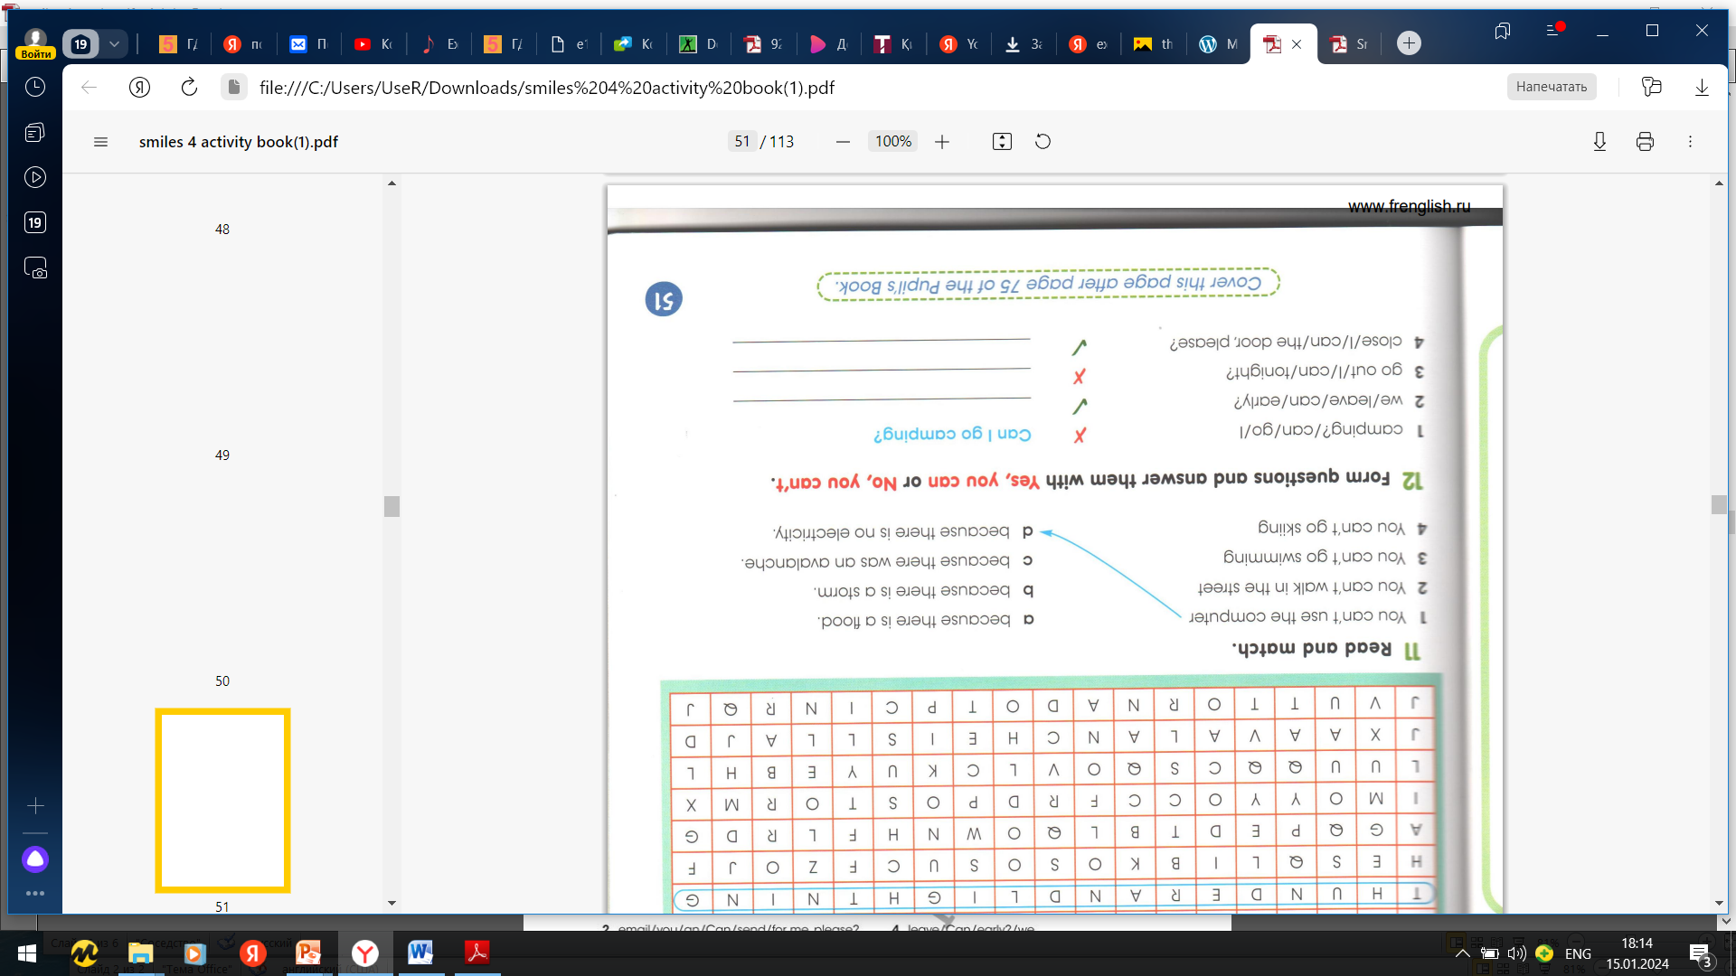
Ex.11,p.51 Activity book
Read and match.
2)A
3)B
4)C

Slide 7
