Slide 1


Subject: English language
Grade: 4
The theme of the lesson: Weather 1

Slide 2
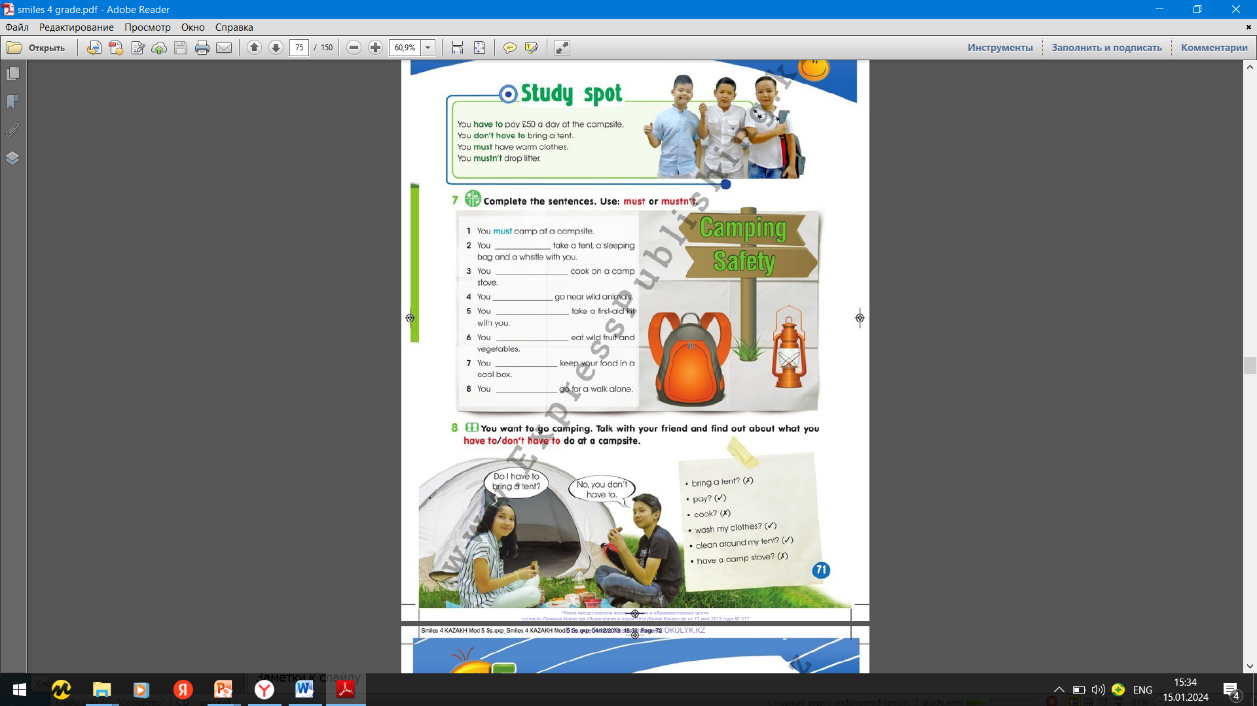
Ex.8,p.71 You want to go camping. Talk with your friend and find out about what you have to/don`t have to do at a campsite
A: Do I have to pay?
B: Yes, you have to. Do I have to cook?
A:No, you don`t have to. Do I have to wash my clothes?
B:Yes, you have to. Do I have to clean around my tent?
A:Yes, you have to. Do I have to have a camp stone?
B:No, you don`t have to.

Slide 3
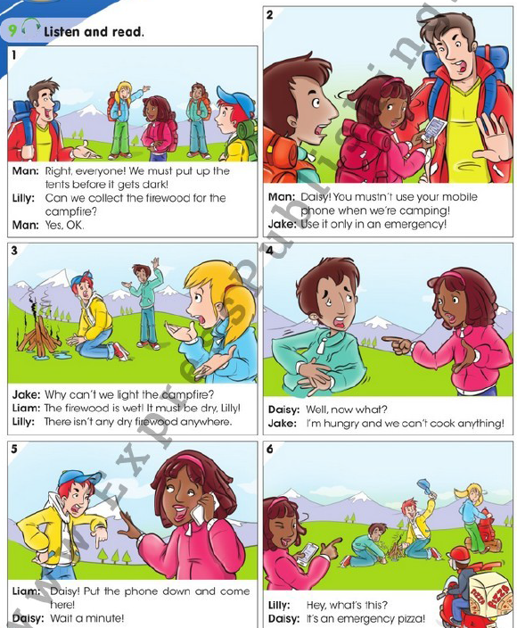
Ex.9,p.72 Listen and read.

Slide 4
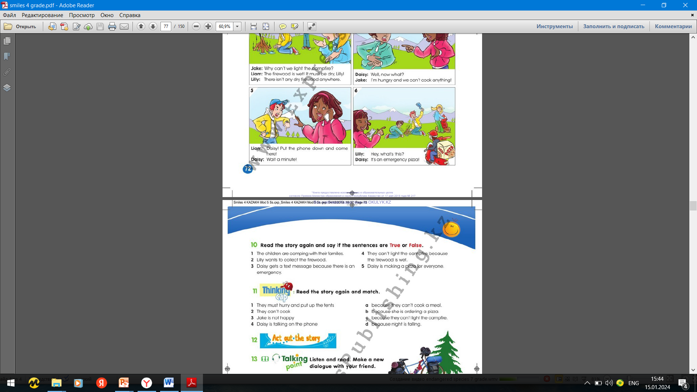
Ex.10,p.73 Read the story again and say if the sentences are True or False.
1)False
2)True
3)False
4)True
5)False

Slide 5
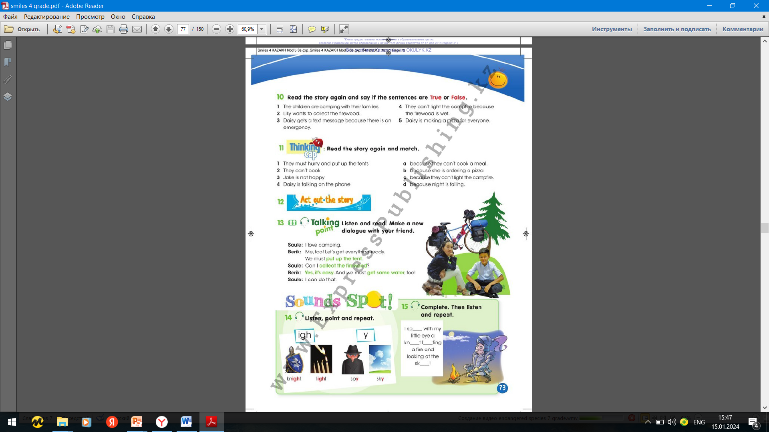
Ex.11,p.73 Read the story again and match.
1)d
2)c
3)a
4)b

Slide 6

Ex.13,p.73 Listen and read. Make a new dialogue with your friend.
Ann: I like climbing mountains.
Colin: Me, too! Let`s this tomorrow. We must make sure that we have all the necessary equipment.
Ann: Can I take a special bag with me?
Colin: Yes, it is possible. Please, make sure that we have enough water with us.
Ann: I will definitely do.

Slide 7

Ex.14,p.73 Listen, point and repeat.

Slide 8
Ex.15,p.73 Complete. Then listen and repeat.
I spy with my little eye a
knight lighting a fire and
looking at the sky.

Slide 9
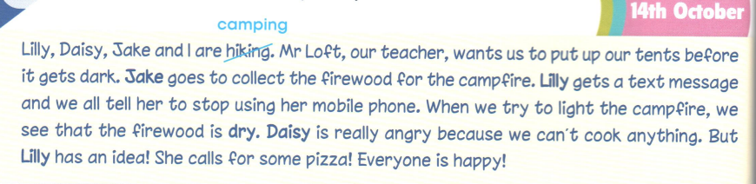
Ex.7,p.50 Activity book Read and correct Liam`s diary entry.
2)Lilly
3)Daisy
4)wet
5)Jake
6)Daisy

Slide 10
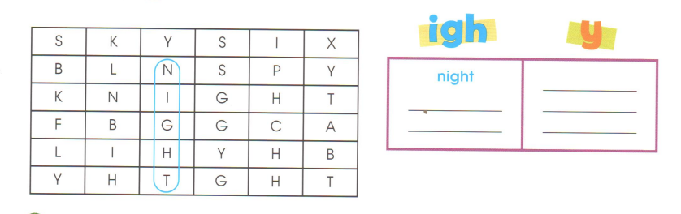
Ex.8,p.50 Activity book Find the words with the /ai/ sound and circle them. Then write them in the correct column.
light
knight
sky
fly
spy

Slide 11
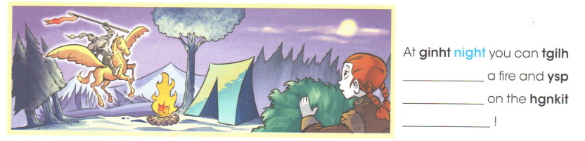
Ex.9,p.50 Activity book Unscramble the letters and complete the sentences. Listen and check.
light
spy
knight

Slide 12
