Slide 1


Subject: English language
Grade: 4
The theme of the lesson: Journey into
space

Slide 2
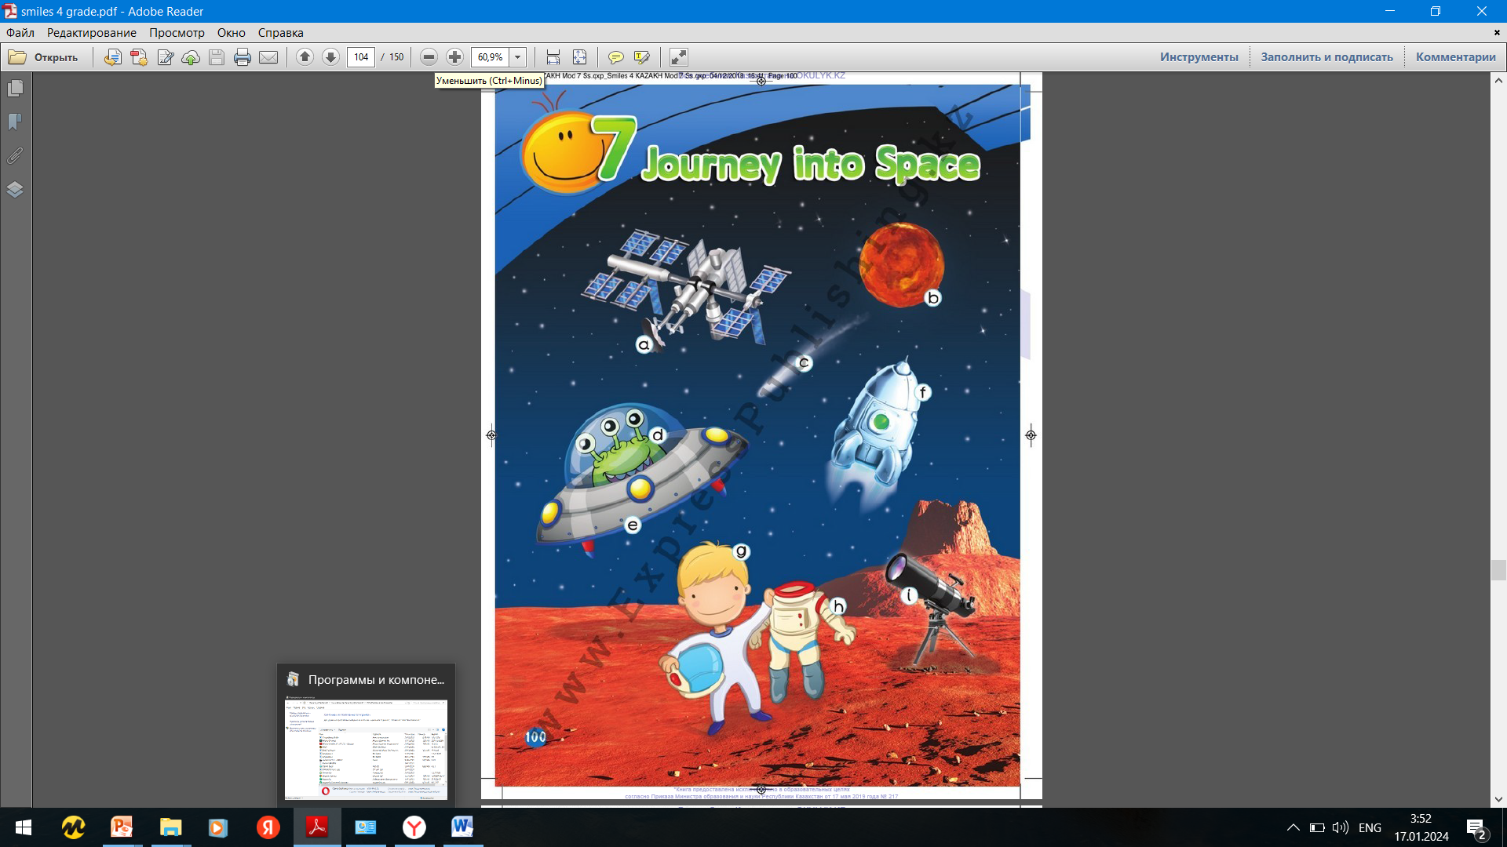
Module 7
Journey into space

Slide 3
New words
Journey – саяхат
Space – ғарыш
Space station – ғарыш бекеті
Telescope – телескоп
Spacesuit – ғарыштық костюм
Rocket – рокета
Alien – басқа ғаламшарлық
Planet – планета
Spaceship –ғарыш кемесі
Comet – қүйрықты жұлдыз

Slide 4
Ex.1,p.101
Look at the picture. Would you like to travel into space? Why/Why not? Do you know any planets bigger than Earth?
I would like to travel into space to visit other planets.
I know Jupiter, Saturn, Uranus and Neptune are bigger than Earth.

Slide 5
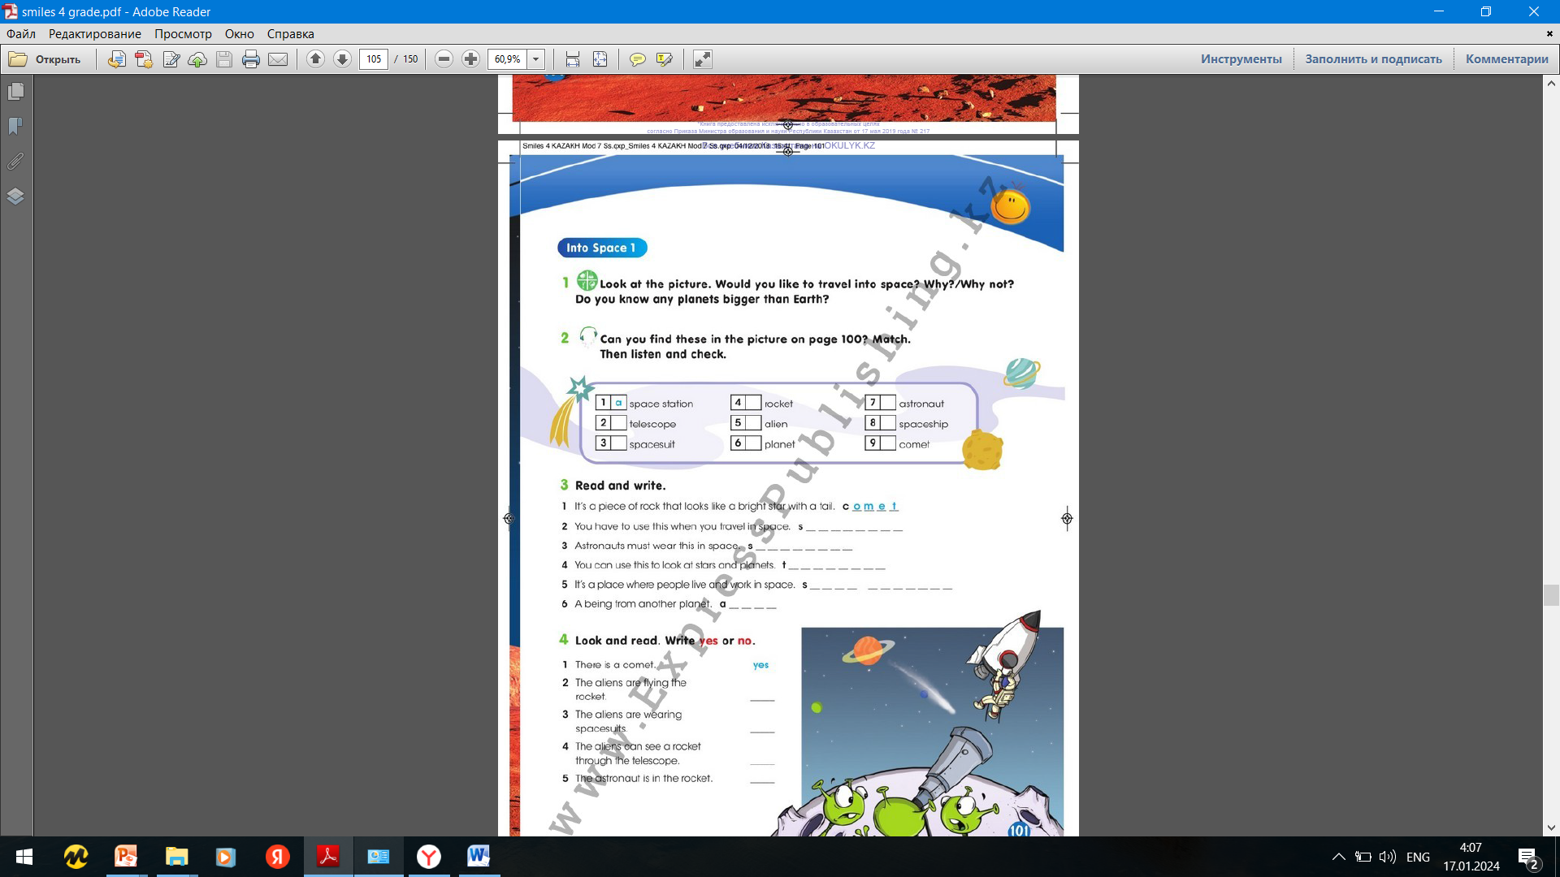
Ex.2,p.101
Can you find these in the picture on page 100? Match. Then listen and check.
2)I
3)H
4)F
5)D
6)B
7)G
8)E
9)C

Slide 6

Ex.3,p.101
Read and write.
2)Spaceship
3)Spacesuit
4)Telescope
5)Space station
6)Alien

Slide 7
Ex.4,p.101
Look and read. Write yes or no.
2)No
3)No
4)Yes
5)No

Slide 8
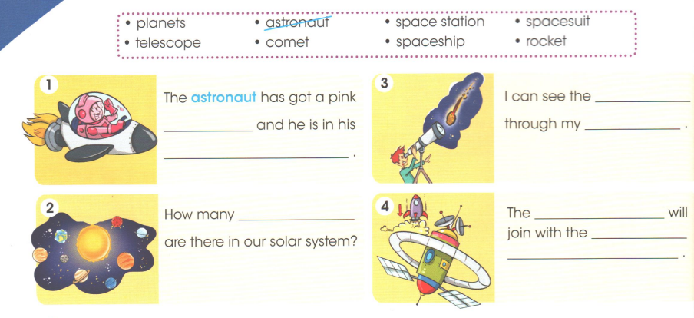
Ex.1,p.70 Activity book
Look, read and complete.
1)spacesuit, spaceship
2)Planets
3)come. Telescope
4)comet, space station

Slide 9
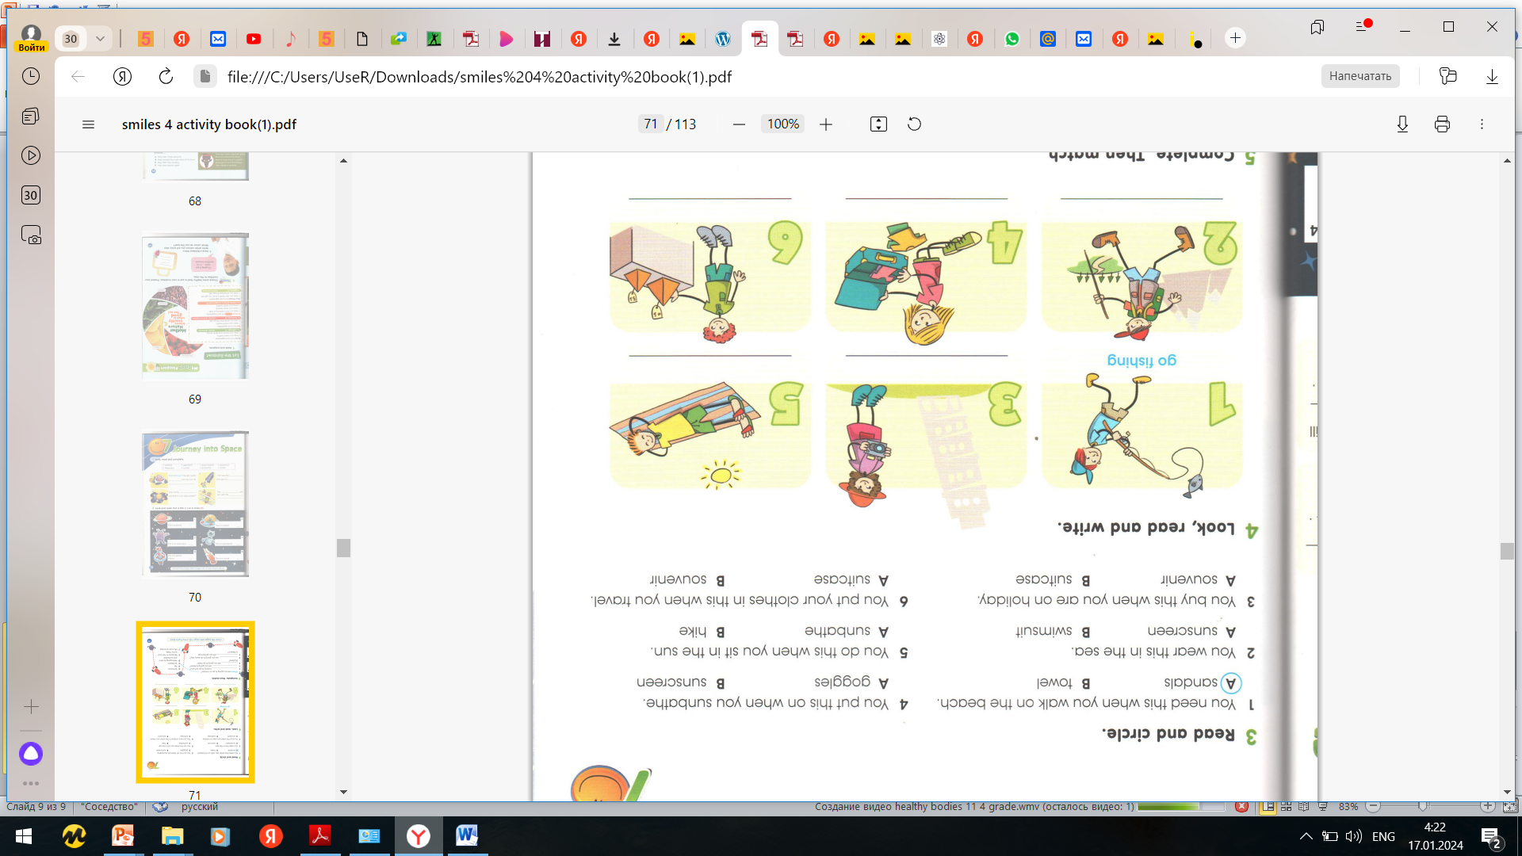
Ex.3,p.71 Activity book
Read and circle.

Slide 10
