Slide 1


Subject: English language
Grade: 4
The theme of the lesson: Help the planet
1

Slide 2
New words
Help – көмектесу
Planet – планета
Rainforest – тропикалық орман
Oxygen – оттегі
Pollution – ластану
Save – сақтау

Slide 3
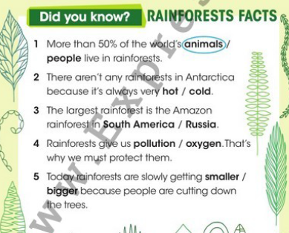
Ex.28,p.93
Read and circle. Then listen and check.

Slide 4
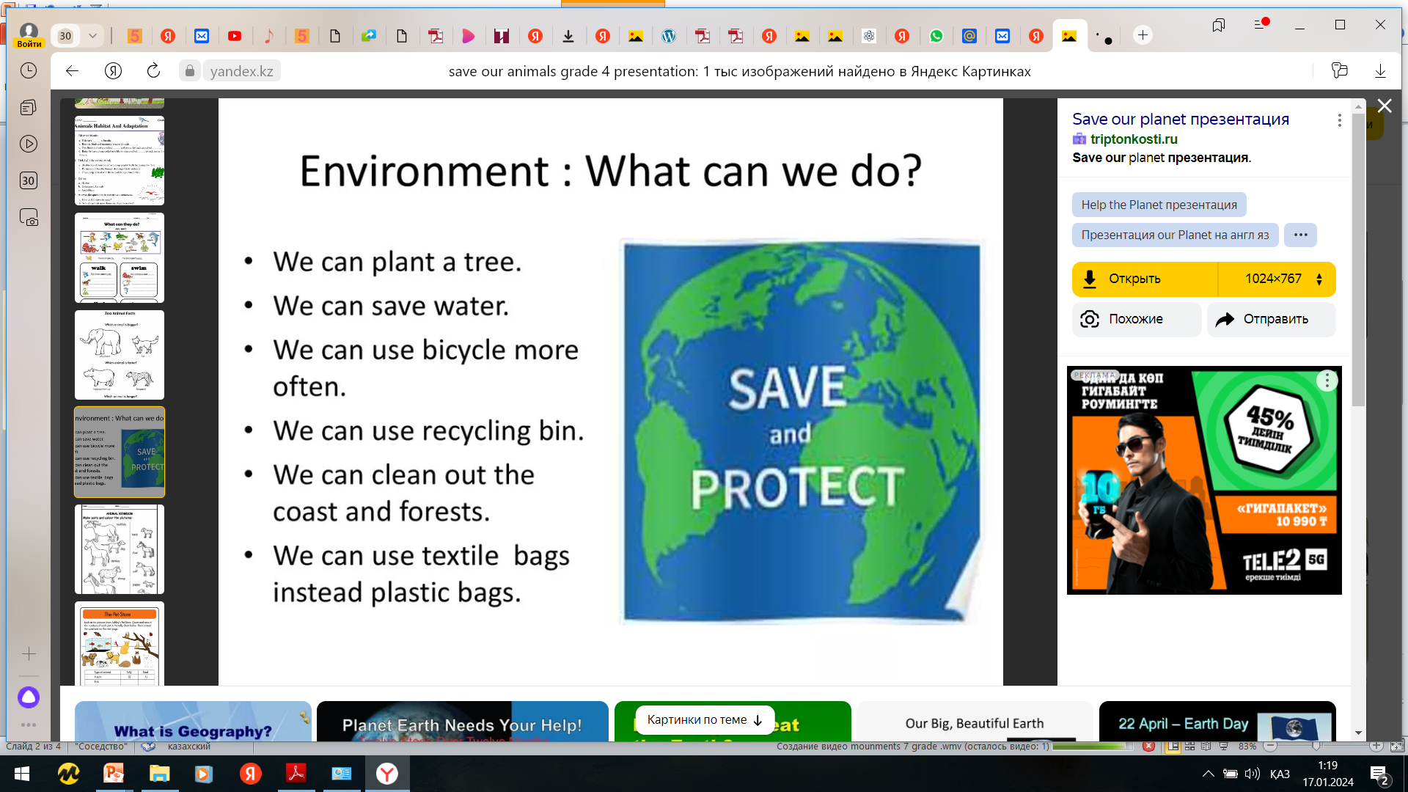

Slide 5
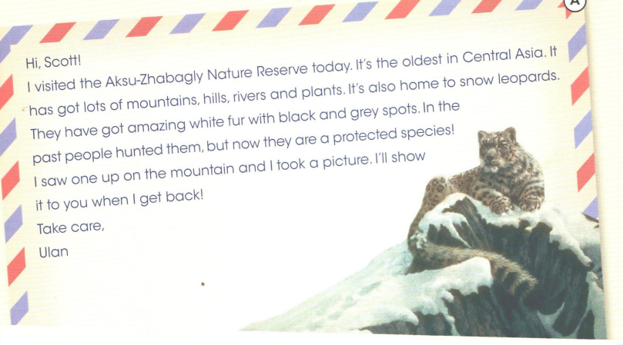
Ex.17,p.65 Activity book
Read and write A or B.

Slide 6
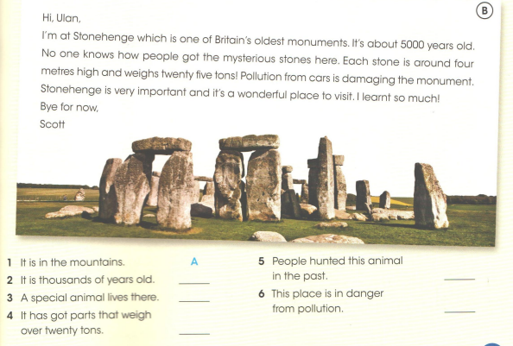
E.17,p.65 Activity book
Read and write A or B.
B
A
A
B
B

Slide 7
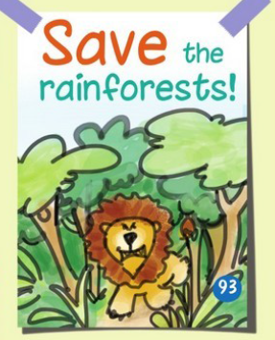
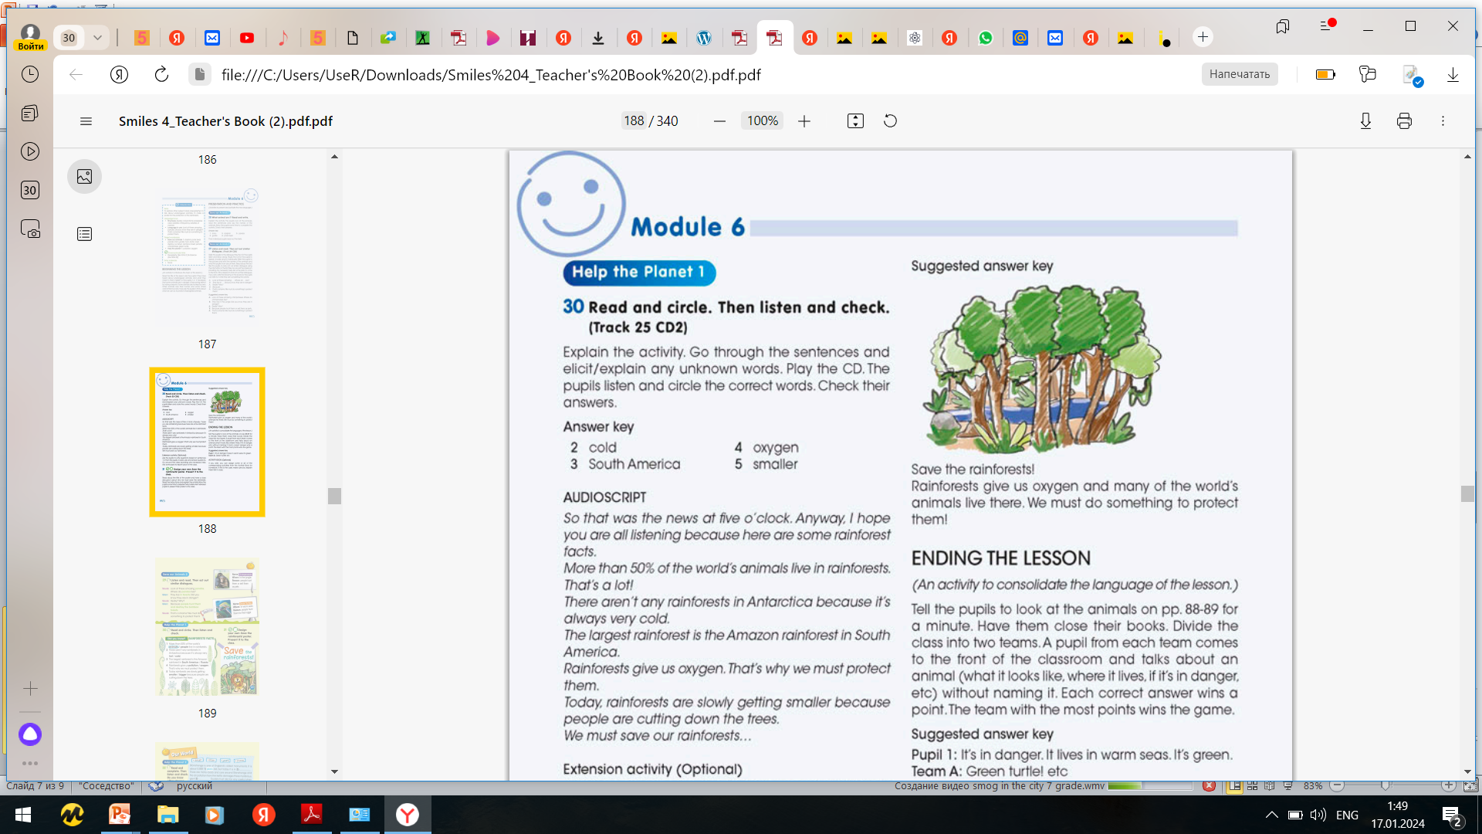
Ex.29,p.93
Design your own Save the rainforests poster. Present it to the class.

Slide 8

Let`s protect the nature.
Nature is our friend!

Slide 9
