Slide 1


Subject: English language
Grade: 4
The theme of the lesson: Healthy bodies
2

Slide 2
New words
Snack – тіскебасар
Unusual – өзгеше, ерекше
Sweet – тәтті
Tasty – дәмді
Peanut – жержаңғақ
Octopus – сегізаяқ
Jelly – желе
Thirsty – шөлдеу
Yummy – дәмді
Camel – түйе
Bowl – табақ
Lemon – лимон

Slide 3
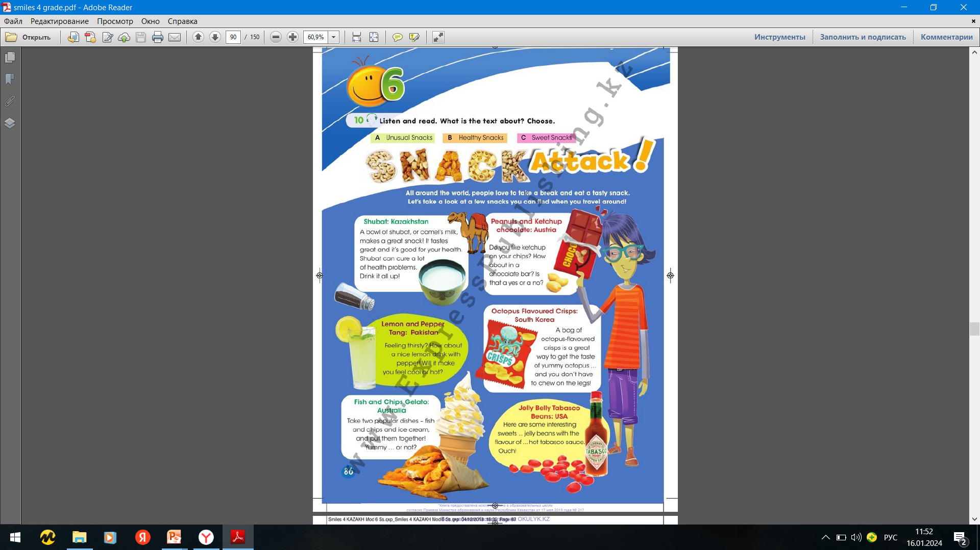
Ex.10,p.86
Listen and read. What is the text about? Choose.

Slide 4
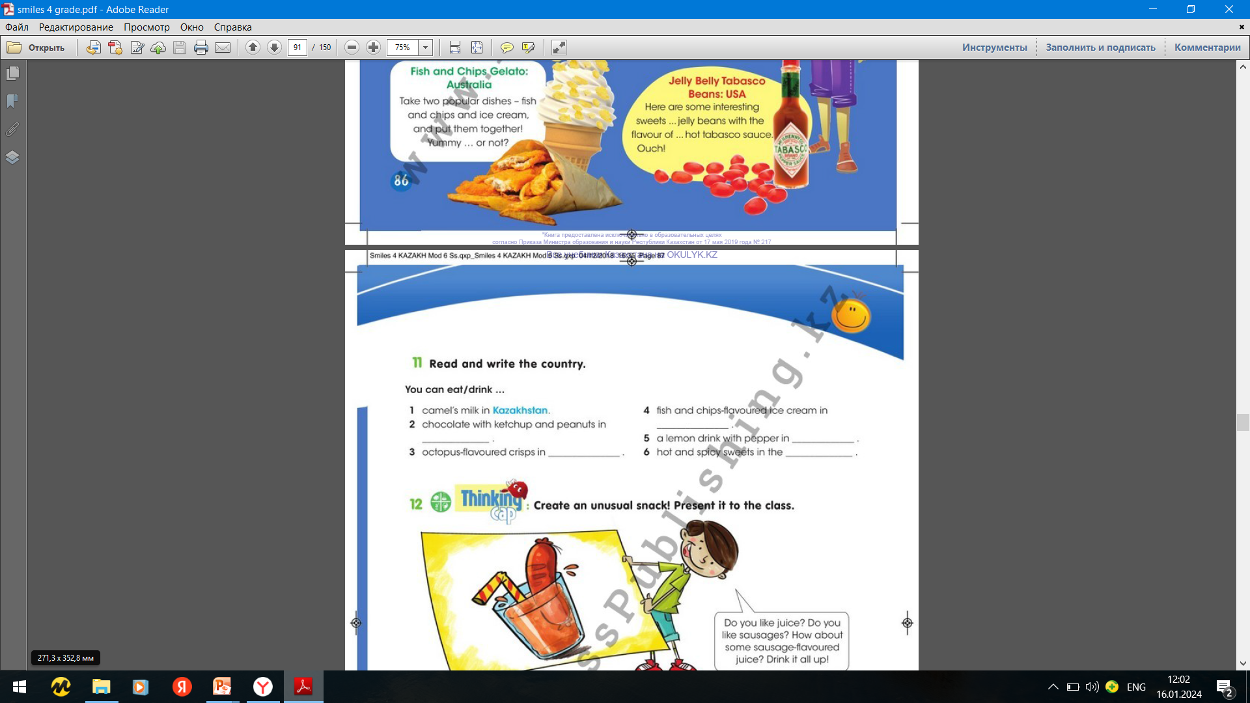
Ex.11,p.87
Read and write the country.
Australia
Austria
Pakistan
South Korea
USA

Slide 5
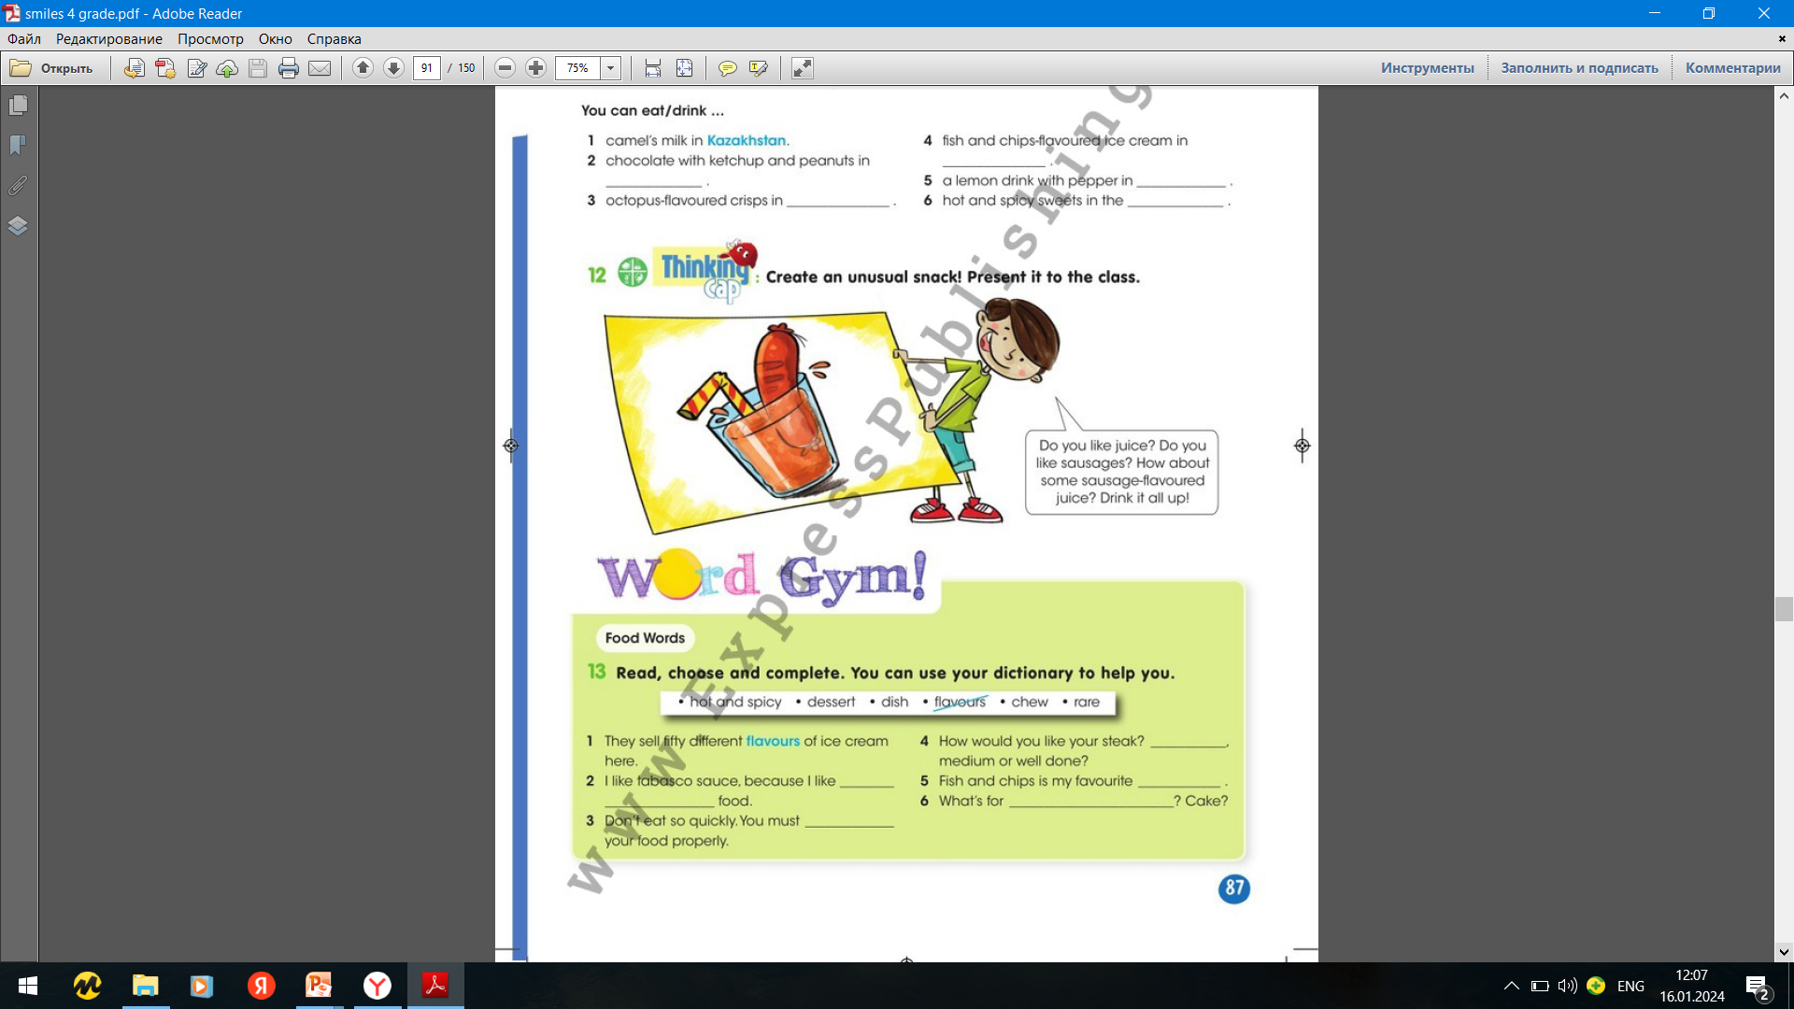
Ex.13,p.87
Read, choose and complete. You can use your dictionary to help you.
rare
dish
hot and spicy
dessert
chew

Slide 6
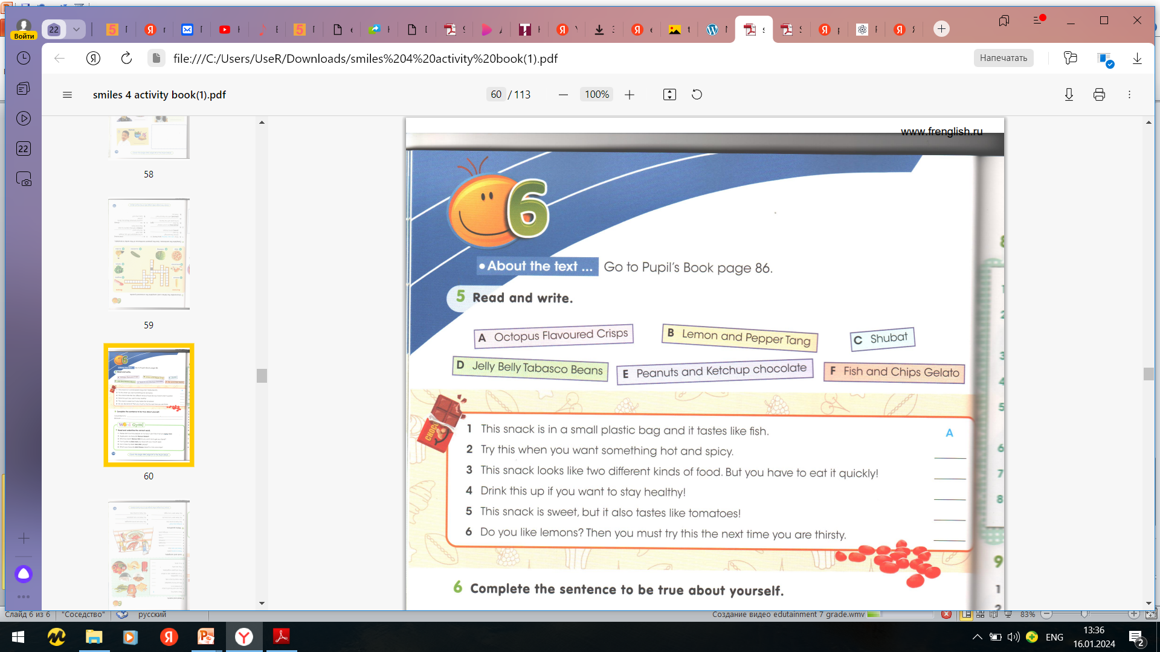
Ex.5,p.60 Activity book
Read and write.
D
F
C
E
B

Slide 7
Ex.6,p.60 Activity book
Complete the sentences to be true about yourself.
I would like to try hot chocolate because it is interesting.
I would like to try white chocolate because it is very tasty.

Slide 8
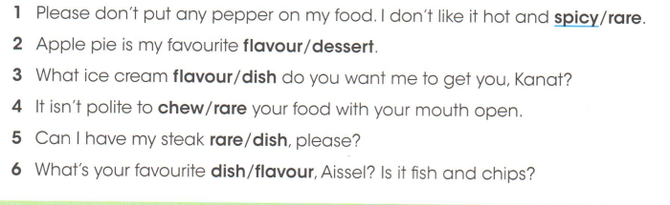
Ex.7,p.60 Activity book
Read and underline the correct word.

Slide 9
