Slide 1


Subject: English language
Grade: 4
The theme of the lesson: Healthy bodies
1

Slide 2
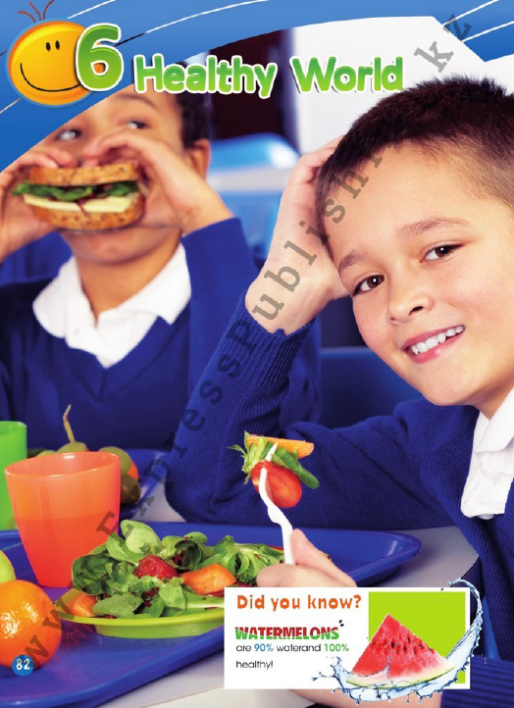
Module 6
Healthy World

Slide 3
New words
Healthy – сау
Healthy food – пайдалы тағам
Properly - дұрыс
Energy – қуат
Usually – әдетте
Eat – жеу
Fat – толық
Sad – қайғылы
Make – жасау

Slide 4
Ex.1,p.83
Look at the picture. Answer the questions.
1)Where are the children?
2)Can you name any of the food?
3)Is the food healthy?
4)What do you usually eat at school?
1)The children are at the school cafeteria.
2)Salad, sandwich, juice.
3)The food is healthy.
4)I usually eat fruit at school.

Slide 5
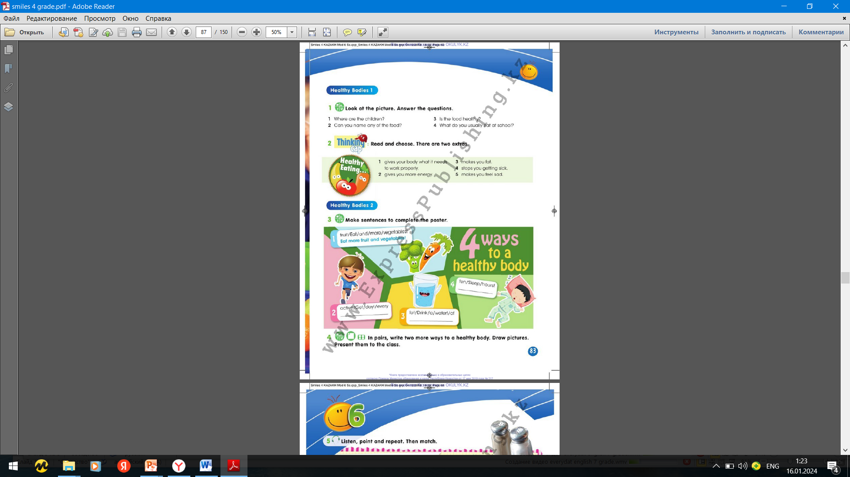
Ex.2,p.83
Read and choose. There are two extras.

Slide 6
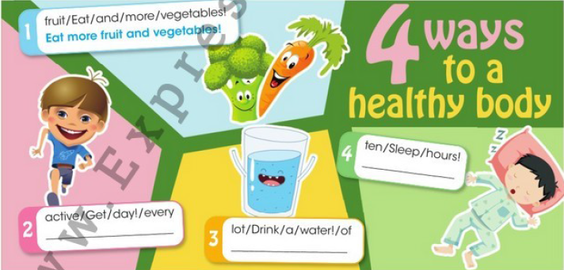
Ex.3,p.83
Make sentences to complete the poster.
Sleep ten hours.
Get active every day.
Drink a lot of water.

Slide 7
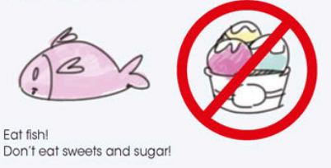
Ex.4,p.83
In pairs, write two more ways of to a healthy body. Draw pictures. Present them to the class.

Slide 8
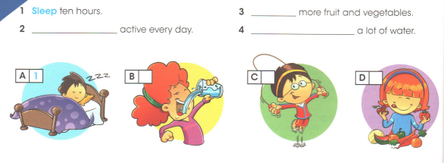
Ex.1,p.58 Activity book
Complete with get, eat, drink or sleep. Then match.
eat
get
drink
4
2
3

Slide 9
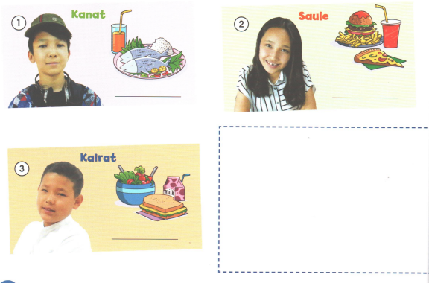
Ex,2,p.58 Activity book
Look and write healthy or unhealthy.
healthy
unhealthy
healthy

Slide 10
