Slide 1


Subject: English language
Grade: 4
The theme of the lesson: Hot and cold

Slide 2
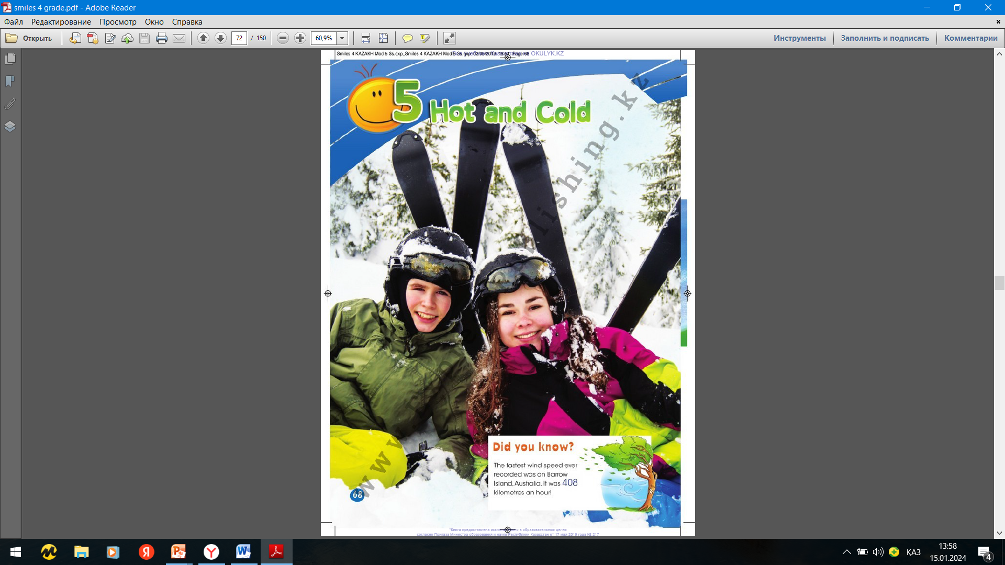
Module 5 Hot and cold

Slide 3
New words
Hot – ыстық
Cold – суық
Snow – қар
Cloud – бұлт
Season – жыл мезгілі
Weather – ауа-райы
Sunny – күнді
Foggy – тұманды
Windy – желді
Rain – жаңбыр

Slide 4
Ex.1,p.68
Look at the picture. Answer the questions.
1)What season is it? 3)What clothes are they wearing?
2)What`s the weather like? 4)What holidays are there in this season?
1)It is a winter.
2)The weather is cold.
3)They are wearing jackets, helmets and gloves.
4)New year.

Slide 5
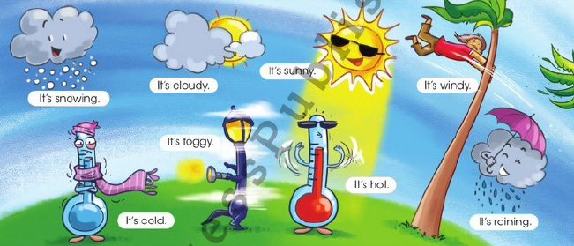
Ex.2,p.69
Listen, point and repeat.

Slide 6
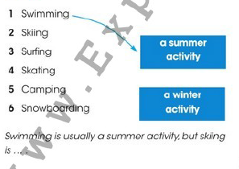
Ex.3,p.69
Read and match. Then say.
Skiing is a winter activity.
Surfing is a summer activity.
Skating is a summer activity.
Camping is a summer activity.
Snowboarding is a winter activity.

Slide 7
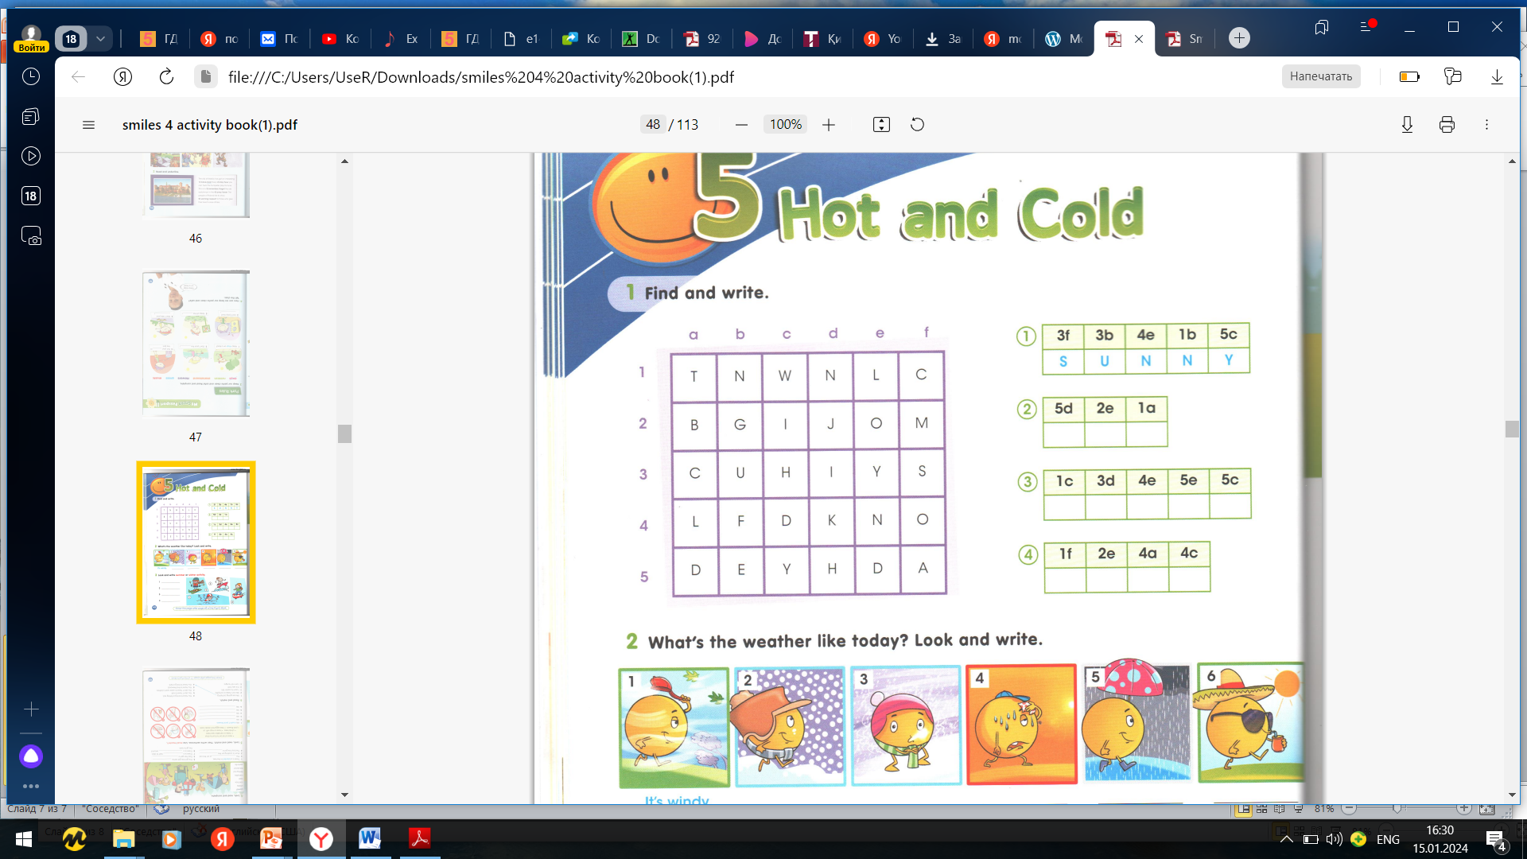
Ex.1,p.48 Activity book
Find and write
h
o
t
w
i
n
d
y
c
o
l
d

Slide 8
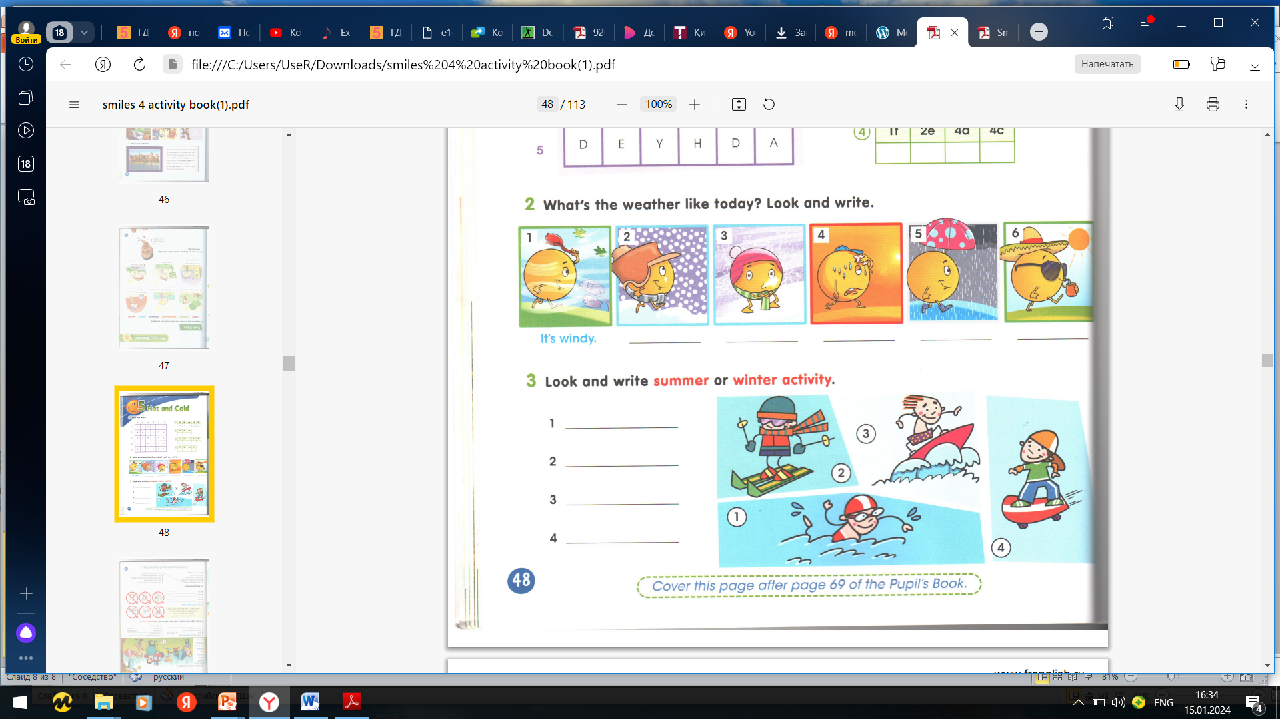
Ex.2,p.48 Activity book
What`s the weather like today? Look and write.
2)Snowing
3)Cold
4)Hot
5)Raining
6)Sunny

Slide 9

Ex.3,p.48 Activity book
Look and write summer or winter activity.
summer
winter
summer
summer

Slide 10
