Slide 1
Unit 7. Natural environment
Lesson 3. Can and cannot

Slide 2
On this lesson you will:
learn how to use the modal verb “can”
practice the modal verb “can”

Slide 3
Greeting song https://www.youtube.com/watch?v=gVIFEVLzP4o
Hello! Hi!
Good morning!
Good afternoon!
Good evening!
Good night!
How are you?
I am fine, thank you.
What is your name?
My name is Marat.
Nice to meet you!
Nice to meet you, too!

Slide 4

Модальды етістік
can

Slide 5
+ I can swim
I cannot=can’t swim
? Can you swim?
+Yes, I can
-No, I can’t

Slide 6
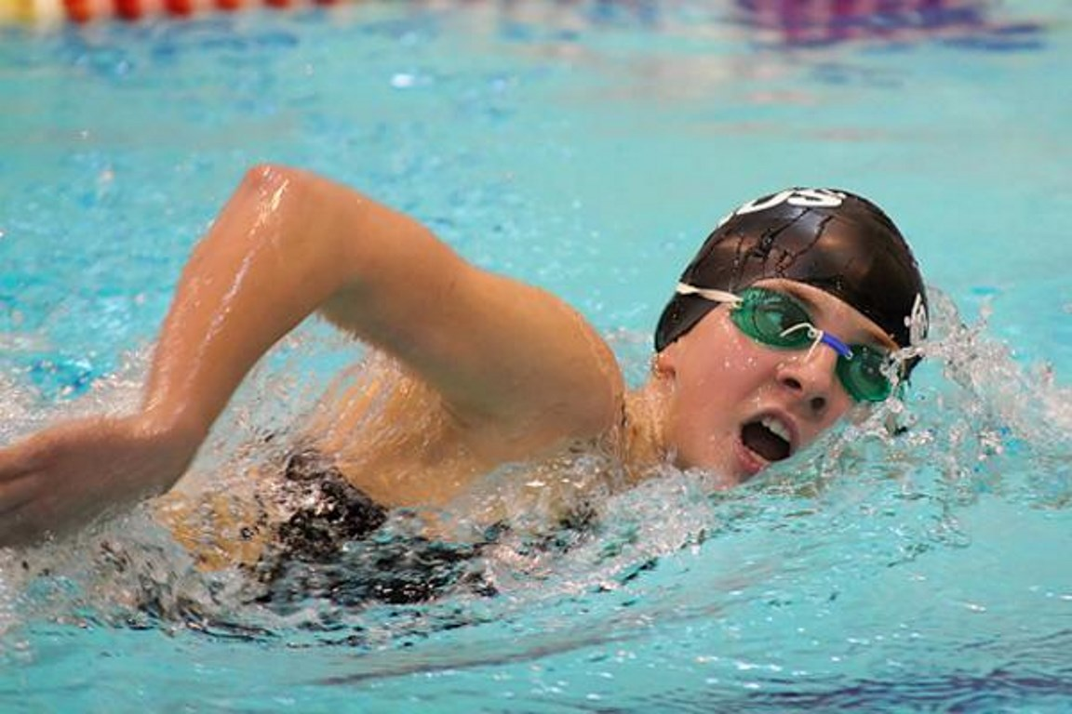


Slide 7
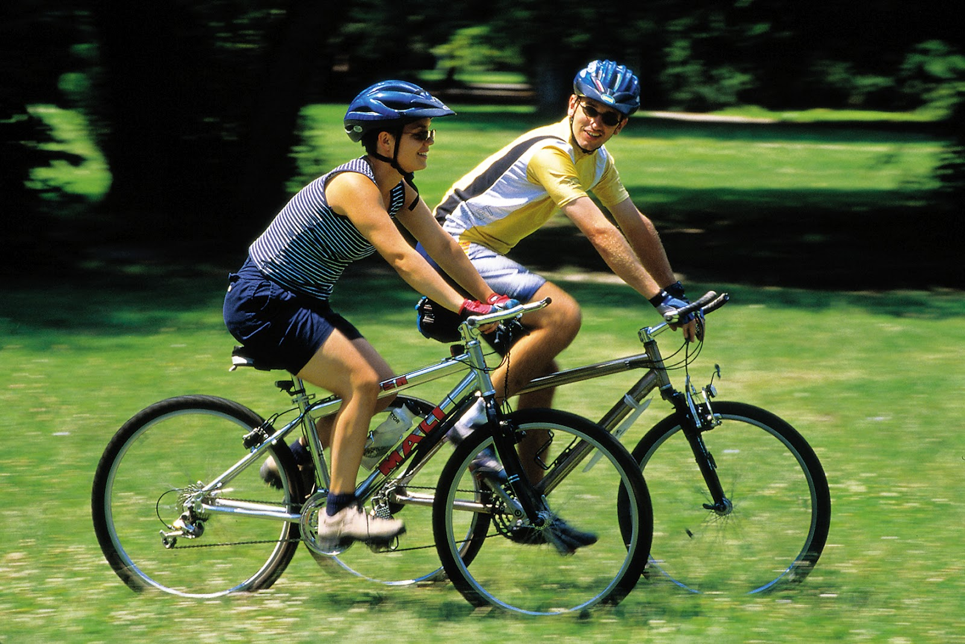


Slide 8
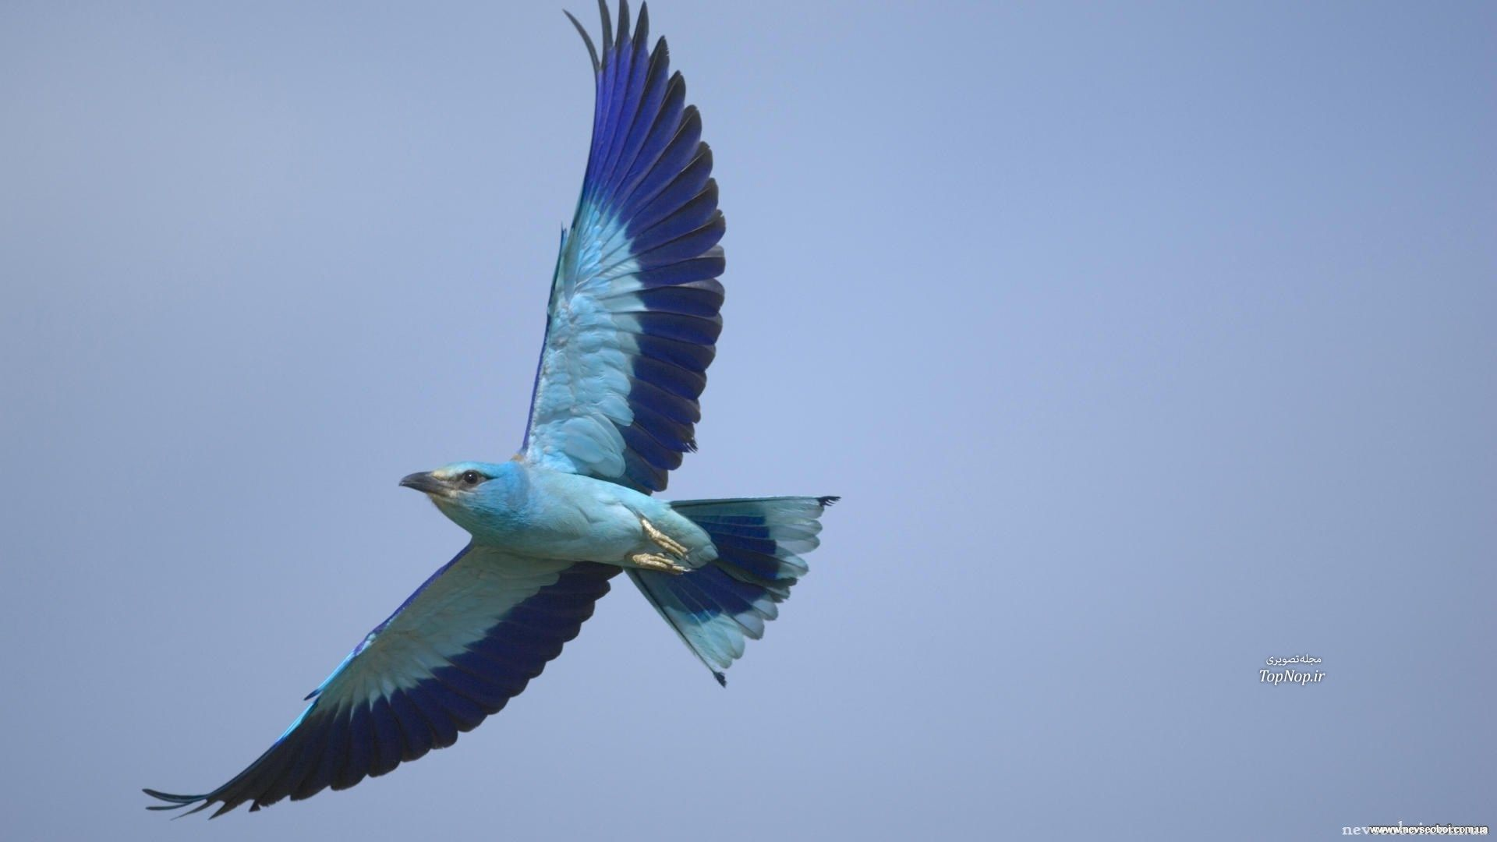


Slide 9
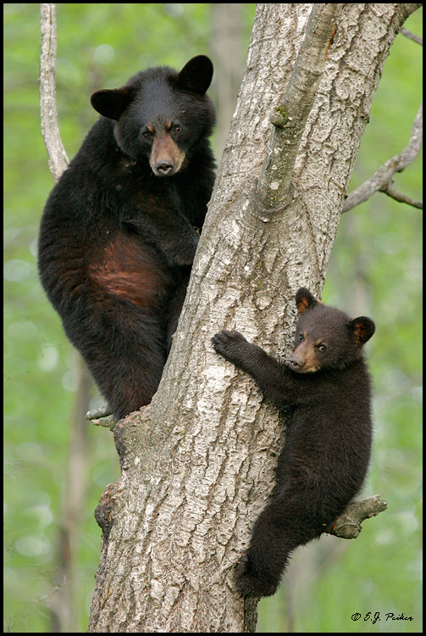


Slide 10
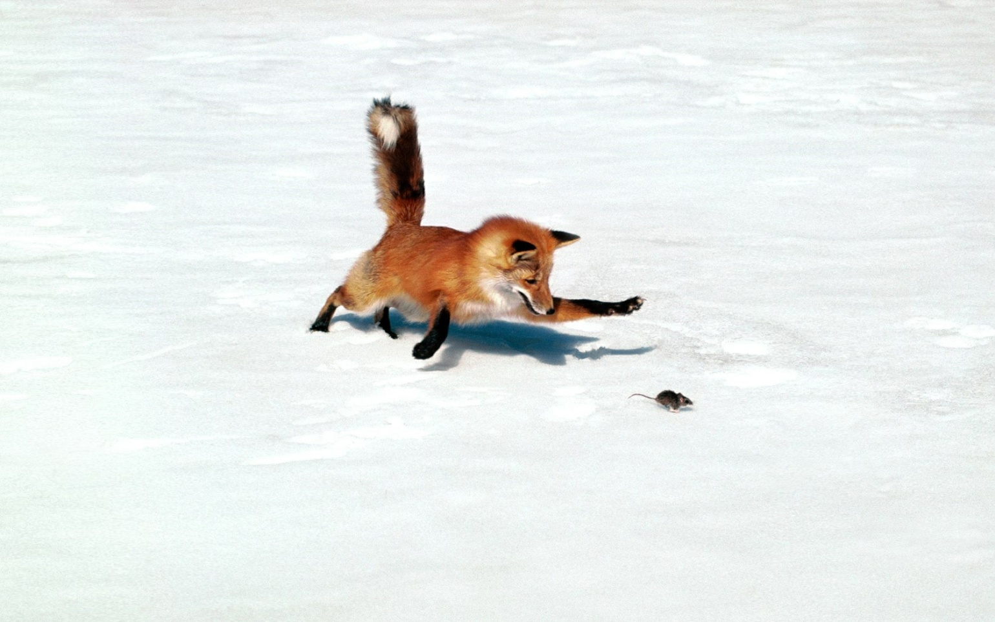


Slide 11
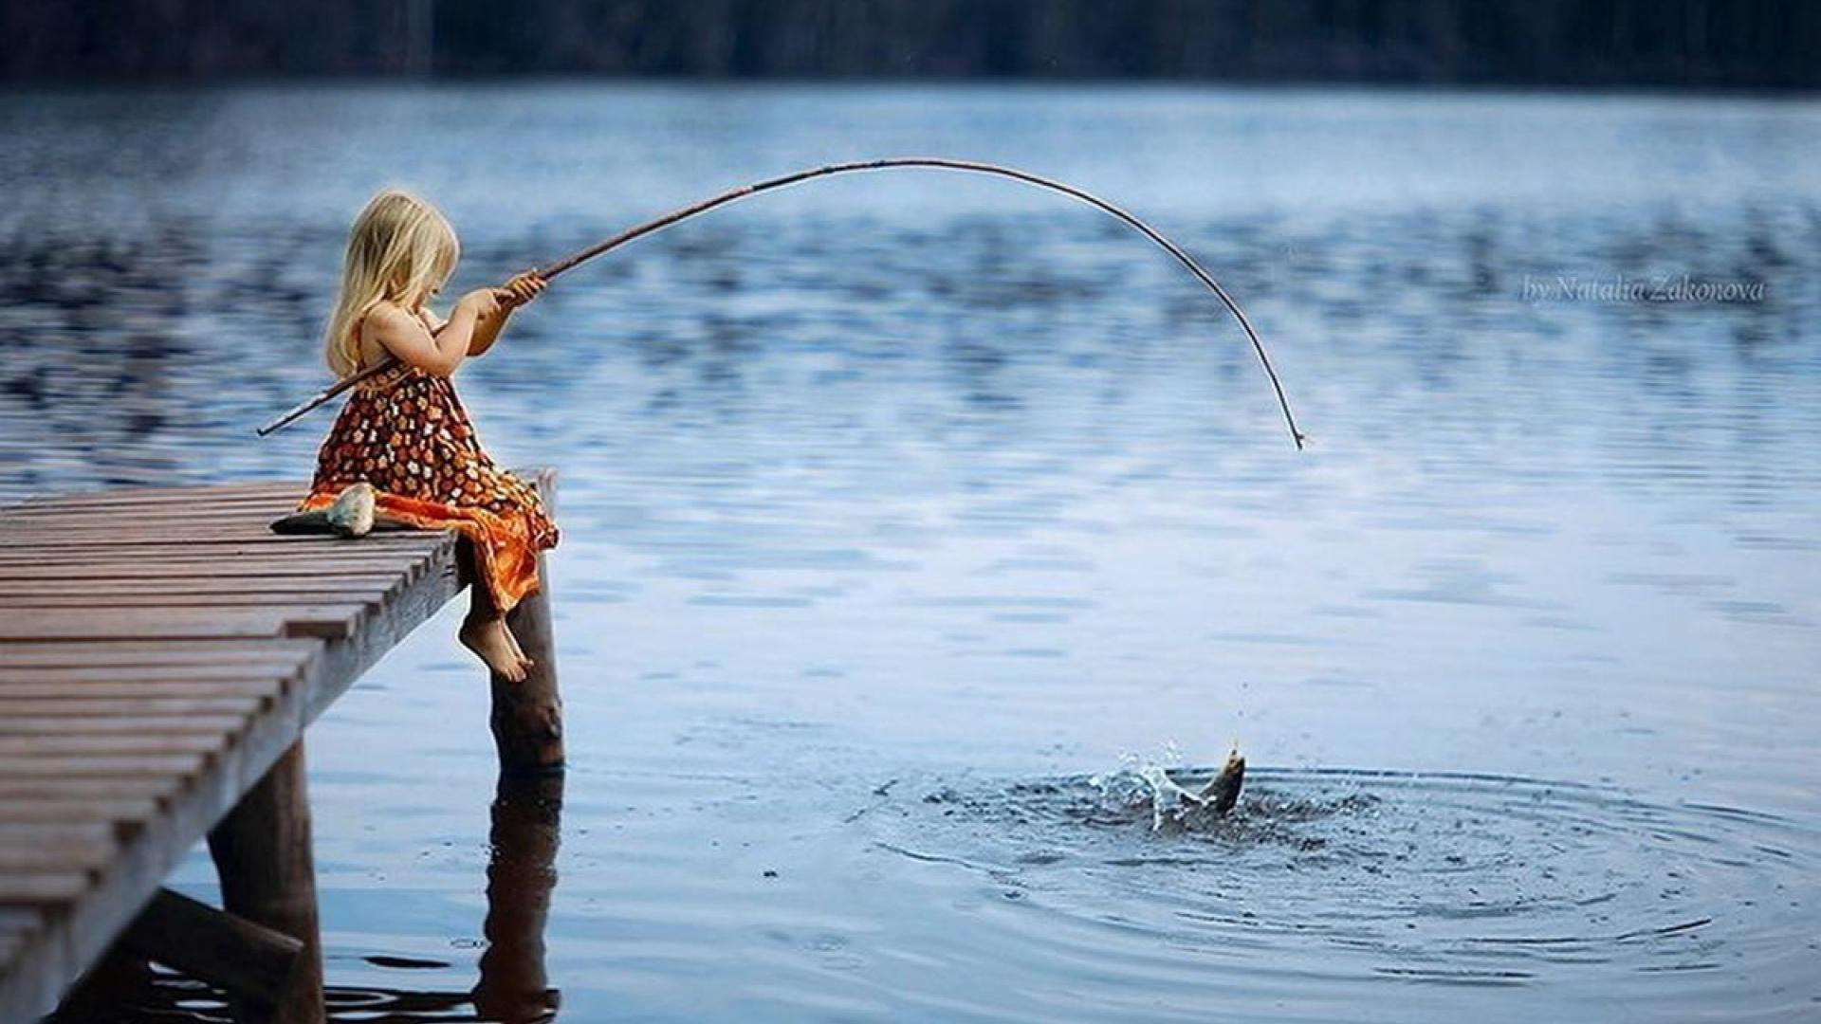


Slide 12
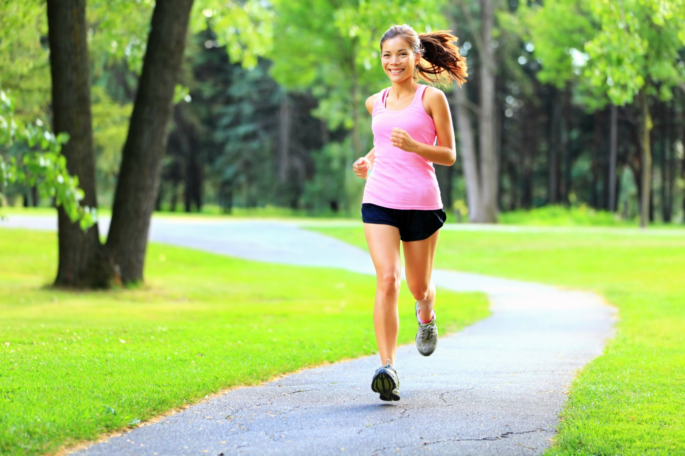


Slide 13
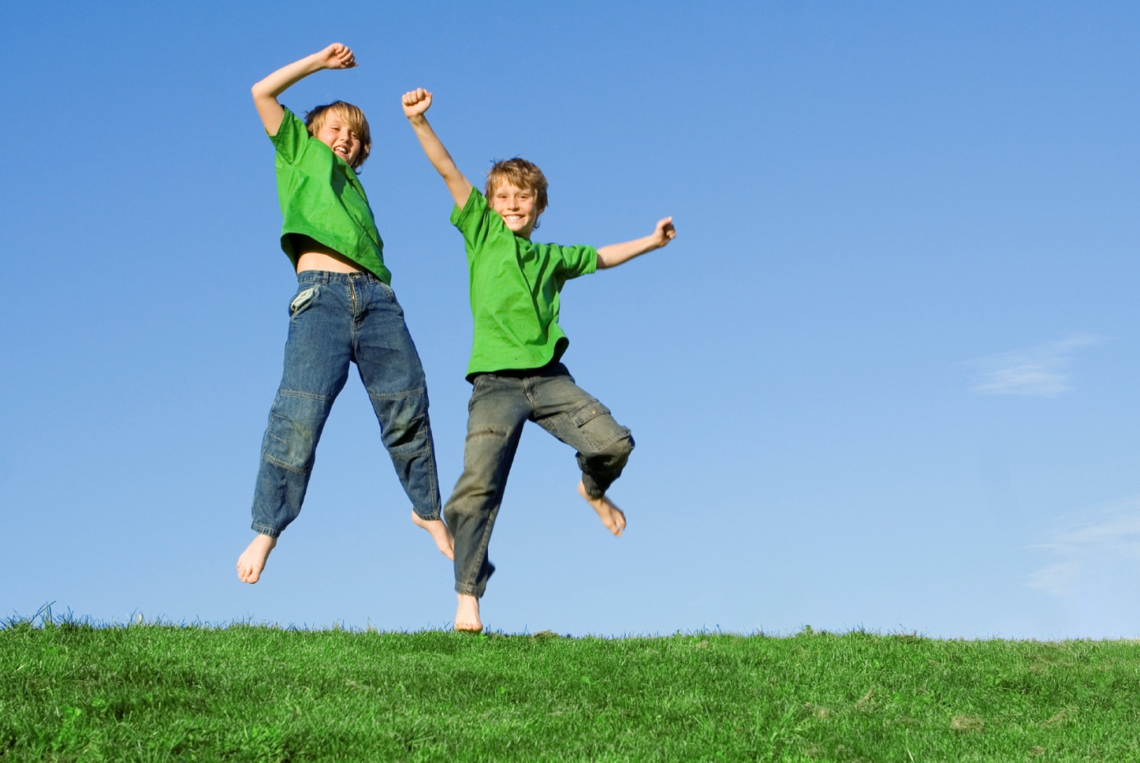


Slide 14

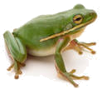
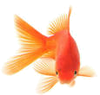


Read, match and say
jump
run
climb
swim
sing

Slide 15
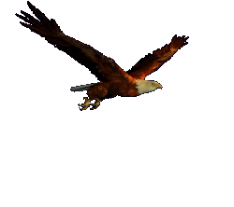
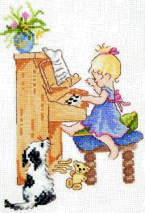
CAN етістігі «істей алу» деп аударылады және бір нәрсе жасай алудың физикалық іс әрекетті білдіреді.
Birds can fly. Құстар ұша алады.
Ann can play the piano.
Аня пианино ойнай алады

Slide 16
Choose the correct answer

Slide 17
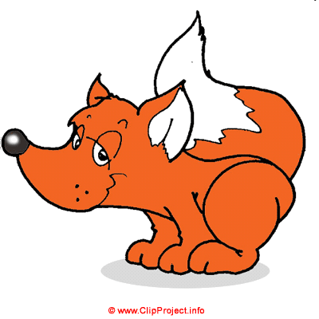
can
can, t
Foxes can run.

Slide 18
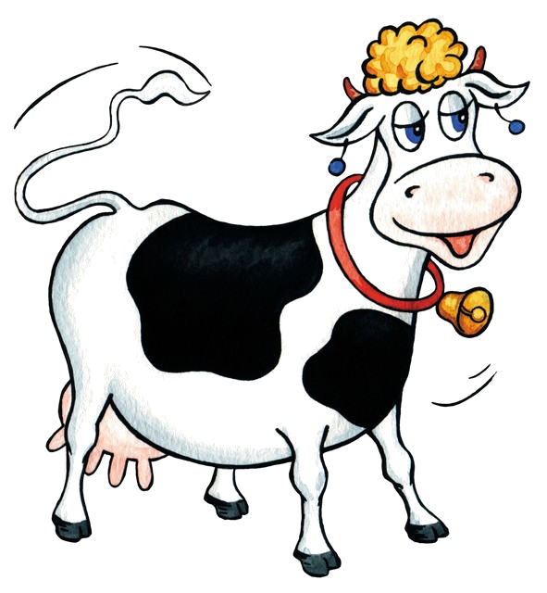
can
can, t
Cows can, t ride a bike.

Slide 19
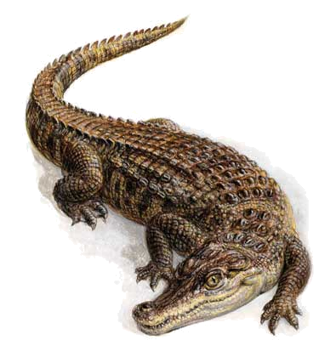
can
can, t
Crocodiles can swim.

Slide 20
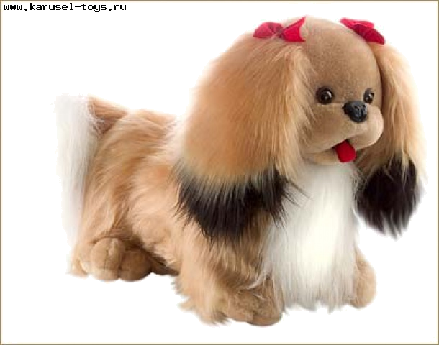
can
can, t
Dogs can, t fly.

Slide 21
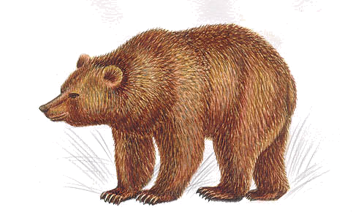
can
can, t
Bears can, t sing.

Slide 22
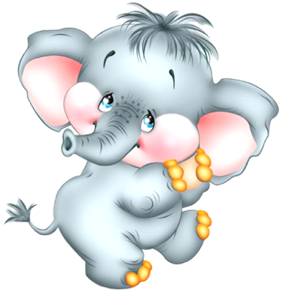
can
can, t
Elephants can, t jump.

Slide 23
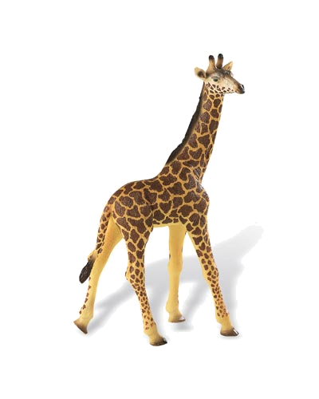
can
can, t
Giraffes can, t dance.

Slide 24
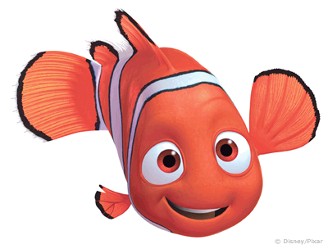
can
can, t
Fish can, t walk.

Slide 25

can
can, t
Frogs can jump.

Slide 26
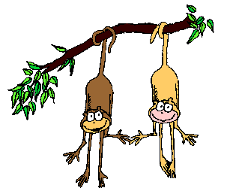
can
can, t
Monkeys can climb.

Slide 27
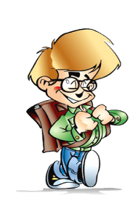
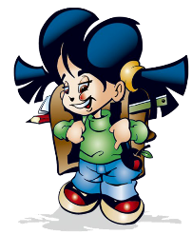



Кестеге мұқият қарап, Билл және Мэри не істей алатынын жаз. CAN және CAN,T мәтінге толықтыр .
 | Bill | Mary
sing | − | +
dance | − | +
play football | + | −
swim | + | +
ride a bicycle | + | +
draw | − | −
Hi! My name is Bill. I have a sister. Her name is Mary. She is nice girl but can, t play football. I can play football but I can, t sing or dance. My sister can sing or dance very well. Mary and I can swim and ride a bicycle. But we can, t draw.
Правило.

Slide 28

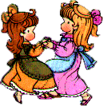


Болымды және болымсыз сөйлемдерде де CAN\CAN’T етістіктері өзгермейді
I can dance.
He can dance.
They can dance.
I can, t sing.
He can, t sing.
They can, t sing.

Slide 29
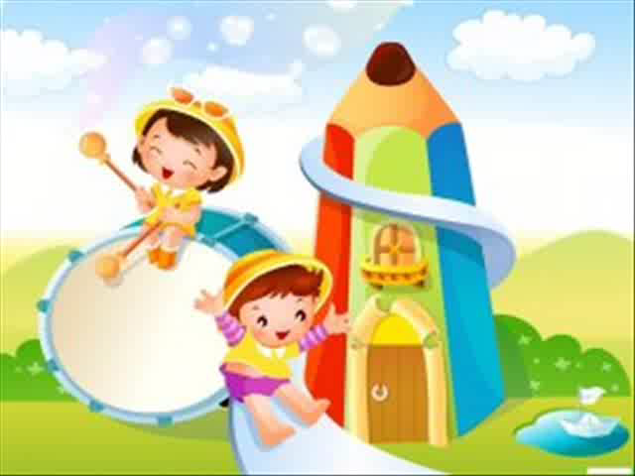
Physical activity

Slide 30
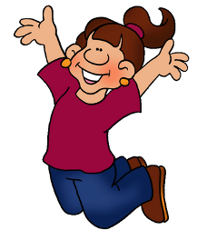
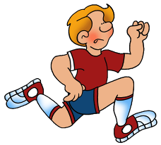
I can jump, I can run,
I can sing, I can dance,
I can swim, I can’t fly,
I can climb and say “good – bye”!

Slide 31
Make right word order
1.can, watch TV, I.
I can watch TV.
2.he, draw, can, a horse.
He can draw a horse.
3. they, fly, can?
Can they fly?
4. can’t, read, she, a book.
She can’t read a book.

Slide 32
Find a word
E.g. dulkhxfjumpghj
afghcaniuhgf
njolflyxgljehm
iujbdsingleghjf
climbhjhdapev
whlodrunxgkwl
cfsfhghfrpjump
kjgswimbhjlsyk
dancehjklbhjdrh

Slide 33

Check your answers
afghcaniuhgf
njolflyxgljehm
iujbdsingleghjf
climbhjhdapev
whlodrunxgkwl
cfsfhghfrpjump
kjgswimbhjlsyk
dancehjklbhjdrh

Slide 34
Good bye song
https://www.youtube.com/watch?v=Xcws7UWWDEs

