Slide 1

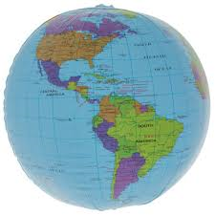
Brainstorming
Look at the picture. What can you see?
What we are going to do?

Slide 2
The theme of the lesson: All together now

Slide 3
Today we will:
- learn some new words;
- talk about travelling around the world;
- do exercises.

Slide 4
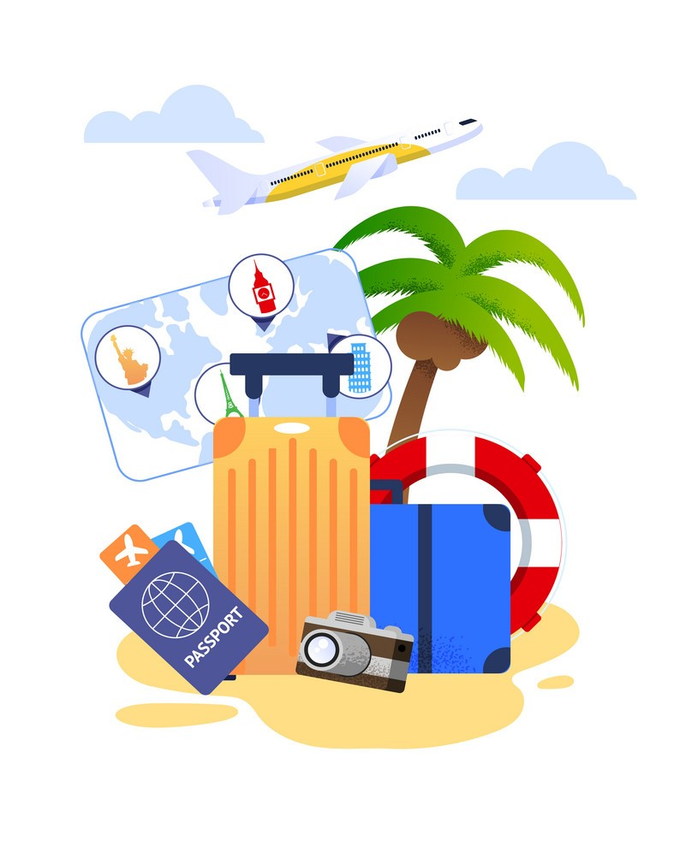
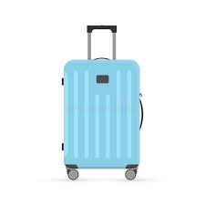
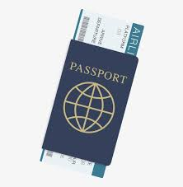
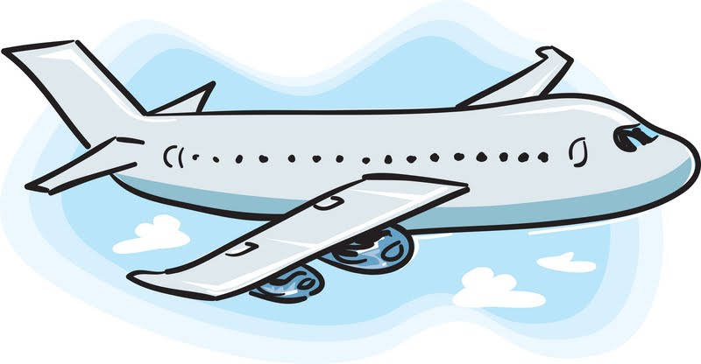

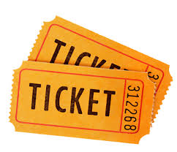
New words
travel
plane
passport
luggage
sunglasses
ticket

Slide 5
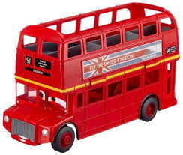
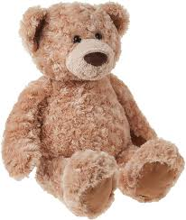


Look at the pictures and describe them.
Where are they from?
double-decker bus
teddy bear
the UK

Slide 6
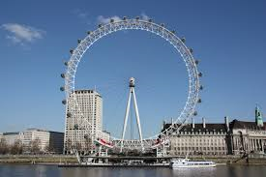
Let’s read the text about the UK
The capital of the UK is London.
The national language of the UK is English.
This is the London Eye. It’s a circle.

Slide 7


Task 1. Look and read. Then choose the correct option.
1.Which country’s flag is it?
It’s a flag of …
the USA
the UK
Italy

Slide 8
Look and read. Then choose the correct option.
2.What is the capital of the UK?
The capital of the UK is …
Nur - Sultan
Paris
London

Slide 9
Look and read. Then choose the correct option.
3.What is this?
This is the …
Bayterek Tower
London Eye
Big Ben

Slide 10
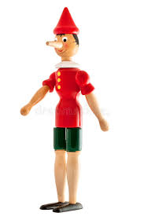

Look at the picture and describe it.
Where is it from?
Pinocchio
Italy

Slide 11
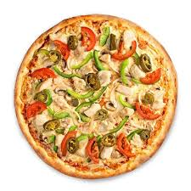
Let’s read the text about Italy
The capital of Italy is Rome.
The national language of Italy is Italian.
Pizza is the national dish of Italy.

Slide 12
Task 2. Look, read and complete.
pizza Rome Italian
Rome
The capital of Italy is _______.
The national dish of Italy is _______.
The national language of Italy is _______.
pizza
Italian

Slide 13
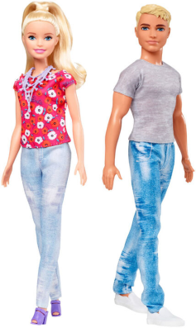

Look at the picture and describe it.
Where are they from?
Barbie and Ken dolls
the USA

Slide 14
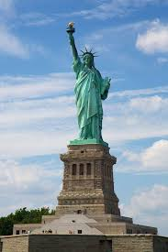
Let’s read the text about the USA
The capital of the USA is Washington D.C.
The national language of the USA is English.
This is the Statue of Liberty. It’s very big.

Slide 15
Task 3. Look, read and match.
a
flag
1
dolls
b
2
c
statue
3

Slide 16

Let’s play the game!
For example:
P
L
A
N
E

Slide 17
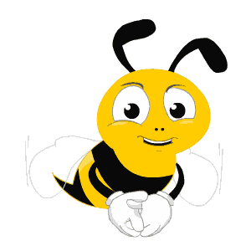
TRAVEL

Slide 18
LUGGAGE

Slide 19
TICKET

Slide 20
Well done, dear students! Travelling around the world helped us to learn other countries’ cultures and traditions.

Slide 21




Slide 22
THANK YOU FOR
YOUR ATTENTION!

