Slide 1

Smiles – 2
Module 6.
Traditions and Customs
Lesson 8. Home cooking 2.

Slide 2
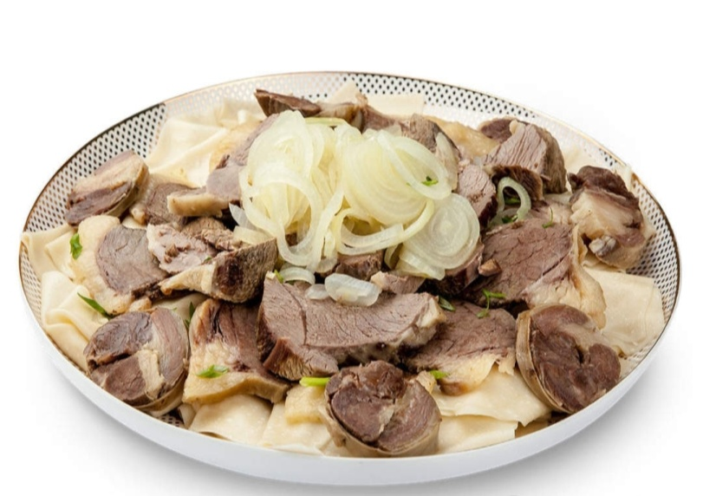
Brainstorming
Look at the picture. What can you see?
What is it?

Slide 3
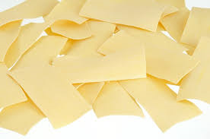
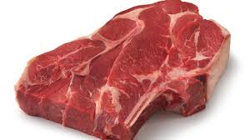

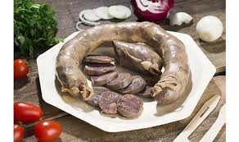
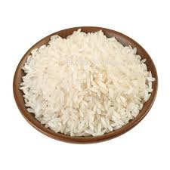
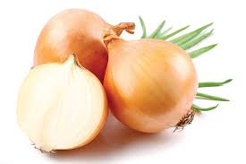
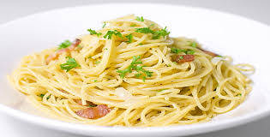
What do we need to cook beshbarmak?
noodles
meat
kazy
rice
onions
spaghetti

Slide 4
The theme of the lesson:
Home cooking 2

Slide 5
Today we will:
- learn new words;
- do some exercises;
- learn how to use grammar construction /like +verb+ing/.

Slide 6
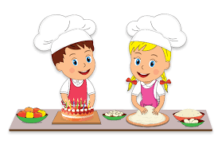
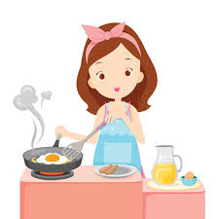
NEW WORDS
noodles
kazy
meat
onion
to make
to cook

Slide 7
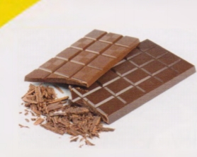
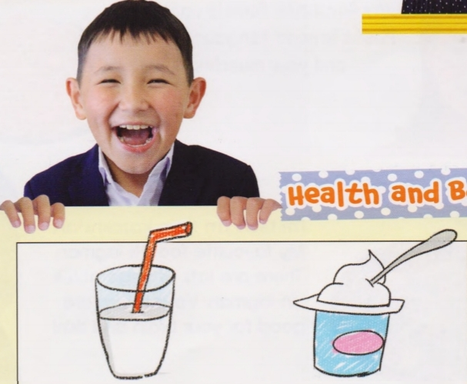
like + verb + ing
We can use “like” to say how we feel about an activity.
For example:
I like eating chocolate.
He likes drinking milk and yogurt. .

Slide 8

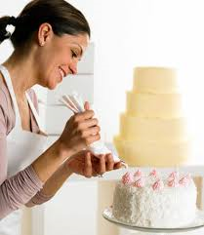
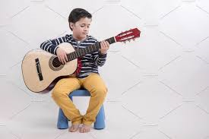

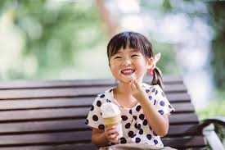


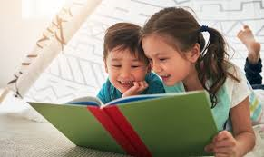
Look , read and match. What do they like doing?
He likes playing the guitar.
B) She likes making a cake.
C) They like reading a book.
D)I like eating an ice-cream.

Slide 9
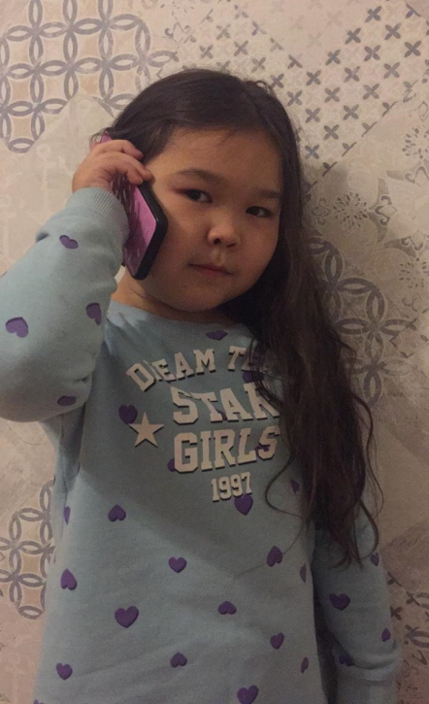
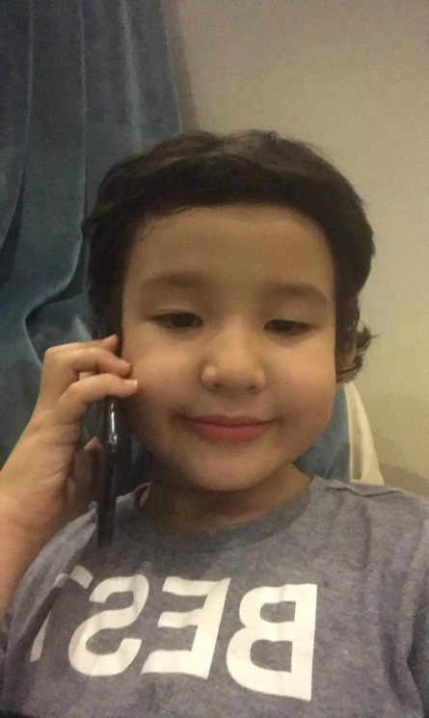

Listen to the conversation between Damina and Magzhan.
Damina : Hello, Magzhan! How are you?
Magzhan: Hello, Damina! I’m good. And you ?
Damina : I’m fine, thanks. I’m having a birthday party today. Can you come to my party?
Magzhan: Oh, that's wonderful. I'd love to be there. Where are you celebrating it?
Damina :At my home, of course. My mummy is cooking beshbarmak and a lot of tasty dishes. And my sister is making a chocolate cake. Because I like eating chocolate cake very much!
Do you like eating chocolate cake?
Magzhan: Yes, I do. But especially I like eating fruit cake.
What time is the party?
Damina :At 6 o’clock in the evening. Bring your parents also.
Magzhan: I will. Thank you for the invitation.
Damina :Bye Magzhan. See you on my birthday!
Magzhan: Bye.

Slide 10
Read the sentences.
Are the sentences True (T) or False (F)?
Damina is having a birthday party._____
Damina invited Magzhan to her birthday. _____
She is celebrating her birthday in a café. ______
Her mummy is cooking meat with rice.______
Magzhan likes eating fruit cake. ______
True
True
False
False
True

Slide 11
What food does your mother/sister cook at home?
For example:
My mother cooks beshbarmak at home .
For example:
My sister can make a cake.

Slide 12
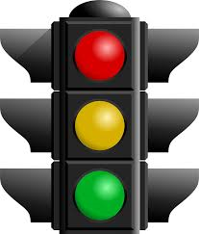
Reflection of the lesson
Green - no problems. All is clear.
Yellow - I have some little problems.
Red - I don’t understand many tasks.
I need one’s help.

Slide 13
THANK YOU FOR
YOUR ATTENTION!

