Slide 1
English
Grade 2
Smiles
Unit 6:Traditions and customs
Lesson 12:“Special Days ”
By the end of the lesson learners will be able to:
Recognize new words with the help of images
Say what they like/ don’t like concerning the food
Recognize sound “ch”- /ʧ/

Slide 2


Today we talk about healthy and junk food and use structure Do you like …..? And respond on a question.

Slide 3
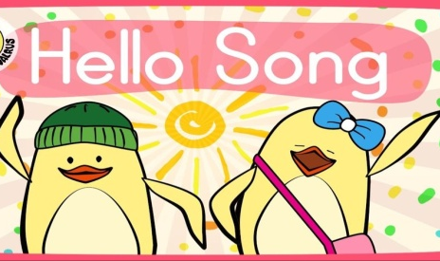

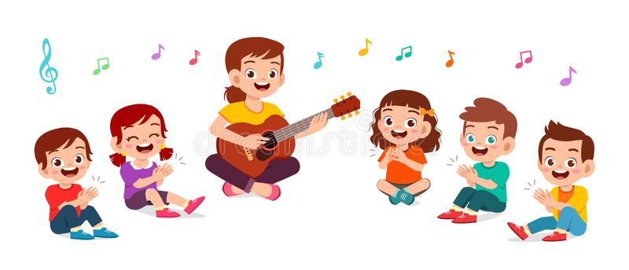
Let’s sing a song “hello ” together.
Hello! Hello!
Hello, how are you?
I'm good!
I'm great!
I'm wonderful!
Hello! Hello!
Hello, how are you?
I'm tired.
I'm hungry.
I'm not so good.
Hello! Hello!
Hello, how are you?

Slide 4
Let’s listen and repeat new words
New words

Slide 5
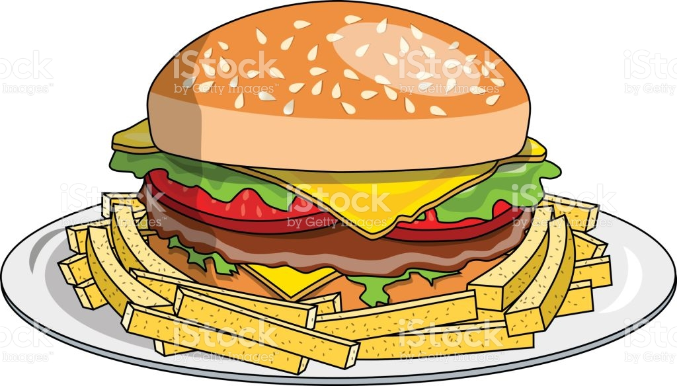
Burger

Slide 6

Apples

Slide 7
“ch”
words
Chips
cheese
chocolate
cherry
check

Slide 8
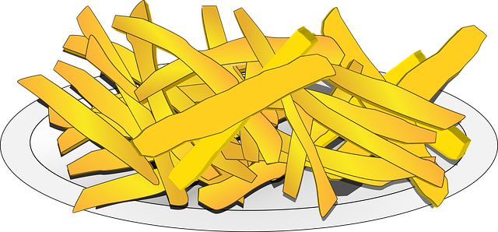
Chips

Slide 9
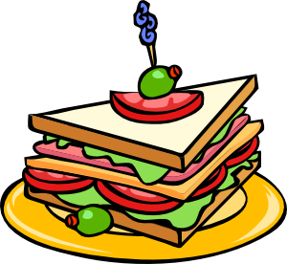
Sandwich

Slide 10
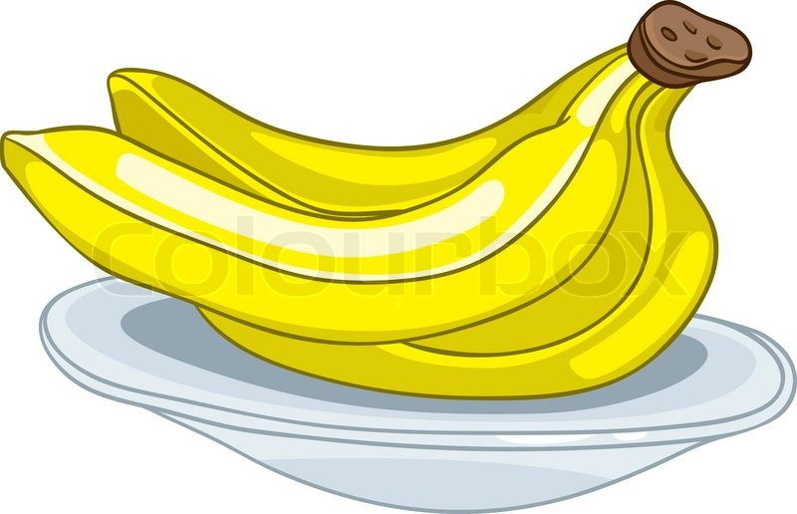
Bananas

Slide 11
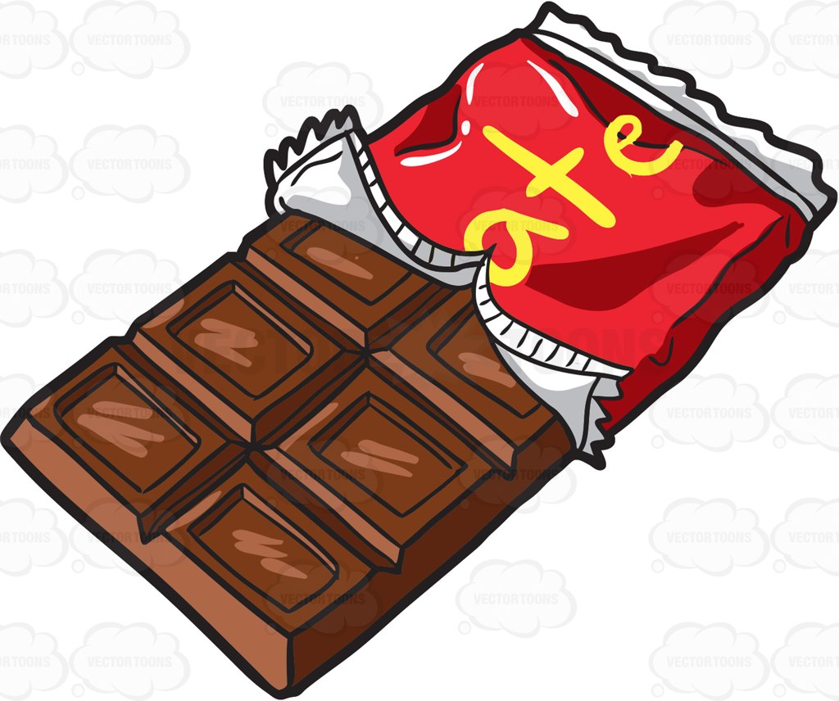
Chocolate

Slide 12
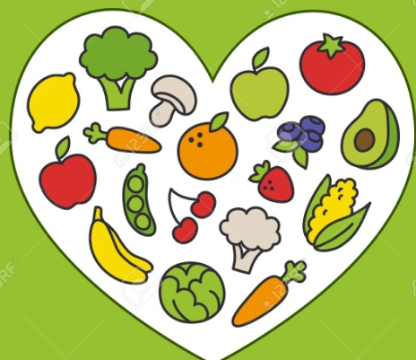
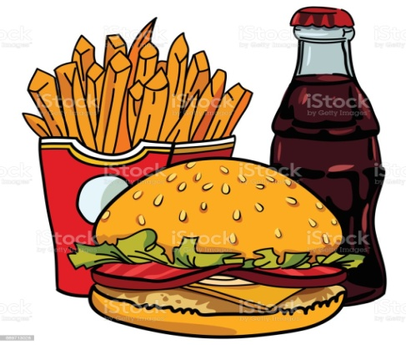
Write the words into the correct box
Burger Apples Chips Sandwich Bananas Chocolate
Healthy food
_________________________
________________________
________________________
Junk food
__________________________
_________________________
_________________________
_______________________
Apples
Burger
Bananas
Chips
Sandwich
Chocolate

Slide 13
PLAY A GAME

Slide 14

What’s missing ?

Slide 15
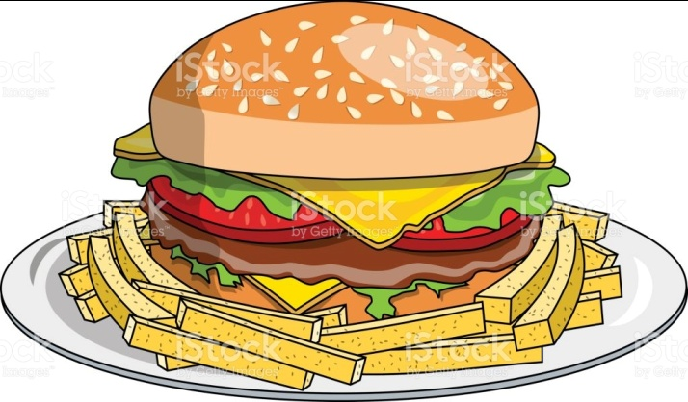


Slide 16
What’s missing ?

Slide 18
What’s missing ?

Slide 20
Grammar time

Slide 21
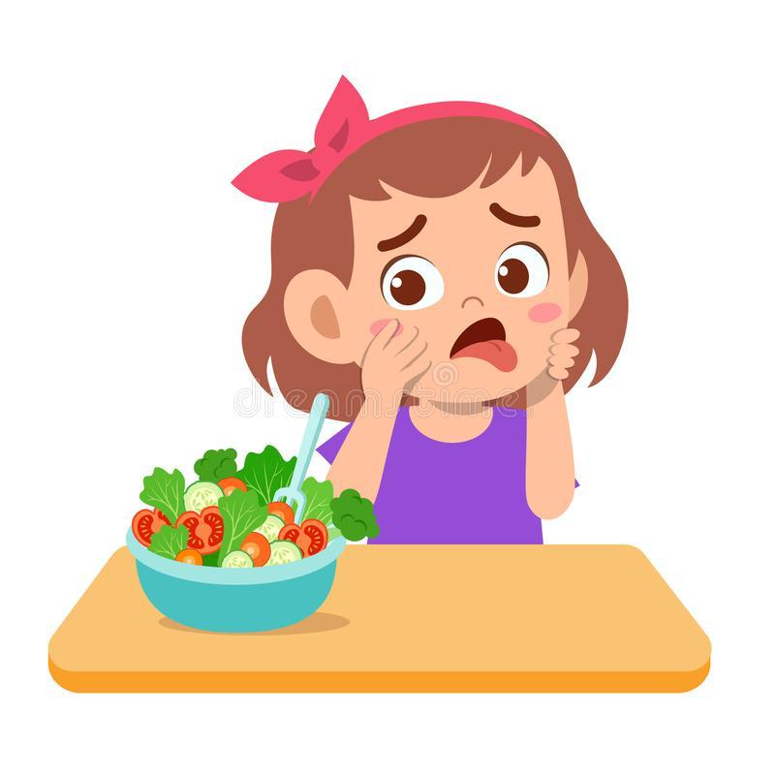
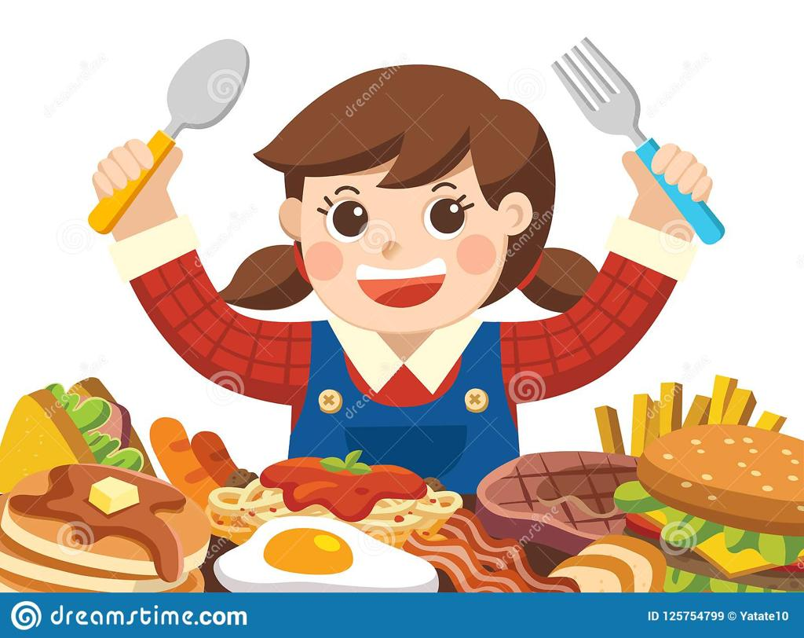

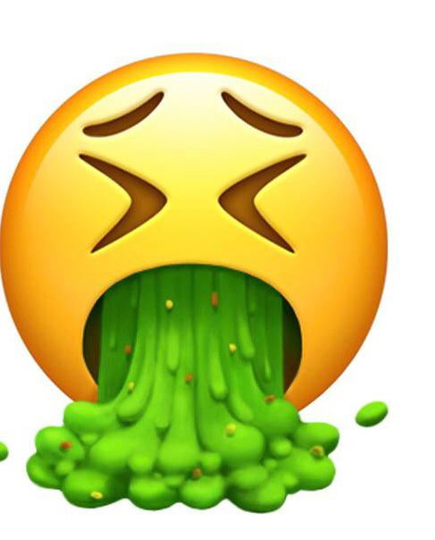
I like
I don’t like

Slide 22
Do you like……?
Yes, I do
No, I don’t

Slide 23
Do you like Bananas?
Yes, I do

Slide 24
Do you like Sandwich?
No, I don’t

Slide 25
Do you like Chocolate?
No, I don’t

Slide 26
Do you like Burger?
Yes, I do

Slide 27
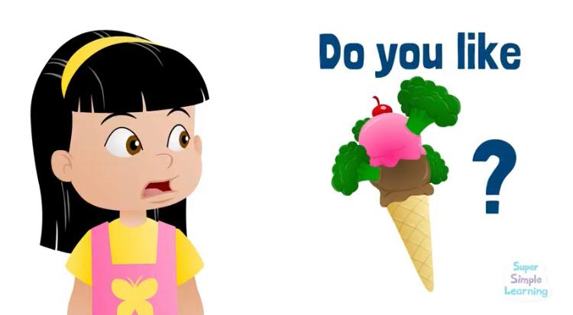
Now, let’s watch a video“do you like…?” together
https://youtu.be/frN3nvhIHUk

Slide 28
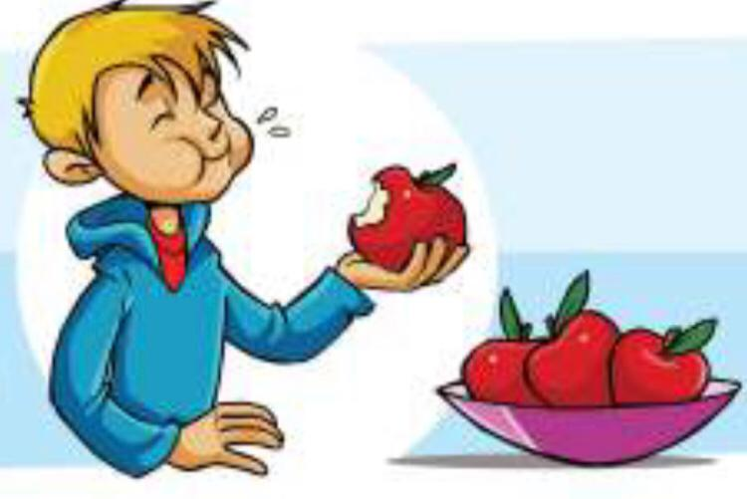

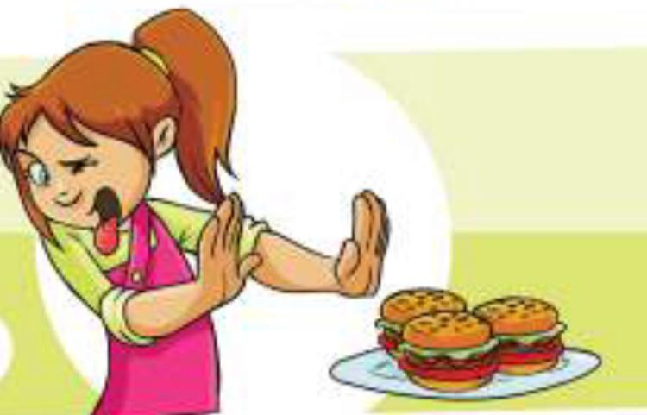
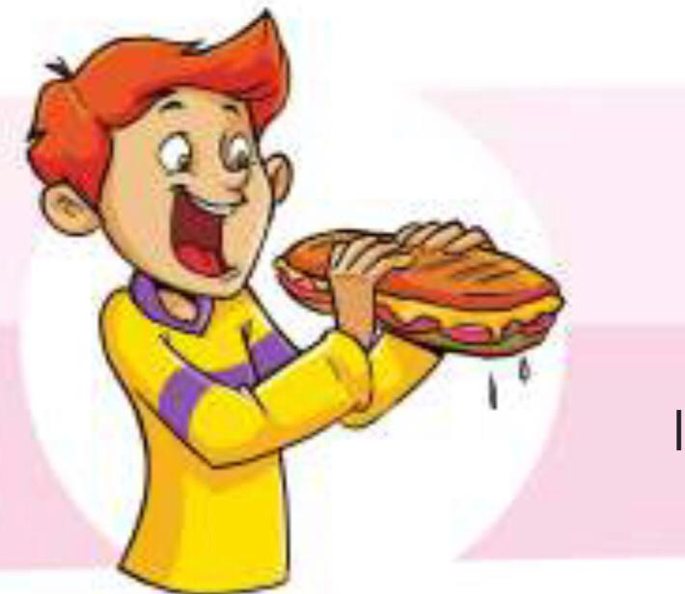
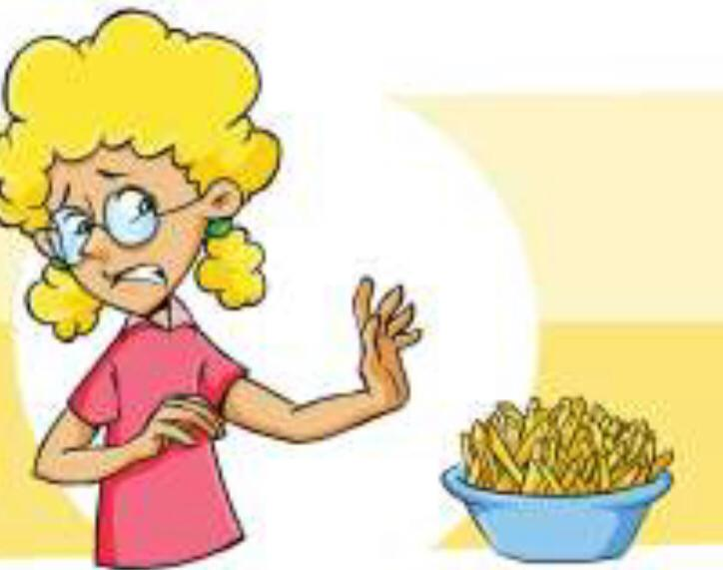
Now look at the picture . read and tick correct answer
I like apples
I don’t like apples
I like burgers
I don’t like burgers
I like sandwiches
I don’t like sandwiches
I like chips
I don’t like chips

Slide 29
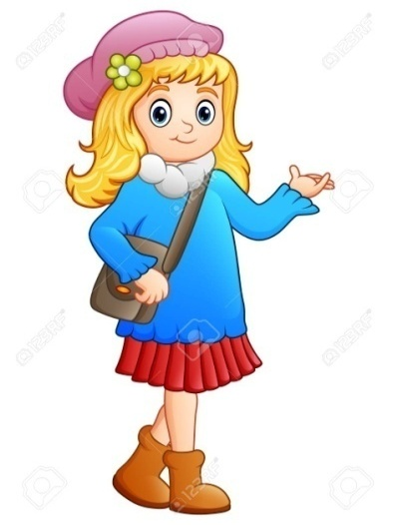
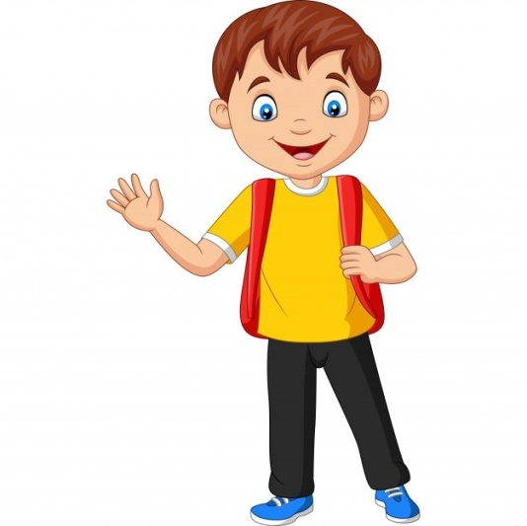
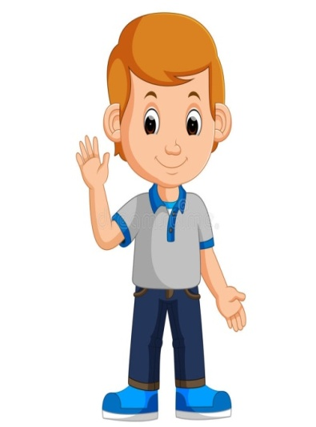
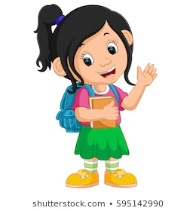
Kids and their favorite food
Hello! I’m Mia. I can make burger.
I like burgers and I don’t like chocolate.
Hi! I’m Luke.
I like chips and I don’t like chocolate too.
Hi! My name is Sam.
I like chocolate and I don’t eat burgers,I don’t like it.
Hello! I’m Ella.
I like fruts , apples , bananas.My mum says they are good for me. I don’t like sandwiches.

Slide 30
Fill in the missed words
don’t like bananas Like
Hello! I’m Ella.
I _____fruts , apples , _________.
My mum says they are good for me. I ____________sandwich.
Like
bananas
don’t like

Slide 31
Answer the questions.
Does Mia like chocolate?
No, she doesn’t
Does Luke like chips ?
Yes , he does
Does Sam like burger ?
Yes , he does
Does Ella like apple ?
Yes , she does

Slide 32
What do you like?

Slide 33
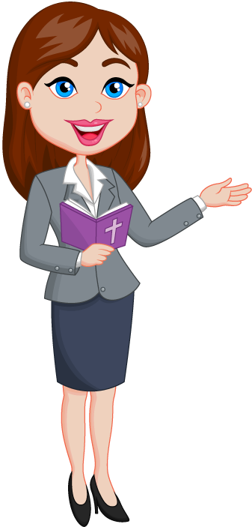
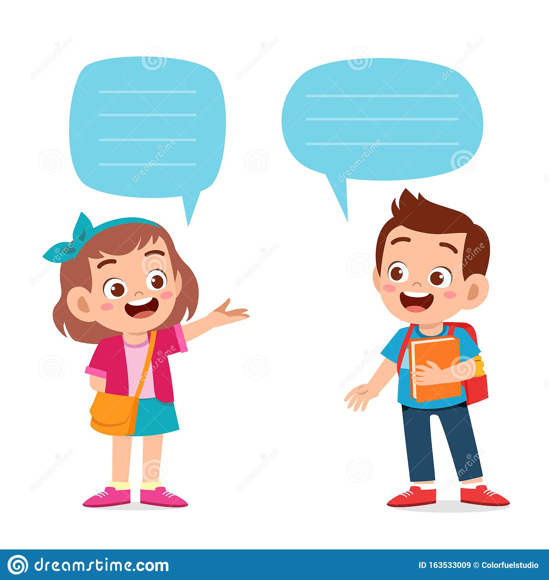
What do you like?
I like _______

Slide 34
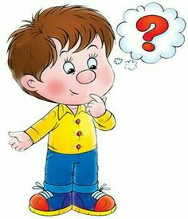
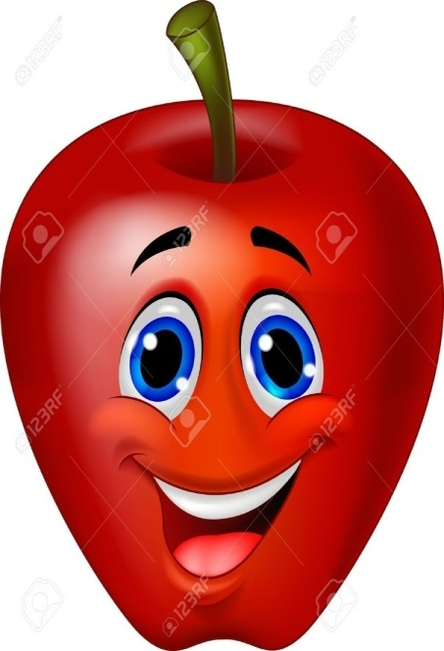
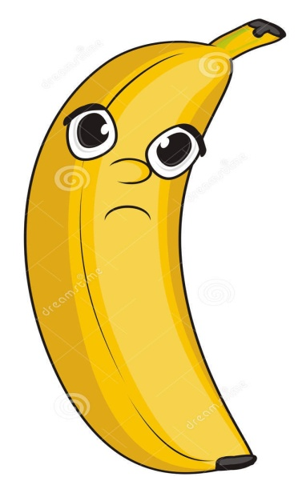
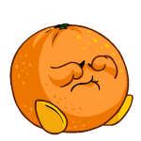
If you understand everything and you liked the lesson
Self- assessment
If you all understand but you have questions
if you don’t understand anything at all

Slide 35

The lesson is over!
See you next time!

