Slide 1
English
Grade 2
Smiles
Unit 6:Traditions and customs
Lesson 11:“Special Days ”
By the end of the lesson learners will be able to:
count from 1 to 20.
answer personal questions

Slide 2


Today we will learn new numbers and answer to the question:
How old are you?

Slide 3
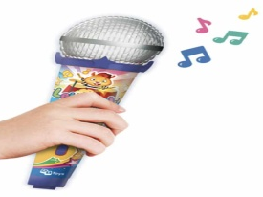
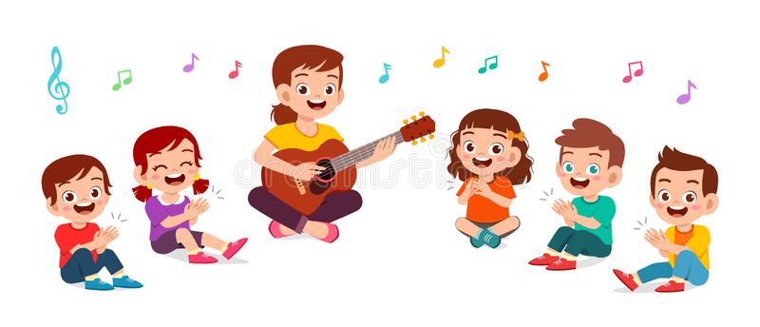
Let’s sing a song
“How old are you?” together.
One, two,three,four,five!
How old are you?
I’m four. I’m four years old!
I’m five. I’m five years old!
Six,seven,eight,nine,ten.
How old are you?
I’m nine. I’m nine years old!
I’m ten. I’m ten years old!

Slide 4
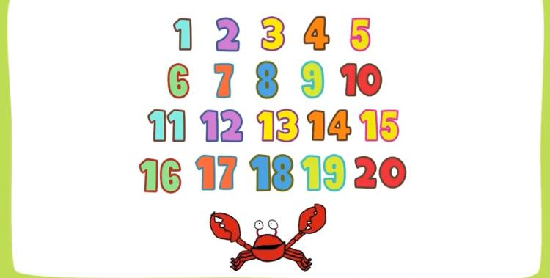
Now, let’s watch a video and sing
“Number song” together
https://youtu.be/D0Ajq682yrA

Slide 5
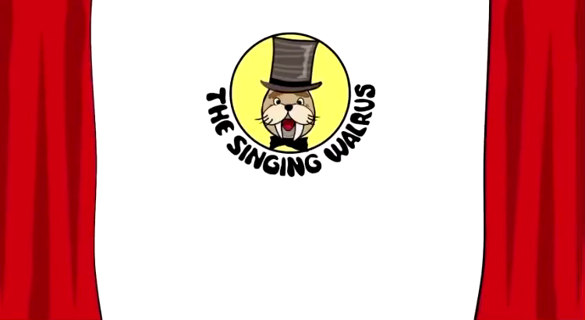

Slide 6
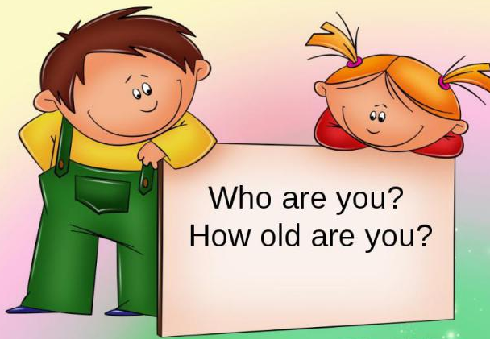
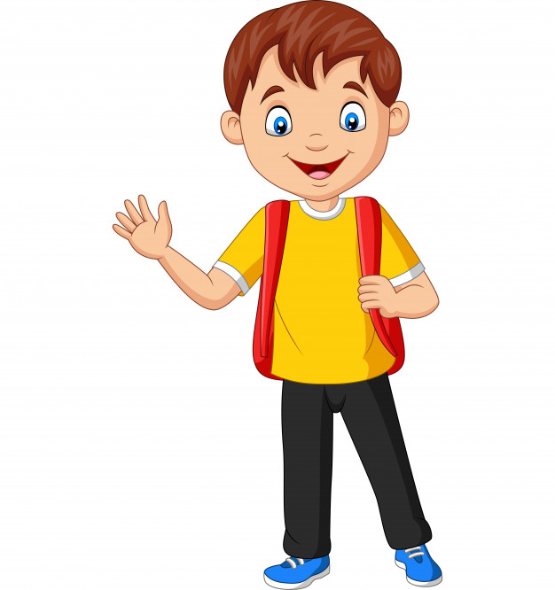
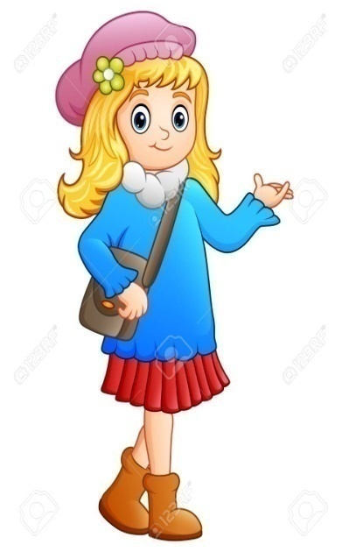

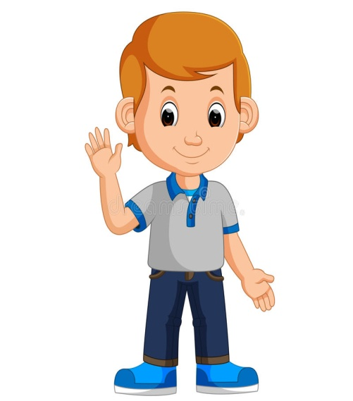
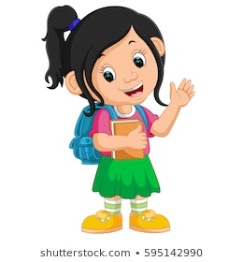
Hello!
I’m Mia
I’m eight years old
Hi!
I’m Luke
I’m nine years old
Hello!
I’m Nick
I’m five years old
Hi!
I’m Sam
I’m seven years old
Hello!
I’m Ella
I’m six years old

Slide 7


Example
How old are you?
I am eight years old.

Slide 8
How old is Luke?
He is ______years old.
nine

Slide 9
How old is Mia?
She is ______years old.
eight

Slide 10
How old is Ella?
She is ______years old.
six

Slide 11
How old is Sam?
He is ______years old.
seven

Slide 12
How old are you?
I am _______years old.

Slide 13
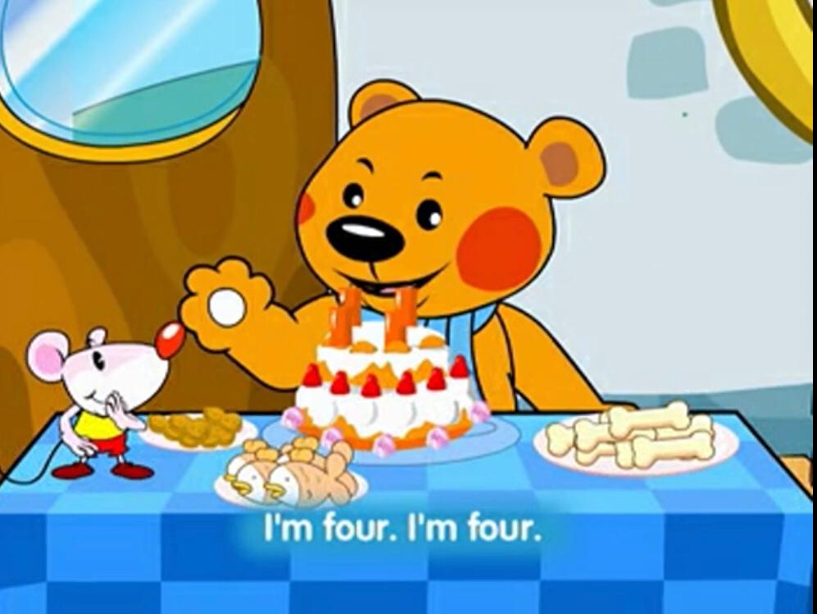
Now, let’s watch a video “birthday party”
https://youtu.be/XeRlcuWhNpU

Slide 14
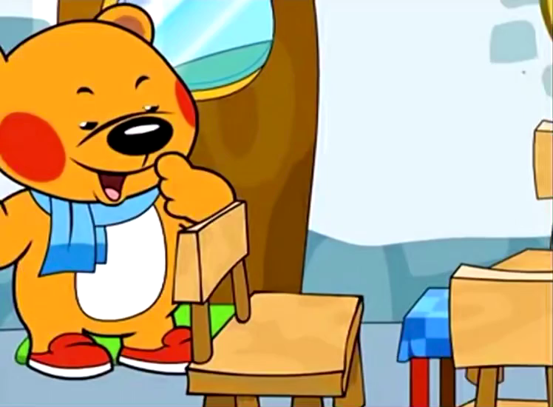

Slide 15
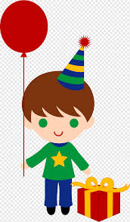

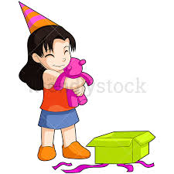

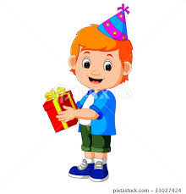
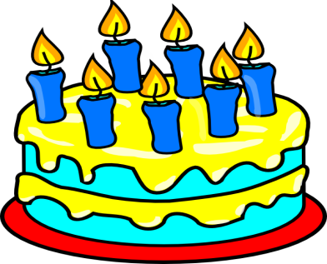
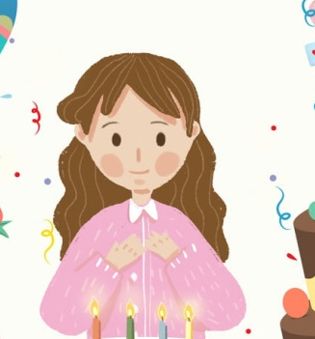

Now count the candles and answer the questions.
How old is he?
He is_______ years old
four
How old is she?
She is_______ years old
five
How old is he?
He is_______ years old
seven
How old is she?
ten
She is_______ years old

Slide 16
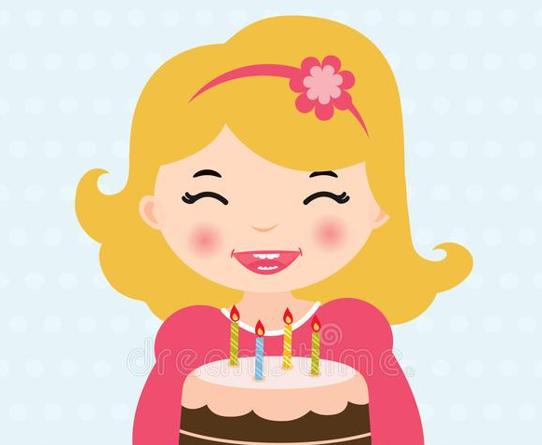

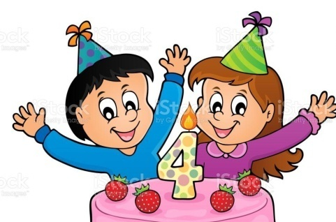
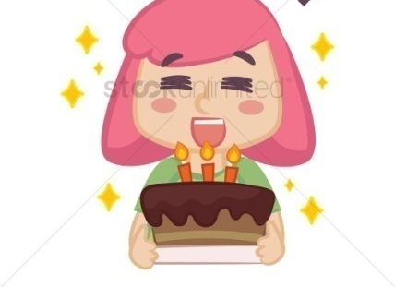
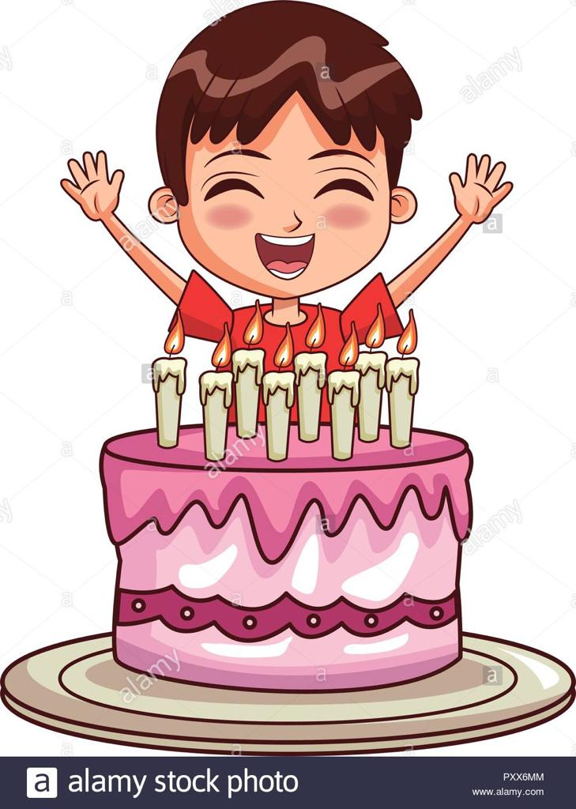
Now read and tick correct answer
She is four years old
She is seven years old
They are four years old
They are five years old
she is three years old
she is eight years old
He is three years old
He is eight years old

Slide 17
PLAY A GAME

Slide 18
How many candles are there?
five
nine
NEXT

Slide 19
How many candles are there?
nine
ten
NEXT

Slide 20

How many candles are there?
eight
four
NEXT

Slide 21
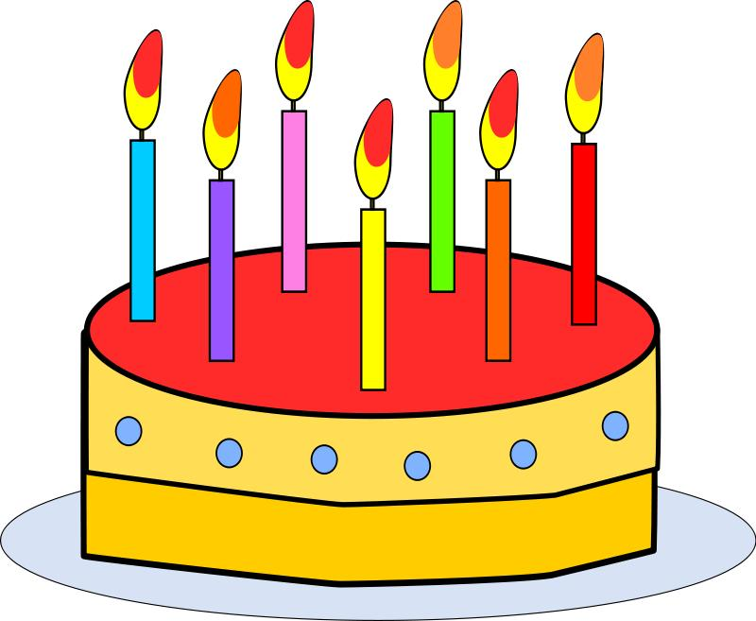
How many candles are there?
seven
six
NEXT

Slide 22
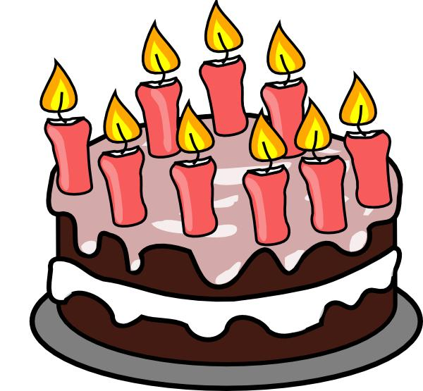
How many candles are there?
two
nine
NEXT

Slide 23
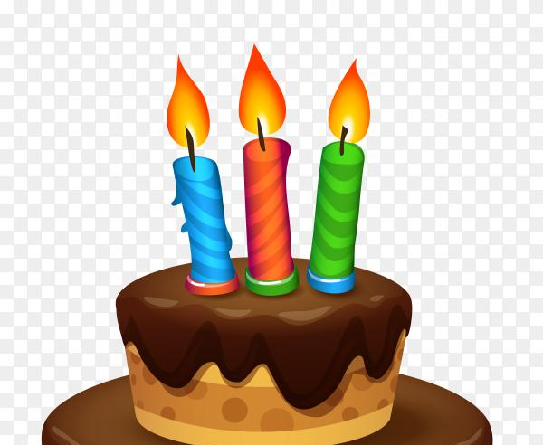
How many candles are there?
three
five
NEXT

Slide 24
Individual Work:
Assessment criteria: write letters and subject-specific vocabulary when read aloud or spelt
Task: Fill in the missed words
She How I’m Old
1. ______old is she?
_________ is seven years old.
2. How ______are you ?
__________ eight years old.
Descriptors: a learner
writes words
uses subject-specific vocabulary properly

Slide 25
Self- assessment
I know numbers.
I can ask “How old are you?”
I can answer the question “How old are you?”

Slide 26


