Slide 1
English
Grade 2
Unit 5: Health and body
Lesson 10:Unit Revision

Slide 2
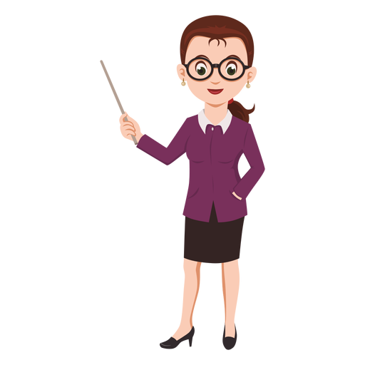
Learners will be able to:
recognize subjects and school objects;
practice vocabulary with / without teacher’s support;
use spoken form of a limited range of everyday and classroom words;
practice and revise vocabulary of unit My school

Slide 3
Unit Revision

Slide 4
Welcome class!
Today we will repeat with you everything that we have learned during our lessons!
Let’s go!

Slide 5
Exercise 1
Name the pictures that you see
Let’s go!

Slide 6
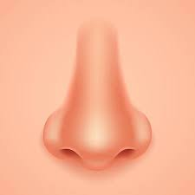
NOSE

Slide 7

TONGUE

Slide 8
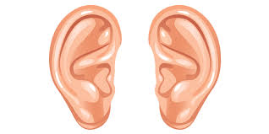
EARS

Slide 9
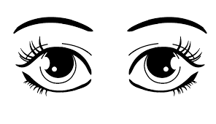
EYES

Slide 10
Exercise 2
Match the body parts with the actions
Let’s go!

Slide 11
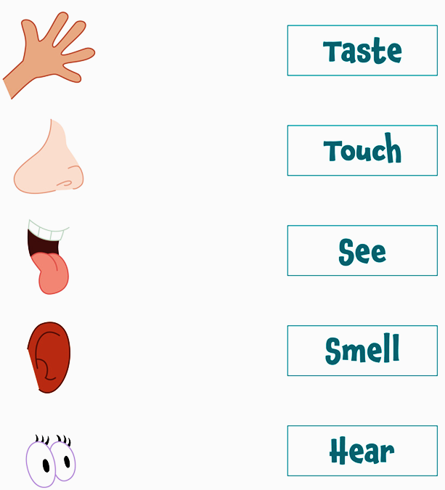
I can…… with my………

Slide 12
Exercise 3
Now match the actions
with the things Let’s go!

Slide 13
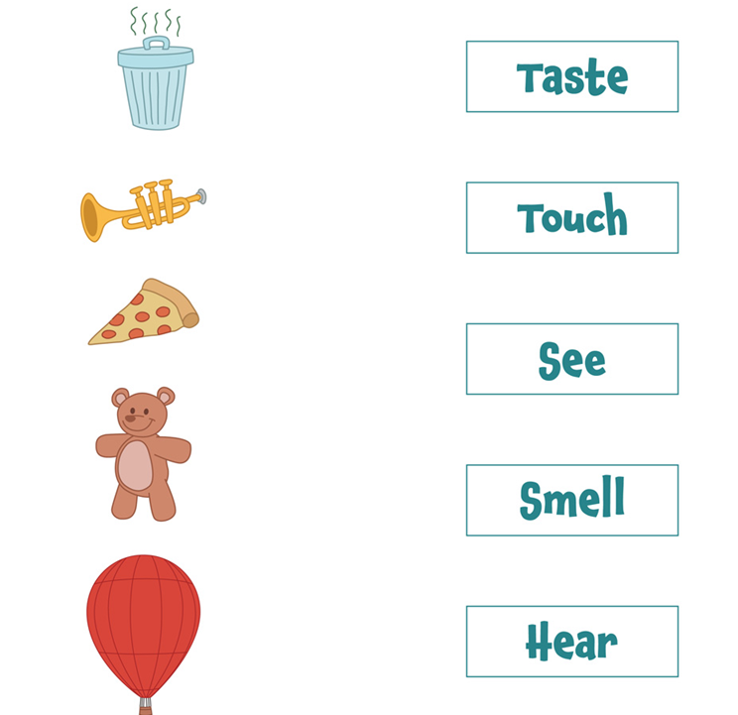
I can……

Slide 14
Exercise 4
Finish the sentences Let’s go!

Slide 15

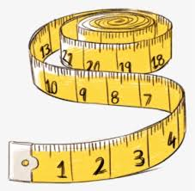
A tool used to measure length…
ruler
A tool used to measure length
measuring tape

Slide 16
Translate
My father works as a doctor.
My mother is a pianist.

Slide 17
Gap filling ‘Place in a school’
1. There are balls in this room. You can jump and run in this room. It is a
g __ m.
2. There are computers in this room. You can come and work there. It is a
c __ __ __ __ __ __ r r __ __ m.
3. There are many books there. You can come and read them.
It is a l __ __ __ __ __ y.
4. There are food and drinks in the room. You can eat there.
It is a c __ __ __ __ __ n.
5. There are many desks and chairs. You can see a teacher there. It is a
c __ __ __ __ r __ __ m.

Slide 18
See you next time!
Good bye!

