Slide 1
Aspect 11
Grammar Schools
Theme of the lesson:
8 D Passion or Profit p105

Slide 2
Lesson objectives:
to learn/practise how to make/respond to suggestions;
to act out a dialogue;
to write an email suggesting that
a friend pursues a career related to
their favourite means of
self-expression;

Slide 3
You are going to listen to five people talking about their preferred means of self-expression. Before you listen, check these words/phrases in the Word List or in your dictionary.
Ex 6 a) p104
avid walker
meditation
restrictive
de-stress

Slide 4
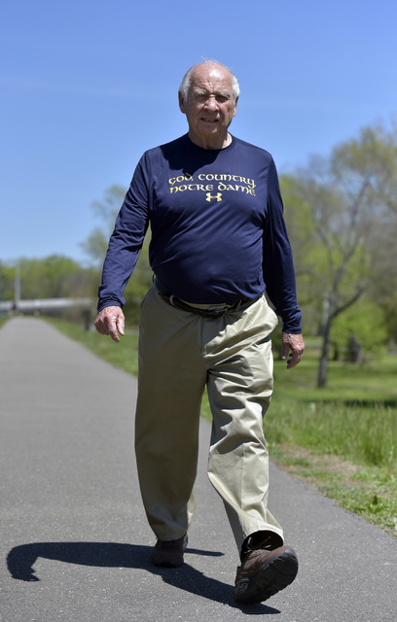
AVID WALKER заядлый ходунки
You use avid to describe someone who is very enthusiastic about something that they do.
usu ADJ n
He misses not having enough books because he's an avid reader.
For years an avid walker
, she's returning gradually to that activity.

Slide 5
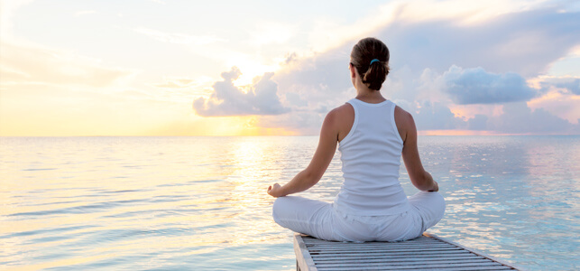
Meditation- is a practice where an individual uses a technique – such as mindfulness, or focusing the mind on a particular object, thought, or activity – to train attention and awareness, and achieve a mentally clear and emotionally calm and stable state

Slide 6
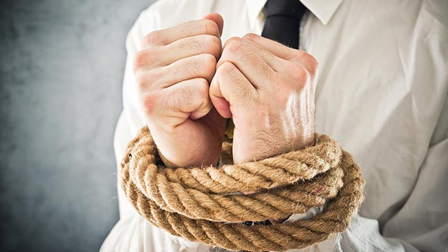
Restrictive -limiting the freedom of someone or preventing something from growing:
He is self-employed because he finds working for other people too restrictive.

Slide 7

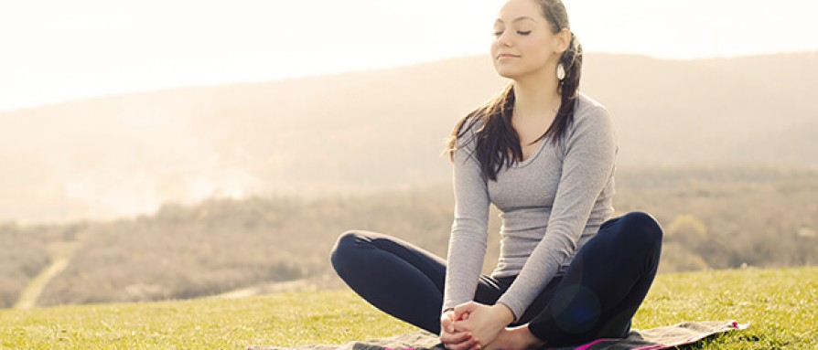
De-stress - to get rid of feelings of stress (= worry caused by difficult situations in your life or job):
I began doing yoga as a way to de-stress.

Slide 8

Read the statements A-F and underline the key words.
Listen and match the speakers to the statements.
Ex 6 b p105
A I discovered a simple way to express a very abstract
feeling.
B I learned something about myself.
C I allow my emotional state to dictate which activities
I engage in.
D I learned about self-expression by listening to
other people.
E I use simple items to express my personal identity.
F I draw on my own thoughts and feelings to create
something

Slide 9
Suggested answer key
Speaker 1: B
Speaker 2: A
Speaker 3: F
Speaker 4: E
Speaker 5: C

Slide 10
Making /responding to suggestions
Making suggestions | Accepting a suggestion/ idea | Rejecting a suggestion/ idea
Have you thought about ...? What if you (went/studied etc.)? Why don’t you ...? Perhaps you could … It might be a good idea to … Have you considered (-ing) | • Great, I hadn’t thought of that. • That would be a good idea in fact. • Sounds like a good idea/ something I could do. •Yes, I could, I guess. | • Well, I don’t know/ I’m not sure that’s such a good idea/choice. • Perhaps it would be better if/to ... • I see what you mean but … . • That’s a good point but … • I was thinking of ... instead.

Slide 11
Complete the gaps (1-4) with the phrases: Why don’t you, I hadn’t thought of that, have you thought about, I’m not sure.
Listen and check. Ex 8 b p105
A: Hey, Anarbek. The school play was fantastic and you were absolutely
great!
B: Thank you Lucy. I’m glad you liked it!
A: I loved it! In fact, I wanted to ask you: 1) .............. pursuing acting as a
career?
B: Well, I don’t know. I haven’t decided what I want to do with my life yet.
A: I recently read an article that talked about how following our passions
can lead to professional success and a high level of fulfilment. Who
wouldn’t want to earn lots of money doing the thing they love most?
B: 2) .................. that’s such a good choice for me. I’ve only
just started acting and there’s so much I don’t know about it.
A: That’s true, but you clearly love doing it. 3) ....................
take some lessons to help you feel more confident?
B: Well, 4) .................................... It sounds like something I could do.
Thanks Lucy.

Slide 12
Suggested answer key
1 have you thought about
2 I'm not sure
3 Why don't you
4 I hadn't thought of that

Slide 13
Ex 9 p105
What is your favourite means of
self-expression?
What would be an ideal career for
you? Why?
Tell the class.

Slide 14
Suggested answer key
My favourite means of self-expression is photography. I love taking pictures of the places I visit and the people I meet. I find that photography really focuses my mind and makes me truly see the world around me Ideally, I would love to be a professional photographer. If I could choose, I’d work for National Geographic, where I’d combine all of my passions in life: photography, animals and nature.

Slide 15
Home-task: Ex 11 p105
Your friend loves writing short stories.
Write an email to him/her to suggest that they pursue a career related to their favourite way of self-expression.

Slide 16
Conclusion
What have you learned today?
We have learned phrases which are used when we make suggestions, when we accept and reject suggestions and ideas ;
We have acted out a situational dialogue;
We have talked about self-expressions;

Slide 17


