Slide 1

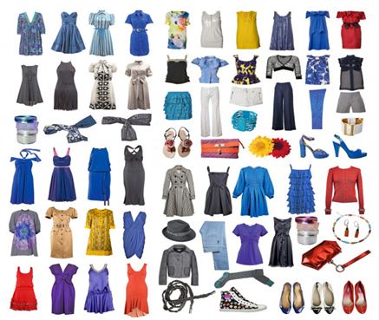
Grade: 11
Module 9
Lesson 3
Parts of clothes

Slide 2

11.5.2 - to use a wide range of vocabulary, which is appropriate to topic and genre, and which is spelt accurately; 11.4.5 - to deduce meaning from context in extended texts on a wide range of familiar and unfamiliar general and curricular topics.
Learning objectives :

Slide 3



Assessment criteria
You will be able to:
learn and practice vocabulary related to clothes, fashion and the clothing industry;
learn and practice idioms related to clothing;
learn and practice phrasal verbs; practice prepositions;
practice word formation.

Slide 4
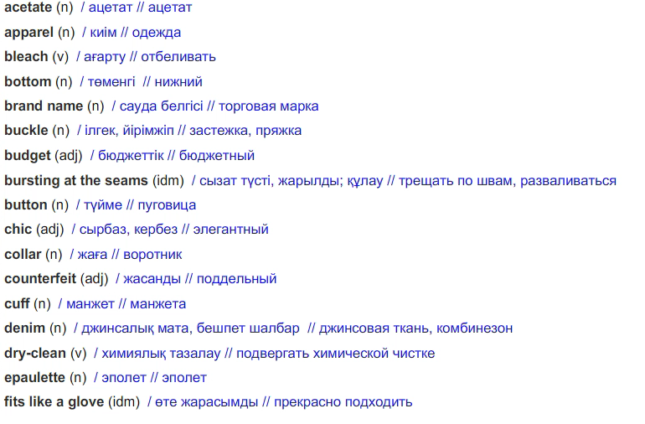
GLOSSARY

Slide 5

Fill in : prototype, mass, assembley, quality, fulfilment
1 Clothes are typically made based on the designer’s specifications and a (an)
………………………………………………..
prototype

Slide 6
2 The orders were processed at the
……………………………………………….. center.
fulfilment

Slide 7
3 Performing ………………………………………….
control ensures that all items meet the specifications.
quality

Slide 8
4 In factories, clothes are typically put on
………………………………………….lines.
assembley

Slide 9
5. …………………………………………. production allows people to have a variety of clothes from over the world.
Mass

Slide 10
Choose the correct item
1 The customer’s specification/perception of the producer is extremely important.
2 Kimonos are crafted with defective/painstaking attention to detail.
3 The fabrics have already been bundled up/embroidered in preparation for packing.
4 Cheap clothes will often pre-wash/shrink the first time they are launched.
5 Rather than discard/source imperfect products, we should sell them at a discount.

Slide 11
Fill in: through, of, into, from, in
through
1 Beibit spent half an hour rummaging …… … …… his closet looking for a matching pair of socks.
2 A huge amount of planning and research is put …………. creating a product.
3 Using low temperatures will prevent your clothes ………… fading during a wash.
4 Regardless ……… your lifestyle, you probably have some interest in fashion.
5 Clothing producers can save money by buying raw materials ……… bulk.
into
from
of
in

Slide 12
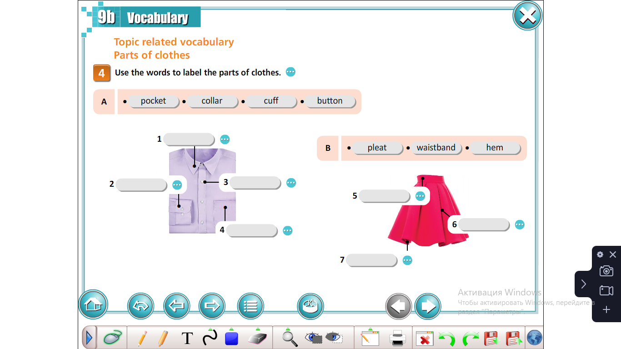

Slide 13
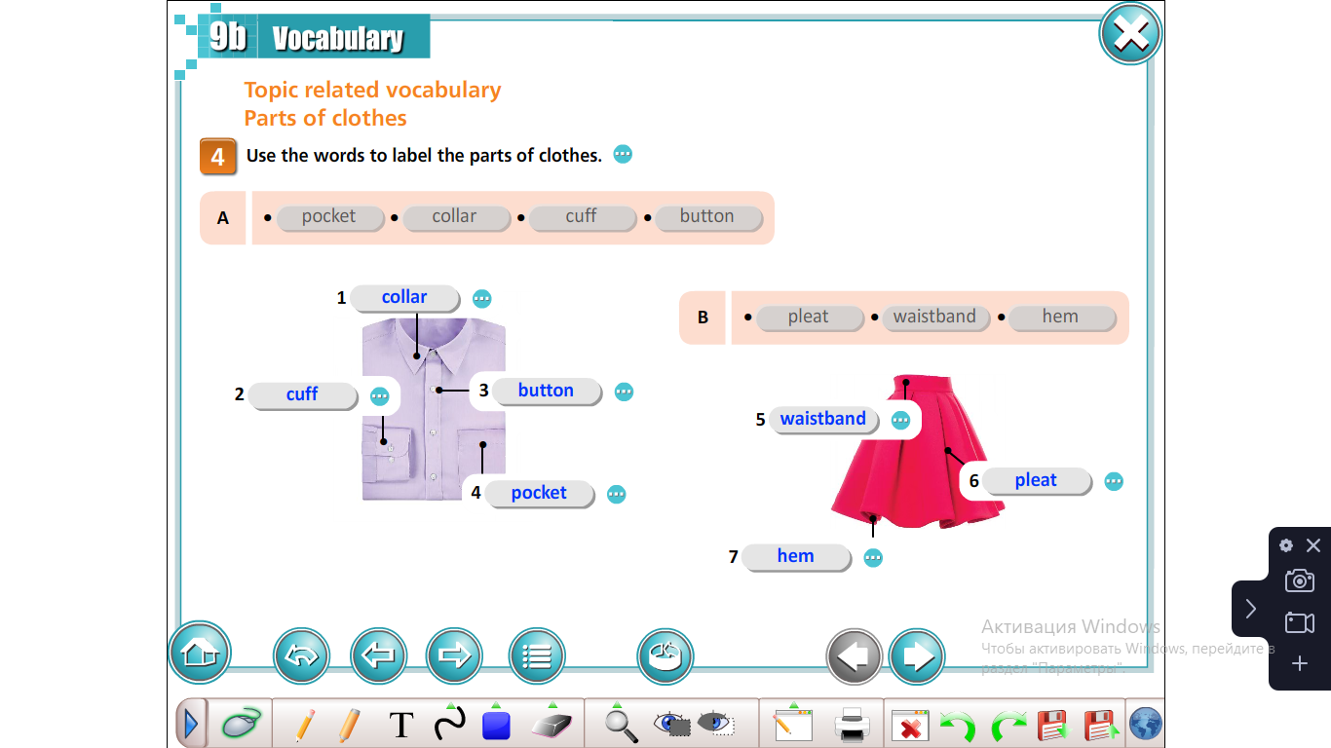

Slide 14
Textiles & Materials cotton nylon silk denim polyester flannel acetate leather linen viscose rayon wool
Textiles from natural fibres
cotton,silk, denim, flannel, leather, linen, wool
Textiles from man-made fibres
polyester, acetate,viscose, rayon

Slide 15

Check the unknown words
сotton: cloth made from the fibres of the cotton plant
nylon: an artificial material used to make clothes such as women’s tights
silk: a very soft material made from the fibre taken from the cocoon of a silkworm
denim: a strong, thick cotton material that’s often blue, used for making jeans

Slide 16
polyester: a synthetic material
flannel: a light material made from acetic acid
acetate: a smooth artificial material made from acetic acid
leather: animal skin that has been preserved
linen: a strong material made from the fibres of the flax plant
viscose: a smooth material made from viscose
rayon: a smooth shiny material made from plants
wool: a soft,thick material that is made from the hair of sheep

Slide 17
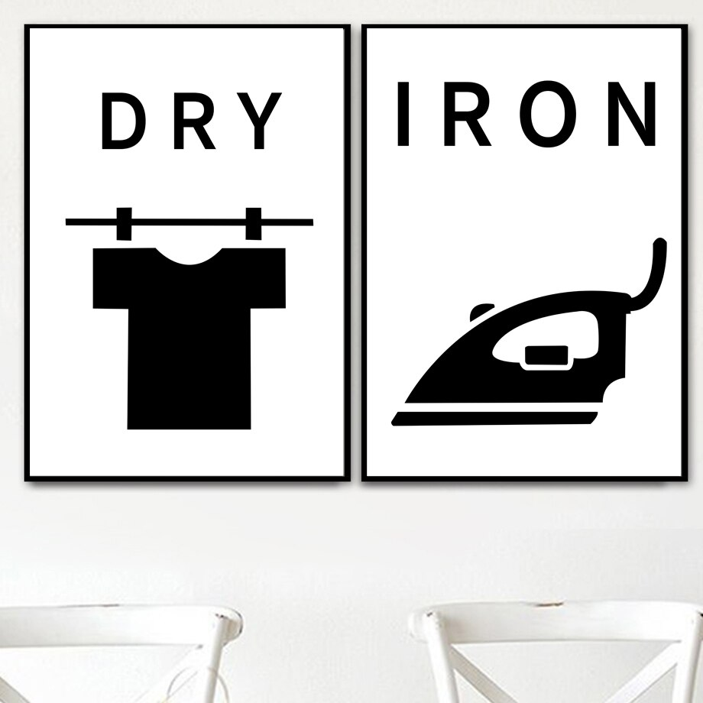

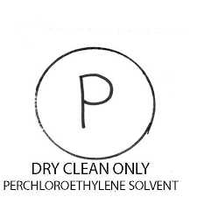
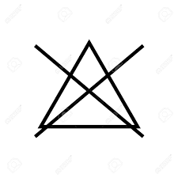
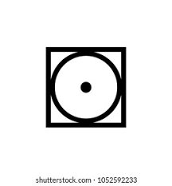
Textile care: iron / dry-clean / hand wash/ bleach tumble dry

Slide 18
The fashion industry. Choose the correct options
Each person has different shopping habits.Most people tend to choose1) mass-produced/assembley-produced items come from recognizable, name 2)tag/brand manufacturers and provide a quarantee of quality. Others prefer 3) budget/sale apparel and some even choose to buy illegal 4) counterfeit/false goods, or knockoffs. This is especially common when purchasing 5) occasional/seasonal clothes, which are only worn for a short time.
For those who can afford luxury items, it’s possible to bypass the conventional 6) stock/supply chain altogether and have expensive, high quality clothes custom-made. This is referred to as 7) haute/chic couture, meaning “high fashion”.

Slide 19
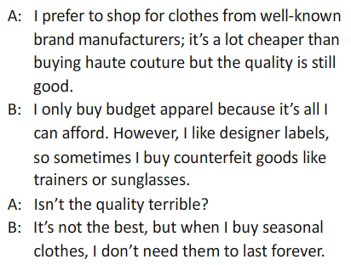
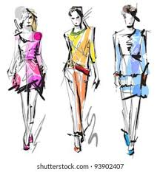
The fashion industry. Discuss how you prefer to shop for clothes

Slide 20
The clothing industry & the invironment a) Match the words to form phrases
1 upcycled
2 eco-friendly
3 fashion
4 chemical
5 environmental
6 consumer
a fibres
b conscious
c impact
d clothes
e demand
f processes

Slide 21
b) Complete the text with phrases from a)
The textiles and clothing industry is heavily criticized for its negative 1)…………….……….because the 2)……………..…involved contribute to global pollution.’ Fast fashion’ is perhaps the primary factor, as manufacturers rapidly produce clothes to keep up with huge 3) …… . However, we can make a difference as consumers, while still remaining 4)……………. When we select what clothes to wear. One way is to support companies which use sustainable or 5) ……………. .
Another way would be to start reusing old fabrics to create 6)…………………. Trendy clothing items from outdated garments we find at the back of our wardrobes.
environmental impact
chemical processes
consumer demand
fashion conscious
eco-friendly fibres
upcycled clothes

Slide 22
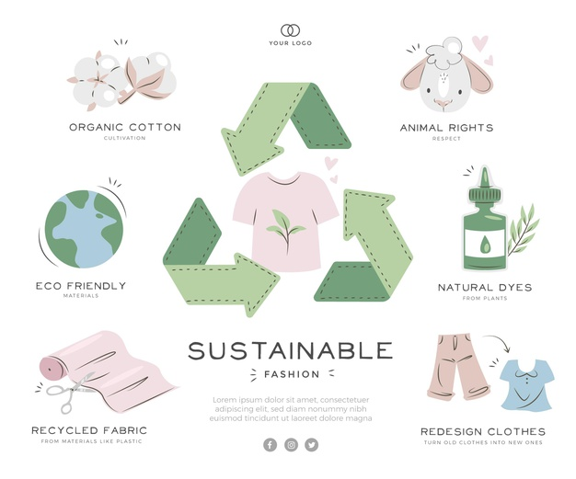
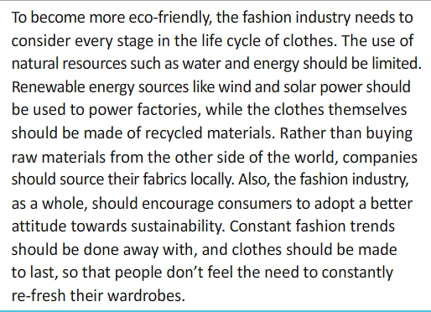
Collect more information abt. how the fashion industry can become eco-friendly

Slide 23
Idioms. Choose the correct word to form idioms
1 The shopping centre was bursting at the seams/hems during the sales!
2 He still has a card up his sleeve/pocket just in case he runs into any problems.
3 Sholpan’s new dress was custom-made, so it fits/matches like a glove.
4 So you have a full-time job and three children! I take my cap/hat off to you!
5 Max wears his heart/mind on his sleeve; he never tries to hide his feelings.
6 Before you judge someone, why don’t you try to put yourself in their boots/shoes first?

Slide 24
Phrasal verbs. Fill in keep, take, throw, try, wrap
1 I asked the tailor to …take... my trousers in because they were a little too big for me.
2 It’s snowing today, so …wrap… up before you go outside.
3 Before buying an item of clothing, you should …try…. it on first.
4 Aibala loves reading fashion magazines in order …keep…up with the latest trends.
5 when I go to the gym, I normally just …throw… on a T-shirt and shorts.

Slide 25
Prepositions. Complete the sentences with the correct preposition
Off
1 …… he peg items are typically cheaper than custom-made clothes.
2 My sister is constantly shopping for new clothes; she’s a slave ……. Fashion!
3 Fashion concious people usually only wear what is …… fashion at the moment.
4 As our culture changes, some styles inevitably go ……. fashion.
5 It’s black-tie event, so we have to dress …… the occasion.
to
in
out of
for

Slide 26
Word formation Fill in the gaps with the words derived from the words in bold.
1 I need to buy something …dressy… . For the wedding. It’s going to be a rather formal occasion (DRESS)
2 The charity organization will gratefully accept all kinds of clothes and shoes in …wearable… condition.(WEAR)
3 He bought a very convenient …reversible… coat which is made up of two different types of fabric. (REVERSE)
4 …Seamless… . Stockings first appeared in the 1950s but were not very popular since women preferred the ones with a seam at the black.(SEAM).
5 You should avoid the socks and sandals combination; it’s considered really …unfashionable …. (FASHION)

Slide 27
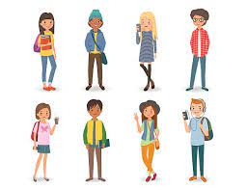
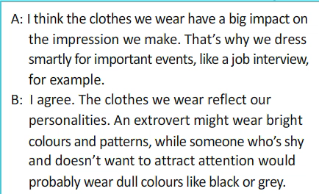
Discuss: what do you think the clothes we wear say abt.us

Slide 28

Recommended H/W:
write an essay: “What do you think the clothes we wear say abt. us? “

Slide 29


Conclusion
We have:
learned and practiced vocabulary related to clothes, fashion and the clothing industry;
learned and practiced idioms related to clothing;
learned and practiced phrasal verbs; practiced prepositions;
practiced word formation.

