Slide 1
The theme: Progress Check
English 11th grade
Action
Term 4
Module 9 Lesson 10

Slide 2
Learning objectives:
11.4.2- understand specific information and detail in extended texts on a wide range of familiar and unfamiliar general and curricular topics;
11.4.6 - recognize the attitude, opinion or tone of the writer in extended texts on a range of more complex and abstract general and curricular topics;
11.4.9 - recognize inconsistencies in argument in extended texts on a range of more complex and abstract general and curricular topics;
11.2.2- understand specific information in unsupported extended talk on a wide range of general and curricular topics, including talk on a growing range of unfamiliar topics;
11.2.5 - recognize the attitude or opinion of the speaker(s) in unsupported extended talk on a wide range of general and curricular topics, including talk on a growing range of unfamiliar topics;

Slide 3
Lesson objectives:
All learners will be able to:
understand specific information and detail in extended texts on a wide range of familiar and unfamiliar general and curricular topics;
Most learners will be able to:
understand specific information and detail in extended texts on a wide range of familiar and unfamiliar general and curricular topics;
understand specific information in unsupported extended talk on a wide range of general and curricular topics, including talk on a growing range of unfamiliar topics;
Some learners will be able to:
understand specific information and detail in extended texts on a wide range of familiar and unfamiliar general and curricular topics;
understand specific information in unsupported extended talk on a wide range of general and curricular topics, including talk on a growing range of unfamiliar topics; deduce meaning from context in unsupported extended talk on a wide range of general and curricular topics, including talk on a growing range of unfamiliar topics

Slide 4
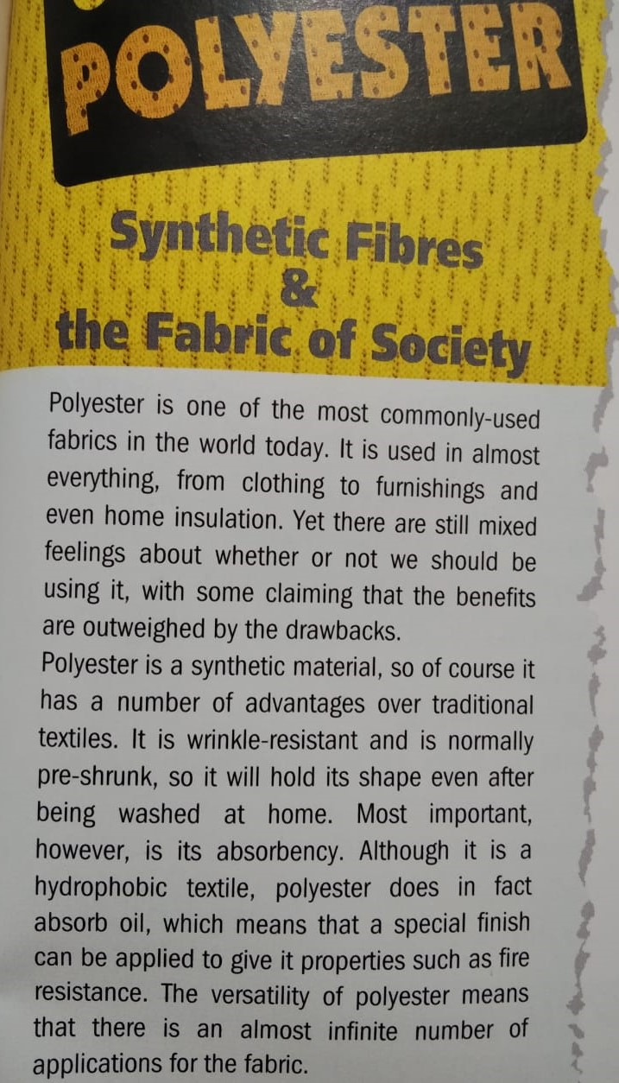
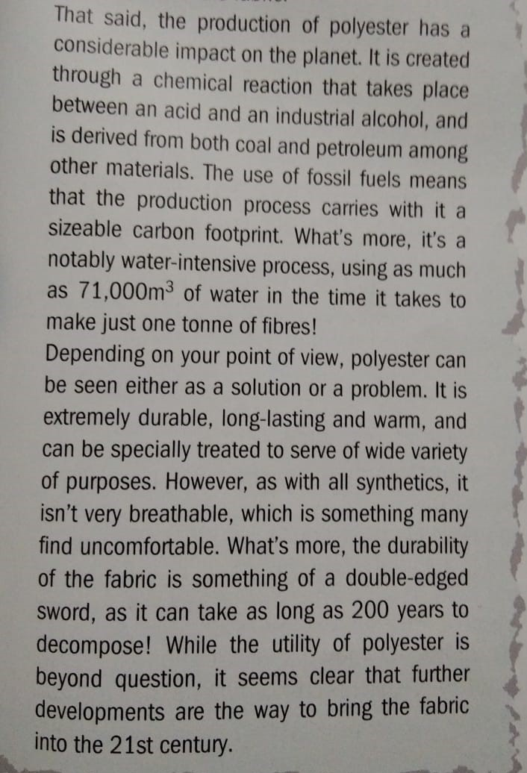
Read the text.

Slide 5
Exercise 1. Read the text and choose the correct answer. p.123
What is the purpose of the text?
2. According to paragraph 2, which of the following is NOT true.
3. In paragraph 3, the writer says that ……….
4. What does the writer mean by the term ‘double-edged sword’?
5. What is the writer’s overall attitude at the end of the text?
C. To compare positive and negative aspects of using polyester.
B. Polyester clothes tend to become loose and baggy.
B. Manufacturing polyester produces large amounts of emissions.
A. Something that can have both positive and negative effects.
C. The textile industry ought to modernise its practices.

Slide 6
Exercise 2. Listen to an interview about making wood wearable. Complete the sentences. p.123
The host says that one drawback of polyester is the fact that it causes damage to the ……………………….. .
The cellulose-based fibres Robert works with come from ……………….. .
Robert says environmental impact of regenerated fibres is …………………… .
than synthetic ones.
4. The use of regenerated fibres in the clothing industry is quite ……………… .
5. In order to break down wood, it’s necessary to use ……………………. .
A spinneret forms long strands of material from a ………………… solution.
Closed-loop systems aim to reduce the environmental ………………. .
Robert’s company has a website and is active on ………………. .
environment
wood
less
common
chemicals
liquid
impact
social media

